Slide 1
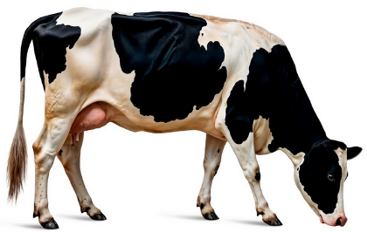
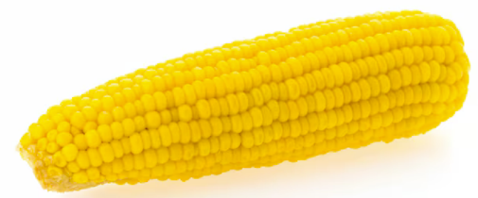
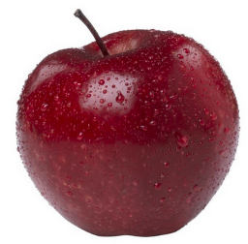
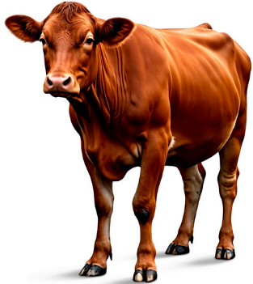
Foods from plants and animals
Food and nutrition unit
Year 2
Notes:
Images: Designed by Freepik

Slide 2
Contents
Lesson 1 | Lesson 6
Lesson 2 | Lesson 7
Lesson 3 | Lesson 8
Lesson 4
Lesson 5

Slide 3
Lesson 1

Slide 4
In this unit we will be:
reviewing the Australian Guide to Healthy Eating
investigating where food comes from
investigating the steps from the farm to the supermarket
investigating the tools and equipment needed to prepare healthy food
designing a healthy snack.

Slide 5
Learning intention: To show what you know about where food comes from.
Success criteria:
sources of food
categories of food
how food gets to the supermarket.

Slide 6
Activity 1: Booklet task
Where does our food come from?
What categories of food can you think of?
How does food get to the supermarket?
  Draw pictures
  Write words

Slide 7
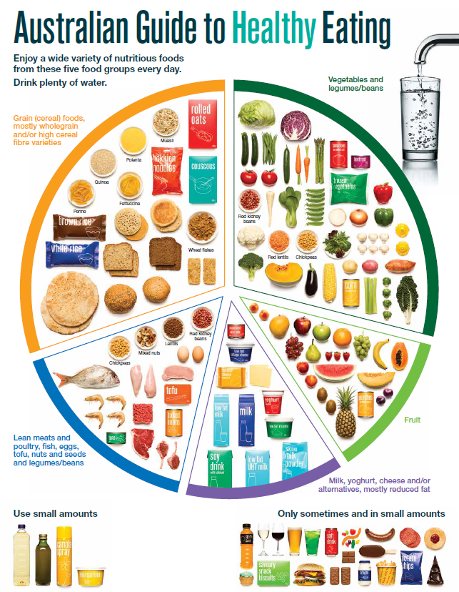
The Australian Guide to Healthy Eating
Notes:
The Australian Guide to Healthy Eating (AGHE) is a visual representation of the Australian Dietary Guidelines.
It is a broad guide to the types and amounts of foods we should eat each day.
The food groups:
Grain foods
Vegetables
Fruit
Dairy and alternatives
Meat and alternatives
Sitting off to the side are foods categorised as ‘sometimes’ foods. These foods are high in saturated fat and/or added sugars, added salt or alcohol and low in fibre. These foods and drinks can also be high in kilojoules (energy).

Slide 8
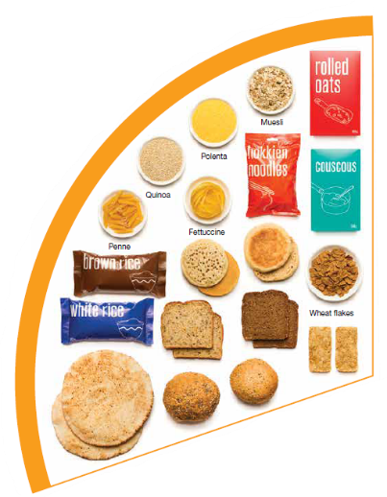
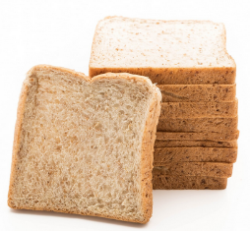
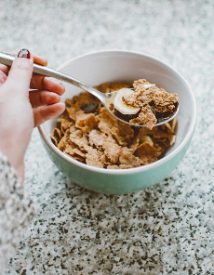
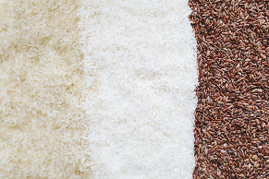
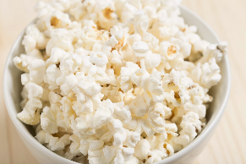
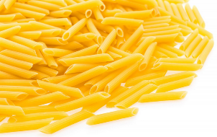
Grain foods
Breads
Breakfast cereal
Grains
Pasta
Other products
Mostly wholegrain and/or high cereal fibre varieties
Notes:
Grain foods comprise grains that can be cooked and eaten whole, ground into flour to make cereal foods, or made into breakfast cereals:
Breads: wholemeal, wholegrain, white, rye, pita, focaccia, crispbreads.
Breakfast cereals: high fibre (wholegrain) oats, porridge, muesli, wholewheat biscuits, ready to eat (such as cornflakes, cheerios).
Grains: rice, barley, corn, polenta, buckwheat, spelt, millet.
Pasta: short and long (white and wholemeal).
Other products: noodles, English muffin, crumpet, rice cakes, couscous, popcorn, flour.
The recommendation is for ‘mostly wholegrain and/or high cereal fibre varieties’ (at least two thirds). Wholegrain cereals contain more nutrients than refined cereal foods (e.g. white bread), because many of the important nutrients occur in the outer layer of the grain which is lost during processing.
Images: Designed by Pexels and Freepik
Based on material provided by the National Health and Medical Research Council (representing the Commonwealth of Australia)

Slide 9
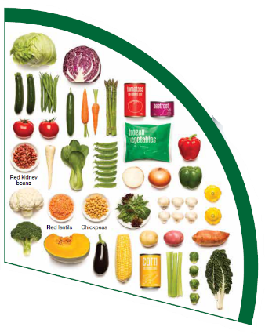
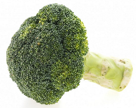
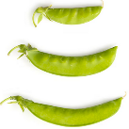
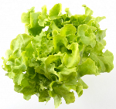

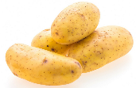
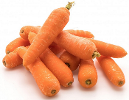
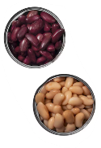
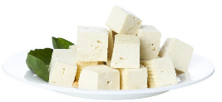
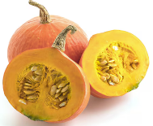
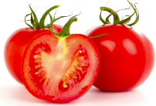
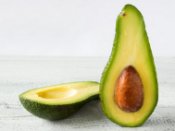
Vegetables
Dark green and cruciferous
Root/ tubular/ bulb
Legumes/beans
Other
Choose a variety, including different colours, each day
Notes:
Types of vegetables (also includes legumes and beans):
Dark green and cruciferous: broccoli, brussels sprouts, bok choy, cabbages, cauliflower, lettuce, spinach, snow peas.
Root/ tubular/ bulb: potato, sweet potato, carrots, beetroot, onion, shallots, garlic, swede, turnip.
Legumes/ beans: kidney beans, soybeans, lima beans, cannellini beans, chickpeas, lentils, split peas, tofu.
Other: tomato, celery, zucchini, avocado, capsicum, eggplant, mushrooms, cucumber, pumpkin, green peas, green beans.
Eat different colours of vegetables, as the different colour groups have different vitamins and minerals.
Vegetables such as tomatoes and pumpkins are technically classified as fruit because they have seeds. They are included in the vegetable group because they have similar nutritional properties as vegetables and are typically eaten as a vegetable.
Images: Designed by Freepik
Based on material provided by the National Health and Medical Research Council (representing the Commonwealth of Australia)

Slide 10
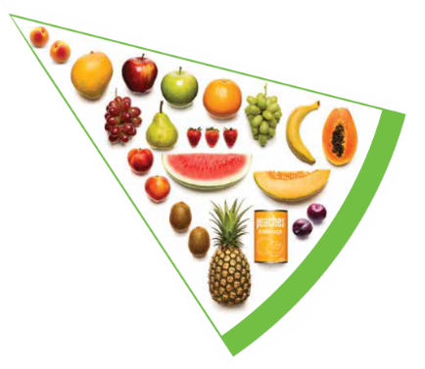
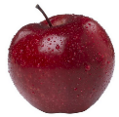

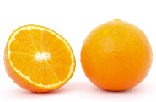
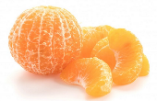
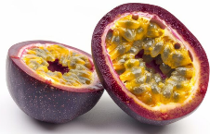
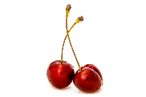




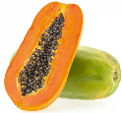
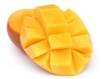
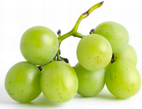

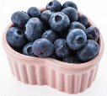
Fruit
Pomme
Citrus
Stone
Tropical
Berries
Choose dried fruit or fruit juice only occasionally
Notes:
Types of fruit:
Pome fruit: apple, pear.
Citrus fruit: orange, mandarin, grapefruit.
Stone fruit: apricot, cherry, peach, nectarine, plum.
Tropical: banana, paw paw, mangoes, pineapple and melon.
Berries: strawberry, blueberry, raspberry, blackberry.
Other: grapes, passionfruit.
Whole or chopped fruit is the best choice.
Fresh, frozen and canned fruits are all part of this food group. It is best to avoid fruits canned in syrup and choose varieties canned in natural juice or water instead.
Choose dried fruit or fruit juice only occasionally:
Eating dried fruit regularly is not recommended as it is high in kilojoules, can stick to the teeth and increases the risk of dental decay. You can also easily eat more than you realise.
Fruit juice is acidic and can increase the risk of dental decay. Fruit juice also has less fibre and other nutrients than whole fruit.
Different fruits can help protect our bodies in different ways, so it’s important to choose a variety, including different colours, each day.
Differences between fruit and vegetables
Fruits and vegetables are from different parts of a plant. Fruits come from the flowering part of a plant and contain seeds. Vegetables are the edible parts of a plant, such as the leaves, stem, roots, and bulbs.
Fruits that are eaten like vegetables: pumpkin, cucumber, tomato (and therefore part of the vegetable group).
Images: Designed by Pexels, Freepik and ChatGPT
Based on material provided by the National Health and Medical Research Council (representing the Commonwealth of Australia)

Slide 11
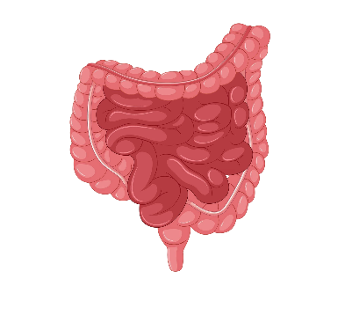




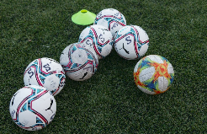
Why grain foods, vegetables and fruit are important
Provide the best source of energy (slow-release energy): fuels our brain (for concentration) and our body
Provide fibre: to help keep our intestines healthy
Provide lots of vitamins and minerals to help our bodies grow and age
Notes:
The complex carbohydrates in these foods are slowly digested, which provides energy over time and helps prevent overeating.
Carbohydrate provides the best source of energy for the brain.
Fibre helps us stay fuller for longer, which can help with concentration.
Fibre is especially useful in keeping the digestive track (including the intestines) healthy and can assist with constipation.
The vast range of vitamins and minerals are important for growth and repair, healthy ageing, and preventing chronic conditions.
Images: Designed by Pexels and Freepik

Slide 12
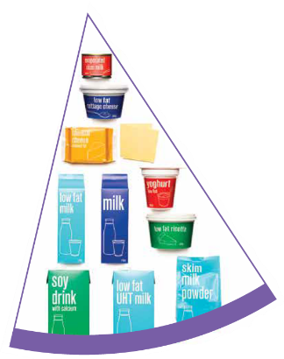
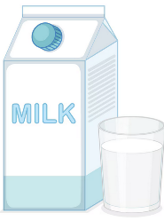

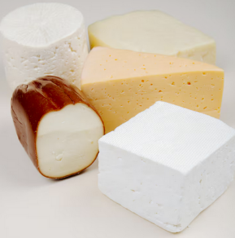
Dairy and alternatives
Milk (fresh and long life)
Yoghurt
Cheese
Reduced fat varieties are the best choice for most
Notes:
Types of foods:
Milks: All reduced fat or full cream milks, plain and flavoured, long life milks, powdered milk, evaporated milk, soy beverages (fortified with at least 100mg calcium/100mL).
Yoghurt: All yoghurts including reduced fat or full cream, plain and flavoured, soy yoghurt (calcium fortified).
Cheese: All hard cheeses, reduced or full fat, for example cheddar, red Leicester, Gloucester, Edam, Gouda Soy cheeses (calcium fortified).
Dairy = products made from milk.
Dairy alternatives:
Calcium-fortified dairy alternatives include soy, rice, almond or oat milk and soy or lactose free yoghurts and cheeses.
Non-dairy alternatives do not naturally contain calcium. It is important to select products labelled as calcium-fortified.
Many of the alternative milks, with the exception of soy milk products, may not be a good source of protein and other key nutrients found in milk and products made from milk.
For vegetarians and vegans, dairy alternative products such as soy milk and cheese are a key source of nutrients, particularly protein and calcium (if calcium is added by the manufacturer), and need to be included regularly to ensure their diet is nutritionally balanced.
Images: Designed by Freepik
Based on material provided by the National Health and Medical Research Council (representing the Commonwealth of Australia)

Slide 13

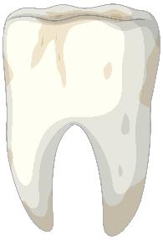
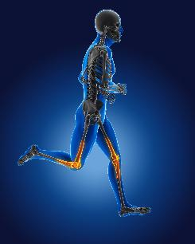
Why dairy and alternative foods are important
Provide calcium: for strong bones and teeth
Provide protein: helps our body grow and become strong
Provide lots of vitamins and minerals to help our bodies grow and age
Notes:
Calcium helps ensure strong bones and teeth.
Proteins are made up of chemical 'building blocks' called amino acids. Your body uses amino acids to build and repair muscles and bones.
Iodine is needed to make essential thyroid hormones. These are used by the body for growth and energy use, as well as brain and bone development in the early years.
Vitamin B12 is essential for the production of red blood cells, which are needed to carry oxygen from the lungs to the body’s tissues and organs.
Images: Designed by Pexels and Freepik

Slide 14
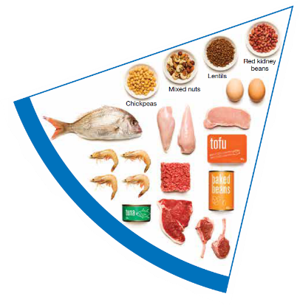
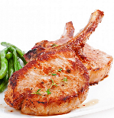

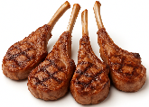
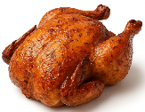
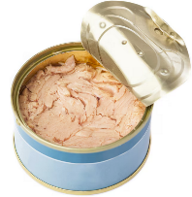
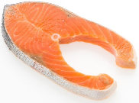

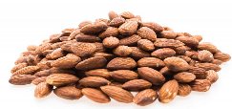
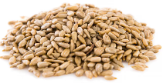
Meat and alternatives
Pink and red meat
Poultry
Fish and seafood
Eggs
Nuts and seeds
Legumes/beans
Choose meat without visible fat
Notes:
Types of foods:
Lean meats: beef, lamb, pork, kangaroo, lean and low salt sausages.
Poultry: chicken, turkey, duck, emu, goose.
Fish and seafood: fish, prawns, crab, lobster, mussels, oysters, scallops, clams.
Eggs: chicken eggs, duck eggs.
Nuts and seeds: almonds, pine nuts, walnut, macadamia, hazelnut, cashew, peanut, nut spreads, brazil nuts, seeds.
Legumes/beans: all beans, lentils, chickpeas, split peas, tofu.
To ensure adequate iron and zinc, about half the serves from this food group should be lean meats. For those who do not eat animal foods, nuts, seeds, legumes (including tofu) can provide some iron and zinc, plus a good mix of plant-based protein.
Choose lean meat options and/or remove the visible fat from the meat prior to cooking to reduce the total amount of saturated fat consumed.
Fresh, frozen and canned varieties of meat, poultry or fish are included in this group. It is important that canned varieties are low in fat and low in salt (no added salt) and canned in water rather than in oil or brine.
Sausages, commercial burgers and meat pastries can be high in saturated fat and are classified as a ‘sometimes’ food. It is recommended the consumption of these foods be limited. If purchasing sausages, it is best to select lean or reduced fat versions and boil or fry in a non-stick pan or BBQ.
Processed meats, such as salami and bacon are high in salt and saturated fats are classified as a ‘sometimes’ food. Consumption should be limited.
Meat alternatives (plant foods):
Nuts and seeds.
Legumes/beans appear in this group as well as the vegetable group.
For vegetarians and vegans, these foods are a key source of nutrients, particularly protein and iron, and need to be included regularly to ensure their diet is nutritionally balanced.
Images: Designed by Freepik and ChatGPT
Based on material provided by the National Health and Medical Research Council (representing the Commonwealth of Australia)

Slide 15

Why meat and alternative foods are important
Provide zinc and iron: keeps our blood healthy and gives us energy
Provide protein: helps our body grow and become strong
Provide essential fatty acids to keep our brains and heart healthy
Notes:
Proteins are made up of chemical 'building blocks' called amino acids. Your body uses amino acids to build and repair muscles and bones.
Iron is particularly important for transporting oxygen in the blood. This is essential for providing energy for daily life. Iron also helps our immune system fight infection.
Zinc is important for growth and for the immune system to fight infection.
Images: Designed by Freepik

Slide 16
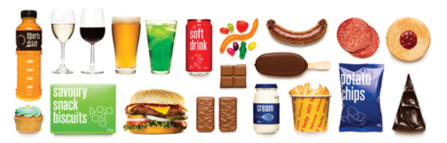
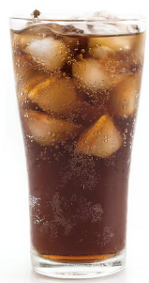

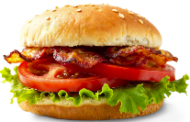



‘Sometimes' foods
Higher in added sugars
Higher in fat (and sodium)
Higher in both
To be consumed sometimes and in small amounts
Notes:
Some foods and drinks do not fit into the five food groups. These foods are high in saturated fat and/or added sugars, added salt or alcohol and low in fibre. These foods and drinks can also be high in kilojoules (energy).
Types of foods:
Higher added sugars: Soft drinks, energy drinks, sugar confectionary, jams, some sauces.
Higher fat: Most processed meats (bacon, ham, sausages, frankfurts), crisps, butter, cream, pastry products, meat pies, sausage rolls, potato chips, commercial pizza.
Higher added sugars AND higher fat: Biscuits, cakes, chocolate, doughnuts, ice cream, iced buns, some muesli bars, muffins, sweet pastries.
Alcoholic drinks.
‘Sometimes’ foods in a healthy diet:
Some people require extra serves of food, for example, those who are taller and more active. These can sometimes include extra serves of ‘sometimes’ foods. It is best if these extra serves come from the five food groups, particularly wholegrain cereals, vegetables including legumes/beans and fruit. However, they can also sometimes include serves of ‘sometimes’ foods (discretionary foods).
These foods can, however, contribute to a feeling of enjoyment. They should be consumed sometimes, and in small amounts, such as once a week.
Images: Designed by Freepik
Based on material provided by the National Health and Medical Research Council (representing the Commonwealth of Australia)

Slide 17
Lesson 2

Slide 18
Review

Slide 19
The Australian Guide to Healthy Eating
Notes:
The Australian Guide to Healthy Eating (AGHE) is a visual representation of the Australian Dietary Guidelines.
It is a broad guide to the types and amounts of foods we should eat each day.
The food groups:
Grain foods
Vegetables
Fruit
Dairy and alternatives
Meat and alternatives
Sitting off to the side are foods categorised as ‘sometimes’ foods. These foods are high in saturated fat and/or added sugars, added salt or alcohol and low in fibre. These foods and drinks can also be high in kilojoules (energy).

Slide 20





Vegetables
Fruit
What are the five food group categories?
Meat and alternatives
Grain foods
Dairy and alternatives
Notes:
Images: Based on material provided by the National Health and Medical Research Council (representing the Commonwealth of Australia)

Slide 21
‘Sometimes’ foods
Why do the ‘sometimes’ foods fit outside the plate?
Provide lots of energy but not a lot of nutrients.
Eating too much means we don’t eat enough foods from the five food groups.
We only need these foods ‘sometimes’ and in small amounts (like once or twice a week).
Notes:
‘Sometimes foods’ (discretionary foods) are energy dense and nutrient poor, meaning they provide a lot of energy and very few nutrients in a small volume of food or drink.
These foods generally have low levels of important vitamins and minerals.
Frequent consumption of such foods may replace healthy, nutritious foods from the five food groups.
Based on material provided by the National Health and Medical Research Council (representing the Commonwealth of Australia)

Slide 22
Why are grain foods, vegetables and fruit important?
How many reasons can you think of?

Slide 23
Answer: Why are grain foods, vegetables and fruit important?
Provide the best source of energy (slow-release energy): fuels our brain (for concentration) and our body
Provide fibre: to help keep our intestines healthy
Provide lots of vitamins and minerals to help our bodies grow and age
Notes:
The complex carbohydrates in these foods are slowly digested, which provides energy over time and helps prevent overeating.
Carbohydrate provides the best source of energy for the brain.
Fibre helps us stay fuller for longer, which can help with concentration.
Fibre is especially useful in keeping the digestive track (including the intestines) healthy and can assist with constipation.
The vast range of vitamins and minerals are important for growth and repair, healthy ageing, and preventing chronic conditions.
Images: Designed by Pexels and Freepik

Slide 24
Learning intention: To learn about where food comes from.
Success criteria:
identify foods from plants
identify food from animals.

Slide 25

All food comes from either a plant or an animal
Notes:
Images: Designed by Freepik

Slide 26



Food from plants
Wheat – used to make flour, bread and breakfast cereals
Fruit
Vegetables
Notes:
These are example foods.
Images: Designed by Freepik

Slide 27







Food from animals
Dairy cow – produces milk for foods like milk, cheese, yoghurt
Chickens – for chicken meat, eggs
Beef cattle – for meat
Notes:
These are example foods.
Images: Designed by Freepik and ChatGPT

Slide 28





Food from animals
Fish – for fish fillets, crumbed fish, canned fish
Pig – for meat (pork)
Sheep – for meat and milk
Notes:
These are example foods.
Images: Designed by Freepik and ChatGPT

Slide 29



Are these from a plant or animal?
Animal (chickens)
Plant
Plant (mainly wheat)
Eggs
Pears
Bread
Notes:
Go through the examples with the students.
Images: Designed by Freepik and ChatGPT

Slide 30



Are these from a plant or animal?
Animal (dairy cow)
Plant
Animal (made by bees)
Cheese
Potato
Honey
Notes:
Go through the examples with the students.
Images: Designed by Freepik

Slide 31
The Australian Guide to Healthy Eating
Let’s link this to the Australian Guide to Healthy Eating.
Notes:
Each of the foods in the food groups come from plants OR animals

Slide 32

Grain foods come from plants
Notes:
Image: Based on material provided by the National Health and Medical Research Council (representing the Commonwealth of Australia)

Slide 33







Grain foods
Wheat is used to make bread, breakfast cereal, pasta
Oats are used to make porridge and muesli
Notes:
Examples of how grains are used to produce foods in the food group.
Images: Designed by Freepik and Pexels

Slide 34

Vegetables come from plants
Notes:
Image: Based on material provided by the National Health and Medical Research Council (representing the Commonwealth of Australia)

Slide 35






Vegetables
Notes:
Examples of vegetable plants.
Images: Designed by Freepik

Slide 36

Fruit come from plants
Notes:
Image: Based on material provided by the National Health and Medical Research Council (representing the Commonwealth of Australia)

Slide 37






Fruit
Notes:
Examples of fruit trees and plants.
Images: Designed by Freepik

Slide 38

Dairy foods come from animals
Dairy alternatives (like soy milk) comes from plants
Notes:
Image: Based on material provided by the National Health and Medical Research Council (representing the Commonwealth of Australia)

Slide 39







Dairy and alternative foods
Milk from cows is used to make drinking milk, cheese, yoghurt and custard
The juice from soybeans are used to make soy milk and soy yoghurt
Notes:
Images: Designed by Freepik

Slide 40

Meat foods come from animals
Meat alternatives (like tofu) come from plants
Notes:
Image: Based on material provided by the National Health and Medical Research Council (representing the Commonwealth of Australia)

Slide 41





Meat and alternative foods
Beef cattle is used for beef (meat)
Chickens are used for chicken (meat) and eggs
Notes:
Images: Designed by Freepik and ChatGPT

Slide 42
Activity 1: Booklet task
Sort foods based on whether they are from plans or animals
Extension
Add additional foods (draw or write)
Label the food group each food belongs to.
Notes:
In their unit booklet (lesson 2), students cut and paste each food into the columns (plants/animals).
Give students the option of working with a partner or in groups.
Extension:
Add additional foods (draw or write).
Label the food group each food belongs to.

Slide 43
Lesson 3

Slide 44
Review

Slide 45
Why are dairy and alternative foods important?
How many reasons can you think of?

Slide 46
Answer: Why are dairy and alternative foods important?
Provide calcium: for strong bones and teeth
Provide protein: helps our body grow and become strong
Provide lots of vitamins and minerals to help our bodies grow and age
Notes:
Calcium helps ensure strong bones and teeth.
Proteins are made up of chemical 'building blocks' called amino acids. Your body uses amino acids to build and repair muscles and bones.
Iodine is needed to make essential thyroid hormones. These are used by the body for growth and energy use, as well as brain and bone development in the early years.
Vitamin B12 is essential for the production of red blood cells, which are needed to carry oxygen from the lungs to the body’s tissues and organs.
Images: Designed by Pexels and Freepik

Slide 47
Why are meat and alternative foods important?
How many reasons can you think of?

Slide 48
Answer: Why are meat and alternative foods important?
Provide zinc and iron: keeps our blood healthy and gives us energy
Provide protein: helps our body grow and become strong
Provide essential fatty acids to keep our brains and heart healthy
Notes:
Proteins are made up of chemical 'building blocks' called amino acids. Your body uses amino acids to build and repair muscles and bones.
Iron is particularly important for transporting oxygen in the blood. This is essential for providing energy for daily life. Iron also helps our immune system fight infection.
Zinc is important for growth and for the immune system to fight infection.
Images: Designed by Freepik

Slide 49
Learning intention: To investigate food from the farm to the supermarket.
Success criteria:
identify where food is grown
Identify at least 3 steps for food to be processed
Identify the equipment that is used.

Slide 50
Food processing
All food that is reared (animals) or grown (like fruits and vegetables), are processed.
Some foods are processed more than others.
Different equipment is used when processing food.

Slide 51
Let’s look at some examples

Slide 52



Grilled lamb
The lamb is reared on a farm
The lamb is processed to get different cuts of meat
We then cook this to eat as a meal
Notes:
Machines are used to transport sheep and cut up the meat ready for the supermarket.
Images: Designed by Freepik and ChatGPT

Slide 53

Milk from the farm to the supermarket
Notes:
[3.06]

Slide 54










Bottled milk: farm to supermarket
1. The dairy cows are kept on a farm
2. The cows are milked on the farm
3. Tankers transport the milk to processing plant
4. The milk is tested
7. The milk is put in containers and transported
6. The milk is homogenised
5. The milk is pasteurised (heat treated)
8. Milk can also be used to make cheese, yoghurt and custard
Notes:
There are lots of steps that use different equipment to bring milk from the farm to the supermarket. This is a simplified flowchart of what was shown in the video.
Dairy cows are kept on a farm where they are given different food to help them produce milk.
The cows are milked by farmers in sheds on the farm.
The milk is pumped into a milk tank and transported to the nearest processing plant.
The testing process is to ensure there is no harmful bacteria and has the right level of nutrients.
The milk is pasteurised where it is heated at high temperatures to remove any harmful bacteria.
The milk is homogenised, which evenly distribute the fat globules (otherwise the fat would sit on top of the milk).
The milk is put into containers and transported to the shops for us to buy.
It can also be made into other products, like cheese, yoghurt and custard.
Images: Some images designed by Freepik

Slide 55







Bread: farm to supermarket
1. Wheat grown on a farm
2. The wheat is harvested with equipment
3. The wheat is transported to a flour mill
4. The wheat is milled into flour
7. The bread is transported
6. The flour is mixed with other ingredients to make bread
5. The flour is transported to a bakery
Notes:
There are lots of steps that use different equipment to bring wheat from the farm, to make bread, to then appear at the shops.
Images: Some images designed by Freepik

Slide 56
Activity 1: Booklet task
Draw the steps (at least 3) that a food takes from a farm to the supermarket. Think about:
Where is the food grown or reared?
What happens to it at the farm?
Where does it go after the farm?
What equipment is used?
Are there multiple steps and factories?
e.g. like bread.
Notes:
This task is not necessarily about accuracy. Students should simply consider the high-level steps involved.
Students could work individually or in small groups and use a device to assist with research (but this is not necessary).
If students are finding it hard to think of a food, suggestions include:
- frozen vegetables e.g. peas, corn
- cornflakes
- weet-bix
- orange juice
- rice

Slide 57
Lesson 4

Slide 58
Review

Slide 59
Do grain foods come from plants or animals?
Grain foods come from plants
Notes:
Image: Based on material provided by the National Health and Medical Research Council (representing the Commonwealth of Australia)

Slide 60
Do vegetables come from plants or animals?
Vegetables come from plants
Notes:
Image: Based on material provided by the National Health and Medical Research Council (representing the Commonwealth of Australia)

Slide 61
Does fruit come from plants or animals?
Fruit come from plants
Notes:
Image: Based on material provided by the National Health and Medical Research Council (representing the Commonwealth of Australia)

Slide 62
Do dairy and alternative foods come from plants or animals?
Dairy foods come from animals
Dairy alternatives (like soy milk) come from plants
Notes:
Image: Based on material provided by the National Health and Medical Research Council (representing the Commonwealth of Australia)

Slide 63
Do meat and alternative foods come from plants or animals?
Meat foods come from animals
Meat alternatives (like tofu) come from plants
Notes:
Image: Based on material provided by the National Health and Medical Research Council (representing the Commonwealth of Australia)

Slide 64
Learning intention: To investigate the tools and equipment needed to prepare food in the home.
Success criteria:
identify the tools and equipment
identify the food groups
identify plant and animal ingredients.

Slide 65








We use different tools and equipment when preparing food to eat in the home.
Notes:
Examples include those on screen.
What else can you think of?
Images: Some images designed by Freepik

Slide 66
Let’s look at some recipes and the tools and equipment needed

Slide 67




Fruit salad
The ingredients need to be combined in a bowl.
The recipe states that the fruit needs to be ‘quartered’, ‘sliced’ and ‘chopped’. This requires a knife and chopping board.
Food groups:
Fruit
Dairy (yoghurt)
Meat and alternatives (almonds)
Recipe: taste.com.au
Notes:
I do
This is a simple recipe, but still requires 4 pieces of equipment to prepare.
We can also look at the food groups it contains.

Slide 68








Almond and date bliss balls
Some of the ingredients need to be put in a food processor (so it can be cut up really finely, like a paste).
In this recipe, equipment includes a plate, an airtight container and baking paper as they are needed to prepare the dish.
Food groups:
Fruit
Meat and alternatives (almond meal)
Recipe: taste.com.au
Notes:
I do
This recipe requires a more advanced piece of equipment (food processor).
We can also look at the food groups it contains.

Slide 69
Let’s do some together
Notes:
A recipe is provided on the next slide. Complete this together as a class.

Slide 70


Chicken sandwich
Recipe: taste.com.au
Notes:
We do
Do this together as a class. Annotate on the screen or list on a whiteboard:
Tools and equipment:
Chopping board to compile the sandwiches (implied)
Bowl to combine ingredients (implied)
Spoon to mix
Knife to slice sandwiches
If you were cooking the chicken yourself, you would need a saucepan or oven tray (depending on how cooking)
Food groups:
Meat and alternatives
Grain foods (uses white bread; however, wholemeal or grain could be used).

Slide 71



Vegetable muffins
Recipe: taste.com.au
Notes:
We do
Do this together as a class. Annotate on the screen or list on a whiteboard:
Tools and equipment:
Oven
Cooking brush
Sieve
Bowl
Grater (for grating the cheese and vegetables)
Knife (for peeling and chopping)
Whisk (for the eggs)
Bowl
Spoon
Jug
Muffin pans
Skewer
There are a lot of tools and equipment for this recipe.
Food groups:
Vegetables
Dairy and alternatives (milk, cheese)
Meat and alternatives (eggs)
Grain foods (flour)

Slide 72
Activity 1: Booklet task
For each of the recipes in the booklet, identify:
the tools and equipment needed to prepare the food
the food groups in the recipe
whether the ingredients are from plants or animals.
Notes:
Provide a copy of the Australian Guide to Healthy Eating to assist with students identifying the food groups (if needed).

Slide 73
Lesson 5

Slide 74
Review

Slide 75









What are some of the tools and equipment we need to prepare foods at home?
Notes:
Examples include those on screen.
What else can you think of?
Images: Some images designed by Freepik

Slide 76
Learning intention: To draw and label a food image.
Success criteria:
title
draw image
label each part of the image.

Slide 77
We can create images of foods and label them with key information
Notes:
A recipe is provided on the next slide. Complete this together as a class.

Slide 78

Notes:
I do: Explain that adding labels to images helps the reader understand the image a lot better and can help communicate a message.
In this image, we can see a girl, with the labels telling us about the parts of her body.
Image: Vecteezy

Slide 79

Apple
Notes:
I do: Explain that adding labels to the image helps the reader understand the image a lot better and can help communicate a message.
In this image here, we can see a whole apple and an apple cut in half, with all the parts labelled.

Slide 80

Bread slice
1 slice = 1 serve of grain foods
Wholemeal flour
Soft centre
Crust
From the grain food group
Notes:
I do: In this image here, we can see a slice of bread. I can add labels.
Notice the words with the lines? Each line links the words with the part of the bread slice.
But, you don’t need to have lines if it’s not relevant. The label ‘From the grain food group’ doesn’t have a line as it’s related to the whole food.
Image: Designed by Freepik

Slide 81

Baked beans on toast
Tools and equipment
Microwave
Spoon
Toaster
Knife
Plate
Grater
Cheese
Dairy food
From animals
Beans
Meat and alternatives food
From plants
Bread
Grain food
From plants
Notes:
I do: Using this example of baked beans on toast, we can add labels showing:
The tools and equipment needed to prepare the food
The food groups in the recipe
Whether the ingredients are from plants or animals
https://www.coop.co.uk/recipes/beans-and-cheese-on-toast

Slide 82



Activity 1: Booklet task
Draw a prepared food item that aligns with Australian Guide to Healthy Eating.
Include:
Title
Label the image with:
  the tools and equipment needed to prepare the food
  the food groups in the recipe
  whether the ingredients are from plants or
  animals.
Notes:
Provide examples to assist students if needed:
Chicken sandwich (wholemeal bread)
Toasted cheese sandwich
Fruit kebabs
Images: Designed by Freepik

Slide 83
Lesson 6

Slide 84
Review

Slide 85
What are examples of dairy and alternative foods?

Slide 86

Answer: What are examples of dairy and alternative foods?
Notes:
Images: Designed by Freepik and ChatGPT

Slide 87
What are examples of grain foods?

Slide 88

Answer: What are examples of grain foods?
Notes:
Images: Designed by Freepik and ChatGPT

Slide 89
Learning intention: To investigate healthy snacks.
Success criteria:
identify a healthy snack option
label the snack with the ingredients.

Slide 90
Snacks
Why do we need snacks?
When are you likely to have snacks?
What are some of the snacks you eat?
Notes:
Elicit responses from students.

Slide 91
Snacks
What should we look for when choosing snacks?
Notes:
Elicit responses from students.
From a nutritional perspective, we should focus on from the Australian Guide to Healthy Eating (the five food groups). However, we also consider taste and convenience. The key is to get a balance between these.

Slide 92
Snacks
Aim for foods from the five food groups
Vegetable pieces and dip | Plain or flavoured milk | Home made fruit muffins
Nuts and seeds (not at school) | Can of tuna | Home made protein balls
Fruit | Hard boiled egg | Baked beans
Flatbread wraps/ sandwich with spread (avocado, cheese) | Wholegrain crackers and spread | Cheese and wholegrain crackers
Yoghurt | Fruit bread | Fruit with yoghurt
Rice cakes with toppings e.g. cheese (tasty, ricotta, cottage), avocado, vegemite
What else can you suggest?

Slide 93

Snacks
For packaged food, you can also use the Health Star Rating as a guide.
Step 1: Identify whether food is a core food in the AGHE.
Step 2: Select a packaged food with the highest rating in that category.

Slide 94

Activity 1: Booklet task
Draw a healthy snack based on the Australian Guide to Healthy Eating.
Label your snack with the ingredients.
Notes:
Use the previous slide for examples.
Extension
Label with:
The tools and equipment needed to prepare the food
The food groups in the recipe
Whether the ingredients are from plants or animals

Slide 95
Lesson 7

Slide 96
Learning intention: To review different apples based on their sensory properties.
Success criteria:
colour
texture
smell
taste

Slide 97
We can evaluate a food based on its sensory properties (e.g. smell, taste, texture).

Slide 98
We can evaluate a food based on its sensory properties (e.g. smell, taste, texture).

Slide 99
These different properties affect whether you enjoy the food and how we use it.

Slide 100

Activity 1: Sensory evaluation
Notes:
This activity requires 4 different types of apples.
Prepare the apples by cutting them into small slices (enough for students to taste).
Have 4 stations set up with the sliced apples, and a whole apple for assessment.
Students rotate around the stations, completing the evaluation in their unit booklet (lesson 7).
Questions to consider:
- Which is your favourite apple?
- Why?
- How might these sensory properties affect how they are used?

Slide 101
Lesson 8

Slide 102
Learning intention: To design a healthy snack for yourself or someone your age.

Slide 103
Task
To design a healthy snack. Explain how the Australian Guide to Healthy Eating helped guide the design of your snack.

Slide 104


Slide 105


