Slide 1
Food packaging
Food packaging helps make food:
transportable (therefore accessible)
safe
longer-lasting.
These factors can also reduce the cost
of food.

Slide 2
Food packaging
Most of the food we buy comes packaged.
Packaging is made of a variety of materials:
glass
metal
paper (including cardboard)
plastic.

Slide 3
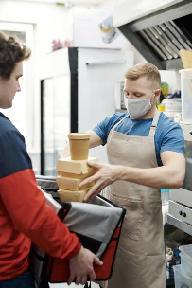
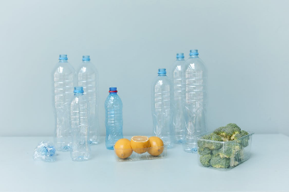
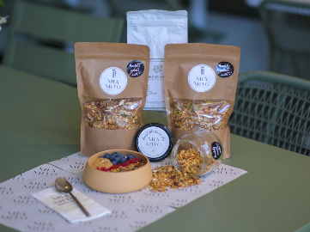
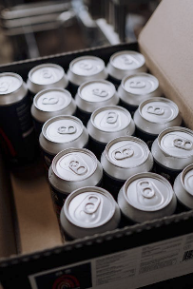
Food packaging and the environment
Resources and energy are used to:
produce the packaging material
dispose of or recycle the packaging.
Notes:
Images: Designed by Pexels

Slide 4
Product stewardship
We all have a shared responsibility to reduce the environmental impact of food packaging:
producers
sellers
consumers.
Notes:
Source: https://www.dcceew.gov.au/environment/protection/waste/product-stewardship

Slide 5
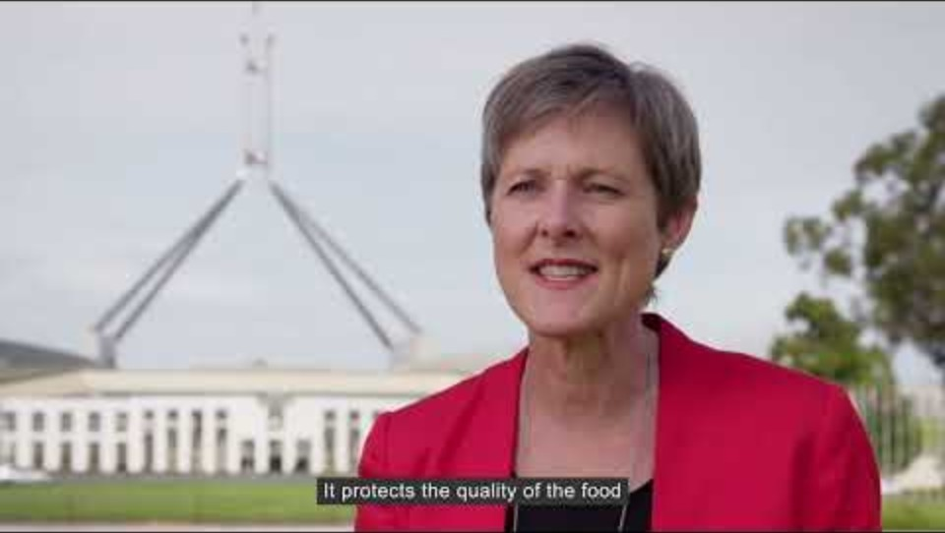
Plastics and packaging
Notes:
[6.34]
Additional videos from AFGC that look at sustainability are available on the AFGC YouTube channel: https://www.youtube.com/@AustralianFoodGroceryCouncil

Slide 6
Changing practices: case study
MasterFoods is trialling paper-based Squeeze-On packs (single-serve tomato sauce packs).
These can be recycled via kerbside recycling.
Contain 58% less plastic than original Squeeze-On packs.
Notes:
Source: https://www.mars.com/en-au/news-and-stories/press-releases-statements/masterfoods-trial-new-paper-based-squeeze-on-packs

Slide 7
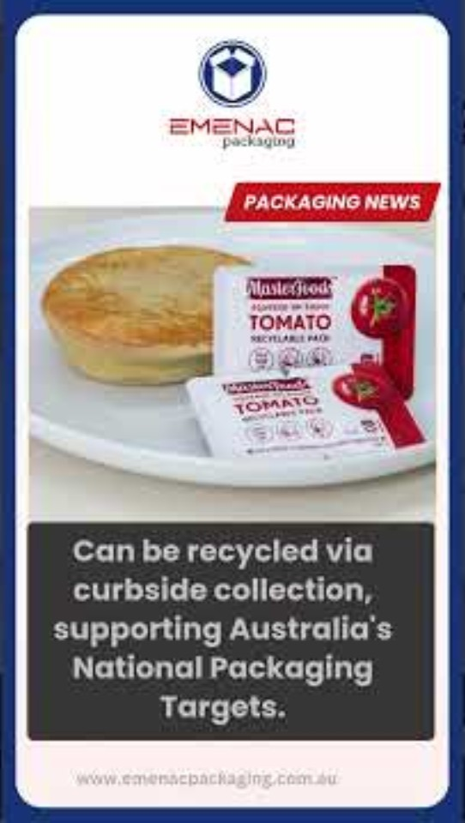
Changing practices: case study

