Slide 1
What is food safety?
Food Safety = handling, preparing and storing food in a way to best reduce the risk of individuals becoming sick from foodborne illnesses.
Foodborne illness is caused by pathogens such as:
bacteria - Salmonella, Campylobacter, E.coli and Listeria
virus - Norovirus, Rotavirus and Hepatitis A
toxins produced by pathogens - Staphylococcus aureus, Bacillus cereus and Clostridium perfringens.
Notes:
Record student ideas first.
Foodborne illness (food poisoning) is the name for the range of illnesses caused by eating or drinking contaminated food or drink.
Further details at: https://www.foodauthority.nsw.gov.au/consumer/food-poisoning/foodborne-illness-pathogens

Slide 2
Foodborne illness symptoms
Nausea (feeling sick)
Stomach cramps
Diarrhoea
Vomiting
Fever
Headaches
Notes:
Record student ideas first.
Further details at: https://www.foodauthority.nsw.gov.au/consumer/food-poisoning

Slide 3
Causes of foodborne illness
Not cooking food thoroughly
Not storing food that needs to be chilled below 5°C
Someone who is ill or has poor hand hygiene handling the food
Eating food after a ‘use-by’ date
Cross contamination–bacteria is spread between food, surfaces, utensils and equipment.
Notes:
Further details at: https://www.foodauthority.nsw.gov.au/consumer/food-poisoning

Slide 4
Higher risk foods
Meat, especially undercooked mince
Raw or undercooked poultry such as chicken
Raw or lightly cooked eggs including foods made from raw egg
Smallgoods such as salami and hams
Cooked rice and pasta not kept at the correct temperature
Prepared salads and fruit salad
Notes:
Some foods accommodate harmful bugs or toxins more than others.
The bugs or toxins may be present on foods at the time of purchase, get onto food by cross contamination and poor hygiene, or grow to harmful levels as a result of poor temperature control.
Further details at: https://www.foodauthority.nsw.gov.au/consumer/food-poisoning

Slide 5
How do we keep food safe?
Properly cleaning and sanitising all surfaces, equipment and utensils
Storing, chilling and heating food correctly: temperature, environment and equipment
Maintaining a high level of personal hygiene, especially hand-washing
Implementing effective pest control
Notes:
Record student ideas first.
Further details at: https://blog.foodsafety.com.au/what-is-food-safety

Slide 6
Personal hygiene standards
Washing hands
Not sneezing or coughing on food
Not sitting on benches/tables or any food preparation surface
Keeping dogs, cats and insects away from food
Tying hair back
Washing hands
Notes:
We can reduce the risk of foodborne illness through following these personal hygiene standards.
Further details at: https://www.health.qld.gov.au/__data/assets/pdf_file/0024/427533/jarjums-sect3-less4.pdf

Slide 7
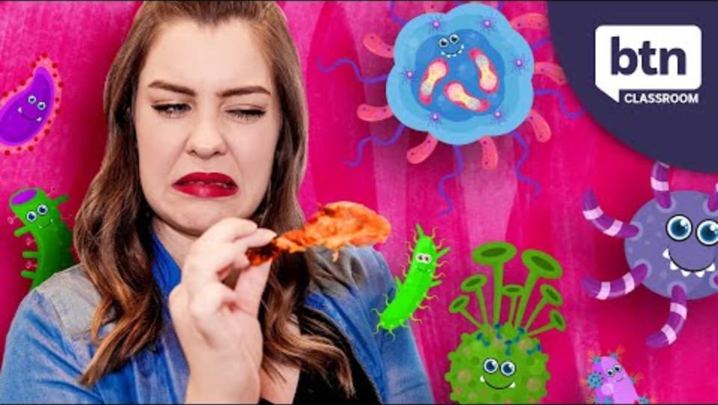
Food safety at home
Notes:
[3.40]

Slide 8
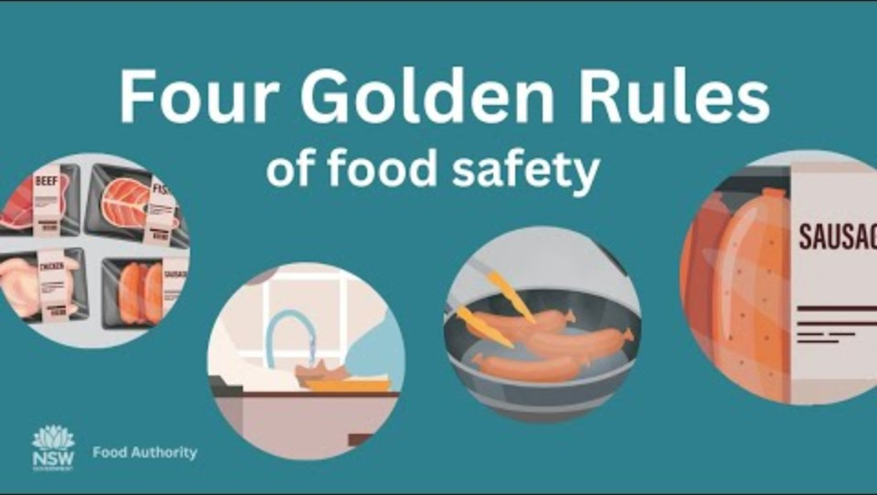
Golden rules on food safety
Notes:
[1.23]
Keep it clean
Keep it hot
Keep it cold
Check the label

Slide 9
Food manufacturing
Food businesses, including food manufacturers, must follow food safety practices to ensure the food they sell is safe.
Kay practices:
Start with safe food
Prevent food contamination
Use processing steps known to achieve food safety
Keep food at safe temperatures
Notes:
Start with safe food
Before you process food, make sure it is safe and suitable (e.g. ingredients from reliable suppliers, safely stored, inspected).
Prevent food contamination
Make sure food handlers know how to correctly use processing equipment and maintain good hygiene.
Keep food processing areas clean.
Clean and sanitise food contact surfaces before use (e.g. chopping boards, cutting and mixing blades, probe thermometers).
Use separate equipment or areas for preparing raw and ready-to-eat foods, or clean thoroughly between uses.
Use processing steps known to achieve food safety
Know the critical limits for temperature, time, pH and water activity used for your food processing steps.
When cooking or pasteurising, ensure the time and temperature makes food safe (e.g. cook chicken and mince to an internal temperature of ≥75°C).
When using other processes such as acidification, fermentation and drying, make sure the food reaches the correct critical limit (e.g. pH ≤4.2 to prevent Salmonella growth).
Keep food at safe temperatures
For potentially hazardous food, keep it cold, keep it hot or make it quick.
Further details at: https://www.foodstandards.gov.au/business/food-safety/processing-food-safely

