Slide 1
Allergies
Allergy: immune system reacts to substances in the environment that are harmless for most people.
Examples: pollen, mould, dust mites, insect bites and food.
Response: immune system releases large amount of chemicals leading to signs and symptoms of an allergic reaction.
Notes:
People can be allergic to many things, such as pollen, mould, dust mites, animal dander or saliva, insect stings or bites, medication, food, and latex.
Source: https://allergyfacts.org.au/about-allergies/

Slide 2
Allergies
An allergic reaction can involve the gut, skin, breathing and/or heart systems.
Symptoms can be mild to moderate or severe (known as anaphylaxis).
Anaphylaxis is a life-threatening emergency as it affects breathing and blood pressure.
Notes:
Source: https://allergyfacts.org.au/__interest/food-allergy/

Slide 3
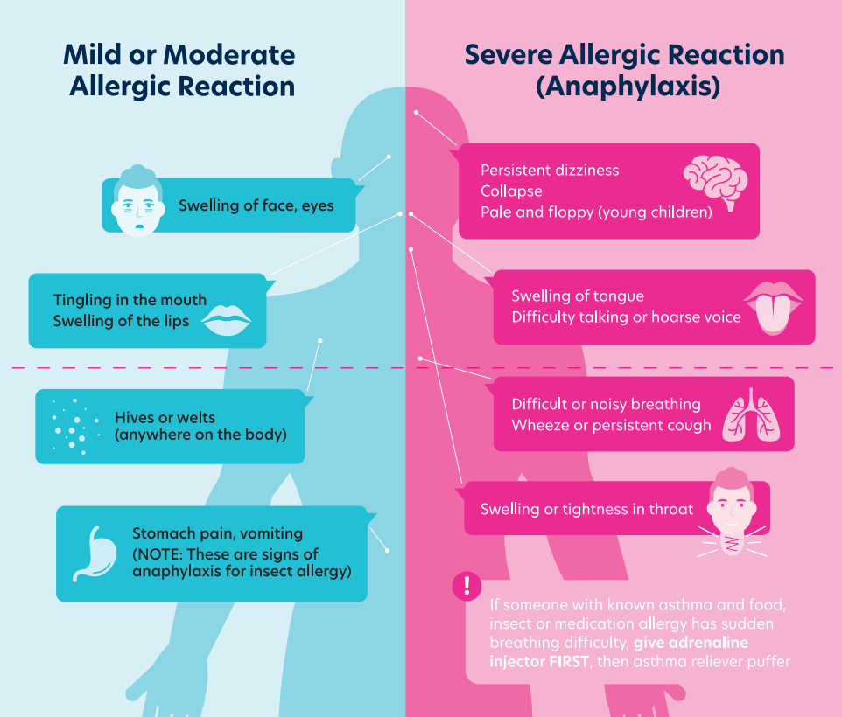
Allergic reactions
Notes:
Source: https://allergyfacts.org.au/signs-and-symptoms-of-an-allergic-reaction/

Slide 4
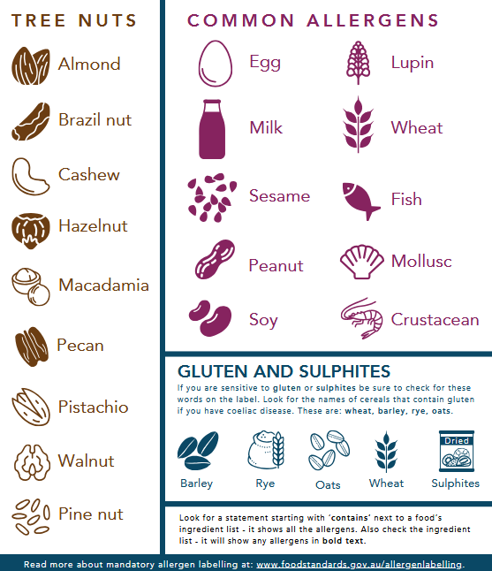
Common food allergens
Notes:
Source: https://www.foodstandards.gov.au/consumer/labelling/allergen-labelling

Slide 5
Food allergen labelling
Allergens must be declared in the ingredient list of foods using the exact name and bolded text e.g. cheese (milk) or milk powder.
A bolded, separate allergen summary statement starting with the word ‘contains’ also needs to be provided near the
ingredient list e.g. ‘Contains milk’.
Notes:
Source: https://www.foodstandards.gov.au/consumer/labelling/allergen-labelling

Slide 6
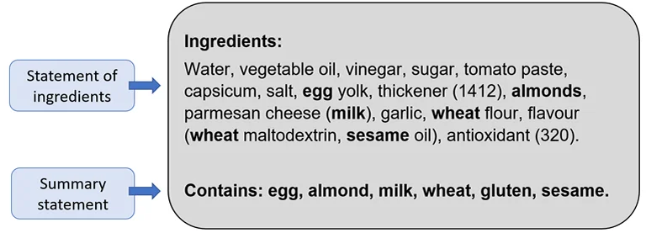
Food allergen labelling
Notes:
Labelling example.
Source: https://foodallergyaware.org.au/everyone/reading-food-labels-for-food-allergens

Slide 7
Precautionary allergen labelling
Statements can be used to warn people that a food might be accidentally contaminated with an allergen.
These are not mandatory, meaning companies can choose to use them.
Made on equipment that also produces products containing…
May be present
May contain….
Notes:
People with food allergies need to make their own decision on whether foods with these labels are safe for them (usually with the help of a doctor or dietitian).
Note: Research by Food Standards Australia New Zealand found that consumers viewed PAL statements such as ‘may contain’, ‘may be present’, ‘made in a factory that also processes’, etc. as unhelpful and confusing, and that they ultimately restrict rather than enable safe food choices (https://allergyfacts.org.au/news/research-allergy-declarations-and-pal/)
Source: https://foodallergyaware.org.au/everyone/reading-food-labels-for-food-allergens

Slide 8
Food intolerance
Food intolerance: chemical reaction to a food (not an allergic reaction).
Can cause can cause gastrointestinal (gut) symptoms such as bloating, gas/flatulence, diarrhoea, constipation, stomach pain, headaches, migraines and fatigue.
Notes:
Source:
https://allergyfacts.org.au/food-allergy-or-food-intolerance/
https://www.betterhealth.vic.gov.au/health/conditionsandtreatments/food-allergy-and-intolerance

Slide 9
Food intolerance
Substances that can trigger symptoms:
Lactose: a sugar found in milk | Vasoactive amines: found naturally in a range of foods
Monosodium glutamate (MSG): added to some foods, and glutamates are also naturally occurring | Salicylates: found in many herbs, spices, fruits, and vegetables
Notes:
Source: https://www.allergy.org.au/patients/food-other-adverse-reactions/food-intolerance

Slide 10
Managing allergies and intolerances
People with food allergies and intolerances must play close attention to the food they eat and their ingredients.
This is particularly important with food allergies because the allergic reaction can be life threatening.

