Slide 1
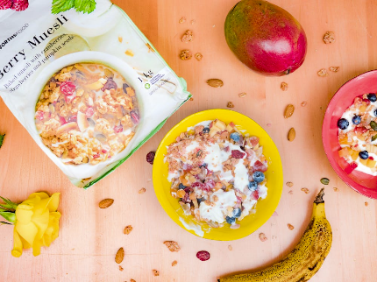
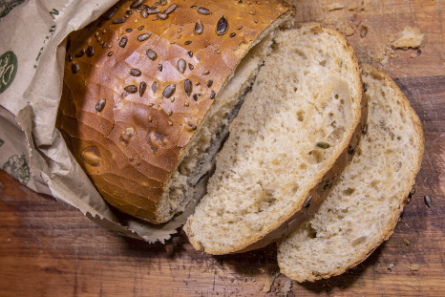
Designing food for consumers, the environment and healthy eating
Food and nutrition unit
Year 10
Notes:
Images: Designed by Pexels

Slide 2
Contents
Lesson 1 | Lesson 5
Lesson 2 | Lesson 6
Lesson 3 | Lesson 7, 8 and 9
Lesson 4

Slide 3
Lesson 1

Slide 4
In this unit we will be:
reviewing the Australian Guide to Healthy Eating
reviewing the role of food processing in Australia
investigating product development concepts
investigate the sensory properties of food
looking at food production and packaging through a sustainability lens
designing a new food product that meets the needs of consumers, the environment and enhances healthy eating.

Slide 5
Learning intention: To recognise the role of packaged foods in a healthy diet.
Success criteria:
identify at least 3 packaged foods in each food group.

Slide 6
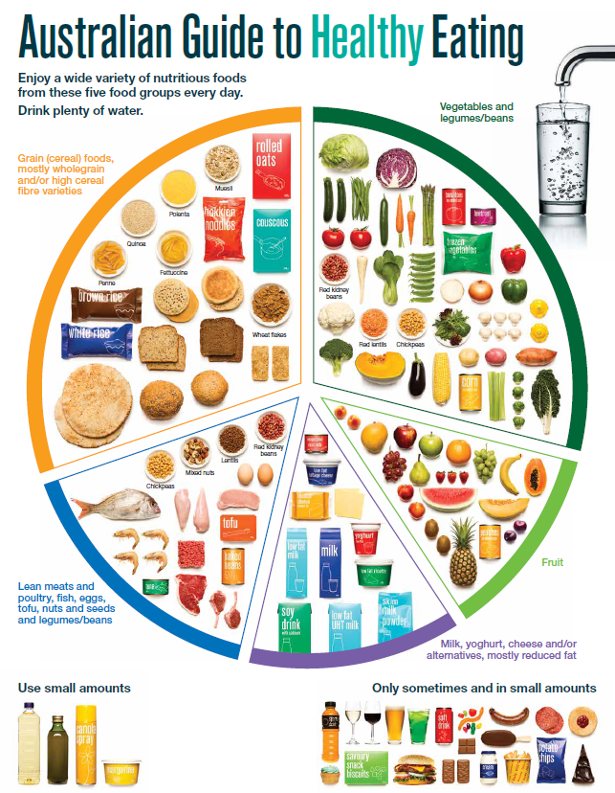
The Australian Guide to Healthy Eating
Notes:
The Australian Guide to Healthy Eating (AGHE) is a visual representation of the Australian Dietary Guidelines.
It is a broad guide to the types and amounts of foods we should eat each day.
The food groups:
Grain foods
Vegetables
Fruit
Dairy and alternatives
Meat and alternatives
Sitting off to the side are foods categorised as ‘sometimes’ foods. These foods are high in saturated fat and/or added sugars, added salt or alcohol and low in fibre. These foods and drinks can also be high in kilojoules (energy).

Slide 7

Overview of the AGHE
Notes:
[2.27]
While this video is directed at teachers, it provides a good overview of the five food groups, represented in the Australian Guide to healthy Eating.

Slide 8
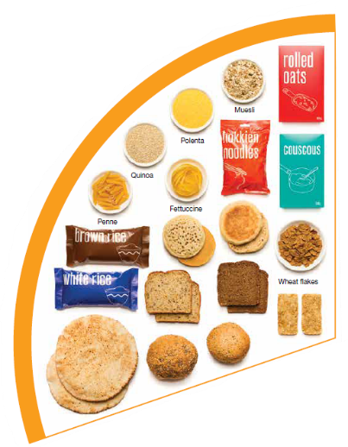
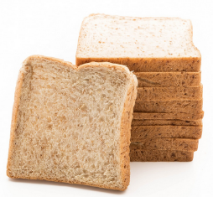
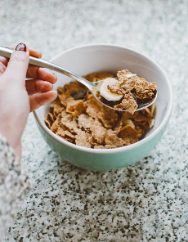
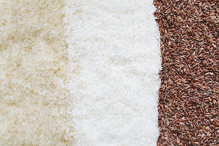

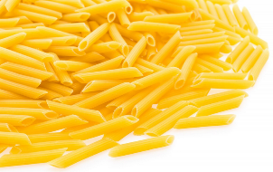
Grain foods
Breads
Breakfast cereal
Grains
Pasta
Other products
Mostly wholegrain and/or high cereal fibre varieties
Notes:
Grain foods comprise grains that can be cooked and eaten whole, ground into flour to make cereal foods, or made into breakfast cereals:
Breads: wholemeal, wholegrain, white, rye, pita, focaccia, crispbreads.
Breakfast cereals: high fibre (wholegrain) oats, porridge, muesli, wholewheat biscuits, ready to eat (such as cornflakes, cheerios).
Grains: rice, barley, corn, polenta, buckwheat, spelt, millet.
Pasta: short and long (white and wholemeal).
Other products: noodles, English muffin, crumpet, rice cakes, couscous, popcorn, flour.
The recommendation is for ‘mostly wholegrain and/or high cereal fibre varieties’ (at least two thirds). Wholegrain cereals contain more nutrients than refined cereal foods (e.g. white bread), because many of the important nutrients occur in the outer layer of the grain which is lost during processing.
Images: Designed by Pexels and Freepik
Based on material provided by the National Health and Medical Research Council (representing the Commonwealth of Australia)

Slide 9
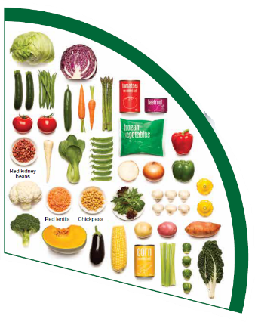
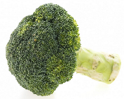
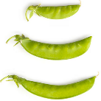
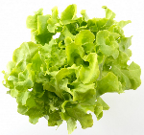

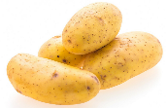
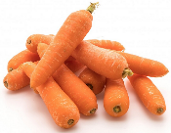
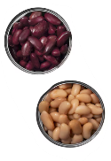
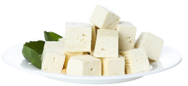
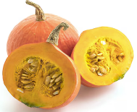
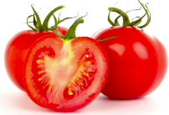
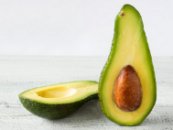
Vegetables
Dark green and cruciferous
Root/ tubular/ bulb
Legumes/beans
Other
Choose a variety, including different colours, each day
Notes:
Types of vegetables (also includes legumes and beans):
Dark green and cruciferous: broccoli, brussels sprouts, bok choy, cabbages, cauliflower, lettuce, spinach, snow peas.
Root/ tubular/ bulb: potato, sweet potato, carrots, beetroot, onion, shallots, garlic, swede, turnip.
Legumes/ beans: kidney beans, soybeans, lima beans, cannellini beans, chickpeas, lentils, split peas, tofu.
Other: tomato, celery, zucchini, avocado, capsicum, eggplant, mushrooms, cucumber, pumpkin, green peas, green beans.
Eat different colours of vegetables, as the different colour groups have different vitamins and minerals.
Vegetables such as tomatoes and pumpkins are technically classified as fruit because they have seeds. They are included in the vegetable group because they have similar nutritional properties as vegetables and are typically eaten as a vegetable.
Images: Designed by Freepik
Based on material provided by the National Health and Medical Research Council (representing the Commonwealth of Australia)

Slide 10
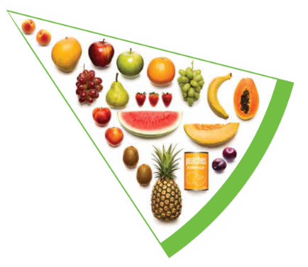
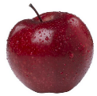

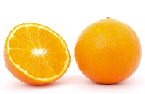

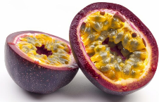
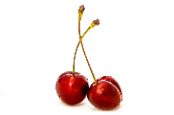




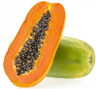
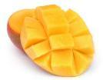
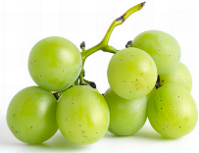

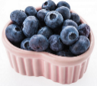
Fruit
Pomme
Citrus
Stone
Tropical
Berries
Choose dried fruit or fruit juice only occasionally
Notes:
Types of fruit:
Pome fruit: apple, pear.
Citrus fruit: orange, mandarin, grapefruit.
Stone fruit: apricot, cherry, peach, nectarine, plum.
Tropical: banana, paw paw, mangoes, pineapple and melon.
Berries: strawberry, blueberry, raspberry, blackberry.
Other: grapes, passionfruit.
Whole or chopped fruit is the best choice.
Fresh, frozen and canned fruits are all part of this food group. It is best to avoid fruits canned in syrup and choose varieties canned in natural juice or water instead.
Choose dried fruit or fruit juice only occasionally:
Eating dried fruit regularly is not recommended as it is high in kilojoules, can stick to the teeth and increases the risk of dental decay. You can also easily eat more than you realise.
Fruit juice is acidic and can increase the risk of dental decay. Fruit juice also has less fibre and other nutrients than whole fruit.
Different fruits can help protect our bodies in different ways, so it’s important to choose a variety, including different colours, each day.
Differences between fruit and vegetables
Fruits and vegetables are from different parts of a plant. Fruits come from the flowering part of a plant and contain seeds. Vegetables are the edible parts of a plant, such as the leaves, stem, roots, and bulbs.
Fruits that are eaten like vegetables: pumpkin, cucumber, tomato (and therefore part of the vegetable group).
Images: Designed by Pexels, Freepik and ChatGPT
Based on material provided by the National Health and Medical Research Council (representing the Commonwealth of Australia)

Slide 11
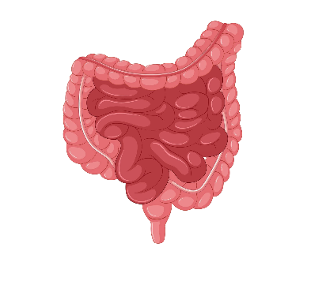





Why grain foods, vegetables and fruit are important
Provide the best source of energy (slow-release energy): fuels our brain (for concentration) and our body
Provide fibre: to help keep our intestines healthy
Provide lots of vitamins and minerals to help our bodies grow and age
Notes:
The complex carbohydrates in these foods are slowly digested, which provides energy over time and helps prevent overeating.
Carbohydrate provides the best source of energy for the brain.
Fibre helps us stay fuller for longer, which can help with concentration.
Fibre is especially useful in keeping the digestive track (including the intestines) healthy and can assist with constipation.
The vast range of vitamins and minerals are important for growth and repair, healthy ageing, and preventing chronic conditions.
Images: Designed by Pexels and Freepik

Slide 12
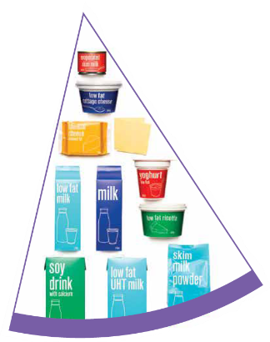
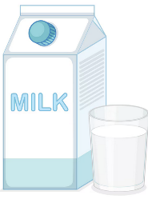
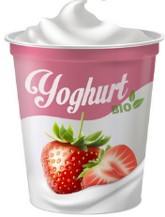
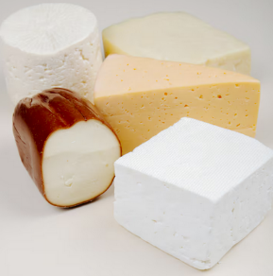
Dairy and alternatives
Milk (fresh and long life)
Yoghurt
Cheese
Reduced fat varieties are the best choice for most
Notes:
Types of foods:
Milks: All reduced fat or full cream milks, plain and flavoured, long life milks, powdered milk, evaporated milk, soy beverages (fortified with at least 100mg calcium/100mL).
Yoghurt: All yoghurts including reduced fat or full cream, plain and flavoured, soy yoghurt (calcium fortified).
Cheese: All hard cheeses, reduced or full fat, for example cheddar, red Leicester, Gloucester, Edam, Gouda Soy cheeses (calcium fortified).
Dairy = products made from milk.
Dairy alternatives:
Calcium-fortified dairy alternatives include soy, rice, almond or oat milk and soy or lactose free yoghurts and cheeses.
Non-dairy alternatives do not naturally contain calcium. It is important to select products labelled as calcium-fortified.
Many of the alternative milks, with the exception of soy milk products, may not be a good source of protein and other key nutrients found in milk and products made from milk.
For vegetarians and vegans, dairy alternative products such as soy milk and cheese are a key source of nutrients, particularly protein and calcium (if calcium is added by the manufacturer), and need to be included regularly to ensure their diet is nutritionally balanced.
Images: Designed by Freepik
Based on material provided by the National Health and Medical Research Council (representing the Commonwealth of Australia)

Slide 13

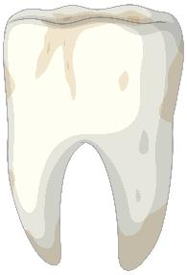

Why dairy and alternative foods are important
Provide calcium: for strong bones and teeth
Provide protein: helps our body grow and become strong
Provide lots of vitamins and minerals to help our bodies grow and age
Notes:
Calcium helps ensure strong bones and teeth.
Proteins are made up of chemical 'building blocks' called amino acids. Your body uses amino acids to build and repair muscles and bones.
Iodine is needed to make essential thyroid hormones. These are used by the body for growth and energy use, as well as brain and bone development in the early years.
Vitamin B12 is essential for the production of red blood cells, which are needed to carry oxygen from the lungs to the body’s tissues and organs.
Images: Designed by Pexels and Freepik

Slide 14
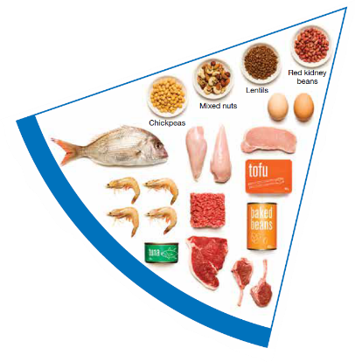


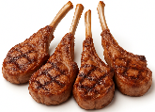
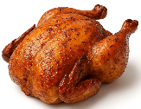
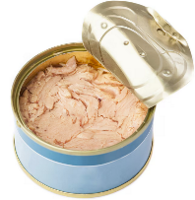
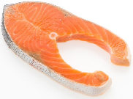

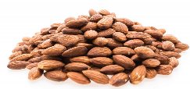
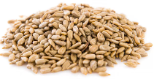
Meat and alternatives
Pink and red meat
Poultry
Fish and seafood
Eggs
Nuts and seeds
Legumes/beans
Choose meat without visible fat
Notes:
Types of foods:
Lean meats: beef, lamb, pork, kangaroo, lean and low salt sausages.
Poultry: chicken, turkey, duck, emu, goose.
Fish and seafood: fish, prawns, crab, lobster, mussels, oysters, scallops, clams.
Eggs: chicken eggs, duck eggs.
Nuts and seeds: almonds, pine nuts, walnut, macadamia, hazelnut, cashew, peanut, nut spreads, brazil nuts, seeds.
Legumes/beans: all beans, lentils, chickpeas, split peas, tofu.
To ensure adequate iron and zinc, about half the serves from this food group should be lean meats. For those who do not eat animal foods, nuts, seeds, legumes (including tofu) can provide some iron and zinc, plus a good mix of plant-based protein.
Choose lean meat options and/or remove the visible fat from the meat prior to cooking to reduce the total amount of saturated fat consumed.
Fresh, frozen and canned varieties of meat, poultry or fish are included in this group. It is important that canned varieties are low in fat and low in salt (no added salt) and canned in water rather than in oil or brine.
Sausages, commercial burgers and meat pastries can be high in saturated fat and are classified as a ‘sometimes’ food. It is recommended the consumption of these foods be limited. If purchasing sausages, it is best to select lean or reduced fat versions and boil or fry in a non-stick pan or BBQ.
Processed meats, such as salami and bacon are high in salt and saturated fats are classified as a ‘sometimes’ food. Consumption should be limited.
Meat alternatives (plant foods):
Nuts and seeds.
Legumes/beans appear in this group as well as the vegetable group.
For vegetarians and vegans, these foods are a key source of nutrients, particularly protein and iron, and need to be included regularly to ensure their diet is nutritionally balanced.
Images: Designed by Freepik and ChatGPT
Based on material provided by the National Health and Medical Research Council (representing the Commonwealth of Australia)

Slide 15

Why meat and alternative foods are important
Provide zinc and iron: keeps our blood healthy and gives us energy
Provide protein: helps our body grow and become strong
Provide essential fatty acids to keep our brains and heart healthy
Notes:
Proteins are made up of chemical 'building blocks' called amino acids. Your body uses amino acids to build and repair muscles and bones.
Iron is particularly important for transporting oxygen in the blood. This is essential for providing energy for daily life. Iron also helps our immune system fight infection.
Zinc is important for growth and for the immune system to fight infection.
Images: Designed by Freepik

Slide 16
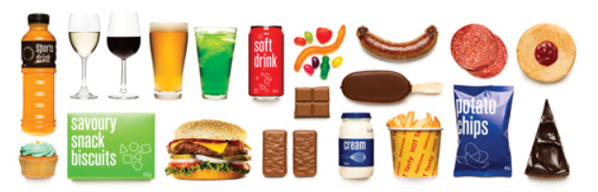
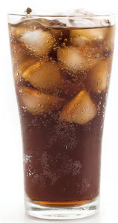

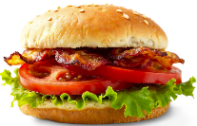
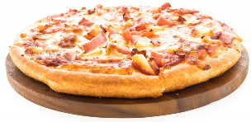
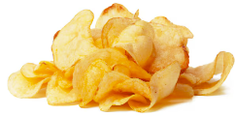
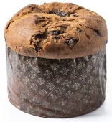
‘Sometimes' foods
Higher in added sugars
Higher in fat (and sodium)
Higher in both
To be consumed sometimes and in small amounts
Notes:
Some foods and drinks do not fit into the five food groups. These foods are high in saturated fat and/or added sugars, added salt or alcohol and low in fibre. These foods and drinks can also be high in kilojoules (energy).
Types of foods:
Higher added sugars: Soft drinks, energy drinks, sugar confectionary, jams, some sauces.
Higher fat: Most processed meats (bacon, ham, sausages, frankfurts), crisps, butter, cream, pastry products, meat pies, sausage rolls, potato chips, commercial pizza.
Higher added sugars AND higher fat: Biscuits, cakes, chocolate, doughnuts, ice cream, iced buns, some muesli bars, muffins, sweet pastries.
Alcoholic drinks.
‘Sometimes’ foods in a healthy diet:
Some people require extra serves of food, for example, those who are taller and more active. These can sometimes include extra serves of ‘sometimes’ foods. It is best if these extra serves come from the five food groups, particularly wholegrain cereals, vegetables including legumes/beans and fruit. However, they can also sometimes include serves of ‘sometimes’ foods (discretionary foods).
These foods can, however, contribute to a feeling of enjoyment. They should be consumed sometimes, and in small amounts, such as once a week.
Images: Designed by Freepik
Based on material provided by the National Health and Medical Research Council (representing the Commonwealth of Australia)

Slide 17
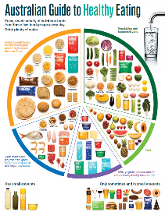
Making food choices
The Australian Guide to Healthy Eating is a guide to food choices.
Packaged foods plays a role in a healthy diet.
The descriptors provided for each food group help support decision-making.
Notes:
The descriptors are presented in the notes to the slides above, but are also provided on the AGHE information sheet.
See: https://www.foodstandards.gov.au/consumer/labelling

Slide 18
Food labelling can also assist with decision-making

Slide 19


Health Star Rating
The Health Star Rating can be voluntarily added.
This system rates the overall nutritional profile of a packaged food.
Rating from ½ to 5 stars (higher is better).
This rating is based on foods within the same category e.g. don’t compare
muesli bar and bread.
Notes:
See: https://www.foodstandards.gov.au/consumer/labelling

Slide 20
Health Star Rating
The first step is to identify whether the food would broadly sit within the AGHE.
The HSR can then be used to choose the most nutritious options within the food category.
For example, a yoghurt with 4.5 stars is a healthier choice than a yoghurt with 2 stars.
Notes:
Not all packaged foods fit within the AGHE.
For some foods it is immediately evident that they do not, that is, through the descriptors provided for ‘sometimes’ foods. Even though these foods can have a HSR, it is not necessary for decision-making.

Slide 21
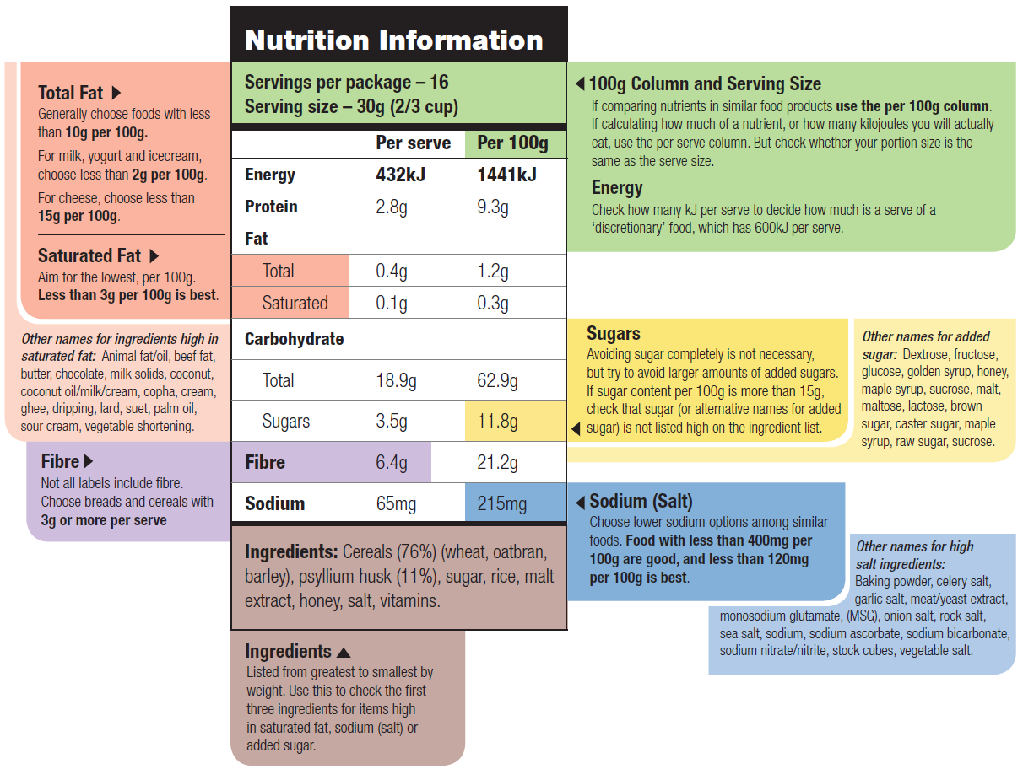
Nutrition Information Panel (NIP)
Notes:
This infographic provides further details on the NIP. It provides information on what to look for in terms of making healthier food choices.
Based on material provided by the National Health and Medical Research Council (representing the Commonwealth of Australia)

Slide 22
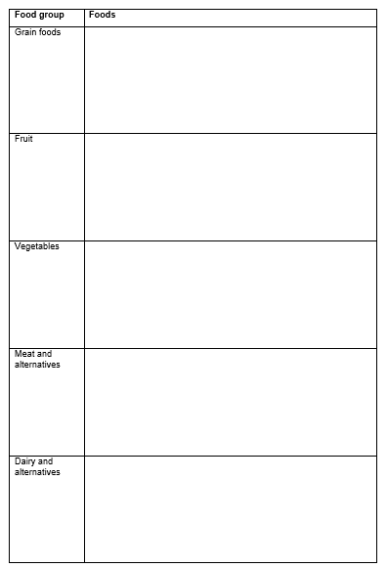
Activity 1: Booklet task
Identify at least 3 packaged foods that can be included in each of the food groups.
Notes:
Students to identify at least 3 packaged foods that would fit within each of the food groups.
Students should have access to the internet to access supermarket and food company websites.
Remember, use the AGHE as the guide to foods in each category.
Possible responses:
Grain foods: English muffins, Muesli, Flat/pita bread, pasta, bread, grain biscuits and crackers, wheat/bran cereal (wholemeal and wholegrain varieties are the best choices).
Fruit: Diced fruit in juice, frozen fruit
Vegetables: Frozen vegetables, baked beans, canned beans and peas
Meat and alternatives: Baked beans, tofu, canned tuna and salmon
Dairy and alternatives: Some flavoured milks (make sure it is low sugar), non-dairy milks (make sure it is fortified with calcium), cheese (reduced fat is the best choice), plain natural yoghurt (reduced fat is the best choice)

Slide 23
Lesson 2

Slide 24
Review

Slide 25
What packaged foods fit within the Australian Guide to Healthy Eating
Notes:
Elicit responses in each of the food groups.

Slide 26
Learning intention: To investigate the role of food processing in healthy eating.
Success criteria:
identify a nutritious packaged food
describe the nutritious components
identify modifications to improve nutritional quality.

Slide 27
Food processing and technologies play a big role in meeting consumer demands for food.
Notes:
Source: Nutrition, the inside story (2020)

Slide 28
Food processing
The process in which raw foodstuffs are made suitable for consumption.
Can include one or a combination of processes, including washing, chopping, cooking, freezing.
Most foods are processed in some way before they reach you, the consumer.
Notes:
Source: Australia’s food and nutrition (2012); Nutrition, the inside story (2020)

Slide 29
Food processing
Consumers expect a food supply that is safe, nutritious, convenient and varied.
Food processing allows this.
There are, however, different levels of processing: washing potatoes to put into bags is different to a chocolate product.
Notes:
Almost all foods undergo some form of processing before they are ready to eat.
Source: Nutrition, the inside story (2020)

Slide 30
Food processing
The term ‘processed food’ is often associated with ‘sometimes’ or ‘junk’ food.
BUT, while ‘sometimes’ food is typically highly processed, not all processed food is a ‘sometimes’ food.
We need to be aware of the differences.
Notes:
Source: Nutrition, the inside story (2020)

Slide 31
Food processing
Why process foods?
Notes:
Elicit student responses.
Reasons are provided on the subsequent slides.

Slide 32
To make food edible
Some foods are not edible in their natural state e.g. grain crops such as wheat and corn.
Wheat can be ground into flour to make bread.
Notes:
Source: Nutrition, the inside story (2020)

Slide 33
To make food safe
Many foods contain potentially harmful microorganisms.
These can make us sick and cause the food to spoil.
Processes that can slow or stop growth:
Heating to a high temperature
Adding preservatives
Chilling or freezing
Altering the pH (acidity)
Removing water
Using air-tight packaging
Notes:
Source: Nutrition, the inside story (2020)

Slide 34
To extend the shelf life of food
Achieved through chilling, freezing, heating, removal of water, and pH control.
This enhances convenience (and safety).
This can mean less frequent shopping.
Also enables less food waste.
Notes:
Source: Nutrition, the inside story (2020)

Slide 35
To increase range and convenience
An extensive range of foods is made from the 5 staple crops: wheat, rice, maize (corn), oats and potatoes.
These are available year-round, not just when the crops are in season.
Packaging technologies also provide a range of convenient foods.
Notes:
Source: Nutrition, the inside story (2020)

Slide 36
To reduce the cost of food
Sometimes, food processing can reduce the cost of food.
The food processor can purchase ingredients in bulk, which reduces the end price.
Examples: canned and frozen
vegetables.
Notes:
Source: Nutrition, the inside story (2020)

Slide 37
To reduce health inequalities
In some remote areas, fresh food is sometimes not available or expensive.
Foods that are canned or packaged can provide cost-effective, nutritious options.
Notes:
Source: Nutrition, the inside story (2020)

Slide 38
REMINDER
The term ‘processed food’ is often associated with ‘sometimes’ or ‘junk’ food.
BUT, while ‘sometimes’ food is typically highly processed, not all processed food is a ‘sometimes’ food.
We need to be aware of the differences.
Notes:
Keeping our mind on the AGHE and reading food labels is important to help us make decisions on foods to include in our diet (link to label reading guide).
Source: Nutrition, the inside story (2020)

Slide 39
Activity 1: Booklet task
Identify a packaged food product that helps consumers eat a healthy diet.
Identify and describe the nutritious components of the food.
Identify whether the nutritional quality of the product could be improved.
Notes:
Resource: AGHE information, Eat for Health label reading guide.

Slide 40
Lesson 3

Slide 41
Review

Slide 42
What are some of the reasons why we process food?
Make food edible
Make food safe
Extend the shelf life
Increase range/ variety
Reduce cost
Reduce health inequalities
Notes:
Suggested responses are provided

Slide 43
Learning intention: To investigate product development.
Success criteria:
identify consumer benefits (nutrition, shelf-life, convenience, sensory).

Slide 44

Product development
Notes:
[2.47]
View this video with the students.

Slide 45
Product development: categories
Line extension: new variety or changes to existing products.
New to world: totally new product.
Me-too: ‘copycat’ products (same product produced by a different company and given a slightly
different name).

Slide 46
Product development: drivers
Improve company success.
Health reasons (consumer demand).
Environmental concerns.
Technological developments (e.g. foods for microwaves, slow cookers, air fryers).
To meet special consumer needs.

Slide 47
Product development: steps
Brief: summary of product purpose.
Research: consumer needs related to product e.g. nutrition, sensory, technologies.
Design specifications e.g. size, sensory characteristics.
Testing.
Manufacturing.

Slide 48
Activity 1: Booklet task
For each of the product development categories, identify current products and specify the benefits to consumers. Consider:
nutrition
shelf-life
convenience
sensory (taste, texture, smell, appearance).
Notes:
Students can discuss as a class and/or use a device to research products.

Slide 49
Lesson 4

Slide 50
Review

Slide 51
What recent products can be classified as a ‘line extension’?
Notes:
Students identify responses from the previous lesson.

Slide 52
What recent products can be classified as a ‘me-too’?
Notes:
Students identify responses from the previous lesson.

Slide 53
What recent products can be classified as ‘new to world’?
Notes:
Students identify responses from the previous lesson.

Slide 54
Learning intention: To identify the sensory properties of food.
Success criteria:
use 5 senses to evaluate 3 food products
compare results across the class.

Slide 55

The senses and food
Notes:
[8.19]
View this video with the students, which provides an overview of the senses we use when eating.

Slide 56
Senses and food
We use a range of senses when deciding whether to eat a food, and to evaluate our enjoyment of food:
sight
smell
hearing
taste
touch.

Slide 57


Sight (appearance of food)
If a food does not look appealing, you may be less likely to eat it.
This includes:
- size
- shape
- consistency
- colour.
Which would you prefer?
Notes:
Images: Designed by Pexels

Slide 58
Sight (appearance of food)
Words to describe appearance:
dry
fluffy
flat
mushy
crumbly
hard
runny
lumpy
fizzy
flaky
Notes:
Words to describe

Slide 59


Smell
The nose detects aromas released from food (odour).
If a food does not smell appealing, you may be less likely to eat it.
Ripe strawberries can have a very ‘sweet’ smell.
Have you ever smelt durian? It has an intense smell, which some people describe as unpleasant.
Notes:
Images: Designed by Pexels

Slide 60
Smell
Words to describe smell:
aromatic
spicy
tart
pungent
sweet
floral
mild
bland
strong
rotten
rotten
Notes:
Words to describe

Slide 61


Hearing (sound)
The sounds of a food being prepared or cooked can influence whether we would like to eat it.
The sound when eating food can influence whether we like the food.
Sizzling meat?
Crunchy or soft apple?
Notes:
Images: Designed by Pexels

Slide 62
Taste (flavour)
Our tongue can detect 5 tastes:
bitter
salt
sour
sweet
umami
Taste can be described through association with a food: minty, fruity.
We can also describe the intensity of taste: mild, strong.

Slide 63
Taste (flavour)
Words to describe taste:
sweet
bitter
zesty
umami
mild
sour
salty
spicy
bland
tart
sharp
acidic
rich
Notes:
Words to describe

Slide 64

Touch (texture)
We can assess touch through texture.
We may or may not like the way a food feels on our tongue, known as mouth-feel.
We may or may not like the feeling when the food is chewed: is it too soft or too chewy?
Do you like the combination of soft yoghurt, with crunchy/ hard muesli and soft fruit?
Notes:
Images: Designed by Pexels

Slide 65
Touch (texture)
Words to describe texture:
brittle
rubbery
dry
crisp
smooth
moist
tender
mushy
hard
sticky
soft
lumpy
chewy
crumbly
gritty
Notes:
Words to describe

Slide 66
Activity 1: Booklet task
Choose 3 food products.
Evaluate these products based on the 5 senses
Compare results.

Slide 67
Lesson 5

Slide 68
Review

Slide 69
Touch (texture)
Words to describe texture:
brittle
rubbery
dry
crisp
smooth
moist
tender
mushy
hard
sticky
soft
lumpy
chewy
crumbly
gritty
Notes:
Elicit responses from students. These are just some examples.

Slide 70
Taste (flavour)
Words to describe taste:
sweet
bitter
zesty
umami
mild
sour
salty
spicy
bland
tart
sharp
acidic
rich
Notes:
Elicit responses from students. These are just some examples.

Slide 71
Learning intention: To investigate the relationship between food production and the environment.
Success criteria:
identify key environmental issues related to growing and preserving food in Australia.

Slide 72
Food production can have a negative impact on the environment
Impacts caused using fossil fuels in:
  manufacture of agricultural inputs e.g. herbicides, stock feed
  transport
  processing in factories.
Notes:
Source: https://www.nma.gov.au/explore/features/urban-farming/australias-food-production

Slide 73
Food production can have a negative impact on the environment
Other impacts during the farming process:
  pollutants through growing/ rearing
  soil erosion
  increases in salinity.
Notes:
Australian agriculture accounts for:
- 55% of Australian land use (measured December 2023)
- 74% of water consumption (measured for 2021–2022).
But it also accounts for:
- 10.8% of goods and services exported (measured for 2023–24)
- 5.9% of rural employment (215,600 people in 2023–24).
Source:
https://www.nma.gov.a.u/explore/features/urban-farming/australias-food-production
https://daff.ent.sirsidynix.net.au/client/en_AU/search/asset/1036762/0

Slide 74


The changing climate also has a negative impact on food production
Increased rainfall variability and extreme weather events impact the sustainability of food production.
Notes:
Farmers needs to adapt their practices to adjust to the changing environment.
Images: Designed by Pexels

Slide 75

Effect of changing weather
Source: Climate change impacts and adaptation on Australian farms, ABARES (2021)
Notes:
In recent decades, Australia has seen a shift towards higher temperatures and lower winter rainfall, which has had effects on many farmers.
However, despite these trends, the long-run effects of climate change on farm businesses is still uncertain.
Source: https://www.agriculture.gov.au/abares/products/insights/climate-change-impacts-and-adaptation

Slide 76

Food production: reducing environmental impact through technology
Notes:
[1.21]
Additional videos from AFGC that look at sustainability are available on the AFGC YouTube channel: https://www.youtube.com/@AustralianFoodGroceryCouncil

Slide 77

Farming and the environment: changing practices using technology
Notes:
[5.27]

Slide 78

Food processing: reducing environmental impact through technology
Notes:
[3.52]

Slide 79
Activity 1: Booklet task
Identify key environmental issues related to:
growing food in Australia
processing food in Australia.
Identify how technology can help reduce the environmental impact of food production.

Slide 80
Lesson 6

Slide 81
Review

Slide 82
What are some strategies that can help reduce the environmental impact of food production?
Notes:
Students identify responses from the previous lesson.

Slide 83
Learning intention: To investigate the relationship between food packaging and the environment.
Success criteria:
identify key strategies that can help reduce the environmental impact of food production.

Slide 84
Food packaging
Food packaging helps make food:
transportable (therefore accessible)
safe
longer-lasting.
These factors can also reduce the cost
of food.

Slide 85
Food packaging
Most of the food we buy comes packaged.
Packaging is made of a variety of materials:
glass
metal
paper (including cardboard)
plastic.

Slide 86




Food packaging and the environment
Resources and energy are used to:
produce the packaging material
dispose of or recycle the packaging.
Notes:
Images: Designed by Pexels

Slide 87
Product stewardship
We all have a shared responsibility to reduce the environmental impact of food packaging:
producers
sellers
consumers.
Notes:
Source: https://www.dcceew.gov.au/environment/protection/waste/product-stewardship

Slide 88

Plastics and packaging
Notes:
[6.34]
Additional videos from AFGC that look at sustainability are available on the AFGC YouTube channel: https://www.youtube.com/@AustralianFoodGroceryCouncil

Slide 89
Changing practices: case study
MasterFoods is trialling paper-based Squeeze-On packs (single-serve tomato sauce packs).
These can be recycled via kerbside recycling.
Contain 58% less plastic than original Squeeze-On packs.
Notes:
Source: https://www.mars.com/en-au/news-and-stories/press-releases-statements/masterfoods-trial-new-paper-based-squeeze-on-packs

Slide 90

Changing practices: case study

Slide 91
Activity 1: Booklet task
Identify key factors or strategies that can help reduce the environmental impact of food packaging.
Consider the entire food packaging chain (production, consumer behaviour, recycling).
Consider the role of industry, government and consumers.

Slide 92
Lesson 7, 8 and 9

Slide 93
Learning intention: To understand the needs of consumers and the environment in relation to food technologies and new product development.

Slide 94
Task
To design a packaged food product that meets the needs of consumers, considers environmental issues, and assists with enhancing healthy eating.

Slide 95


Slide 96


