Slide 1
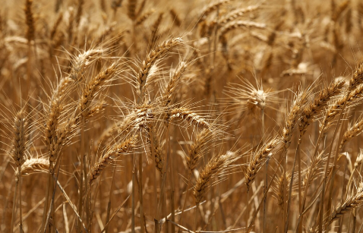
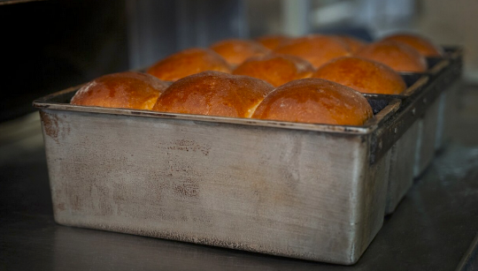
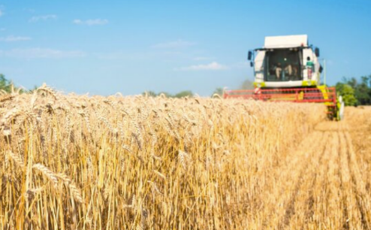
Growing food for healthy eating
Food and nutrition unit
Year 6
Notes:
Images: Designed by Freepik

Slide 2
Contents
Lesson 1 | Lesson 5
Lesson 2 | Lesson 6
Lesson 3 | Lesson 7, 8 and 9
Lesson 4

Slide 3
Lesson 1

Slide 4
In this unit we will be:
reviewing the source of food in Australia
investigating food safety
investigating animal welfare and environmental issues related to food production
investigating food growing conditions
reviewing the Australian Guide to Healthy Eating
researching and presenting information on the production of a healthy food item.

Slide 5
Learning intention: To identify the steps of food production.
Success criteria:
steps at the farm
steps through transport
steps at the factory.

Slide 6
Let’s review where food comes from

Slide 7
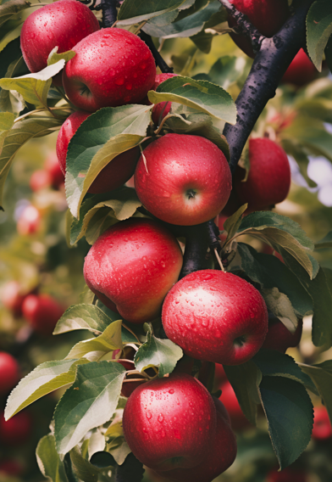
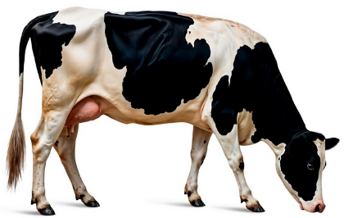
All food comes from either a plant or an animal
Notes:
Images: Designed by Freepik

Slide 8
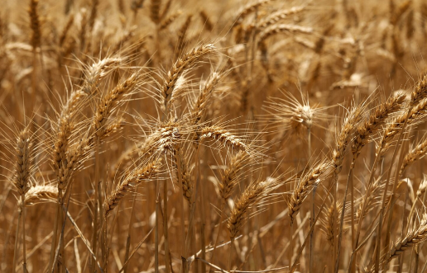
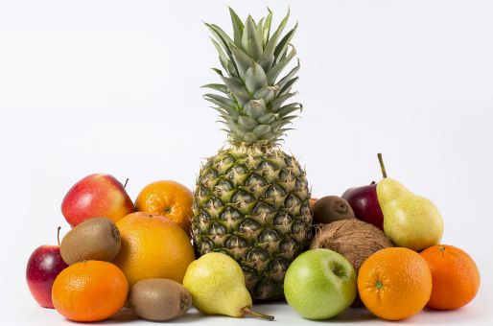
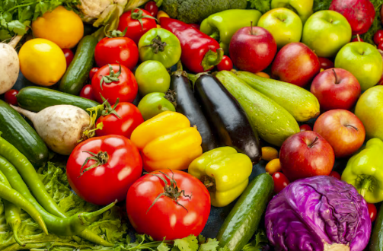
Food from plants
Wheat – used to make flour, bread and breakfast cereals
Fruit
Vegetables
Notes:
These are example foods.
Images: Designed by Freepik

Slide 9
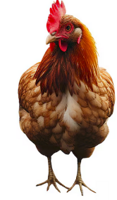
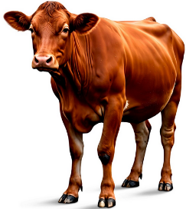
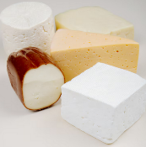
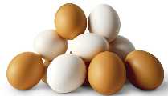
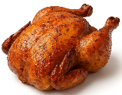

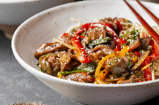


Food from animals
Dairy cow – produces milk for foods like milk, cheese, yoghurt
Chickens – for chicken meat, eggs
Beef cattle – for meat
Notes:
These are example foods.
Images: Designed by Freepik and ChatGPT

Slide 10
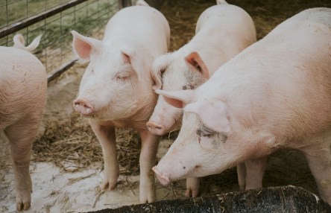
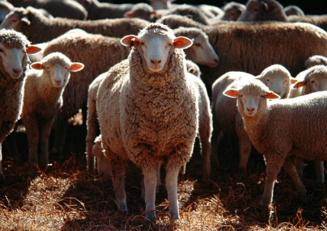
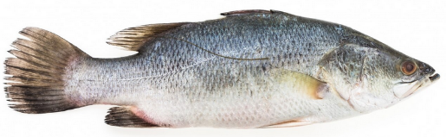
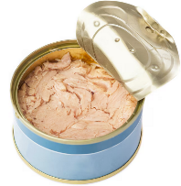
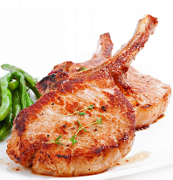
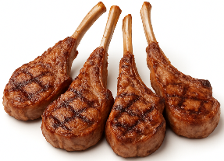
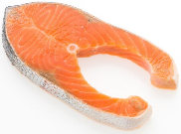
Food from animals
Fish – for fish fillets, crumbed fish, canned fish
Pig – for meat (pork)
Sheep – for meat and milk
Notes:
These are example foods.
Images: Designed by Freepik and ChatGPT

Slide 11
Food processing
All food that is reared (animals) or grown (like fruits and vegetables), are processed.
Some foods are processed more than others.
Different equipment is used when processing food.

Slide 12
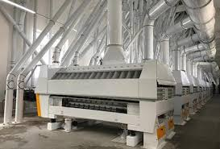


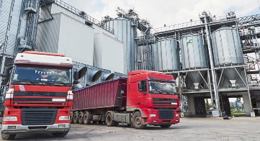
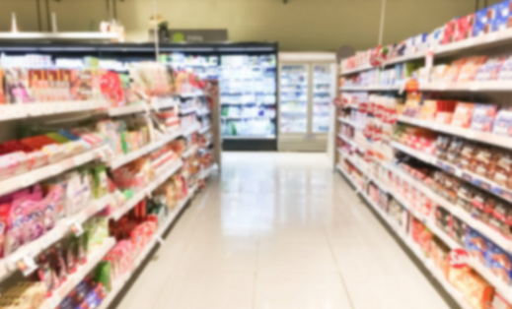

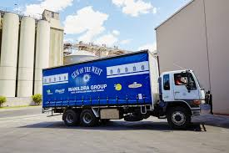
Bread: farm to supermarket
1. Wheat grown on a farm
2. The wheat is harvested with equipment
3. The wheat is transported to a flour mill
4. The wheat is milled into flour
7. The bread is transported
6. The flour is mixed with other ingredients to make bread
5. The flour is transported to a bakery
Notes:
There are lots of steps that use different equipment to bring wheat from the farm, to make bread, to then appear at the shops.
Images: Some images designed by Freepik

Slide 13
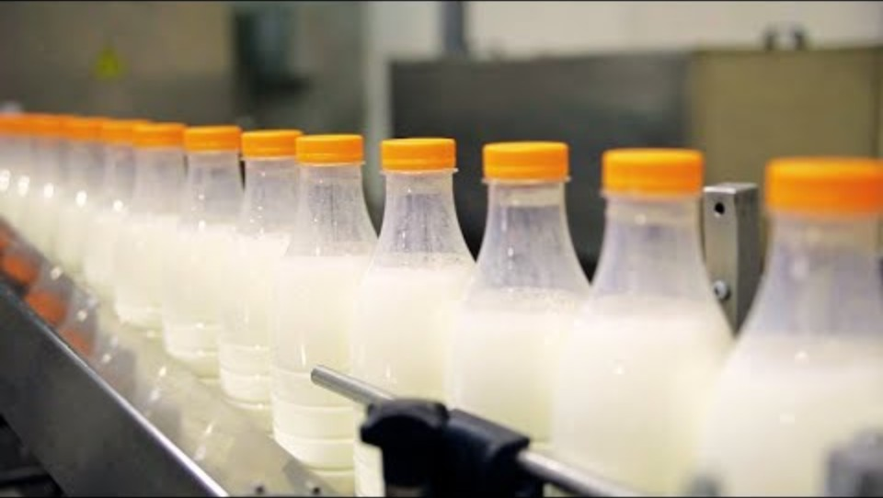
Milk from the farm to the supermarket
Notes:
[3.06]

Slide 14
Activity 1: Booklet task
Milk from farm to supermarket
Identify the steps:
at the farm
through transport
at the factory.
Prepare into a flow chart.
Notes:
Students can access the video to assist with the task: https://www.youtube.com/watch?v=SO9RXavMVk8&t=67s
The following slide gives and example response.

Slide 15
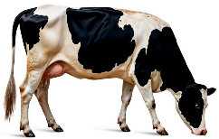
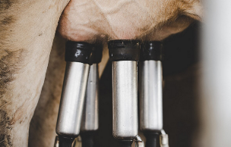
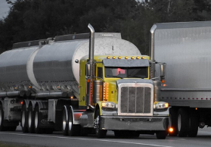

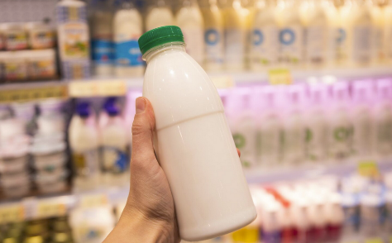
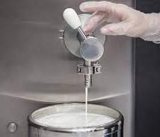
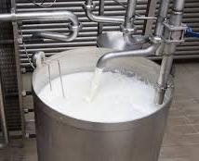


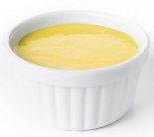
Bottled milk: farm to supermarket
1. The dairy cows are kept on a farm
2. The cows are milked on the farm
3. Tankers transport the milk to processing plant
4. The milk is tested
7. The milk is put in containers and transported
6. The milk is homogenised
5. The milk is pasteurised (heat treated)
8. Milk can also be used to make cheese, yoghurt and custard
Notes:
Suggested response: There are lots of steps that use different equipment to bring milk from the farm to the supermarket. This is a simplified flowchart of what was shown in the video.
Dairy cows are kept on a farm where they are given different food to help them produce milk.
The cows are milked by farmers in sheds on the farm.
The milk is pumped into a milk tank and transported to the nearest processing plant.
The testing process is to ensure there is no harmful bacteria and has the right level of nutrients.
The milk is pasteurised where it is heated at high temperatures to remove any harmful bacteria.
The milk is homogenised, which evenly distribute the fat globules (otherwise the fat would sit on top of the milk).
The milk is put into containers and transported to the shops for us to buy.
It can also be made into other products, like cheese, yoghurt and custard.
Images: Some images designed by Freepik

Slide 16
Lesson 2

Slide 17
Review

Slide 18
Milking
Transport to processing plant
What are some of the key steps for producing milk: from the farm to the supermarket?
Testing
Homogenisation
Packaging
Pasteurisation
Transport to supermarket

Slide 19
Learning intention: To investigate practices to keep food safe.
Success criteria:
positive food safety practices at home
areas for improvement.

Slide 20
What is food safety?
Food Safety = handling, preparing and storing food in a way to best reduce the risk of individuals becoming sick from foodborne illnesses.
Foodborne illness is caused by pathogens such as:
bacteria - Salmonella, Campylobacter, E.coli and Listeria
virus - Norovirus, Rotavirus and Hepatitis A
toxins produced by pathogens - Staphylococcus aureus, Bacillus cereus and Clostridium perfringens.
Notes:
Record student ideas first.
Foodborne illness (food poisoning) is the name for the range of illnesses caused by eating or drinking contaminated food or drink.
Further details at: https://www.foodauthority.nsw.gov.au/consumer/food-poisoning/foodborne-illness-pathogens

Slide 21
Foodborne illness symptoms
Nausea (feeling sick)
Stomach cramps
Diarrhoea
Vomiting
Fever
Headaches
Notes:
Record student ideas first.
Further details at: https://www.foodauthority.nsw.gov.au/consumer/food-poisoning

Slide 22
Causes of foodborne illness
Not cooking food thoroughly
Not storing food that needs to be chilled below 5°C
Someone who is ill or has poor hand hygiene handling the food
Eating food after a ‘use-by’ date
Cross contamination–bacteria is spread between food, surfaces, utensils and equipment.
Notes:
Further details at: https://www.foodauthority.nsw.gov.au/consumer/food-poisoning

Slide 23
Higher risk foods
Meat, especially undercooked mince
Raw or undercooked poultry such as chicken
Raw or lightly cooked eggs including foods made from raw egg
Smallgoods such as salami and hams
Cooked rice and pasta not kept at the correct temperature
Prepared salads and fruit salad
Notes:
Some foods accommodate harmful bugs or toxins more than others.
The bugs or toxins may be present on foods at the time of purchase, get onto food by cross contamination and poor hygiene, or grow to harmful levels as a result of poor temperature control.
Further details at: https://www.foodauthority.nsw.gov.au/consumer/food-poisoning

Slide 24
How do we keep food safe?
Properly cleaning and sanitising all surfaces, equipment and utensils
Storing, chilling and heating food correctly: temperature, environment and equipment
Maintaining a high level of personal hygiene, especially hand-washing
Implementing effective pest control
Notes:
Record student ideas first.
Further details at: https://blog.foodsafety.com.au/what-is-food-safety

Slide 25
Personal hygiene standards
Washing hands
Not sneezing or coughing on food
Not sitting on benches/tables or any food preparation surface
Keeping dogs, cats and insects away from food
Tying hair back
Washing hands
Notes:
We can reduce the risk of foodborne illness through following these personal hygiene standards.
Further details at: https://www.health.qld.gov.au/__data/assets/pdf_file/0024/427533/jarjums-sect3-less4.pdf

Slide 26
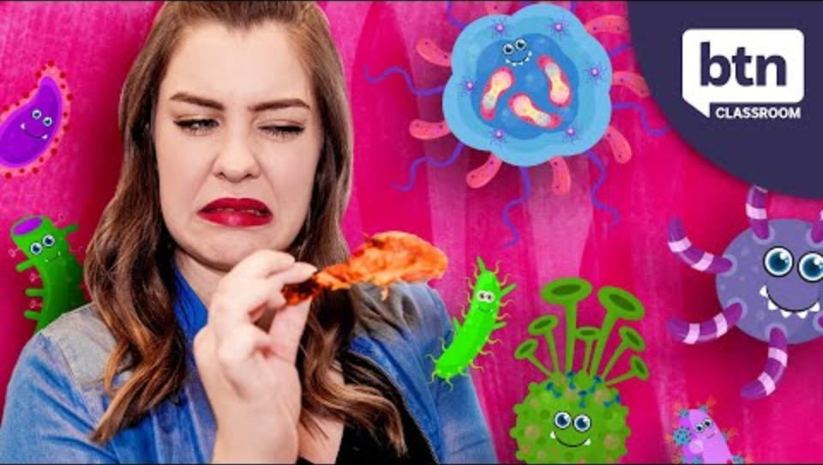
Food safety at home
Notes:
[3.40]

Slide 27
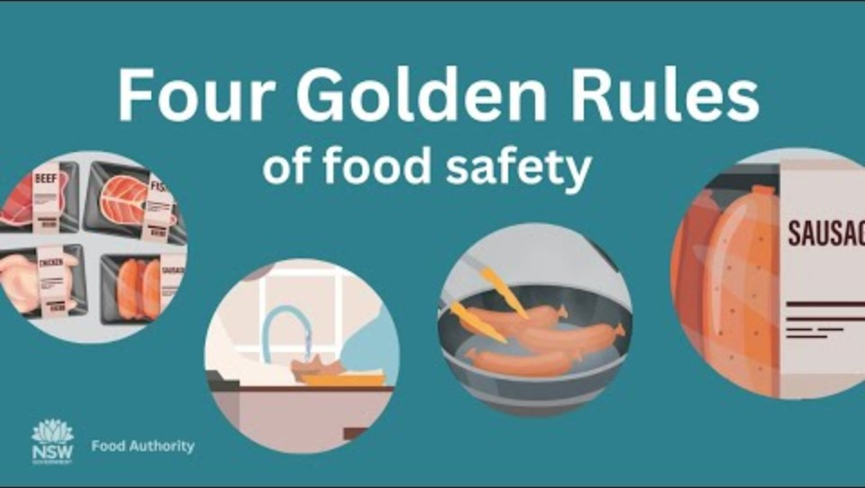
Golden rules on food safety
Notes:
[1.23]
Keep it clean
Keep it hot
Keep it cold
Check the label

Slide 28
Food manufacturing
Food businesses, including food manufacturers, must follow food safety practices to ensure the food they sell is safe.
Kay practices:
Start with safe food
Prevent food contamination
Use processing steps known to achieve food safety
Keep food at safe temperatures
Notes:
Start with safe food
Before you process food, make sure it is safe and suitable (e.g. ingredients from reliable suppliers, safely stored, inspected).
Prevent food contamination
Make sure food handlers know how to correctly use processing equipment and maintain good hygiene.
Keep food processing areas clean.
Clean and sanitise food contact surfaces before use (e.g. chopping boards, cutting and mixing blades, probe thermometers).
Use separate equipment or areas for preparing raw and ready-to-eat foods, or clean thoroughly between uses.
Use processing steps known to achieve food safety
Know the critical limits for temperature, time, pH and water activity used for your food processing steps.
When cooking or pasteurising, ensure the time and temperature makes food safe (e.g. cook chicken and mince to an internal temperature of ≥75°C).
When using other processes such as acidification, fermentation and drying, make sure the food reaches the correct critical limit (e.g. pH ≤4.2 to prevent Salmonella growth).
Keep food at safe temperatures
For potentially hazardous food, keep it cold, keep it hot or make it quick.
Further details at: https://www.foodstandards.gov.au/business/food-safety/processing-food-safely

Slide 29
Activity 1: Booklet task
Food safety at home
What are some of the things you and your family do at home to keep food safe?
What are some things you think you could do better to keep food safe?
Notes:
Students can chat with a partner to share practices.

Slide 30
Lesson 3

Slide 31
Review

Slide 32
What is food safety?
Food Safety = handling, preparing and storing food in a way to best reduce the risk of individuals becoming sick from foodborne illnesses.

Slide 33
How do we keep food safe?
Properly cleaning and sanitising all surfaces, equipment and utensils
Storing, chilling and heating food correctly: temperature, environment and equipment
Maintaining a high level of personal hygiene, especially hand-washing
Implementing effective pest control
Notes:
Suggested responses

Slide 34
What are the higher risk foods?
Raw or undercooked poultry such as chicken
Meat, especially undercooked mince
Cooked rice and pasta not kept at the correct temperature
Raw or lightly cooked eggs including foods made from raw egg
Smallgoods such as salami and hams
Prepared salads and fruit salad

Slide 35
Learning intention: To investigate animal welfare practices in food production.
Success criteria:
on farm strategies
strategies within the ‘five freedoms of animal welfare’.

Slide 36
Animal welfare
Looking after the health and wellbeing (welfare) of animals is a legal requirement in Australia.
It is important throughout the whole supply chain:
  on the farm
  at the saleyards
  when transported (around the country and overseas)
  in processing facilities

Slide 37
Five Freedoms of animal welfare
Freedom from hunger and thirst.
Freedom from discomfort.
Freedom from pain, injury and disease.
Freedom to express normal behaviour.
Freedom from fear and distress.
Notes:
There are also the Five Domains, which extend on these Five Freedoms to offer a way of measuring welfare outcomes.

Slide 38
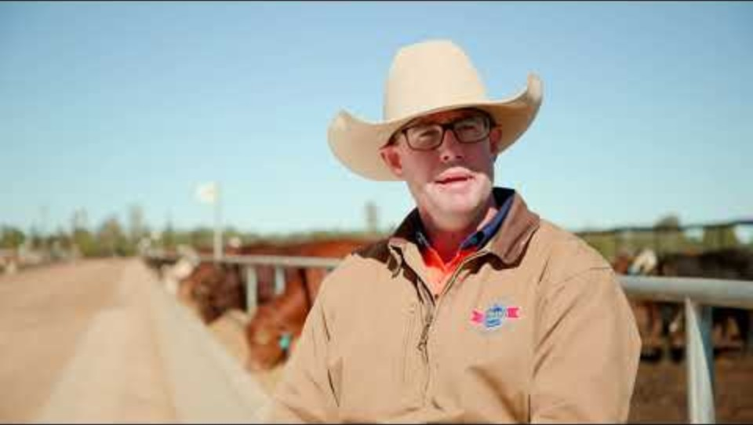
Animal welfare
Notes:
[1.37]
These 5 freedoms in action on a cattle feedlot farm.

Slide 39
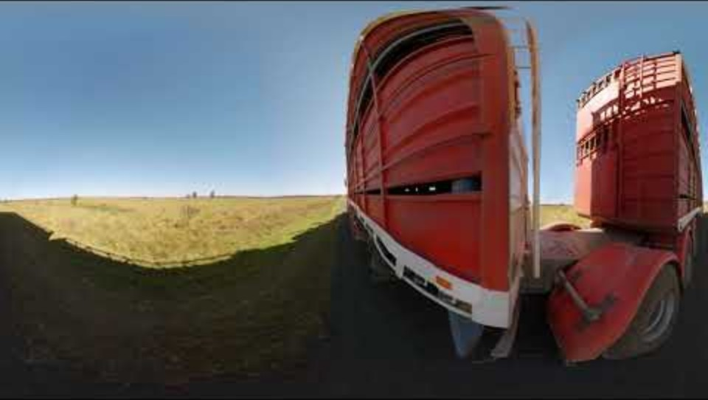
Beef production
Notes:
Additional video [6.21]
This covers animal welfare, along with beef production processes. It’s a 360 degree video – use the arrows on the top left to move the screen – down, up, behind.
NOTE: it contains images of beef carcases to discretion is advised.

Slide 40
Activity 1: Booklet task
Identify strategies for farmers to adhere to the Five Freedoms of animal welfare (at least 1 in each area).
What might it look like, sound like?
Provide notes in your student booklet.
Notes:
In relation to the Five Freedoms of animal welfare, identify strategies for farmers to meet these freedoms (what might it look like, sound like)?
Students can view additional videos in relation to feedlot cattle (see links in lesson plan)

Slide 41
Lesson 4

Slide 42
Review

Slide 43
What are the Five Freedoms of animal welfare?
Freedom from hunger and thirst.
Freedom from discomfort.
Freedom from pain, injury and disease.
Freedom to express normal behaviour.
Freedom from fear and distress.

Slide 44
What are some on farm strategies to ensure animal welfare?
Notes:
Elicit student responses

Slide 45
Learning intention: To investigate resources and growing conditions suitable for food production.
Success criteria:
suitable growing conditions
resources needed
best location for growing.

Slide 46
Growing conditions
Different types of agriculture need different resources to grow, or be raised, effectively.
These include different climates, temperatures and fresh water.

Slide 47
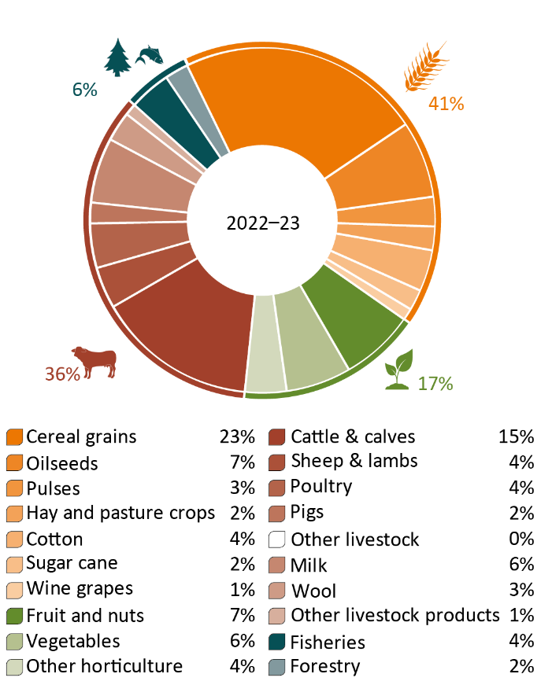
Agriculture, fisheries and forestry value of production, by commodity, 2023–24
Source: DAFF, Snapshot of Australian
Agriculture 2025
Notes:
This infographic shows the proportion of different commodities that make up Australia’s agriculture, fisheries and forestry production (by value).
The biggest commodities are cereal grains, followed by cattle and calves.
Source: https://daff.ent.sirsidynix.net.au/client/en_AU/search/asset/1036762/0

Slide 48
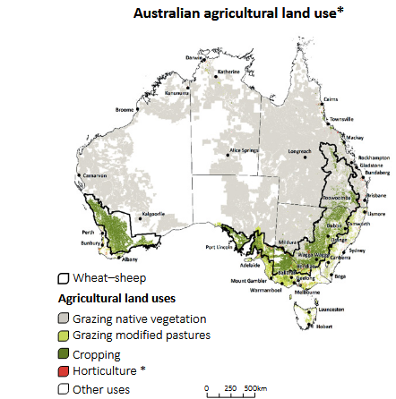
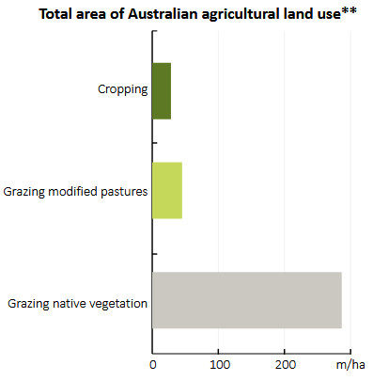
Australian agricultural production zones
Notes:
The mix of Australian agricultural activity is determined by climate, water availability, soil type and proximity to markets.
This infographic shows that livestock grazing is widespread, occurring in most areas of Australia, while cropping and horticulture are generally concentrated in areas relatively close to the coast.
Most of Australia’s food is produced in country areas, and eaten in our cities where most of the population lives.
Source:
https://daff.ent.sirsidynix.net.au/client/en_AU/search/asset/1036762/0
https://www.nma.gov.au/explore/features/urban-farming/australias-food-production

Slide 49
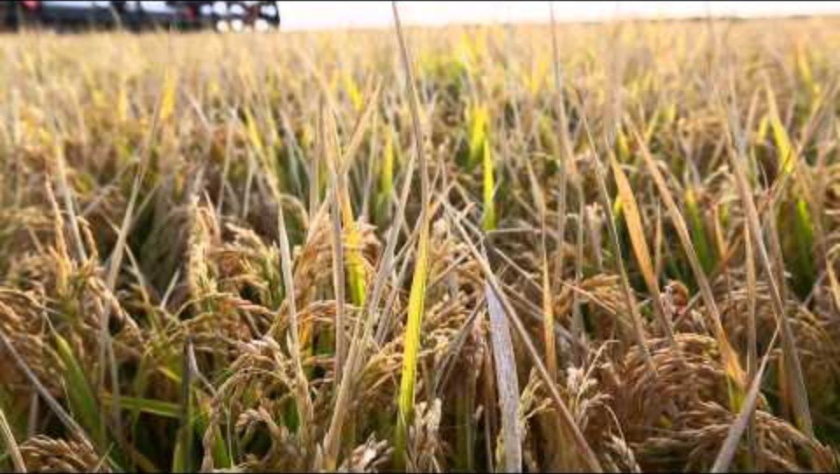
Growing rice
Notes:
[9.08 – but up to 5.30 for the growing aspect]

Slide 50
Growing rice
What are the resources needed for rice production?
What are the growing conditions needed for rice production?
The resources needed and growing conditions determine the best place to grow that food in Australia.
Notes:
Brainstorm responses with the students.

Slide 51
Activity 1: Booklet task
Select an agricultural product. Identify:
the growing conditions needed to produce the food
the resources needed to produce the food
the best location to grow the food in Australia.
Food suggestions: oats, wheat, dairy cows, corn, rice
Notes:
Links to resources in the lesson plan.

Slide 52
Lesson 5

Slide 53
Review

Slide 54
With a focus on a particular food, what are the resource requirements and growing conditions needed to produce the food in Australia?
Notes:
Elicit student responses. These will differ based on different commodities.

Slide 55
Learning intention: To investigate the relationship between the environment and food production.
Success criteria:
impact of the environment on farming
impact of farming on the environment
farming practices to reduce environmental impact.

Slide 56
Food production can have a negative impact on the environment
Impacts caused by using fossil fuels in:
  manufacture of agricultural inputs e.g. herbicides, stock feed
  transport
  processing in factories.
Notes:
Source: https://www.nma.gov.au/explore/features/urban-farming/australias-food-production

Slide 57
Food production can have a negative impact on the environment
Other impacts during the farming process:
  pollutants through growing/ rearing
  soil erosion
  increases in salinity.
Notes:
Australian agriculture accounts for:
55% of Australian land use (measured December 2023)
74% of water consumption (measured for 2021–2022).
But it also accounts for:
0.8% of goods and services exported (measured for 2023–24)
5.9% of rural employment (215,600 people in 2023–24).
Source:
https://www.nma.gov.a.u/explore/features/urban-farming/australias-food-production
https://daff.ent.sirsidynix.net.au/client/en_AU/search/asset/1036762/0

Slide 58
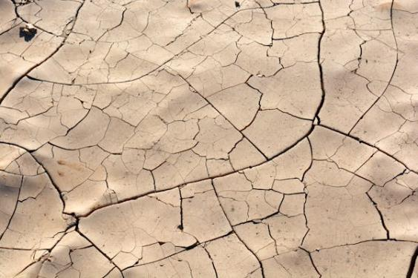
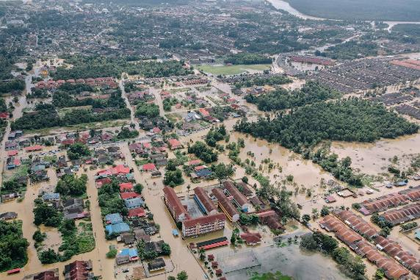
The changing climate also has a negative impact on food production
Increased rainfall variability and extreme weather events impact the sustainability of food production.
Notes:
Images: Designed by Pexels

Slide 59
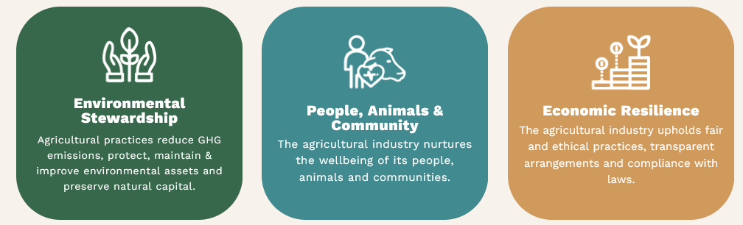
Industry action: Australian Agriculture Sustainability Framework (AASF)
Notes:
The Australian Agricultural Sustainability Framework (AASF) is a joint initiative led by the National Farmers’ Federation and supported by the Australian Government.
The AASF was developed in response to increasing pressures on the agricultural sector to demonstrate sustainability performance, both domestically and internationally.
Global shifts towards environmental, social, and governance (ESG) standards put pressure on Australian agriculture to demonstrate its sustainability performance.
Source: https://aasf.org.au/

Slide 60
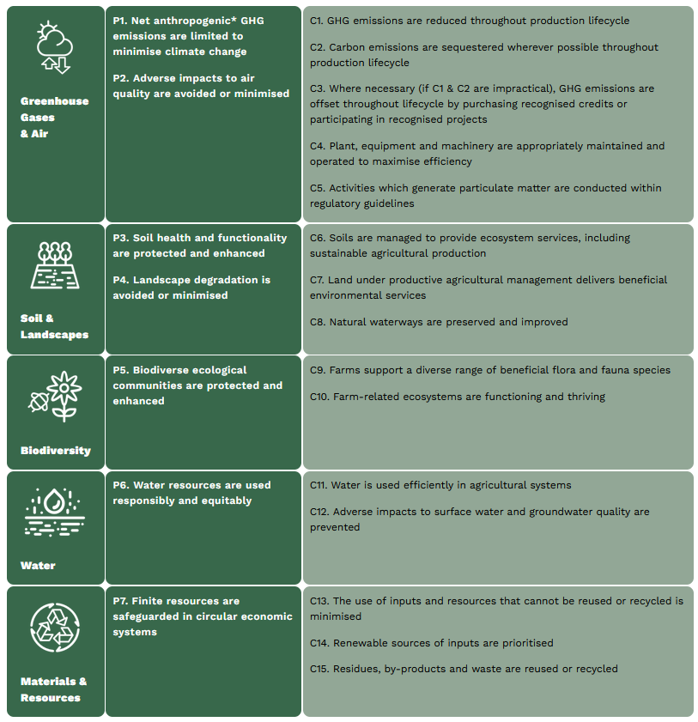
Environmental Stewardship
Notes:
With a focus on the Environmental Stewardship components, ensuring environmental sustainability in agriculture involves:
reducing greenhouse gas emissions throughout the production lifecycle
preserving on-farm natural capital
protecting, maintaining and improving our soil, land and water assets
using finite resources responsibly
promoting recycling where possible.
The AASF embraces the theme of environmental stewardship through five Principles. These Principles aim to demonstrate sustainable agricultural practices, covering greenhouse gas emissions and air, soil and landscapes, biodiversity, water, and materials and resources.
Source: https://aasf.org.au/environmental-stewardship/

Slide 61
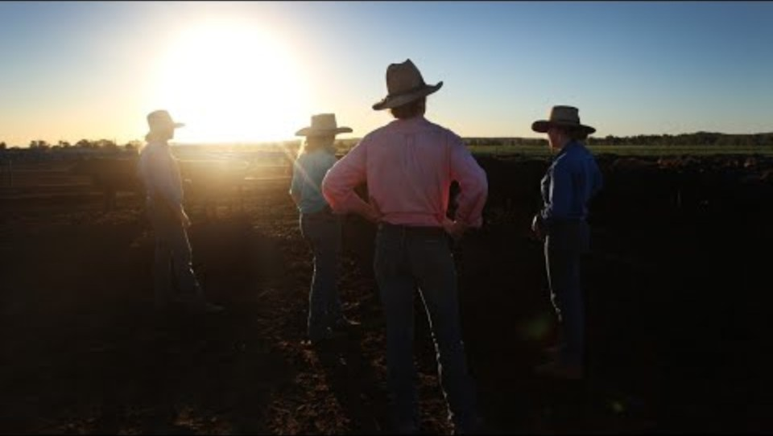
Climate change and farming
Notes:
[4.29]
Watch with students – provides an overview. Impact of climate change on farmers.

Slide 62
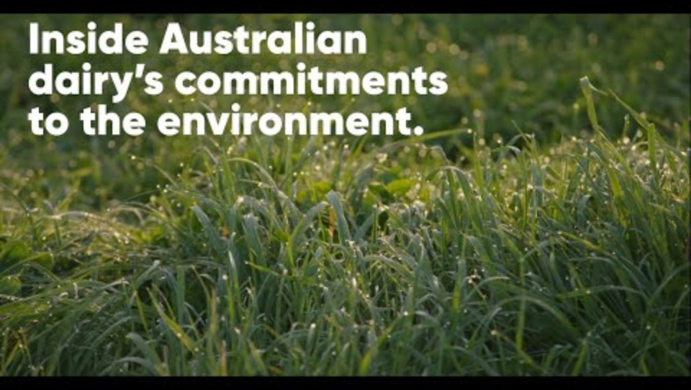
Farming and the environment
Notes:
[2.55]
Watch with students – this video looks at the practices that farmers can implement to help protect the environment.

Slide 63
Activity 1: Booklet task
Investigate:
the impact of the environment on farming
the impact of farming on the environment
farming practices to overcome/ reduce environmental impacts.

Slide 64
Lesson 6

Slide 65
Review

Slide 66
What are some of the impacts of the environment on farming?
Notes:
Elicit student responses.

Slide 67
What are some of the impacts of farming on the environment?
Notes:
Elicit student responses.

Slide 68
What are some farming practices to overcome/ reduce environmental impacts?
Notes:
Elicit student responses.

Slide 69
Learning intention: To investigate the nutritional benefit of a food product.
Success criteria:
at least 5 nutritional benefits.

Slide 70
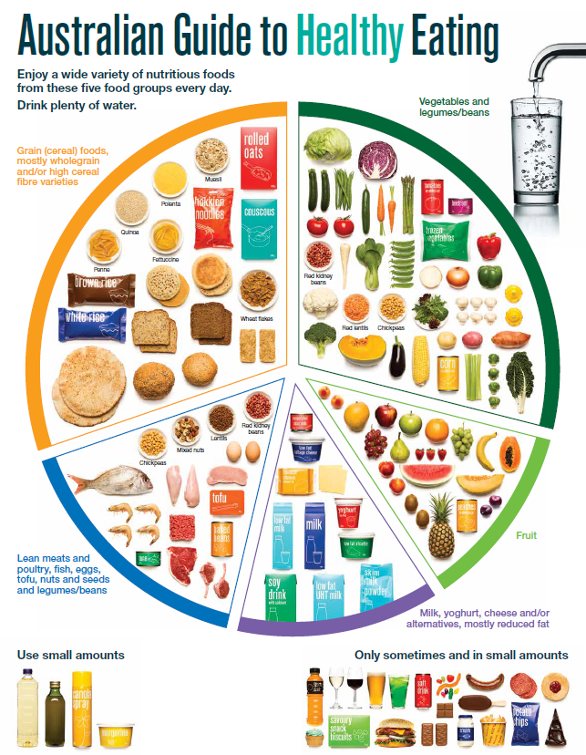
The Australian Guide to Healthy Eating
Notes:
The Australian Guide to Healthy Eating (AGHE) is a visual representation of the Australian Dietary Guidelines.
It is a broad guide to the types and amounts of foods we should eat each day.
The food groups:
Grain foods
Vegetables
Fruit
Dairy and alternatives
Meat and alternatives
Sitting off to the side are foods categorised as ‘sometimes’ foods. These foods are high in saturated fat and/or added sugars, added salt or alcohol and low in fibre. These foods and drinks can also be high in kilojoules (energy).

Slide 71
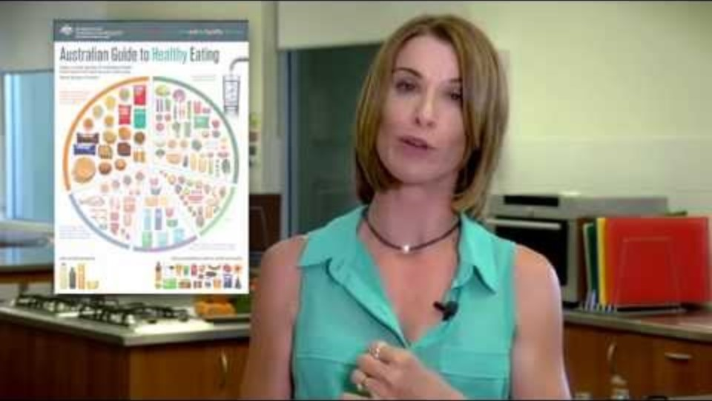
Overview of the AGHE
Notes:
[2.27]
While this video is directed at teachers, it provides a good overview of the five food groups, represented in the Australian Guide to healthy Eating.

Slide 72
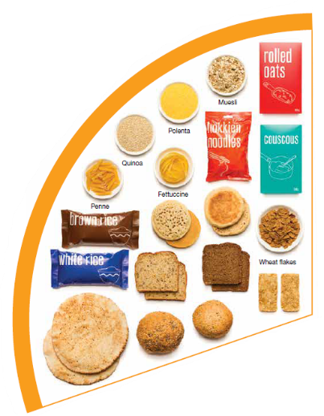





Grain foods
Breads
Breakfast cereal
Grains
Pasta
Other products
Mostly wholegrain and/or high cereal fibre varieties
Notes:
Grain foods comprise grains that can be cooked and eaten whole, ground into flour to make cereal foods, or made into breakfast cereals:
Breads: wholemeal, wholegrain, white, rye, pita, focaccia, crispbreads.
Breakfast cereals: high fibre (wholegrain) oats, porridge, muesli, wholewheat biscuits, ready to eat (such as cornflakes, cheerios).
Grains: rice, barley, corn, polenta, buckwheat, spelt, millet.
Pasta: short and long (white and wholemeal).
Other products: noodles, English muffin, crumpet, rice cakes, couscous, popcorn, flour.
The recommendation is for ‘mostly wholegrain and/or high cereal fibre varieties’ (at least two thirds). Wholegrain cereals contain more nutrients than refined cereal foods (e.g. white bread), because many of the important nutrients occur in the outer layer of the grain which is lost during processing.
Images: Designed by Pexels and Freepik
Based on material provided by the National Health and Medical Research Council (representing the Commonwealth of Australia)

Slide 73












Vegetables
Dark green and cruciferous
Root/ tubular/ bulb
Legumes/beans
Other
Choose a variety, including different colours, each day
Notes:
Types of vegetables (also includes legumes and beans):
Dark green and cruciferous: broccoli, brussels sprouts, bok choy, cabbages, cauliflower, lettuce, spinach, snow peas.
Root/ tubular/ bulb: potato, sweet potato, carrots, beetroot, onion, shallots, garlic, swede, turnip.
Legumes/ beans: kidney beans, soybeans, lima beans, cannellini beans, chickpeas, lentils, split peas, tofu.
Other: tomato, celery, zucchini, avocado, capsicum, eggplant, mushrooms, cucumber, pumpkin, green peas, green beans.
Eat different colours of vegetables, as the different colour groups have different vitamins and minerals.
Vegetables such as tomatoes and pumpkins are technically classified as fruit because they have seeds. They are included in the vegetable group because they have similar nutritional properties as vegetables and are typically eaten as a vegetable.
Images: Designed by Freepik
Based on material provided by the National Health and Medical Research Council (representing the Commonwealth of Australia)

Slide 74
















Fruit
Pomme
Citrus
Stone
Tropical
Berries
Choose dried fruit or fruit juice only occasionally
Notes:
Types of fruit:
Pome fruit: apple, pear.
Citrus fruit: orange, mandarin, grapefruit.
Stone fruit: apricot, cherry, peach, nectarine, plum.
Tropical: banana, paw paw, mangoes, pineapple and melon.
Berries: strawberry, blueberry, raspberry, blackberry.
Other: grapes, passionfruit.
Whole or chopped fruit is the best choice.
Fresh, frozen and canned fruits are all part of this food group. It is best to avoid fruits canned in syrup and choose varieties canned in natural juice or water instead.
Choose dried fruit or fruit juice only occasionally:
Eating dried fruit regularly is not recommended as it is high in kilojoules, can stick to the teeth and increases the risk of dental decay. You can also easily eat more than you realise.
Fruit juice is acidic and can increase the risk of dental decay. Fruit juice also has less fibre and other nutrients than whole fruit.
Different fruits can help protect our bodies in different ways, so it’s important to choose a variety, including different colours, each day.
Differences between fruit and vegetables
Fruits and vegetables are from different parts of a plant. Fruits come from the flowering part of a plant and contain seeds. Vegetables are the edible parts of a plant, such as the leaves, stem, roots, and bulbs.
Fruits that are eaten like vegetables: pumpkin, cucumber, tomato (and therefore part of the vegetable group).
Images: Designed by Pexels, Freepik and ChatGPT

Slide 75






Why grain foods, vegetables and fruit are important
Provide the best source of energy (slow-release energy): fuels our brain (for concentration) and our body
Provide fibre: to help keep our intestines healthy
Provide lots of vitamins and minerals to help our bodies grow and age
Notes:
The complex carbohydrates in these foods are slowly digested, which provides energy over time and helps prevent overeating.
Carbohydrate provides the best source of energy for the brain.
Fibre helps us stay fuller for longer, which can help with concentration.
Fibre is especially useful in keeping the digestive track (including the intestines) healthy and can assist with constipation.
The vast range of vitamins and minerals are important for growth and repair, healthy ageing, and preventing chronic conditions.
Images: Designed by Pexels and Freepik

Slide 76




Dairy and alternatives
Milk (fresh and long life)
Yoghurt
Cheese
Reduced fat varieties are the best choice for most
Notes:
Types of foods:
Milks: All reduced fat or full cream milks, plain and flavoured, long life milks, powdered milk, evaporated milk, soy beverages (fortified with at least 100mg calcium/100mL).
Yoghurt: All yoghurts including reduced fat or full cream, plain and flavoured, soy yoghurt (calcium fortified).
Cheese: All hard cheeses, reduced or full fat, for example cheddar, red Leicester, Gloucester, Edam, Gouda Soy cheeses (calcium fortified).
Dairy = products made from milk.
Dairy alternatives:
Calcium-fortified dairy alternatives include soy, rice, almond or oat milk and soy or lactose free yoghurts and cheeses.
Non-dairy alternatives do not naturally contain calcium. It is important to select products labelled as calcium-fortified.
Many of the alternative milks, with the exception of soy milk products, may not be a good source of protein and other key nutrients found in milk and products made from milk.
For vegetarians and vegans, dairy alternative products such as soy milk and cheese are a key source of nutrients, particularly protein and calcium (if calcium is added by the manufacturer), and need to be included regularly to ensure their diet is nutritionally balanced.
Images: Designed by Freepik
Based on material provided by the National Health and Medical Research Council (representing the Commonwealth of Australia)

Slide 77



Why dairy and alternative foods are important
Provide calcium: for strong bones and teeth
Provide protein: helps our body grow and become strong
Provide lots of vitamins and minerals to help our bodies grow and age
Notes:
Calcium helps ensure strong bones and teeth.
Proteins are made up of chemical 'building blocks' called amino acids. Your body uses amino acids to build and repair muscles and bones.
Iodine is needed to make essential thyroid hormones. These are used by the body for growth and energy use, as well as brain and bone development in the early years.
Vitamin B12 is essential for the production of red blood cells, which are needed to carry oxygen from the lungs to the body’s tissues and organs.
Images: Designed by Pexels and Freepik

Slide 78






Meat and alternatives
Pink and red meat
Poultry
Fish and seafood
Eggs
Nuts and seeds
Legumes/beans
Choose meat without visible fat
Notes:
Types of foods:
Lean meats: beef, lamb, pork, kangaroo, lean and low salt sausages.
Poultry: chicken, turkey, duck, emu, goose.
Fish and seafood: fish, prawns, crab, lobster, mussels, oysters, scallops, clams.
Eggs: chicken eggs, duck eggs.
Nuts and seeds: almonds, pine nuts, walnut, macadamia, hazelnut, cashew, peanut, nut spreads, brazil nuts, seeds.
Legumes/beans: all beans, lentils, chickpeas, split peas, tofu.
To ensure adequate iron and zinc, about half the serves from this food group should be lean meats. For those who do not eat animal foods, nuts, seeds, legumes (including tofu) can provide some iron and zinc, plus a good mix of plant-based protein.
Choose lean meat options and/or remove the visible fat from the meat prior to cooking to reduce the total amount of saturated fat consumed.
Fresh, frozen and canned varieties of meat, poultry or fish are included in this group. It is important that canned varieties are low in fat and low in salt (no added salt) and canned in water rather than in oil or brine.
Sausages, commercial burgers and meat pastries can be high in saturated fat and are classified as a ‘sometimes’ food. It is recommended the consumption of these foods be limited. If purchasing sausages, it is best to select lean or reduced fat versions and boil or fry in a non-stick pan or BBQ.
Processed meats, such as salami and bacon are high in salt and saturated fats are classified as a ‘sometimes’ food. Consumption should be limited.
Meat alternatives (plant foods):
Nuts and seeds.
Legumes/beans appear in this group as well as the vegetable group.
For vegetarians and vegans, these foods are a key source of nutrients, particularly protein and iron, and need to be included regularly to ensure their diet is nutritionally balanced.
Images: Designed by Freepik and ChatGPT
Based on material provided by the National Health and Medical Research Council (representing the Commonwealth of Australia)

Slide 79

Why meat and alternative foods are important
Provide zinc and iron: keeps our blood healthy and gives us energy
Provide protein: helps our body grow and become strong
Provide essential fatty acids to keep our brains and heart healthy
Notes:
Proteins are made up of chemical 'building blocks' called amino acids. Your body uses amino acids to build and repair muscles and bones.
Iron is particularly important for transporting oxygen in the blood. This is essential for providing energy for daily life. Iron also helps our immune system fight infection.
Zinc is important for growth and for the immune system to fight infection.
Images: Designed by Freepik

Slide 80







‘Sometimes' foods
Higher in added sugars
Higher in fat (and sodium)
Higher in both
To be consumed sometimes and in small amounts
Notes:
Some foods and drinks do not fit into the five food groups. These foods are high in saturated fat and/or added sugars, added salt or alcohol and low in fibre. These foods and drinks can also be high in kilojoules (energy).
Types of foods:
Higher added sugars: Soft drinks, energy drinks, sugar confectionary, jams, some sauces.
Higher fat: Most processed meats (bacon, ham, sausages, frankfurts), crisps, butter, cream, pastry products, meat pies, sausage rolls, potato chips, commercial pizza.
Higher added sugars AND higher fat: Biscuits, cakes, chocolate, doughnuts, ice cream, iced buns, some muesli bars, muffins, sweet pastries.
Alcoholic drinks.
‘Sometimes’ foods in a healthy diet:
Some people require extra serves of food, for example, those who are taller and more active. These can sometimes include extra serves of ‘sometimes’ foods. It is best if these extra serves come from the five food groups, particularly wholegrain cereals, vegetables including legumes/beans and fruit. However, they can also sometimes include serves of ‘sometimes’ foods (discretionary foods).
These foods can, however, contribute to a feeling of enjoyment. They should be consumed sometimes, and in small amounts, such as once a week.
Images: Designed by Freepik
Based on material provided by the National Health and Medical Research Council (representing the Commonwealth of Australia)

Slide 81
How much should you be eating?
There is a recommended amount of each food group that should be eaten each day.
These amounts are different depending on your age, and sometimes your gender.

Slide 82

Grain food serves
Children aged 9–11 years need 5 (boys) and 4 (girls) serves of grain
foods each day.
Children aged 12–13 years need 6 (boys) and 5 (girls) serves of grain
foods each day.
Notes:
Focus on children aged 9-11 years and 12-13 years.
Based on material provided by the National Health and Medical Research Council (representing the Commonwealth of Australia)

Slide 83

Vegetable serves
Children aged 9–11 years need 5 serves of vegetables each day.
Children aged 12–13 years need 5½ (boys) and 5 (girls) serves
of vegetables each day.
Notes:
Focus on children aged 9-11 years and 12-13 years.
Based on material provided by the National Health and Medical Research Council (representing the Commonwealth of Australia)

Slide 84

Fruit serves
Children aged 9–11 and 12–13 years need 2 serves of fruit each day.
Notes:
Focus on children aged 9–11 and 12–13 years.
Based on material provided by the National Health and Medical Research Council (representing the Commonwealth of Australia)

Slide 85

Dairy and alternative serves
Children aged 9–11 years need 2½ (boys) and 3 (girls) serves of dairy and alternative foods each day.
Children aged 12-13 years need 3 ½ serves of dairy and alternative foods each day.
Notes:
Focus on children aged 9–11 years and 12–13 years.
These difference in serves relates to the high calcium and protein needs for girls in this age group.
Based on material provided by the National Health and Medical Research Council (representing the Commonwealth of Australia)

Slide 86

Meat and alternative serves
Children aged 9–11 and 12–13 years need 2½ serves of meat and alternative foods each day.
Notes:
Focus on children aged 9–11 years and 12–13 years.
Based on material provided by the National Health and Medical Research Council (representing the Commonwealth of Australia)

Slide 87

Food group serves: 9–11 and 12–13 years
Notes:
This slide brings together the serves for children aged 9–11 and 12–13 years.
Why are the serve amounts different across the food groups?
Responses could include:
Different types of nutrients (vitamins and minerals) provided.
Different amounts of energy (sugars) in the foods e.g. more sugar in fruit than in vegetables.
Also to note: Slightly higher serves are needed with the increase in age.
Images: Designed by Pexels, Freepik and ChatGPT
Based on material provided by the National Health and Medical Research Council (representing the Commonwealth of Australia)

Slide 88
Activity 1: Booklet task
Select a food from the 5 food groups
Provide a summary of the nutritional benefits of the food (at least 5 benefits).

Slide 89
Lesson 7, 8 and 9

Slide 90
Learning intention: To investigate the production of a healthy food item.

Slide 91
Task
To develop an information report on the production of a food item that assists with healthy eating.

Slide 92


Slide 93


