Slide 1
Food labelling
Food labelling provides consumers with information to make safe and nutritious food choices.
Food Standards Australia New Zealand (FSANZ) sets the standards for what information must be on food labels.
Notes:
See: https://www.foodstandards.gov.au/consumer/labelling

Slide 2
Food labelling
Mandatory information
Additional information may be included.
Name and/or description of the food | Name and Australian street address of the supplier of food
‘Lot’ number (for traceability) | List of ingredients
Date mark (use by or best before) | Nutrition information panel (NIP)
Country of origin of the food | Warning and advisory statements and declarations (e.g. for allergens)
Directions for use and storage (some foods)
Notes:
Further specific information is available here:
https://www.foodauthority.nsw.gov.au/food-labelling/labels-law/labelling-laws

Slide 3
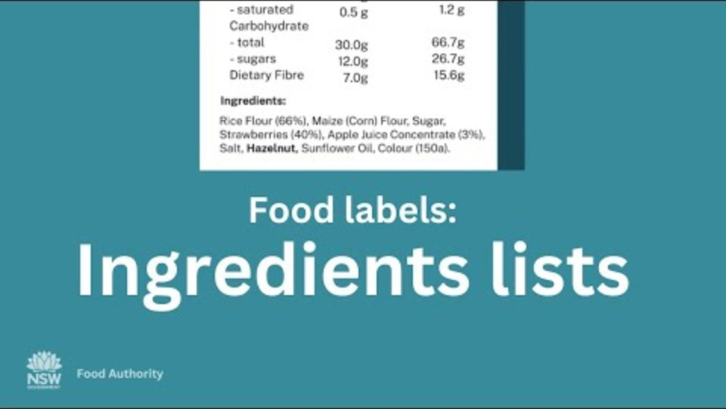
Ingredient list
Notes:
[1.24]
For additional information see:
https://www.foodstandards.gov.au/consumer/labelling/ingredients

Slide 4
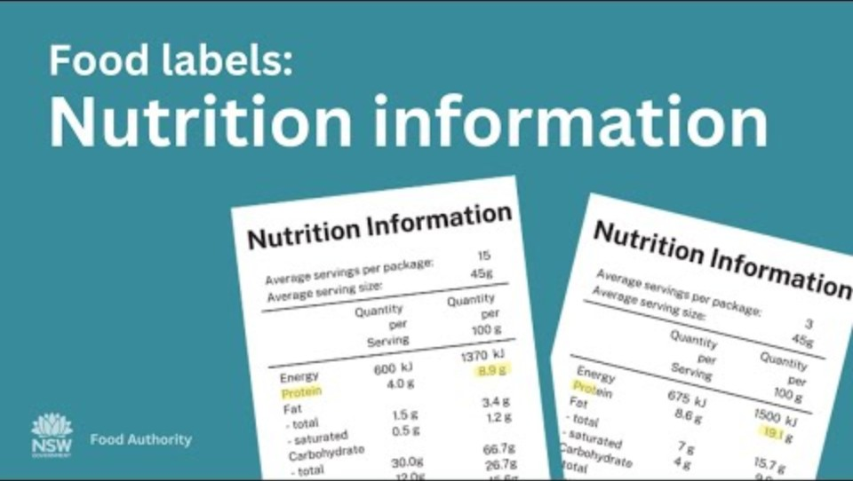
Nutrition Information Panel (NIP)
Notes:
[0.54]
For additional information see:
https://www.foodstandards.gov.au/consumer/labelling/panels

Slide 5
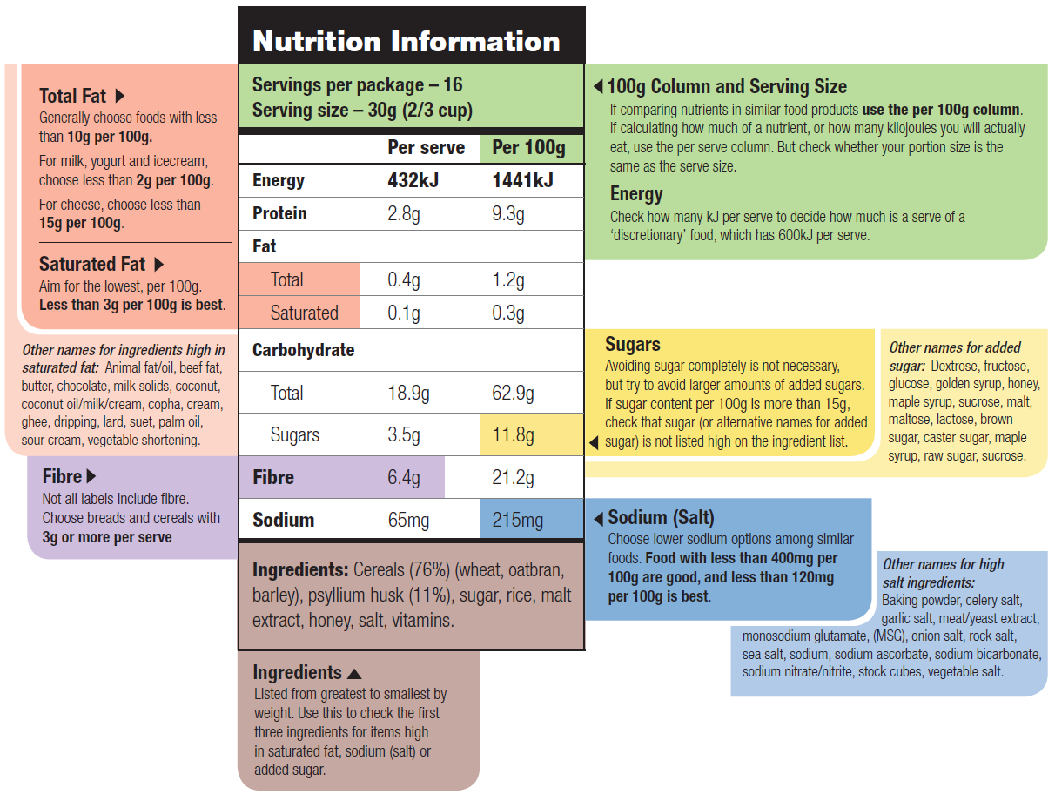
Nutrition Information Panel (NIP)
Notes:
This infographic provides further details on the NIP. It provides information on what to look for in terms of making healthier food choices.
Source: eatforhalth.gov.au

Slide 6
Nutrition and health claims
These claims can be voluntarily added.
Nutrition content claims = claims about the content of certain nutrients or substances in a food e.g. low in fat, good source of calcium.
Notes:
The FSANZ Food Standards Code regulates these claims, including the foods in which they can be placed (not all foods can carry nutrition and health claims).
For further details:
https://www.foodauthority.nsw.gov.au/food-labelling/labels-law/health-nutrition-claims
https://www.foodstandards.gov.au/consumer/labelling/nutrition

Slide 7
Nutrition and health claims
Health claims = relationship between a food and its health benefits.
There are two types:
  Low level e.g. Fibre helps keep you regular.
  High level e.g. Diets high in calcium may reduce the risk of osteoporosis in people
  65 years of age and over.

Slide 8
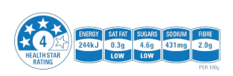

Health Star Rating
The Health Star Rating can be voluntarily added.
This system rates the overall nutritional profile of a packaged food.
Rating from ½ to 5 stars (higher is better).
This rating is based on foods within the same category e.g. don’t compare
muesli bar and bread.
Notes:
See: https://www.foodstandards.gov.au/consumer/labelling

Slide 9

Health Star Rating
For packaged food, you can use the Health Star Rating as a food selection guide.
Step 1: Identify whether food is a core food in the AGHE.
Step 2: Select a packaged food with
the highest rating in that category.

