Slide 1
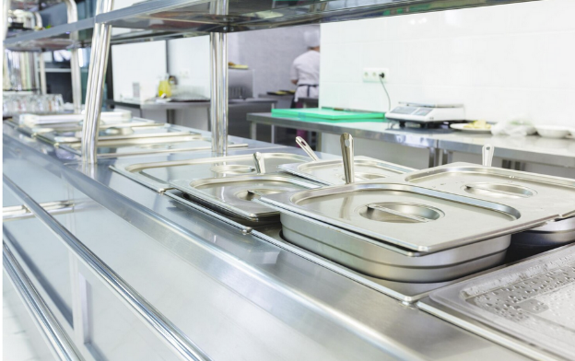
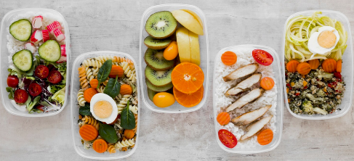
Designing food for healthy eating
Food and nutrition unit
Year 4
Notes:
Images: Designed by Freepik

Slide 2
Contents
Lesson 1 | Lesson 6
Lesson 2 | Lesson 7
Lesson 3 | Lesson 8
Lesson 4
Lesson 5

Slide 3
Lesson 1

Slide 4
In this unit we will be:
reviewing the source of food in Australia
reviewing equipment for preparing foods
reviewing the Australian Guide to Healthy Eating
sourcing healthy recipes
designing a healthy meal for the
school canteen

Slide 5
Activity 1: Booklet task
Identify a healthy school meal for the school canteen.
Identify why this would make a healthy meal (at least 3 reasons)
Identify the tools and equipment needed to prepare the meal.
Notes:
Allow approximately 15 minutes for this task.

Slide 6
Learning intention: To review where food comes from.
Success criteria:
steps that take a food from the farm to the supermarket.

Slide 7
Let’s review where food comes from

Slide 8
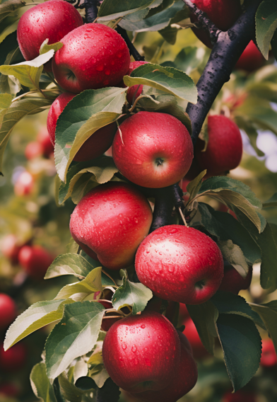
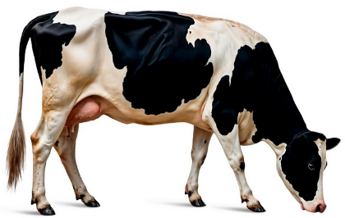
All food comes from either a plant or an animal
Notes:
Images: Designed by Freepik

Slide 9
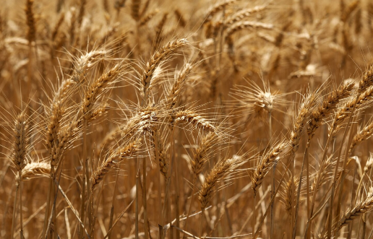
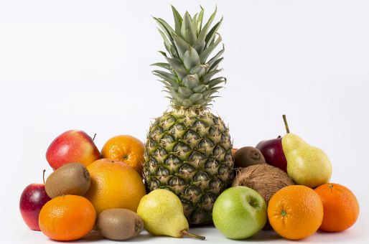
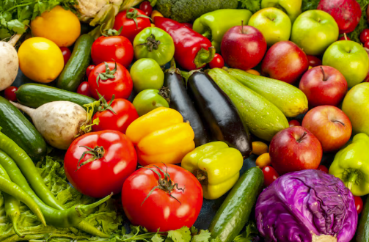
Food from plants
Wheat – used to make flour, bread and breakfast cereals
Fruit
Vegetables
Notes:
These are example foods.
Images: Designed by Freepik

Slide 10
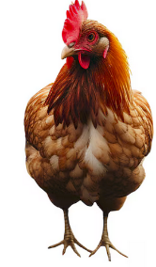
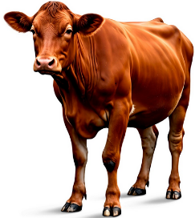
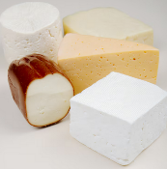
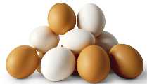
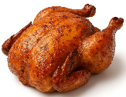

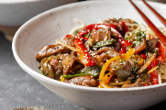


Food from animals
Dairy cow – produces milk for foods like milk, cheese, yoghurt
Chickens – for chicken meat, eggs
Beef cattle – for meat
Notes:
These are example foods.
Images: Designed by Freepik and ChatGPT

Slide 11
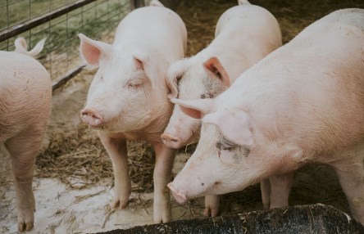
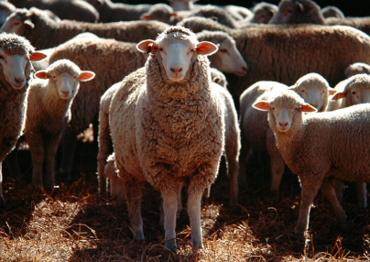
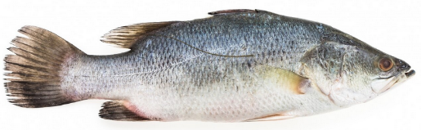
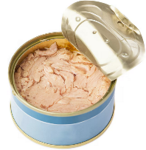
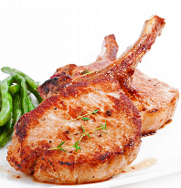
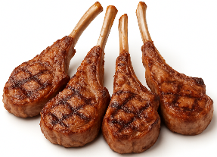
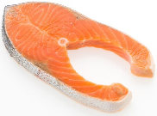
Food from animals
Fish – for fish fillets, crumbed fish, canned fish
Pig – for meat (pork)
Sheep – for meat and milk
Notes:
These are example foods.
Images: Designed by Freepik and ChatGPT

Slide 12
Food processing
All food that is reared (animals) or grown (like fruits and vegetables), are processed.
Some foods are processed more than others.
Different equipment is used when processing food.

Slide 13
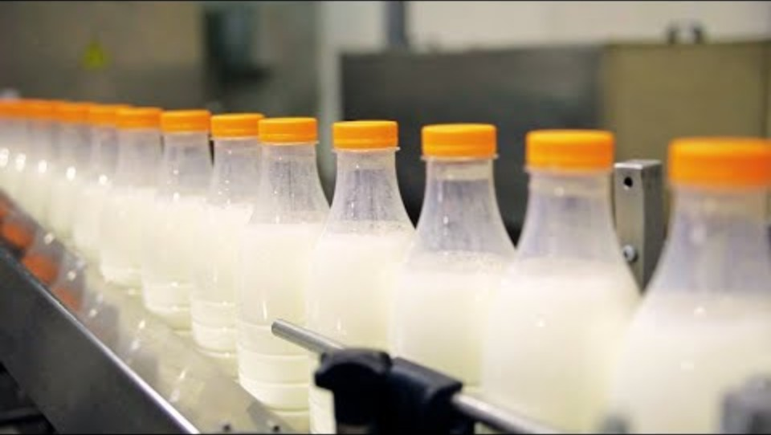
Milk from the farm to the supermarket
Notes:
[3.06]

Slide 14
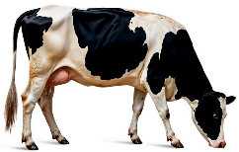
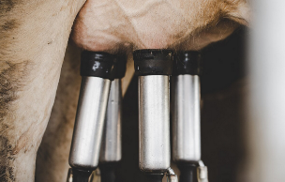
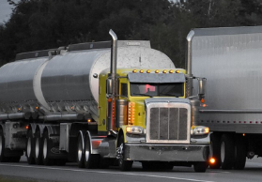

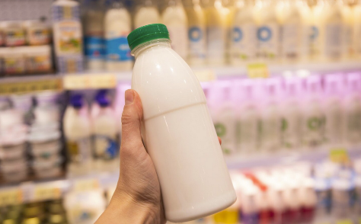
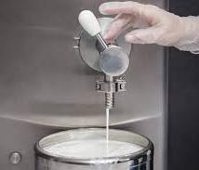
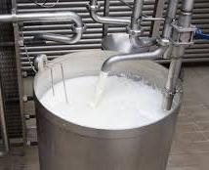


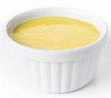
Bottled milk: farm to supermarket
1. The dairy cows are kept on a farm
2. The cows are milked on the farm
3. Tankers transport the milk to processing plant
4. The milk is tested
7. The milk is put in containers and transported
6. The milk is homogenised
5. The milk is pasteurised (heat treated)
8. Milk can also be used to make cheese, yoghurt and custard
Notes:
There are lots of steps that use different equipment to bring milk from the farm to the supermarket. This is a simplified flowchart of what was shown in the video.
Dairy cows are kept on a farm where they are given different food to help them produce milk.
The cows are milked by farmers in sheds on the farm.
The milk is pumped into a milk tank and transported to the nearest processing plant.
The testing process is to ensure there is no harmful bacteria and has the right level of nutrients.
The milk is pasteurised where it is heated at high temperatures to remove any harmful bacteria.
The milk is homogenised, which evenly distribute the fat globules (otherwise the fat would sit on top of the milk).
The milk is put into containers and transported to the shops for us to buy.
It can also be made into other products, like cheese, yoghurt and custard.
Images: Some images designed by Freepik

Slide 15
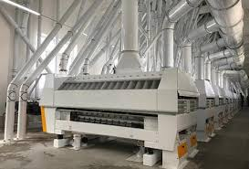

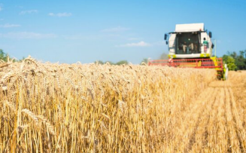
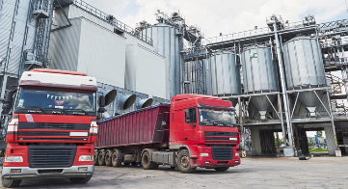
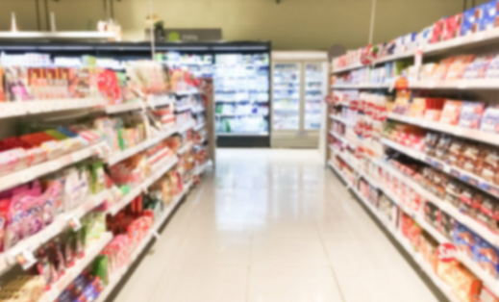
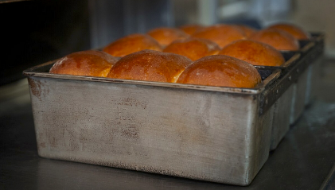
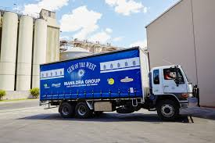
Bread: farm to supermarket
1. Wheat grown on a farm
2. The wheat is harvested with equipment
3. The wheat is transported to a flour mill
4. The wheat is milled into flour
7. The bread is transported
6. The flour is mixed with other ingredients to make bread
5. The flour is transported to a bakery
Notes:
There are lots of steps that use different equipment to bring wheat from the farm, to make bread, to then appear at the shops.
Images: Some images designed by Freepik

Slide 16
Let’s complete a flow chart together
Notes:
This is an optional activity if time allows.
We do: Create a flow chart together. Complete on whiteboard or anchor chart – very high-level. Suggested foods include:
frozen vegetables e.g. peas, corn (see https://www.youtube.com/watch?v=Gq687i5ie-I)
cornflakes (see https://www.youtube.com/watch?v=02O-XTs2vWg)
wheat biscuits (see https://www.youtube.com/watch?v=XtqwnlHuGdY)
orange juice (see https://www.youtube.com/watch?v=kvWrLXwJzck)
rice (see https://www.youtube.com/watch?v=ray8LsGvvgQ)

Slide 17
Lesson 2

Slide 18
Review

Slide 19
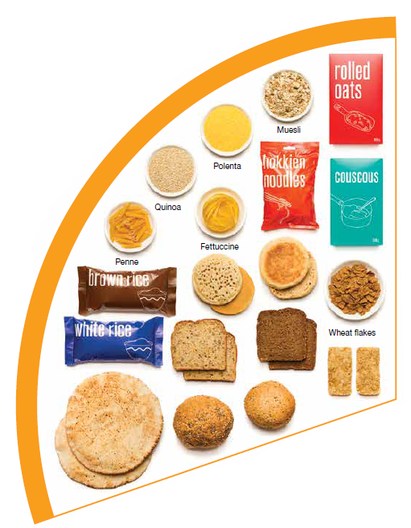
Do grain foods come from plants or animals?
Grain foods come from plants
Notes:
Image: Based on material provided by the National Health and Medical Research Council (representing the Commonwealth of Australia)

Slide 20
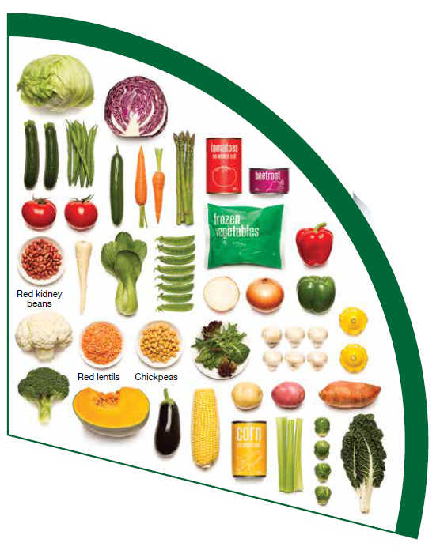
Do vegetables come from plants or animals?
Vegetables come from plants
Notes:
Image: Based on material provided by the National Health and Medical Research Council (representing the Commonwealth of Australia)

Slide 21
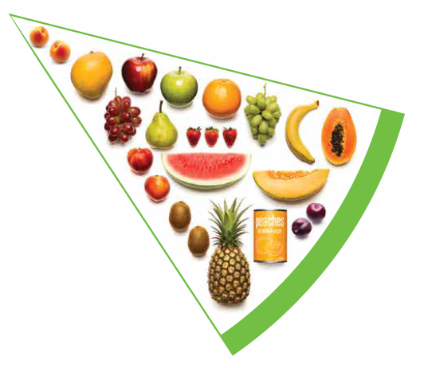
Does fruit come from plants or animals?
Fruit come from plants
Notes:
Image: Based on material provided by the National Health and Medical Research Council (representing the Commonwealth of Australia)

Slide 22
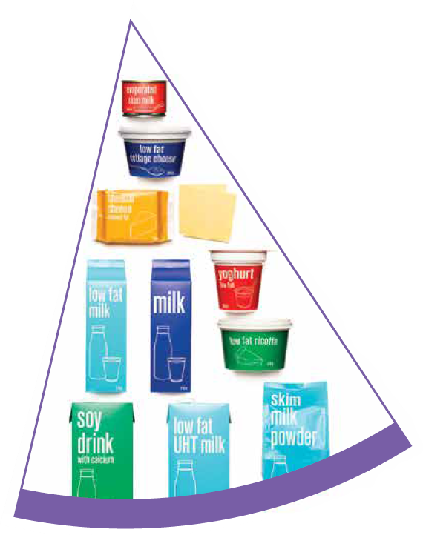
Do dairy and alternative foods come from plants or animals?
Dairy foods come from animals
Dairy alternatives (like soy milk) come from plants
Notes:
Image: Based on material provided by the National Health and Medical Research Council (representing the Commonwealth of Australia)

Slide 23
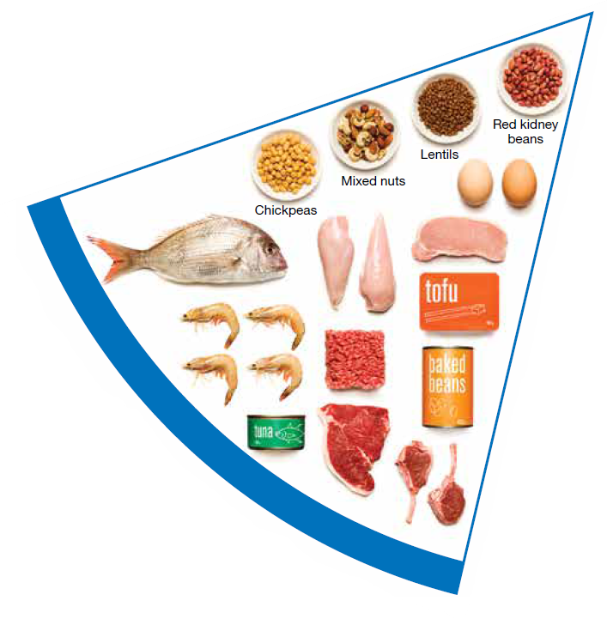
Do meat and alternative foods come from plants or animals?
Meat foods come from animals
Meat alternatives (like tofu) come from plants
Notes:
Image: Based on material provided by the National Health and Medical Research Council (representing the Commonwealth of Australia)

Slide 24
Learning intention: To compare farming between Australia and Vietnam.
Success criteria:
3 things unique to Australia
3 things unique to Vietnam
3 things that are the same.

Slide 25
Agriculture (growing food) is important to both Vietnam and Australia

Slide 26
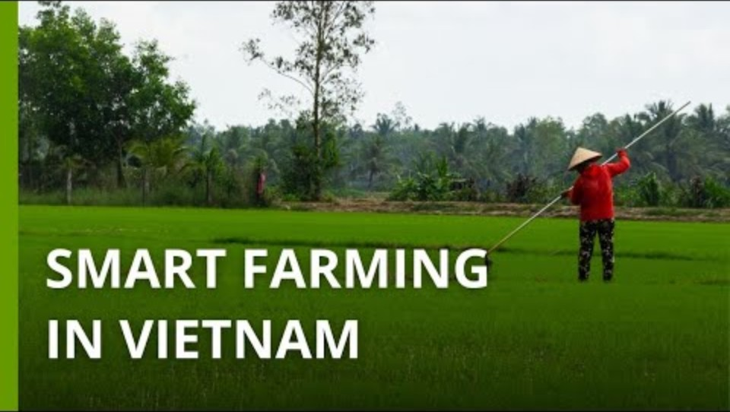
Growing rice in Vietnam
Notes:
[3.18]

Slide 27

Rearing meat in Australia
Notes:
[12.05]

Slide 28

Activity 1: Booklet task
Compare farming between Australia and Vietnam. At least 3 things that are:
unique to Australia
unique to Vietnam
the same.
Notes:
Resources
Australia:
https://kids.britannica.com/students/article/Australian-agriculture/632963
https://www.agriculture.gov.au/abares/products/insights/snapshot-of-australian-agriculture
Vietnam:
https://www.britannica.com/place/Vietnam/Agriculture-forestry-and-fishing
https://www.statista.com/topics/5653/agriculture-in-vietnam/#topicOverview

Slide 29
Lesson 3

Slide 30
Review

Slide 31
What are some key features of farming in Australia?
Notes:
Elicit responses from students

Slide 32
What are some of the foods farmed in Australia?
Notes:
Elicit responses from students

Slide 33
What are some key features of farming in Vietnam?
Notes:
Elicit responses from students

Slide 34
What are some of the foods farmed in Vietnam?
Notes:
Elicit responses from students

Slide 35
Learning intention: To identify food production techniques of First Nations Australians.
Success criteria:
identify at least 5 key production techniques.

Slide 36

First Nations Australians: More than hunter gatherers
Notes:
[12.33]
Students take notes as they watch the video.

Slide 37
Activity 1: Booklet task
Research and identify at least 5 key food production techniques of First Nations Australians.
Provide a summary of each technique.
Notes:
Resources:
Main article: https://deadlystory.com/page/culture/Life_Lore/Food
Supplementary articles to add more detail:
https://www.abc.net.au/listen/radionational/archived/bushtelegraph/rethinking-indigenous-australias-agricultural-past/5452454
https://landcareaustralia.org.au/resources/first-nations-resources-and-guidelines/cultural-burns-and-land-management/
https://www.integratesustainability.com.au/2019/08/07/australias-hidden-agricultural-legacy/

Slide 38
Lesson 4

Slide 39
Review

Slide 40
Seed planting
Controlled burning
Building dams and trenches
Only taking what is needed
What are some key food production techniques of First Nations Australians?
Preserving
Cultivating
Harvesting
Baking
Spear fishing
Storage units
Notes:
Suggested responses

Slide 41
Learning intention: To investigate technologies for safe and nutritious food.
Success criteria:
identify the technology
identify the purpose
identify the process.

Slide 42
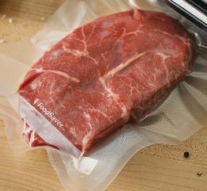
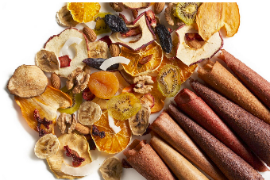
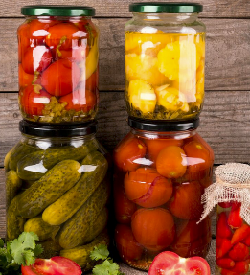
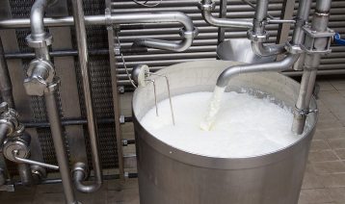
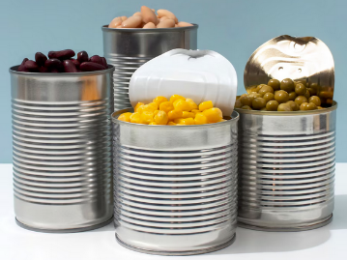
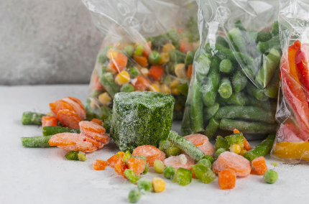
vacuum sealing
dehydrating
pickling
Food processing techniques help ensure safe and nutritious food is available
pasteurising
canning
freezing
Notes:
Food safety relates to ensuring there are no harmful levels of pathogens (bacteria, viruses, fungi, protozoa, worms).
Images: Designed by Freepik

Slide 43
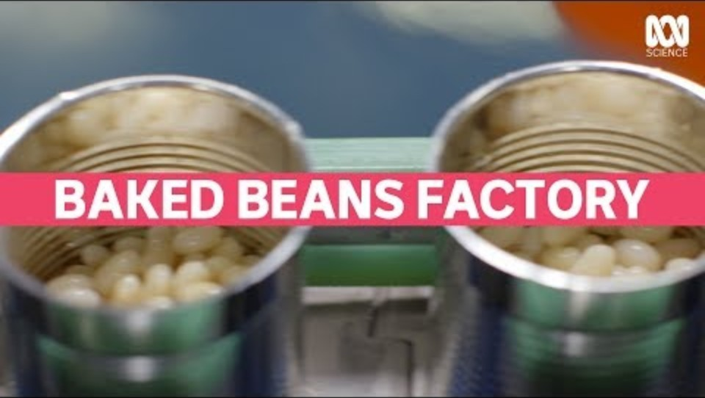
Food processing: making baked beans
Notes:
[5.29]

Slide 44
Activity 1: Booklet task
Select one food processing technique.
Identify:
  purpose
  process (including technologies
  other information about the processing technique.
Notes:
Students can locate their own sources. Links provided here if needed.
Pasteurising (pasteurisation): https://nationalfoodinstitute.com.au/nfi/how-is-milk-pasteurised/
Dehydrating: https://www.healthline.com/nutrition/dehydrated-food#methods
Vacuum sealing: https://www.grutto.com/uk/vacuum-packing
Canning: https://www.sanitarium.com/au/health-nutrition/vegetarian-eating/canned-food-recipes and https://www.healthyfood.com/advice/how-do-they-make-canned-food/
Pickling: https://theconversation.com/great-time-to-try-pickling-135052
Freezing: https://mccainfoodservice.com.au/professional-advice/frozen-vs-fresh-the-case-for-frozen-vegetables/

Slide 45
Lesson 5

Slide 46
Review

Slide 47
vacuum sealing
pickling
dehydrating
What are some food processing techniques to help ensure the availability of safe and nutritious foods?
pasteurising
freezing
canning

Slide 48
Learning intention: To investigate the Australian Guide to Healthy Eating.
Success criteria:
provide key information
identify the importance of each food group.

Slide 49
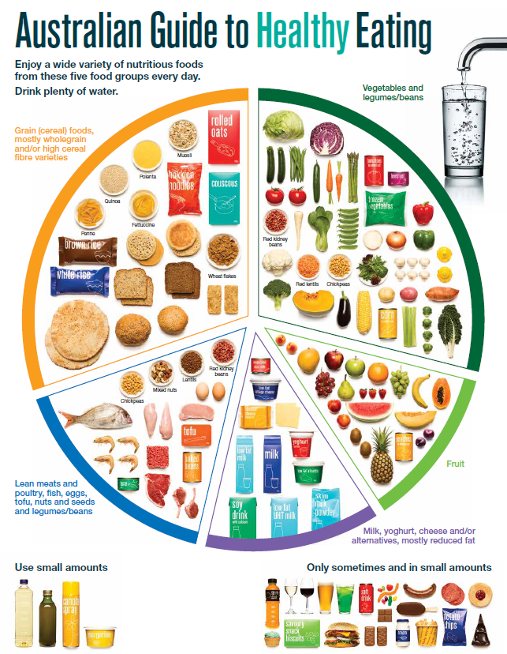
The Australian Guide to Healthy Eating
Notes:
The Australian Guide to Healthy Eating (AGHE) is a visual representation of the Australian Dietary Guidelines.
It is a broad guide to the types and amounts of foods we should eat each day.
The food groups:
Grain foods
Vegetables
Fruit
Dairy and alternatives
Meat and alternatives
Sitting off to the side are foods categorised as ‘sometimes’ foods. These foods are high in saturated fat and/or added sugars, added salt or alcohol and low in fibre. These foods and drinks can also be high in kilojoules (energy).

Slide 50

Overview of the AGHE
Notes:
[2.27]
While this video is directed at teachers, it provides a good overview of the five food groups, represented in the Australian Guide to healthy Eating.

Slide 51

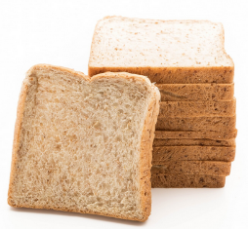
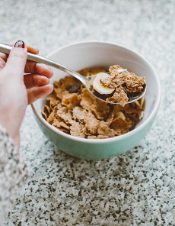



Grain foods
Breads
Breakfast cereal
Grains
Pasta
Other products
Mostly wholegrain and/or high cereal fibre varieties
Notes:
Grain foods comprise grains that can be cooked and eaten whole, ground into flour to make cereal foods, or made into breakfast cereals:
Breads: wholemeal, wholegrain, white, rye, pita, focaccia, crispbreads.
Breakfast cereals: high fibre (wholegrain) oats, porridge, muesli, wholewheat biscuits, ready to eat (such as cornflakes, cheerios).
Grains: rice, barley, corn, polenta, buckwheat, spelt, millet.
Pasta: short and long (white and wholemeal).
Other products: noodles, English muffin, crumpet, rice cakes, couscous, popcorn, flour.
The recommendation is for ‘mostly wholegrain and/or high cereal fibre varieties’ (at least two thirds). Wholegrain cereals contain more nutrients than refined cereal foods (e.g. white bread), because many of the important nutrients occur in the outer layer of the grain which is lost during processing.
Images: Designed by Pexels and Freepik
Based on material provided by the National Health and Medical Research Council (representing the Commonwealth of Australia)

Slide 52












Vegetables
Dark green and cruciferous
Root/ tubular/ bulb
Legumes/beans
Other
Choose a variety, including different colours, each day
Notes:
Types of vegetables (also includes legumes and beans):
Dark green and cruciferous: broccoli, brussels sprouts, bok choy, cabbages, cauliflower, lettuce, spinach, snow peas.
Root/ tubular/ bulb: potato, sweet potato, carrots, beetroot, onion, shallots, garlic, swede, turnip.
Legumes/ beans: kidney beans, soybeans, lima beans, cannellini beans, chickpeas, lentils, split peas, tofu.
Other: tomato, celery, zucchini, avocado, capsicum, eggplant, mushrooms, cucumber, pumpkin, green peas, green beans.
Eat different colours of vegetables, as the different colour groups have different vitamins and minerals.
Vegetables such as tomatoes and pumpkins are technically classified as fruit because they have seeds. They are included in the vegetable group because they have similar nutritional properties as vegetables and are typically eaten as a vegetable.
Images: Designed by Freepik
Based on material provided by the National Health and Medical Research Council (representing the Commonwealth of Australia)

Slide 53
















Fruit
Pomme
Citrus
Stone
Tropical
Berries
Choose dried fruit or fruit juice only occasionally
Notes:
Types of fruit:
Pome fruit: apple, pear.
Citrus fruit: orange, mandarin, grapefruit.
Stone fruit: apricot, cherry, peach, nectarine, plum.
Tropical: banana, paw paw, mangoes, pineapple and melon.
Berries: strawberry, blueberry, raspberry, blackberry.
Other: grapes, passionfruit.
Whole or chopped fruit is the best choice.
Fresh, frozen and canned fruits are all part of this food group. It is best to avoid fruits canned in syrup and choose varieties canned in natural juice or water instead.
Choose dried fruit or fruit juice only occasionally:
Eating dried fruit regularly is not recommended as it is high in kilojoules, can stick to the teeth and increases the risk of dental decay. You can also easily eat more than you realise.
Fruit juice is acidic and can increase the risk of dental decay. Fruit juice also has less fibre and other nutrients than whole fruit.
Different fruits can help protect our bodies in different ways, so it’s important to choose a variety, including different colours, each day.
Differences between fruit and vegetables
Fruits and vegetables are from different parts of a plant. Fruits come from the flowering part of a plant and contain seeds. Vegetables are the edible parts of a plant, such as the leaves, stem, roots, and bulbs.
Fruits that are eaten like vegetables: pumpkin, cucumber, tomato (and therefore part of the vegetable group).
Images: Designed by Pexels, Freepik and ChatGPT
Based on material provided by the National Health and Medical Research Council (representing the Commonwealth of Australia)

Slide 54






Why grain foods, vegetables and fruit are important
Provide the best source of energy (slow-release energy): fuels our brain (for concentration) and our body
Provide fibre: to help keep our intestines healthy
Provide lots of vitamins and minerals to help our bodies grow and age
Notes:
The complex carbohydrates in these foods are slowly digested, which provides energy over time and helps prevent overeating.
Carbohydrate provides the best source of energy for the brain.
Fibre helps us stay fuller for longer, which can help with concentration.
Fibre is especially useful in keeping the digestive track (including the intestines) healthy and can assist with constipation.
The vast range of vitamins and minerals are important for growth and repair, healthy ageing, and preventing chronic conditions.
Images: Designed by Pexels and Freepik

Slide 55




Dairy and alternatives
Milk (fresh and long life)
Yoghurt
Cheese
Reduced fat varieties are the best choice for most
Notes:
Types of foods:
Milks: All reduced fat or full cream milks, plain and flavoured, long life milks, powdered milk, evaporated milk, soy beverages (fortified with at least 100mg calcium/100mL).
Yoghurt: All yoghurts including reduced fat or full cream, plain and flavoured, soy yoghurt (calcium fortified).
Cheese: All hard cheeses, reduced or full fat, for example cheddar, red Leicester, Gloucester, Edam, Gouda Soy cheeses (calcium fortified).
Dairy = products made from milk.
Dairy alternatives:
Calcium-fortified dairy alternatives include soy, rice, almond or oat milk and soy or lactose free yoghurts and cheeses.
Non-dairy alternatives do not naturally contain calcium. It is important to select products labelled as calcium-fortified.
Many of the alternative milks, with the exception of soy milk products, may not be a good source of protein and other key nutrients found in milk and products made from milk.
For vegetarians and vegans, dairy alternative products such as soy milk and cheese are a key source of nutrients, particularly protein and calcium (if calcium is added by the manufacturer), and need to be included regularly to ensure their diet is nutritionally balanced.
Images: Designed by Freepik
Based on material provided by the National Health and Medical Research Council (representing the Commonwealth of Australia)

Slide 56



Why dairy and alternative foods are important
Provide calcium: for strong bones and teeth
Provide protein: helps our body grow and become strong
Provide lots of vitamins and minerals to help our bodies grow and age
Notes:
Calcium helps ensure strong bones and teeth.
Proteins are made up of chemical 'building blocks' called amino acids. Your body uses amino acids to build and repair muscles and bones.
Iodine is needed to make essential thyroid hormones. These are used by the body for growth and energy use, as well as brain and bone development in the early years.
Vitamin B12 is essential for the production of red blood cells, which are needed to carry oxygen from the lungs to the body’s tissues and organs.
Images: Designed by Pexels and Freepik

Slide 57






Meat and alternatives
Pink and red meat
Poultry
Fish and seafood
Eggs
Nuts and seeds
Legumes/beans
Choose meat without visible fat
Notes:
Types of foods:
Lean meats: beef, lamb, pork, kangaroo, lean and low salt sausages.
Poultry: chicken, turkey, duck, emu, goose.
Fish and seafood: fish, prawns, crab, lobster, mussels, oysters, scallops, clams.
Eggs: chicken eggs, duck eggs.
Nuts and seeds: almonds, pine nuts, walnut, macadamia, hazelnut, cashew, peanut, nut spreads, brazil nuts, seeds.
Legumes/beans: all beans, lentils, chickpeas, split peas, tofu.
To ensure adequate iron and zinc, about half the serves from this food group should be lean meats. For those who do not eat animal foods, nuts, seeds, legumes (including tofu) can provide some iron and zinc, plus a good mix of plant-based protein.
Choose lean meat options and/or remove the visible fat from the meat prior to cooking to reduce the total amount of saturated fat consumed.
Fresh, frozen and canned varieties of meat, poultry or fish are included in this group. It is important that canned varieties are low in fat and low in salt (no added salt) and canned in water rather than in oil or brine.
Sausages, commercial burgers and meat pastries can be high in saturated fat and are classified as a ‘sometimes’ food. It is recommended the consumption of these foods be limited. If purchasing sausages, it is best to select lean or reduced fat versions and boil or fry in a non-stick pan or BBQ.
Processed meats, such as salami and bacon are high in salt and saturated fats are classified as a ‘sometimes’ food. Consumption should be limited.
Meat alternatives (plant foods):
Nuts and seeds.
Legumes/beans appear in this group as well as the vegetable group.
For vegetarians and vegans, these foods are a key source of nutrients, particularly protein and iron, and need to be included regularly to ensure their diet is nutritionally balanced.
Images: Designed by Freepik and ChatGPT
Based on material provided by the National Health and Medical Research Council (representing the Commonwealth of Australia)

Slide 58

Why meat and alternative foods are important
Provide zinc and iron: keeps our blood healthy and gives us energy
Provide protein: helps our body grow and become strong
Provide essential fatty acids to keep our brains and heart healthy
Notes:
Proteins are made up of chemical 'building blocks' called amino acids. Your body uses amino acids to build and repair muscles and bones.
Iron is particularly important for transporting oxygen in the blood. This is essential for providing energy for daily life. Iron also helps our immune system fight infection.
Zinc is important for growth and for the immune system to fight infection.
Images: Designed by Freepik

Slide 59







‘Sometimes' foods
Higher in added sugars
Higher in fat (and sodium)
Higher in both
To be consumed sometimes and in small amounts
Notes:
Some foods and drinks do not fit into the five food groups. These foods are high in saturated fat and/or added sugars, added salt or alcohol and low in fibre. These foods and drinks can also be high in kilojoules (energy).
Types of foods:
Higher added sugars: Soft drinks, energy drinks, sugar confectionary, jams, some sauces.
Higher fat: Most processed meats (bacon, ham, sausages, frankfurts), crisps, butter, cream, pastry products, meat pies, sausage rolls, potato chips, commercial pizza.
Higher added sugars AND higher fat: Biscuits, cakes, chocolate, doughnuts, ice cream, iced buns, some muesli bars, muffins, sweet pastries.
Alcoholic drinks.
‘Sometimes’ foods in a healthy diet:
Some people require extra serves of food, for example, those who are taller and more active. These can sometimes include extra serves of ‘sometimes’ foods. It is best if these extra serves come from the five food groups, particularly wholegrain cereals, vegetables including legumes/beans and fruit. However, they can also sometimes include serves of ‘sometimes’ foods (discretionary foods).
These foods can, however, contribute to a feeling of enjoyment. They should be consumed sometimes, and in small amounts, such as once a week.
Images: Designed by Freepik
Based on material provided by the National Health and Medical Research Council (representing the Commonwealth of Australia)

Slide 60
Activity 1: Booklet task
Review the AGHE. Provide information on the following:
key information
health benefits of each of the food groups.

Slide 61
Lesson 6

Slide 62
Review

Slide 63
Why are grain foods, vegetables and fruit important?
How many reasons can you think of?

Slide 64
Answer: Why are grain foods, vegetables and fruit important?
Provide the best source of energy (slow-release energy): fuels our brain (for concentration) and our body
Provide fibre: to help keep our intestines healthy
Provide lots of vitamins and minerals to help our bodies grow and age
Notes:
The complex carbohydrates in these foods are slowly digested, which provides energy over time and helps prevent overeating.
Carbohydrate provides the best source of energy for the brain.
Fibre helps us stay fuller for longer, which can help with concentration.
Fibre is especially useful in keeping the digestive track (including the intestines) healthy and can assist with constipation.
The vast range of vitamins and minerals are important for growth and repair, healthy ageing, and preventing chronic conditions.
Images: Designed by Pexels and Freepik

Slide 65
Why are dairy and alternative foods important?
How many reasons can you think of?

Slide 66
Answer: Why are dairy and alternative foods important?
Provide calcium: for strong bones and teeth
Provide protein: helps our body grow and become strong
Provide lots of vitamins and minerals to help our bodies grow and age
Notes:
Calcium helps ensure strong bones and teeth.
Proteins are made up of chemical 'building blocks' called amino acids. Your body uses amino acids to build and repair muscles and bones.
Iodine is needed to make essential thyroid hormones. These are used by the body for growth and energy use, as well as brain and bone development in the early years.
Vitamin B12 is essential for the production of red blood cells, which are needed to carry oxygen from the lungs to the body’s tissues and organs.
Images: Designed by Pexels and Freepik

Slide 67
Why are meat and alternative foods important?
How many reasons can you think of?

Slide 68
Answer: Why are meat and alternative foods important?
Provide zinc and iron: keeps our blood healthy and gives us energy
Provide protein: helps our body grow and become strong
Provide essential fatty acids to keep our brains and heart healthy
Notes:
Proteins are made up of chemical 'building blocks' called amino acids. Your body uses amino acids to build and repair muscles and bones.
Iron is particularly important for transporting oxygen in the blood. This is essential for providing energy for daily life. Iron also helps our immune system fight infection.
Zinc is important for growth and for the immune system to fight infection.
Images: Designed by Freepik

Slide 69
Learning intention: To investigate schools sold in school canteens.
Success criteria:
positive aspects
negative aspects.

Slide 70
School canteen menus
What are some things to consider when designing school canteen menus?
Healthy eating!
What students will enjoy eating
Ease of preparation
Tools and equipment are available
How it can be served
Cost
Safe for students
Notes:
Suggested responses:
what students will enjoy eating.
cost.
ease of preparation.
how it can be served (e.g. in a box or bag).
safe for students (will not spoil before the student eats it).
required tools and equipment are available in the canteen.
healthy eating!

Slide 71
School canteen menus
Let’s look at some menus.

Slide 72

I do
What are some positive aspects?
These could have added vegetables
These are ‘sometimes’ foods
Fresh fruit option
These are largely ‘sometimes’ foods and there are more nutritious snack options
What are some negative aspects?
Notes:
I do: When completing this task, keep in mind the principles of the Australian Guide to Healthy Eating.

Slide 73

We do
These are healthy options
What are some positive aspects?
These are largely ‘sometimes’ foods and there are more nutritious snack options
These could have added vegetables
These are largely ‘sometimes’ foods and there are more nutritious breakfast options
These are ‘sometimes’ foods
What are some negative aspects?
Notes:
We do: Let’s complete one together.
What are some positive aspects?
What are some negative aspects?
Complete on an interactive whiteboard or make notes on an anchor chart or whiteboard.
Example response provided.

Slide 74
Activity 1: Booklet task
You do
Annotate this canteen menu, with details on: positive aspects; negative aspects.
Refer to your knowledge on the principles of the Australian Guide to Healthy Eating to assist with this task.
Notes:
You do: Students complete themselves. Remind students to keep in mind the principles of the Australian Guide to Healthy Eating.

Slide 75
Lesson 7

Slide 76
Review

Slide 77
What are examples of dairy and alternative foods?

Slide 78

Answer: What are examples of dairy and alternative foods?
Notes:
Images: Designed by Freepik and ChatGPT

Slide 79
What are examples of grain foods?

Slide 80

Answer: What are examples of grain foods?
Notes:
Images: Designed by Freepik and ChatGPT

Slide 81
Learning intention: To investigate healthy canteen food options.
Success criteria:
healthy meal ideas
food groups
how ingredients are produced
equipment requirements.

Slide 82

Case study review
Notes:
Principles:
Balance between profit and nutrition (because sometimes foods are often a cheaper option)
Mostly homemade snacks and meals – not pre-made.
Meal preparation is key – have things prepared beforehand. Make things in large batches that can be refrigerated or frozen.
Can be simple changes like adding fruit to muffins or veggies to meals (like the penne bolognaise – where onion, grated carrot and zucchini is added).
Frozen fruit and vegetables are good options.
Equipment:
Large pie warmer for storing pre-cooked can reheated food.
George Forman Griddle for cooking pikelets.
Large fridge

Slide 83

Healthy menu example
Green items are healthy choices.
Amber items are sometimes choices
Equipment needs:
Large fridge to store items
Rice cooker (rice dishes)
Grill for making pikelets
Oven for cooking meal items
Stove for cooking meal items
Pie warmer for keeping items warm
Microwave
What else?

Slide 84

Canteen meal ideas
Notes:
Review with the students

Slide 85
Activity 1: Booklet task
In small groups, review ‘Canteen meal ideas’. Select a meal and identify:
name of meal
ingredients
food groups in the meal
equipment needed for the recipe
how one of the ingredients are
produced.

Slide 86
Lesson 8

Slide 87
Learning intention: To make a healthy lunch item that could be sold in a canteen.

Slide 88
Suggestions
Sandwiches with different fillings
Chicken and salad
Green salad with a protein (tuna, pre-cooked chicken)
Fruit salad and yoghurt
Fried rice (using pre-cooked ingredients)

Slide 89
Lesson 9

Slide 90
Learning intention: To design a healthy meal for your school canteen.

Slide 91
Task
To design a healthy meal for your school canteen (lunch item). Describe what makes this meal a healthy lunch item.

Slide 92


Slide 93


