Slide 1
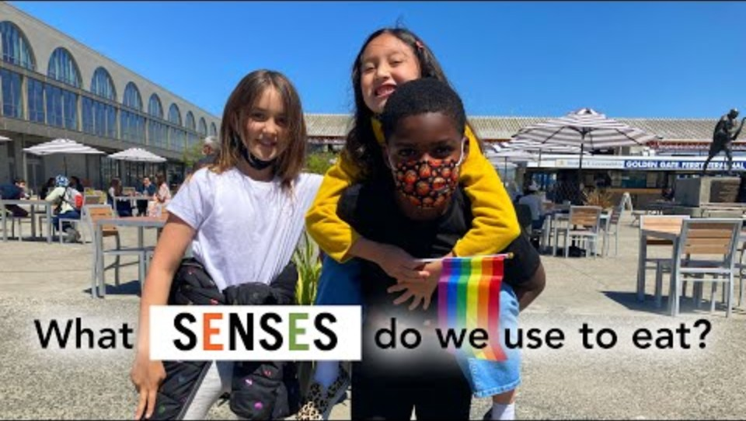
The senses and food
Notes:
[8.19]
View this video with the students, which provides an overview of the senses we use when eating.

Slide 2
Senses and food
We use a range of senses when deciding whether to eat a food, and to evaluate our enjoyment of food:
sight
smell
hearing
taste
touch.

Slide 3
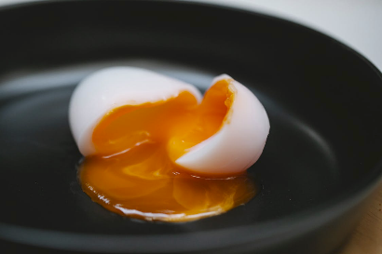
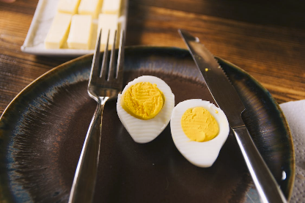
Sight (appearance of food)
If a food does not look appealing, you may be less likely to eat it.
This includes:
- size
- shape
- consistency
- colour.
Which would you prefer?
Notes:
Images: Designed by Pexels

Slide 4
Sight (appearance of food)
Words to describe appearance:
dry
fluffy
flat
mushy
crumbly
hard
runny
lumpy
fizzy
flaky
Notes:
Words to describe

Slide 5
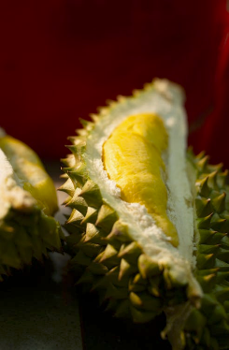
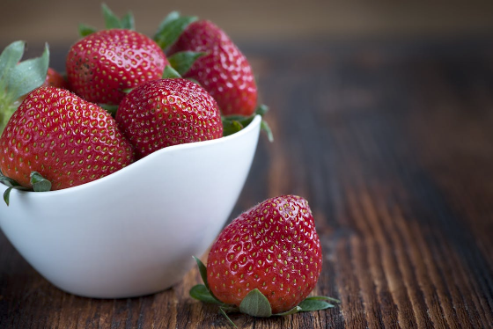
Smell
The nose detects aromas released from food (odour).
If a food does not smell appealing, you may be less likely to eat it.
Ripe strawberries can have a very ‘sweet’ smell.
Have you ever smelt durian? It has an intense smell, which some people describe as unpleasant.
Notes:
Images: Designed by Pexels

Slide 6
Smell
Words to describe smell:
aromatic
spicy
tart
pungent
sweet
floral
mild
bland
strong
rotten
rotten
Notes:
Words to describe

Slide 7
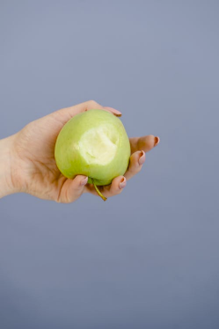
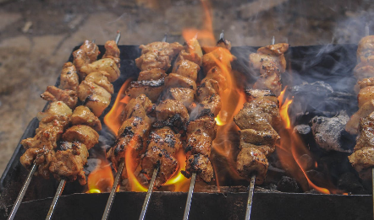
Hearing (sound)
The sounds of a food being prepared or cooked can influence whether we would like to eat it.
The sound when eating food can influence whether we like the food.
Sizzling meat?
Crunchy or soft apple?
Notes:
Images: Designed by Pexels

Slide 8
Taste (flavour)
Our tongue can detect 5 tastes:
bitter
salt
sour
sweet
umami
Taste can be described through association with a food: minty, fruity.
We can also describe the intensity of taste: mild, strong.

Slide 9
Taste (flavour)
Words to describe taste:
sweet
bitter
zesty
umami
mild
sour
salty
spicy
bland
tart
sharp
acidic
rich
Notes:
Words to describe

Slide 10
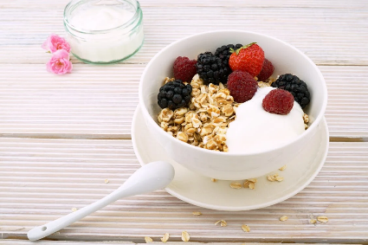
Touch (texture)
We can assess touch through texture.
We may or may not like the way a food feels on our tongue, known as mouth-feel.
We may or may not like the feeling when the food is chewed: is it too soft or too chewy?
Do you like the combination of soft yoghurt, with crunchy/ hard muesli and soft fruit?
Notes:
Images: Designed by Pexels

Slide 11
Touch (texture)
Words to describe texture:
brittle
rubbery
dry
crisp
smooth
moist
tender
mushy
hard
sticky
soft
lumpy
chewy
crumbly
gritty
Notes:
Words to describe

