Slide 1
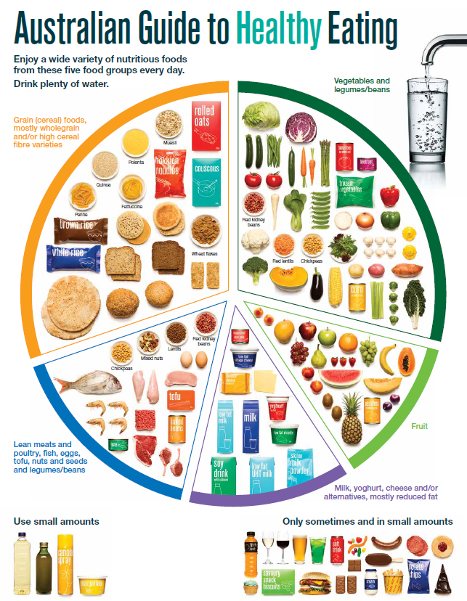
The Australian Guide to Healthy Eating
Notes:
The Australian Guide to Healthy Eating (AGHE) is a visual representation of the Australian Dietary Guidelines.
It is a broad guide to the types and amounts of foods we should eat each day.
The food groups:
Grain foods
Vegetables
Fruit
Dairy and alternatives
Meat and alternatives
Sitting off to the side are foods categorised as ‘sometimes’ foods. These foods are high in saturated fat and/or added sugars, added salt or alcohol and low in fibre. These foods and drinks can also be high in kilojoules (energy).

Slide 2
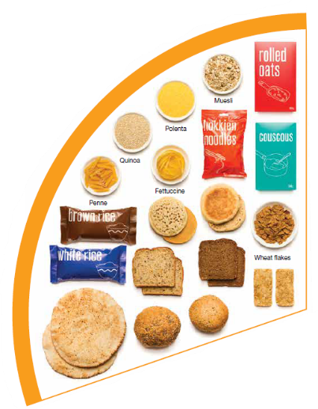
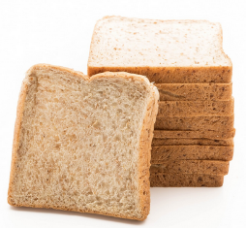
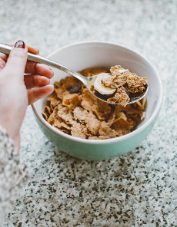
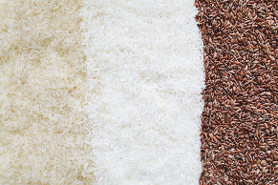

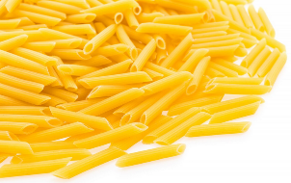
Grain foods
Breads
Breakfast cereal
Grains
Pasta
Other products
Mostly wholegrain and/or high cereal fibre varieties
Notes:
Grain foods comprise grains that can be cooked and eaten whole, ground into flour to make cereal foods, or made into breakfast cereals:
Breads: wholemeal, wholegrain, white, rye, pita, focaccia, crispbreads.
Breakfast cereals: high fibre (wholegrain) oats, porridge, muesli, wholewheat biscuits, ready to eat (such as cornflakes, cheerios).
Grains: rice, barley, corn, polenta, buckwheat, spelt, millet.
Pasta: short and long (white and wholemeal).
Other products: noodles, English muffin, crumpet, rice cakes, couscous, popcorn, flour.
The recommendation is for ‘mostly wholegrain and/or high cereal fibre varieties’ (at least two thirds). Wholegrain cereals contain more nutrients than refined cereal foods (e.g. white bread), because many of the important nutrients occur in the outer layer of the grain which is lost during processing.
Images: Designed by Pexels and Freepik
Based on material provided by the National Health and Medical Research Council (representing the Commonwealth of Australia)

Slide 3
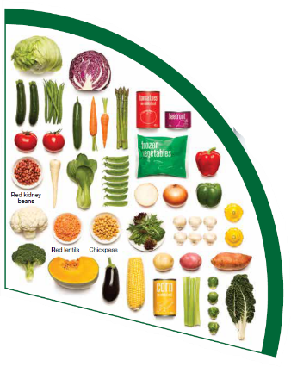
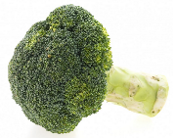
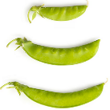
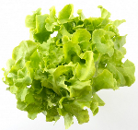

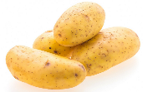
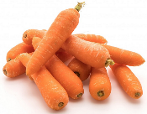
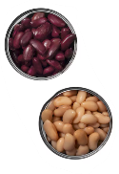
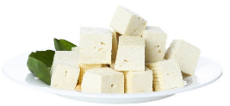
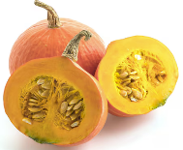
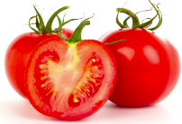
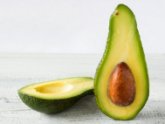
Vegetables
Dark green and cruciferous
Root/ tubular/ bulb
Legumes/beans
Other
Choose a variety, including different colours, each day
Notes:
Types of vegetables (also includes legumes and beans):
Dark green and cruciferous: broccoli, brussels sprouts, bok choy, cabbages, cauliflower, lettuce, spinach, snow peas.
Root/ tubular/ bulb: potato, sweet potato, carrots, beetroot, onion, shallots, garlic, swede, turnip.
Legumes/ beans: kidney beans, soybeans, lima beans, cannellini beans, chickpeas, lentils, split peas, tofu.
Other: tomato, celery, zucchini, avocado, capsicum, eggplant, mushrooms, cucumber, pumpkin, green peas, green beans.
Eat different colours of vegetables, as the different colour groups have different vitamins and minerals.
Vegetables such as tomatoes and pumpkins are technically classified as fruit because they have seeds. They are included in the vegetable group because they have similar nutritional properties as vegetables and are typically eaten as a vegetable.
Images: Designed by Freepik
Based on material provided by the National Health and Medical Research Council (representing the Commonwealth of Australia)

Slide 4
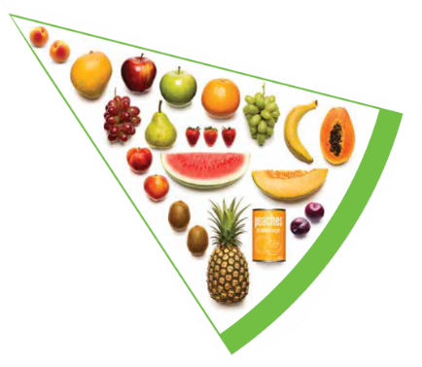
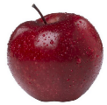

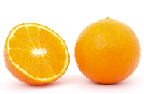

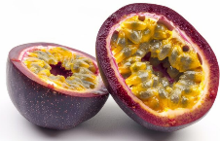

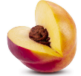



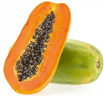
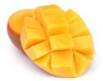
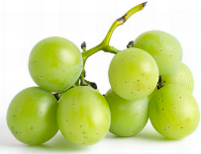

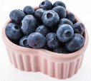
Fruit
Pomme
Citrus
Stone
Tropical
Berries
Choose dried fruit or fruit juice only occasionally
Notes:
Types of fruit:
Pome fruit: apple, pear.
Citrus fruit: orange, mandarin, grapefruit.
Stone fruit: apricot, cherry, peach, nectarine, plum.
Tropical: banana, paw paw, mangoes, pineapple and melon.
Berries: strawberry, blueberry, raspberry, blackberry.
Other: grapes, passionfruit.
Whole or chopped fruit is the best choice.
Fresh, frozen and canned fruits are all part of this food group. It is best to avoid fruits canned in syrup and choose varieties canned in natural juice or water instead.
Choose dried fruit or fruit juice only occasionally:
Eating dried fruit regularly is not recommended as it is high in kilojoules, can stick to the teeth and increases the risk of dental decay. You can also easily eat more than you realise.
Fruit juice is acidic and can increase the risk of dental decay. Fruit juice also has less fibre and other nutrients than whole fruit.
Different fruits can help protect our bodies in different ways, so it’s important to choose a variety, including different colours, each day.
Differences between fruit and vegetables
Fruits and vegetables are from different parts of a plant. Fruits come from the flowering part of a plant and contain seeds. Vegetables are the edible parts of a plant, such as the leaves, stem, roots, and bulbs.
Fruits that are eaten like vegetables: pumpkin, cucumber, tomato (and therefore part of the vegetable group).
Images: Designed by Pexels, Freepik and ChatGPT
Based on material provided by the National Health and Medical Research Council (representing the Commonwealth of Australia)

Slide 5
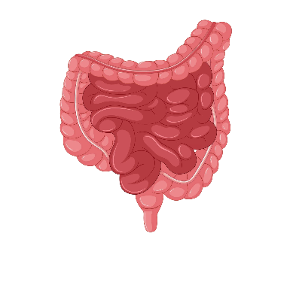





Why grain foods, vegetables and fruit are important
Provide the best source of energy (slow-release energy): fuels our brain (for concentration) and our body
Provide fibre: to help keep our intestines healthy
Provide lots of vitamins and minerals to help our bodies grow and age
Notes:
The complex carbohydrates in these foods are slowly digested, which provides energy over time and helps prevent overeating.
Carbohydrate provides the best source of energy for the brain.
Fibre helps us stay fuller for longer, which can help with concentration.
Fibre is especially useful in keeping the digestive track (including the intestines) healthy and can assist with constipation.
The vast range of vitamins and minerals are important for growth and repair, healthy ageing, and preventing chronic conditions.
Images: Designed by Pexels and Freepik

Slide 6
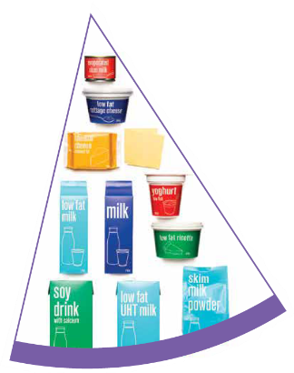
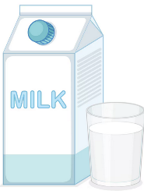
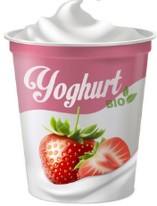
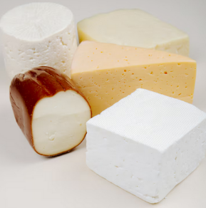
Dairy and alternatives
Milk (fresh and long life)
Yoghurt
Cheese
Reduced fat varieties are the best choice for most
Notes:
Types of foods:
Milks: All reduced fat or full cream milks, plain and flavoured, long life milks, powdered milk, evaporated milk, soy beverages (fortified with at least 100mg calcium/100mL).
Yoghurt: All yoghurts including reduced fat or full cream, plain and flavoured, soy yoghurt (calcium fortified).
Cheese: All hard cheeses, reduced or full fat, for example cheddar, red Leicester, Gloucester, Edam, Gouda Soy cheeses (calcium fortified).
Dairy = products made from milk.
Dairy alternatives:
Calcium-fortified dairy alternatives include soy, rice, almond or oat milk and soy or lactose free yoghurts and cheeses.
Non-dairy alternatives do not naturally contain calcium. It is important to select products labelled as calcium-fortified.
Many of the alternative milks, with the exception of soy milk products, may not be a good source of protein and other key nutrients found in milk and products made from milk.
For vegetarians and vegans, dairy alternative products such as soy milk and cheese are a key source of nutrients, particularly protein and calcium (if calcium is added by the manufacturer), and need to be included regularly to ensure their diet is nutritionally balanced.
Images: Designed by Freepik
Based on material provided by the National Health and Medical Research Council (representing the Commonwealth of Australia)

Slide 7

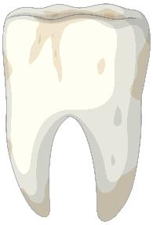
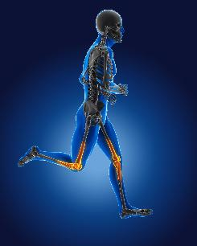
Why dairy and alternative foods are important
Provide calcium: for strong bones and teeth
Provide protein: helps our body grow and become strong
Provide lots of vitamins and minerals to help our bodies grow and age
Notes:
Calcium helps ensure strong bones and teeth.
Proteins are made up of chemical 'building blocks' called amino acids. Your body uses amino acids to build and repair muscles and bones.
Iodine is needed to make essential thyroid hormones. These are used by the body for growth and energy use, as well as brain and bone development in the early years.
Vitamin B12 is essential for the production of red blood cells, which are needed to carry oxygen from the lungs to the body’s tissues and organs.
Images: Designed by Pexels and Freepik

Slide 8
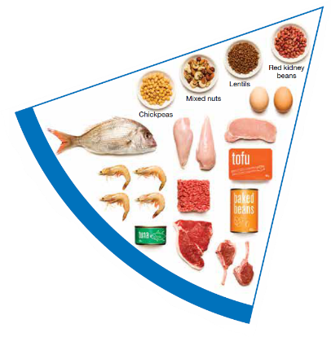


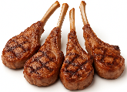

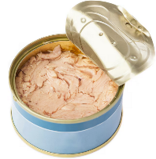
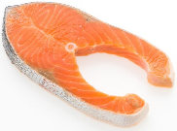

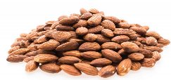
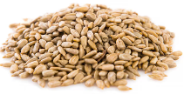
Meat and alternatives
Pink and red meat
Poultry
Fish and seafood
Eggs
Nuts and seeds
Legumes/beans
Choose meat without visible fat
Notes:
Types of foods:
Lean meats: beef, lamb, pork, kangaroo, lean and low salt sausages.
Poultry: chicken, turkey, duck, emu, goose.
Fish and seafood: fish, prawns, crab, lobster, mussels, oysters, scallops, clams.
Eggs: chicken eggs, duck eggs.
Nuts and seeds: almonds, pine nuts, walnut, macadamia, hazelnut, cashew, peanut, nut spreads, brazil nuts, seeds.
Legumes/beans: all beans, lentils, chickpeas, split peas, tofu.
To ensure adequate iron and zinc, about half the serves from this food group should be lean meats. For those who do not eat animal foods, nuts, seeds, legumes (including tofu) can provide some iron and zinc, plus a good mix of plant-based protein.
Choose lean meat options and/or remove the visible fat from the meat prior to cooking to reduce the total amount of saturated fat consumed.
Fresh, frozen and canned varieties of meat, poultry or fish are included in this group. It is important that canned varieties are low in fat and low in salt (no added salt) and canned in water rather than in oil or brine.
Sausages, commercial burgers and meat pastries can be high in saturated fat and are classified as a ‘sometimes’ food. It is recommended the consumption of these foods be limited. If purchasing sausages, it is best to select lean or reduced fat versions and boil or fry in a non-stick pan or BBQ.
Processed meats, such as salami and bacon are high in salt and saturated fats are classified as a ‘sometimes’ food. Consumption should be limited.
Meat alternatives (plant foods):
Nuts and seeds.
Legumes/beans appear in this group as well as the vegetable group.
For vegetarians and vegans, these foods are a key source of nutrients, particularly protein and iron, and need to be included regularly to ensure their diet is nutritionally balanced.
Images: Designed by Freepik and ChatGPT
Based on material provided by the National Health and Medical Research Council (representing the Commonwealth of Australia)

Slide 9

Why meat and alternative foods are important
Provide zinc and iron: keeps our blood healthy and gives us energy
Provide protein: helps our body grow and become strong
Provide essential fatty acids to keep our brains and heart healthy
Notes:
Proteins are made up of chemical 'building blocks' called amino acids. Your body uses amino acids to build and repair muscles and bones.
Iron is particularly important for transporting oxygen in the blood. This is essential for providing energy for daily life. Iron also helps our immune system fight infection.
Zinc is important for growth and for the immune system to fight infection.
Images: Designed by Freepik

Slide 10






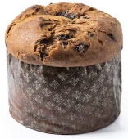
‘Sometimes’ foods
Higher in added sugars
Higher in fat (and sodium)
Higher in both
To be consumed sometimes and in small amounts
Notes:
Some foods and drinks do not fit into the five food groups. These foods are high in saturated fat and/or added sugars, added salt or alcohol and low in fibre. These foods and drinks can also be high in kilojoules (energy).
Types of foods:
Higher added sugars: Soft drinks, energy drinks, sugar confectionary, jams, some sauces.
Higher fat: Most processed meats (bacon, ham, sausages, frankfurts), crisps, butter, cream, pastry products, meat pies, sausage rolls, potato chips, commercial pizza.
Higher added sugars AND higher fat: Biscuits, cakes, chocolate, doughnuts, ice cream, iced buns, some muesli bars, muffins, sweet pastries.
Alcoholic drinks.
‘Sometimes’ foods in a healthy diet:
Some people require extra serves of food, for example, those who are taller and more active. These can sometimes include extra serves of ‘sometimes’ foods. It is best if these extra serves come from the five food groups, particularly wholegrain cereals, vegetables including legumes/beans and fruit. However, they can also sometimes include serves of ‘sometimes’ foods (discretionary foods).
These foods can, however, contribute to a feeling of enjoyment. They should be consumed sometimes, and in small amounts, such as once a week.
Images: Designed by Freepik
Based on material provided by the National Health and Medical Research Council (representing the Commonwealth of Australia)

