Slide 1
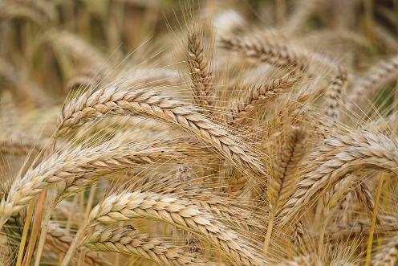
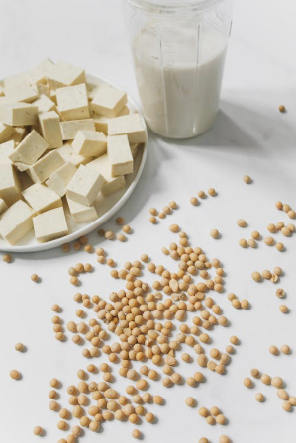
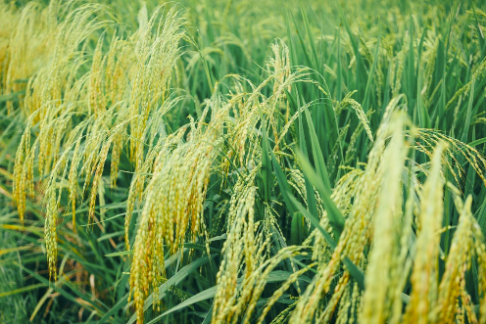
Developing food for the environment and healthy eating
Food and nutrition unit
Year 8
Notes:
Images: Designed by Pexels

Slide 2
Contents
Lesson 1 | Lesson 5
Lesson 2 | Lesson 6
Lesson 3 | Lesson 7, 8 and 9
Lesson 4

Slide 3
Lesson 1

Slide 4
In this unit we will be:
investigating the role of food production in Australia
reviewing environmental issues related to food production
reviewing the Australian Guide to Healthy Eating
investigating consumer needs related to food
investigating new foods and products
researching and presenting information on a
food product, through a technology,
environment and nutrition lens.

Slide 5
Learning intention: To investigate the role of food production in Australia.
Success criteria:
identify 10 pieces of data/information related to agriculture in Australia.

Slide 6
Role of food production in Australia
Economic
Nutrition
Food security
Notes:
There are various functions related to the food production industry in Australia:
- economic
- nutrition
- food security

Slide 7
Food production: economy
There are 3 components that make up the food industry:
Primary (agriculture and fishing)
Secondary (manufacturing and processing) (the largest manufacturing industry in Australia)
Tertiary (retail)
Notes:
An important distinction between the primary and secondary food industries is the degree of transformation.
For example, cattle feedlot operations come under primary production, whereas the slaughter and freezing of carcasses are part of the secondary food industry, as is fruit and vegetable canning.
Grape growing is classed as primary production whereas preserving and wine production are part of the secondary food industry.
Most food is processed to some extent. There are, however, differing levels of food processing, from minimally processed (such as rolled oats), to more substantial processing (such as Weet-Bix).
Source:
- Australia’s food and nutrition, 2012, https://www.aihw.gov.au/reports/food-nutrition/australias-food-nutrition-2012/summary
- DAFF: https://www.agriculture.gov.au/agriculture-land/farm-food-drought/food

Slide 8
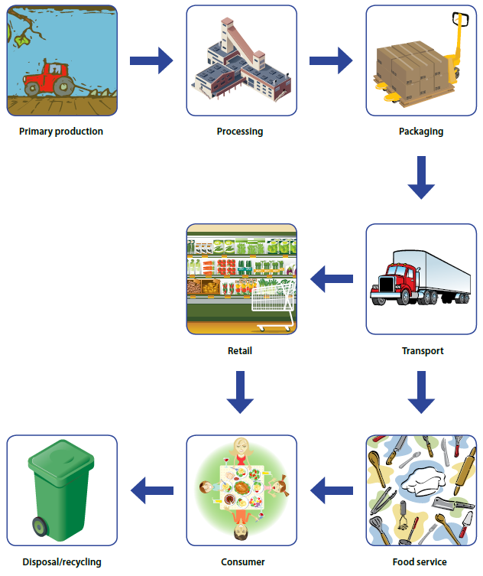
Australia’s food supply chain
Source: Australia’s food and nutrition, Australian Institute of Health and Welfare (2012)
Notes:
A simplified version of Australia’s food system is presented here.
Source: Australia’s food and nutrition, 2012, https://www.aihw.gov.au/reports/food-nutrition/australias-food-nutrition-2012/summary

Slide 9
Food production: economy
The food industry is an important part of Australia’s economy.
Around 70% of agricultural production is exported (growing our economy).
Many Australians are employed in the different areas of the food industry.
Notes:
Source:
- Australia’s food and nutrition, 2012, https://www.aihw.gov.au/reports/food-nutrition/australias-food-nutrition-2012/summary
- https://www.agriculture.gov.au/agriculture-land/farm-food-drought/food
- https://daff.ent.sirsidynix.net.au/client/en_AU/search/asset/1036762/0
Data on the workforce is available at:
Farms: https://www.agriculture.gov.au/abares/products/insights/snapshot-of-australian-agriculture#employment-on-australian-farms-is-significant-and-varies-throughout-the-year
Manufacturing (processing): https://afgc.org.au/resources/state-of-the-industry/

Slide 10
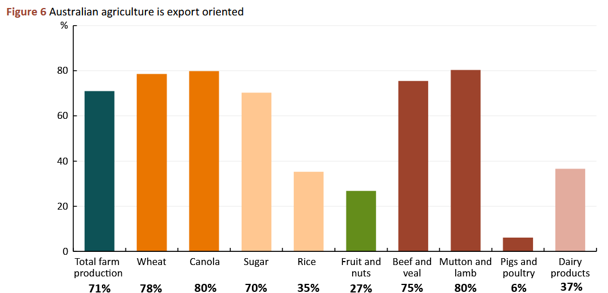
Food production: economy
Source: Snapshot of Australian Agriculture 2025, ABARES (2025)
Notes:
In the three years to 2023–24 Australia exported around 70% of the total volume of agricultural, fisheries and forestry production.
The export orientation of each industry can vary by commodity type.
Source: https://www.agriculture.gov.au/abares/products/insights/snapshot-of-australian-agriculture#around-70-of-agricultural-production-is-exported

Slide 11
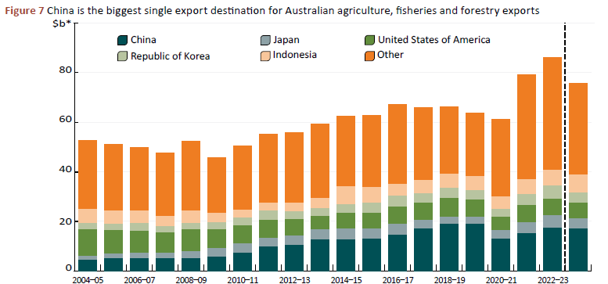
Food production: economy
Source: Snapshot of Australian Agriculture 2025, ABARES (2025)
Notes:
China is the biggest single export destination for Australian agriculture, fisheries and forestry exports.
Source: https://www.agriculture.gov.au/abares/products/insights/snapshot-of-australian-agriculture#around-70-of-agricultural-production-is-exported

Slide 12
Food security
Australia has a reputation as a modern, safe, and sustainable producer of food.
Most food in Australia is grown and supplied by Australian farmers.
More than 90% of fresh fruit and vegetables, meat, milk and eggs are grown in Australia.
Notes:
Source: https://www.agriculture.gov.au/agriculture-land/farm-food-drought/food

Slide 13
Food security
While Australia produces sufficient food for the population…..
There is not equal distribution of this food, due to factors such as poverty, remoteness, ability to prepare meals, social isolation.
This is known as ‘food insecurity’.
Notes:
Source: Australia’s food and nutrition, 2012, https://www.aihw.gov.au/reports/food-nutrition/australias-food-nutrition-2012/summary

Slide 14
Food security
Certain groups experience food insecurity at a higher rather than the general population:
  Indigenous people
  unemployed people
  single parent households
  low-income earners
  young people.
Notes:
Source: https://aifs.gov.au/resources/practice-guides/food-insecurity-australia-what-it-who-experiences-it-and-how-can-child

Slide 15
Nutrition
We rely on the availability of nutritious and affordable food to assist with healthy eating.
This could come from food produced in Australia or imported food.

Slide 16
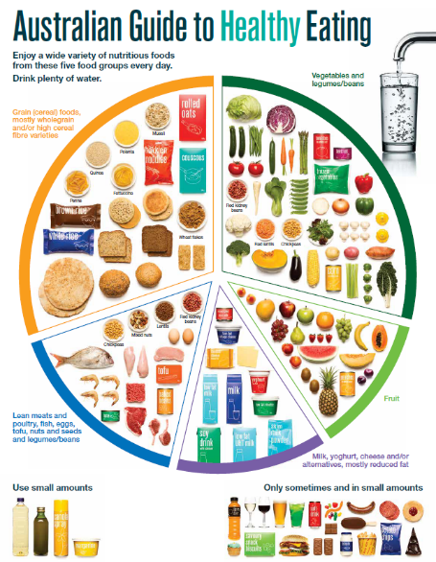
Nutrition
The Australian Guide to Healthy Eating helps guide our food choices.
Notes:
The Australian Guide to Healthy Eating (AGHE) is a visual representation of the Australian Dietary Guidelines.
It is a broad guide to the types and amounts of foods we should eat each day.
The food groups:
Grain foods
Vegetables
Fruit
Dairy and alternatives
Meat and alternatives
Sitting off to the side are foods categorised as ‘sometimes’ foods. These foods are high in saturated fat and/or added sugars, added salt or alcohol and low in fibre. These foods and drinks can also be high in kilojoules (energy).

Slide 17
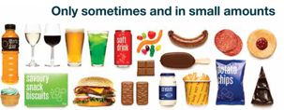
Nutrition
We are, however, currently eating too much ‘sometimes’ foods:
Age group (years) | Males (%) | Females (%)
2–4 | 28 | 26
5–11 | 37 | 38
12–17 | 34 | 36
18–29 | 32 | 29
30–49 | 29 | 31
50–64 | 32 | 30
65–74 | 32 | 29
75 and over | 33 | 31
A third of energy intake
Notes:
For adolescents aged 12-17, these foods make up around one third energy intake. While these foods can contribute to a feeling of enjoyment, this level is currently too high.
To note: This level slightly decreased from the previous survey in 2011-12, with sometimes foods contributing around 40% of energy intake for children and adolescents.
Source: 2023 National Nutrition and Physical Activity Survey
Image: Based on material provided by the National Health and Medical Research Council (representing the Commonwealth of Australia)

Slide 18
Activity 1: Booklet task
Using Snapshot of Australian Agriculture 2025, ABARES (2025) (or most recent year), identify:
10 key pieces of data/ information that you found most interesting in relation to agriculture in Australia (from across the report).
Notes:
Students can share their findings with the class.
NOTE: Teacher to check whether an updated version of this report is available prior to the lesson e.g. 2026 year.

Slide 19
Lesson 2

Slide 20
Review

Slide 21
What are the 3 components that make up the food industry?
Primary – agriculture and fishing
Tertiary – retail
Secondary – manufacturing and processing

Slide 22
What proportion of Australia’s agriculture, fisheries and forestry production is exported?
Source: Snapshot of Australian Agriculture 2025, ABARES (2025)
Notes:
In the three years to 2023–24 Australia exported around 70% of the total volume of agricultural, fisheries and forestry production.
The export orientation of each industry can vary by commodity type.
Source: https://www.agriculture.gov.au/abares/products/insights/snapshot-of-australian-agriculture#around-70-of-agricultural-production-is-exported

Slide 23
What tool can Australians use to guide our food choices?

Slide 24
Learning intention: To understand the impact of the environment on food production.
Success criteria:
identify 3 key pieces of information on each of:
changes in seasonal conditions
impact on farmers
how farmers are adapting.

Slide 25
Food production can have a negative impact on the environment
Impacts caused using fossil fuels in:
  manufacture of agricultural inputs e.g. herbicides, stock feed
  transport
  processing in factories.
Notes:
Source: https://www.nma.gov.au/explore/features/urban-farming/australias-food-production

Slide 26
Food production can have a negative impact on the environment
Other impacts during the farming process:
  pollutants through growing/ rearing
  soil erosion
  increases in salinity.
Notes:
Australian agriculture accounts for:
- 55% of Australian land use (measured December 2023)
- 74% of water consumption (measured for 2021–2022).
But it also accounts for:
- 10.8% of goods and services exported (measured for 2023–24)
- 5.9% of rural employment (215,600 people in 2023–24).
Source:
https://www.nma.gov.a.u/explore/features/urban-farming/australias-food-production
https://daff.ent.sirsidynix.net.au/client/en_AU/search/asset/1036762/0

Slide 27
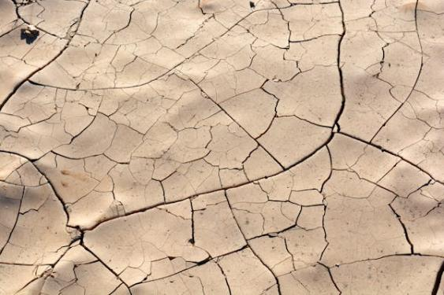

The changing climate also has a negative impact on food production
Increased rainfall variability and extreme weather events impact the sustainability of food production.
Notes:
Farmers needs to adapt their practices to adjust to the changing environment.
Images: Designed by Pexels

Slide 28
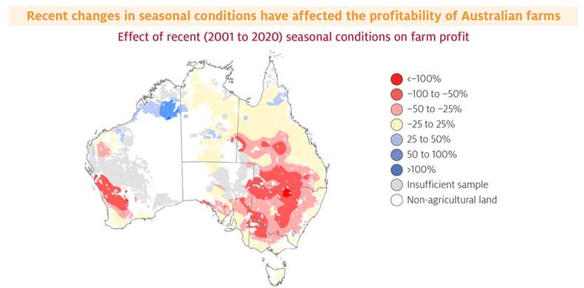
Effect of changing weather
Source: Climate change impacts and adaptation on Australian farms, ABARES (2021)
Notes:
In recent decades, Australia has seen a shift towards higher temperatures and lower winter rainfall, which has had effects on many farmers.
However, despite these trends, the long-run effects of climate change on farm businesses is still uncertain.
Source: https://www.agriculture.gov.au/abares/products/insights/climate-change-impacts-and-adaptation

Slide 29
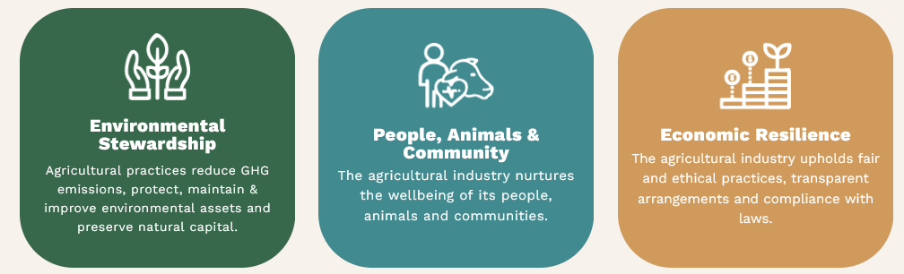
Industry action: Australian Agriculture Sustainability Framework (AASF)
Notes:
The Australian Agricultural Sustainability Framework (AASF) is a joint initiative led by the National Farmers’ Federation and supported by the Australian Government.
The AASF was developed in response to increasing pressures on the agricultural sector to demonstrate sustainability performance, both domestically and internationally.
Global shifts towards environmental, social, and governance (ESG) standards put pressure on Australian agriculture to demonstrate its sustainability performance.
Source: https://aasf.org.au/

Slide 30
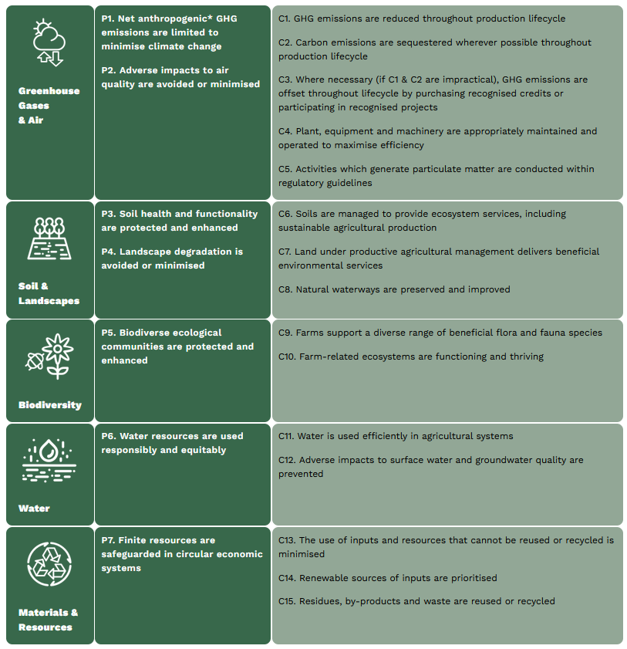
Environmental Stewardship
Notes:
With a focus on the Environmental Stewardship components, ensuring environmental sustainability in agriculture involves:
reducing greenhouse gas emissions throughout the production lifecycle
preserving on-farm natural capital, protecting
maintaining and improving our soil, land and water assets
using finite resources responsibly
promoting recycling where possible.
The AASF embraces the theme of environmental stewardship through five Principles. These Principles aim to demonstrate sustainable agricultural practices, covering greenhouse gas emissions and air, soil and landscapes, biodiversity, water, and materials and resources.
Source: https://aasf.org.au/environmental-stewardship/

Slide 31
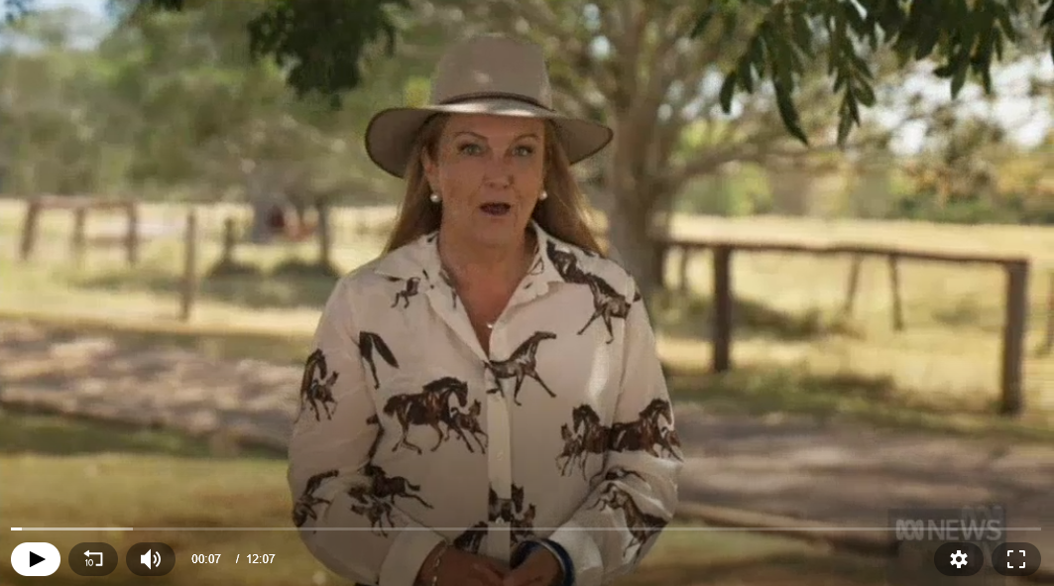
Farming and the environment: changing practices
Notes:
[12.07]
Watch with students, which looks at the practices that farmers can implement to use resources more efficiently.
This is not a YouTube clip. It needs to play from the ABC News website.

Slide 32
Activity 1: Booklet task
Identify 3 key pieces of information on each of:
changes in seasonal conditions in Australia
impact on farmers due to these changes
how farmers are adapting.
Notes:
Students to use the resources:
Climate change impacts and adaptation on Australian farms: https://www.agriculture.gov.au/abares/products/insights/climate-change-impacts-and-adaptation#adaptation-will-help-offset-future-climate-impacts
State of the climate 2024: http://www.bom.gov.au/state-of-the-climate/
Conversation article: https://theconversation.com/farms-are-adapting-well-to-climate-change-but-theres-work-ahead-164860
Teacher note: Check to see whether more recent reports are available.

Slide 33
Lesson 3

Slide 34
Review

Slide 35
How can farmers adapt to produce foods given the changes in seasonal conditions in Australia?
Notes:
Responses vary based on the student research from the previous lesson.

Slide 36
Learning intention: To map out food choices based on the Australian Guide to Healthy Eating.
Success criteria:
recommended serves
food choices
serve size

Slide 37

The Australian Guide to Healthy Eating
Notes:
The Australian Guide to Healthy Eating (AGHE) is a visual representation of the Australian Dietary Guidelines.
It is a broad guide to the types and amounts of foods we should eat each day.
The food groups:
Grain foods
Vegetables
Fruit
Dairy and alternatives
Meat and alternatives
Sitting off to the side are foods categorised as ‘sometimes’ foods. These foods are high in saturated fat and/or added sugars, added salt or alcohol and low in fibre. These foods and drinks can also be high in kilojoules (energy).

Slide 38

Overview of the AGHE
Notes:
[2.27]
While this video is directed at teachers, it provides a good overview of the five food groups, represented in the Australian Guide to healthy Eating.

Slide 39
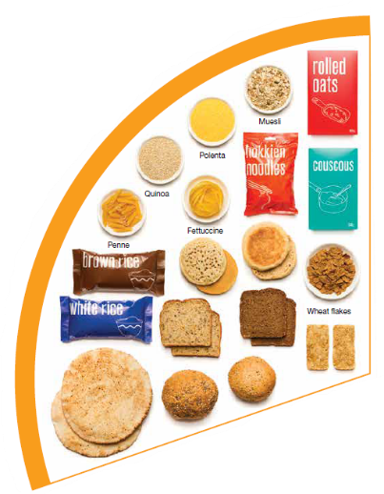
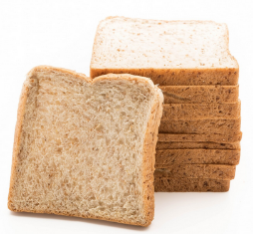
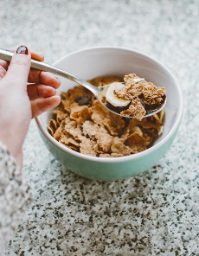
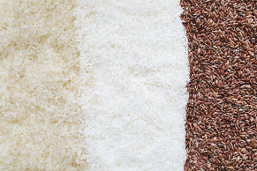

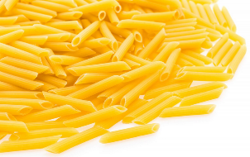
Grain foods
Breads
Breakfast cereal
Grains
Pasta
Other products
Mostly wholegrain and/or high cereal fibre varieties
Notes:
Grain foods comprise grains that can be cooked and eaten whole, ground into flour to make cereal foods, or made into breakfast cereals:
Breads: wholemeal, wholegrain, white, rye, pita, focaccia, crispbreads.
Breakfast cereals: high fibre (wholegrain) oats, porridge, muesli, wholewheat biscuits, ready to eat (such as cornflakes, cheerios).
Grains: rice, barley, corn, polenta, buckwheat, spelt, millet.
Pasta: short and long (white and wholemeal).
Other products: noodles, English muffin, crumpet, rice cakes, couscous, popcorn, flour.
The recommendation is for ‘mostly wholegrain and/or high cereal fibre varieties’ (at least two thirds). Wholegrain cereals contain more nutrients than refined cereal foods (e.g. white bread), because many of the important nutrients occur in the outer layer of the grain which is lost during processing.
Images: Designed by Pexels and Freepik
Based on material provided by the National Health and Medical Research Council (representing the Commonwealth of Australia)

Slide 40
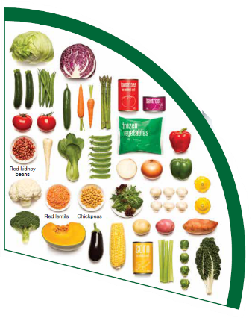
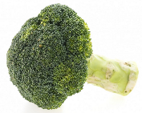
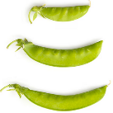
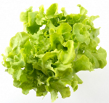

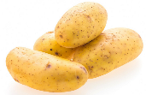
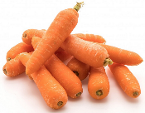
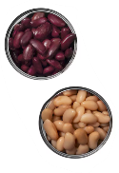

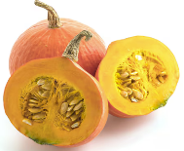
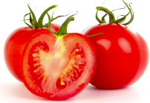
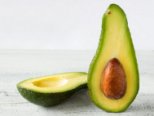
Vegetables
Dark green and cruciferous
Root/ tubular/ bulb
Legumes/beans
Other
Choose a variety, including different colours, each day
Notes:
Types of vegetables (also includes legumes and beans):
Dark green and cruciferous: broccoli, brussels sprouts, bok choy, cabbages, cauliflower, lettuce, spinach, snow peas.
Root/ tubular/ bulb: potato, sweet potato, carrots, beetroot, onion, shallots, garlic, swede, turnip.
Legumes/ beans: kidney beans, soybeans, lima beans, cannellini beans, chickpeas, lentils, split peas, tofu.
Other: tomato, celery, zucchini, avocado, capsicum, eggplant, mushrooms, cucumber, pumpkin, green peas, green beans.
Eat different colours of vegetables, as the different colour groups have different vitamins and minerals.
Vegetables such as tomatoes and pumpkins are technically classified as fruit because they have seeds. They are included in the vegetable group because they have similar nutritional properties as vegetables and are typically eaten as a vegetable.
Images: Designed by Freepik
Based on material provided by the National Health and Medical Research Council (representing the Commonwealth of Australia)

Slide 41
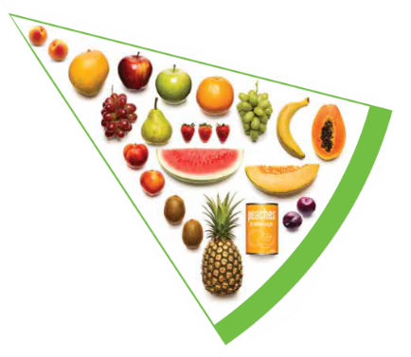


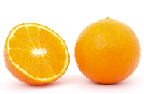

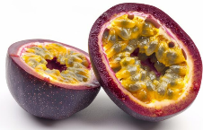





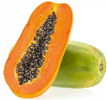
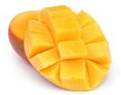
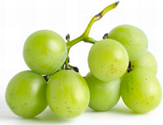


Fruit
Pomme
Citrus
Stone
Tropical
Berries
Choose dried fruit or fruit juice only occasionally
Notes:
Types of fruit:
Pome fruit: apple, pear.
Citrus fruit: orange, mandarin, grapefruit.
Stone fruit: apricot, cherry, peach, nectarine, plum.
Tropical: banana, paw paw, mangoes, pineapple and melon.
Berries: strawberry, blueberry, raspberry, blackberry.
Other: grapes, passionfruit.
Whole or chopped fruit is the best choice.
Fresh, frozen and canned fruits are all part of this food group. It is best to avoid fruits canned in syrup and choose varieties canned in natural juice or water instead.
Choose dried fruit or fruit juice only occasionally:
Eating dried fruit regularly is not recommended as it is high in kilojoules, can stick to the teeth and increases the risk of dental decay. You can also easily eat more than you realise.
Fruit juice is acidic and can increase the risk of dental decay. Fruit juice also has less fibre and other nutrients than whole fruit.
Different fruits can help protect our bodies in different ways, so it’s important to choose a variety, including different colours, each day.
Differences between fruit and vegetables
Fruits and vegetables are from different parts of a plant. Fruits come from the flowering part of a plant and contain seeds. Vegetables are the edible parts of a plant, such as the leaves, stem, roots, and bulbs.
Fruits that are eaten like vegetables: pumpkin, cucumber, tomato (and therefore part of the vegetable group).
Images: Designed by Pexels, Freepik and ChatGPT
Based on material provided by the National Health and Medical Research Council (representing the Commonwealth of Australia)

Slide 42
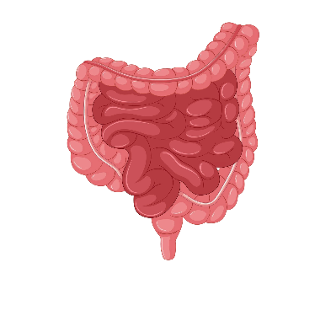





Why grain foods, vegetables and fruit are important
Provide the best source of energy (slow-release energy): fuels our brain (for concentration) and our body
Provide fibre: to help keep our intestines healthy
Provide lots of vitamins and minerals to help our bodies grow and age
Notes:
The complex carbohydrates in these foods are slowly digested, which provides energy over time and helps prevent overeating.
Carbohydrate provides the best source of energy for the brain.
Fibre helps us stay fuller for longer, which can help with concentration.
Fibre is especially useful in keeping the digestive track (including the intestines) healthy and can assist with constipation.
The vast range of vitamins and minerals are important for growth and repair, healthy ageing, and preventing chronic conditions.
Images: Designed by Pexels and Freepik

Slide 43
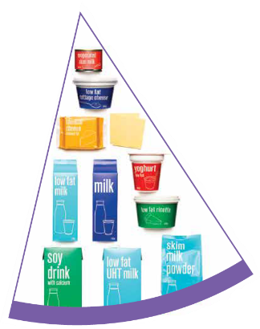
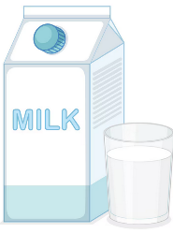
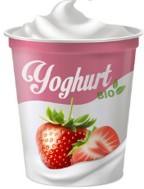
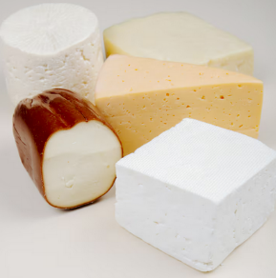
Dairy and alternatives
Milk (fresh and long life)
Yoghurt
Cheese
Reduced fat varieties are the best choice for most
Notes:
Types of foods:
Milks: All reduced fat or full cream milks, plain and flavoured, long life milks, powdered milk, evaporated milk, soy beverages (fortified with at least 100mg calcium/100mL).
Yoghurt: All yoghurts including reduced fat or full cream, plain and flavoured, soy yoghurt (calcium fortified).
Cheese: All hard cheeses, reduced or full fat, for example cheddar, red Leicester, Gloucester, Edam, Gouda Soy cheeses (calcium fortified).
Dairy = products made from milk.
Dairy alternatives:
Calcium-fortified dairy alternatives include soy, rice, almond or oat milk and soy or lactose free yoghurts and cheeses.
Non-dairy alternatives do not naturally contain calcium. It is important to select products labelled as calcium-fortified.
Many of the alternative milks, with the exception of soy milk products, may not be a good source of protein and other key nutrients found in milk and products made from milk.
For vegetarians and vegans, dairy alternative products such as soy milk and cheese are a key source of nutrients, particularly protein and calcium (if calcium is added by the manufacturer), and need to be included regularly to ensure their diet is nutritionally balanced.
Images: Designed by Freepik
Based on material provided by the National Health and Medical Research Council (representing the Commonwealth of Australia)

Slide 44

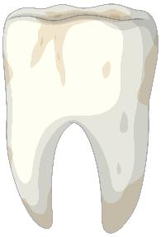

Why dairy and alternative foods are important
Provide calcium: for strong bones and teeth
Provide protein: helps our body grow and become strong
Provide lots of vitamins and minerals to help our bodies grow and age
Notes:
Calcium helps ensure strong bones and teeth.
Proteins are made up of chemical 'building blocks' called amino acids. Your body uses amino acids to build and repair muscles and bones.
Iodine is needed to make essential thyroid hormones. These are used by the body for growth and energy use, as well as brain and bone development in the early years.
Vitamin B12 is essential for the production of red blood cells, which are needed to carry oxygen from the lungs to the body’s tissues and organs.
Images: Designed by Pexels and Freepik

Slide 45
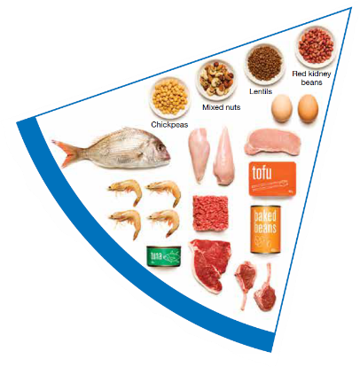


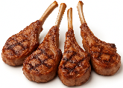
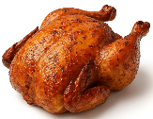
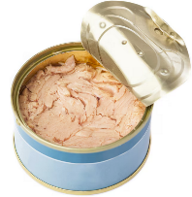
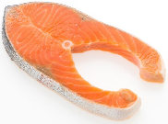

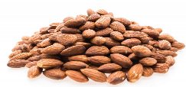
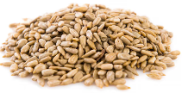
Meat and alternatives
Pink and red meat
Poultry
Fish and seafood
Eggs
Nuts and seeds
Legumes/beans
Choose meat without visible fat
Notes:
Types of foods:
Lean meats: beef, lamb, pork, kangaroo, lean and low salt sausages.
Poultry: chicken, turkey, duck, emu, goose.
Fish and seafood: fish, prawns, crab, lobster, mussels, oysters, scallops, clams.
Eggs: chicken eggs, duck eggs.
Nuts and seeds: almonds, pine nuts, walnut, macadamia, hazelnut, cashew, peanut, nut spreads, brazil nuts, seeds.
Legumes/beans: all beans, lentils, chickpeas, split peas, tofu.
To ensure adequate iron and zinc, about half the serves from this food group should be lean meats. For those who do not eat animal foods, nuts, seeds, legumes (including tofu) can provide some iron and zinc, plus a good mix of plant-based protein.
Choose lean meat options and/or remove the visible fat from the meat prior to cooking to reduce the total amount of saturated fat consumed.
Fresh, frozen and canned varieties of meat, poultry or fish are included in this group. It is important that canned varieties are low in fat and low in salt (no added salt) and canned in water rather than in oil or brine.
Sausages, commercial burgers and meat pastries can be high in saturated fat and are classified as a ‘sometimes’ food. It is recommended the consumption of these foods be limited. If purchasing sausages, it is best to select lean or reduced fat versions and boil or fry in a non-stick pan or BBQ.
Processed meats, such as salami and bacon are high in salt and saturated fats are classified as a ‘sometimes’ food. Consumption should be limited.
Meat alternatives (plant foods):
Nuts and seeds.
Legumes/beans appear in this group as well as the vegetable group.
For vegetarians and vegans, these foods are a key source of nutrients, particularly protein and iron, and need to be included regularly to ensure their diet is nutritionally balanced.
Images: Designed by Freepik and ChatGPT
Based on material provided by the National Health and Medical Research Council (representing the Commonwealth of Australia)

Slide 46

Why meat and alternative foods are important
Provide zinc and iron: keeps our blood healthy and gives us energy
Provide protein: helps our body grow and become strong
Provide essential fatty acids to keep our brains and heart healthy
Notes:
Proteins are made up of chemical 'building blocks' called amino acids. Your body uses amino acids to build and repair muscles and bones.
Iron is particularly important for transporting oxygen in the blood. This is essential for providing energy for daily life. Iron also helps our immune system fight infection.
Zinc is important for growth and for the immune system to fight infection.
Images: Designed by Freepik

Slide 47






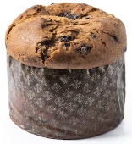
‘Sometimes' foods
Higher in added sugars
Higher in fat (and sodium)
Higher in both
To be consumed sometimes and in small amounts
Notes:
Some foods and drinks do not fit into the five food groups. These foods are high in saturated fat and/or added sugars, added salt or alcohol and low in fibre. These foods and drinks can also be high in kilojoules (energy).
Types of foods:
Higher added sugars: Soft drinks, energy drinks, sugar confectionary, jams, some sauces.
Higher fat: Most processed meats (bacon, ham, sausages, frankfurts), crisps, butter, cream, pastry products, meat pies, sausage rolls, potato chips, commercial pizza.
Higher added sugars AND higher fat: Biscuits, cakes, chocolate, doughnuts, ice cream, iced buns, some muesli bars, muffins, sweet pastries.
Alcoholic drinks.
‘Sometimes’ foods in a healthy diet:
Some people require extra serves of food, for example, those who are taller and more active. These can sometimes include extra serves of ‘sometimes’ foods. It is best if these extra serves come from the five food groups, particularly wholegrain cereals, vegetables including legumes/beans and fruit. However, they can also sometimes include serves of ‘sometimes’ foods (discretionary foods).
These foods can, however, contribute to a feeling of enjoyment. They should be consumed sometimes, and in small amounts, such as once a week.
Images: Designed by Freepik
Based on material provided by the National Health and Medical Research Council (representing the Commonwealth of Australia)

Slide 48
How much should you be eating?
There is a recommended amount of each food group that should be eaten each day.
These amounts are different depending on your age, and sometimes your gender.

Slide 49
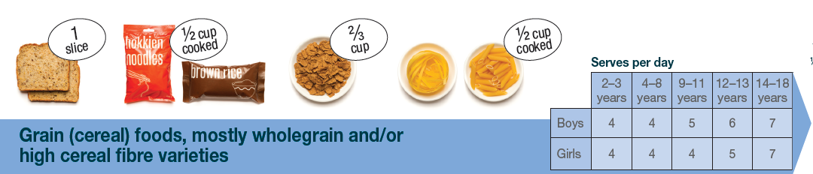
Grain food serves
Notes:
Focus on the age of the students in the class (12–13 and 14–18 years)
Based on material provided by the National Health and Medical Research Council (representing the Commonwealth of Australia)

Slide 50
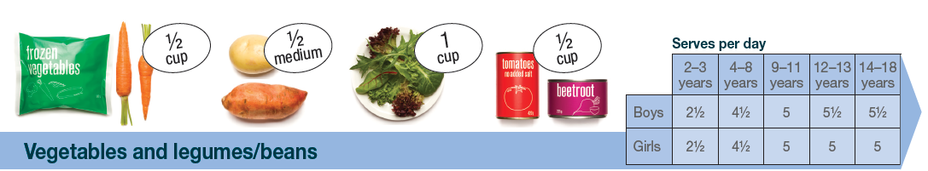
Vegetable serves
Notes:
Focus on the age of the students in the class (12–13 and 14–18 years)
Based on material provided by the National Health and Medical Research Council (representing the Commonwealth of Australia)

Slide 51

Fruit serves
Notes:
Focus on the age of the students in the class (12–13 and 14–18 years)
Based on material provided by the National Health and Medical Research Council (representing the Commonwealth of Australia)

Slide 52

Dairy and alternative serves
Notes:
Focus on the age of the students in the class (12–13 and 14–18 years)
Based on material provided by the National Health and Medical Research Council (representing the Commonwealth of Australia)

Slide 53

Meat and alternative serves
Notes:
Focus on the age of the students in the class (12–13 and 14–18 years)
Based on material provided by the National Health and Medical Research Council (representing the Commonwealth of Australia)

Slide 54

Food group serves
Notes:
This slide brings together the serves for children aged 12-13 and 14–18 years.
Why are the serve amounts different across the food groups?
Responses could include:
- Different types of nutrients (vitamins and minerals) provided
- Different amounts of energy (sugars) in the foods e.g. more sugar in fruit than in vegetables
Images: Designed by Pexels, Freepik and ChatGPT
Based on material provided by the National Health and Medical Research Council (representing the Commonwealth of Australia)

Slide 55
Activity 1: Booklet task
For each of the food groups, identify:
number of serves you need
your preferred foods
serve size for chosen foods.
Notes:
Teacher note: The idea here is not for a definitive meal plan, rather for students to get a better sense of the quantity of each food group that they need, and the serve size. Students are encouraged to consider the range of foods in the food groups and the foods they would choose.

Slide 56
Lesson 4

Slide 57
Review

Slide 58
Why are grain foods, vegetables and fruit important?
How many reasons can you think of?

Slide 59
Answer: Why are grain foods, vegetables and fruit important?
Provide the best source of energy (slow-release energy): fuels our brain (for concentration) and our body
Provide fibre: to help keep our intestines healthy
Provide lots of vitamins and minerals to help our bodies grow and age
Notes:
The complex carbohydrates in these foods are slowly digested, which provides energy over time and helps prevent overeating.
Carbohydrate provides the best source of energy for the brain.
Fibre helps us stay fuller for longer, which can help with concentration.
Fibre is especially useful in keeping the digestive track (including the intestines) healthy and can assist with constipation.
The vast range of vitamins and minerals are important for growth and repair, healthy ageing, and preventing chronic conditions.
Images: Designed by Pexels and Freepik

Slide 60
Why are dairy and alternative foods important?
How many reasons can you think of?

Slide 61
Answer: Why are dairy and alternative foods important?
Provide calcium: for strong bones and teeth
Provide protein: helps our body grow and become strong
Provide lots of vitamins and minerals to help our bodies grow and age
Notes:
Calcium helps ensure strong bones and teeth.
Proteins are made up of chemical 'building blocks' called amino acids. Your body uses amino acids to build and repair muscles and bones.
Iodine is needed to make essential thyroid hormones. These are used by the body for growth and energy use, as well as brain and bone development in the early years.
Vitamin B12 is essential for the production of red blood cells, which are needed to carry oxygen from the lungs to the body’s tissues and organs.
Images: Designed by Pexels and Freepik

Slide 62
Why are meat and alternative foods important?
How many reasons can you think of?

Slide 63
Answer: Why are meat and alternative foods important?
Provide zinc and iron: keeps our blood healthy and gives us energy
Provide protein: helps our body grow and become strong
Provide essential fatty acids to keep our brains and heart healthy
Notes:
Proteins are made up of chemical 'building blocks' called amino acids. Your body uses amino acids to build and repair muscles and bones.
Iron is particularly important for transporting oxygen in the blood. This is essential for providing energy for daily life. Iron also helps our immune system fight infection.
Zinc is important for growth and for the immune system to fight infection.
Images: Designed by Freepik

Slide 64
Learning intention: To identify consumer needs and preferences in relation to foods, and the foods that meet these needs.
Success criteria:
factors that influence your food choices
foods that help meet these needs.

Slide 65
What consumers want
Our food choices are influenced by factors such as:
  personal needs (e.g. convenience, nutrition)
  tastes
  values
  knowledge
  skills.
Notes:
Source: Nutrition, the inside story (2020)

Slide 66
Food processing and technologies play a big role in meeting consumer demands for food.
Notes:
Source: Nutrition, the inside story (2020)

Slide 67
Food processing
The process in which raw foodstuffs are made suitable for consumption.
Can include one or a combination of processes, including washing, chopping, cooking, freezing.
Most foods are processed in some way before they reach you, the consumer.
Notes:
Source: Australia’s food and nutrition (2012); Nutrition, the inside story (2020)

Slide 68
Food processing
Consumers expect a food supply that is safe, nutritious, convenient and varied.
Food processing allows this.
There are, however, different levels of processing: washing potatoes to put into bags is different to a chocolate product.
Notes:
Almost all foods undergo some form of processing before they are ready to eat.
Source: Nutrition, the inside story (2020)

Slide 69
Food processing
The term ‘processed food’ is often associated with ‘sometimes’ or ‘junk’ food.
BUT, while ‘sometimes’ food is typically highly processed, not all processed food is a ‘sometimes’ food.
We need to be aware of the differences.
Notes:
Source: Nutrition, the inside story (2020)

Slide 70
Food processing
Why process foods?
Notes:
Elicit student responses.
Reasons are provided on the subsequent slides.

Slide 71
To make food edible
Some foods are not edible in their natural state e.g. grain crops such as wheat and corn.
Wheat can be ground into flour to make bread.
Notes:
Source: Nutrition, the inside story (2020)

Slide 72
To make food safe
Many foods contain potentially harmful microorganisms.
These can make us sick and cause the food to spoil.
Processes that can slow or stop growth:
Heating to a high temperature
Adding preservatives
Chilling or freezing
Altering the pH (acidity)
Removing water
Using air-tight packaging
Notes:
Source: Nutrition, the inside story (2020)

Slide 73
To extend the shelf life of food
Achieved through chilling, freezing, heating, removal of water, and pH control.
This enhances convenience (and safety).
This can mean less frequent shopping.
Also enables less food waste.
Notes:
Source: Nutrition, the inside story (2020)

Slide 74
To increase range and convenience
An extensive range of foods is made from the 5 staple crops: wheat, rice, maize (corn), oats and potatoes.
These are available year-round, not just when the crops are in season.
Packaging technologies also provide a range of convenient foods.
Notes:
Source: Nutrition, the inside story (2020)

Slide 75
To reduce the cost of food
Sometimes, food processing can reduce the cost of food.
The food processor can purchase ingredients in bulk, which reduces the end price.
Examples: canned and frozen
vegetables.
Notes:
Source: Nutrition, the inside story (2020)

Slide 76
To reduce health inequalities
In some remote areas, fresh food is sometimes not available or expensive.
Foods that are canned or packaged can provide cost-effective, nutritious options.
Notes:
Source: Nutrition, the inside story (2020)

Slide 77
REMINDER
The term ‘processed food’ is often associated with ‘sometimes’ or ‘junk’ food.
BUT, while ‘sometimes’ food is typically highly processed, not all processed food is a ‘sometimes’ food.
We need to be aware of the differences.
Notes:
Keeping our mind on the AGHE and reading food labels is important to help us make decisions on foods to include in our diet (link to label reading guide).
Source: Nutrition, the inside story (2020)

Slide 78
Activity 1: Booklet task
What are the factors that influence the selection of foods in your family? Identify at least 3 factors.
What foods does your family purchase to help meet their needs?
Try to consider foods that help your family adhere to the
Notes:
For example, factors could include:
- Nutrition (core foods from the five food groups)
- Quick to prepare
- Cost (balance between quality, nutrition and price)
- Taste – considering the 5 different family members
Foods purchased:
- Plain meats that we can combine with in-season vegetables and prepared sauces
- Different pastas and rice
- Packaged wholegrain cereal for easy, nutritious breakfasts
- Wholegrain bread, for a nutritious breakfast option, and for sandwiches
- We have UHT milk in the cupboard for when we run out of fresh milk

Slide 79
Lesson 5

Slide 80
Review

Slide 81
What are some of the factors that influence food choices?
Skills
Convenience
Taste
Nutrition
Knowledge
Values e.g. vegetarian
Notes:
Suggested responses are provided

Slide 82
What are some of the reasons why we process food?
Make food edible
Make food safe
Extend the shelf life
Increase range/ variety
Reduce cost
Reduce health inequalities
Notes:
Suggested responses are provided

Slide 83
Learning intention: To investigate new food developments.
Success criteria:
nutritional benefits
environmental benefits
consumer benefits.

Slide 84
New foods are being produced, some through enhancements in technology, to help meet the needs of consumers and/or for environmental benefits.
Let’s look closely at 2 of these.

Slide 85

Lab grown meat (cell-cultured meat)
Notes:
Watch with students [4.27].
Note issues under the following headings:
Technologies/equipment:
- Vats (like a brewery)
- Very scientific process so need highly qualified and skilled professionals
Key consumer benefits:
- Nutrition.
- Question: is the nutritional profile the same as meat?
Environmental benefits:
- Helps eliminate potential issues with animal products such as greenhouse gas emissions, less land use BUT it does use a lot of overall energy to produce lab grown meat
- Potential to have 50% less emissions than the same amount of chicken
Production aspects:
- Cost and scale can be issues, as need special equipment
- Not same consistency and aroma as meat
- Investor interest is decreasing (capital investment is reduced)
Consumer concerns:
- Needs to be safe
- Weird factor
- Vegan – can they eat it? It is grown from animal cells, so likely no.
To note, as at July 2025, only cell-cultured quail is approved for sale in Australia

Slide 86

Edible insects
Notes:
Watch with students [6.16].
Highlight to the students that while a range of insects are discussed, at present the only insects that can be sold in Australia are:
Zophobas morio (super mealworm)
Achaeta domestica (house crickets)
Tenebrio molitor (mealworm beetle).
These can be in whole, ground or paste form.
This is regulated in the Australia New Zealand Food Standards Code, administered by Food Standards Australia New Zealand.
Note issues under the following headings:
Technologies/equipment:
- Can be farmed from the wild, or can look at commercial opportunities.
Key consumer benefits:
- Another source of protein (cricket flour is 68% protein)
- The flour form is gluten free so can be a flour alternative for coeliacs.
- Question: will it be cost effective?
Environmental benefits:
- Sustainable way of producing high quality protein, given the growing population.
- Require ‘a fraction’ of the land and water resources as traditional cattle and livestock
Production aspects:
- There are opportunities to explore the 60 native animal insects (noting that currently there is only approval to sell 3 of these).
- They can be wild harvested, but also grown in warehouses in the city (a benefit)
Consumer concerns:
- Weird factor

Slide 87
Activity 1: Booklet task
Create a poster that promotes either lab grown meat (cell-cultured meat), or edible insects as a new food source. Include the following aspects:
Nutritional benefits
Environmental benefits
Consumer benefits
Notes:
Teachers – feel free to change this up e.g. students could present FOR and AGAINST arguments

Slide 88
Lesson 6

Slide 89
Review

Slide 90
What are some environmental benefits of lab grown meat and edible insects?
Notes:
Responses vary based on the student research from the previous lesson.

Slide 91
What are some nutritional benefits of lab grown meat and edible insects?
Notes:
Responses vary based on the student research from the previous lesson.

Slide 92
What are some consumer benefits of lab grown meat and edible insects?
Notes:
Responses vary based on the student research from the previous lesson.

Slide 93
Learning intention: To identify resources to assist us to eat a healthy diet.
Success criteria:
3 key facts for foods in each of the five food groups.

Slide 94
We have looked at the Australian Guide to Healthy Eating.
What other resources are available to help us eat a healthy diet?
Notes:
Elicit student responses.

Slide 95
There is a lot of information available on food and nutrition.
Be careful to use a critical lens and ask yourself:
does it align with the Australian Guide to Healthy Eating?
is it not recommending something
extreme?
If the answer is NO, be wary of this information

Slide 96




Some great resources
Websites that end with .gov.au
foodstandards.gov.au
nhmrc.gov.au
health.gov.au
aihw.gov.au
Notes:
Information on Australian government websites can be relied upon to provide evidence-based information that aligns with the Australian Guide to Healthy Eating.

Slide 97


Some great resources
Nutrition organisations
nutritionaustralia.org
dietitiansaustralia.org.au
Notes:
Information produced by nutrition organisations such as Dietitians Australia and Nutrition Australia are by professionals who are university qualified and either Accredited Practicing Dietitians or Registered Nutritionists.

Slide 98





Some great resources
Industry bodies
www.dairy.com.au
veggycation.com.au
glnc.org.au
goodmeat.com.au
sanitarium.com.au
Notes:
While the information provided by industry will be focused on their specific foods, the information is usually developed by Registered Nutritionists or Accredited Practicing Dietitians, and will therefore be accurate.
Dairy Australia has some particularly great resources about dairy.
AUSVEG has some great information on the ‘veggycation’ website. Students can look at the nutritional benefits of specific vegetables.

Slide 99

Some great resources
Notes:
Take students through some of the features of veggycation, produced by Hort Innovation (through grower levies).

Slide 100
Activity 1: Booklet task
Explore the range of websites identified in this lesson.
Identify 3 key facts for foods in each of the five food groups.
These can be related to nutritional benefits and/or broader health information related to these foods.

Slide 101
Lesson 7, 8 and 9

Slide 102
Learning intention: To investigate the benefits of a food product on the environment and to enhance healthy eating.

Slide 103
Task
To develop an information text on a food product that aims to assist with addressing environmental issues and enhance healthy eating.

Slide 104


Slide 105


