Slide 1
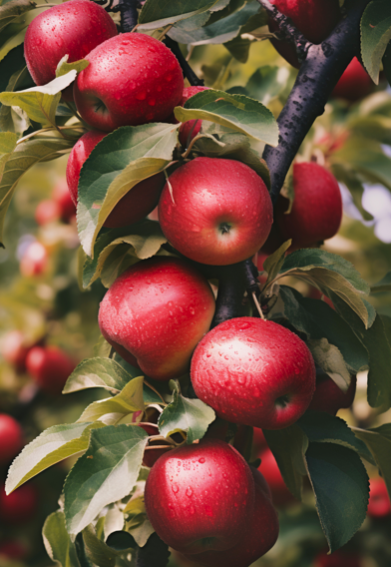
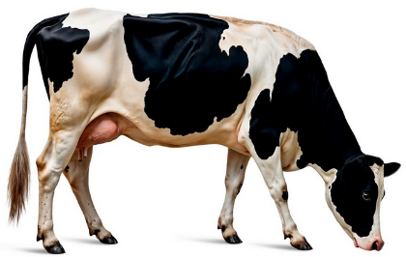
All food comes from either a plant or an animal
Notes:
Images: Designed by Freepik

Slide 2
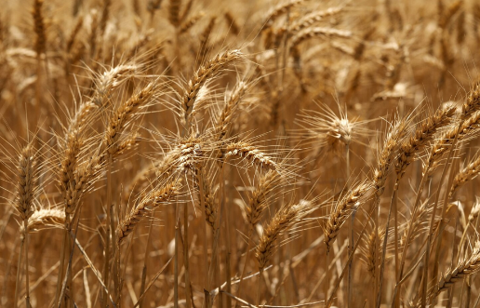
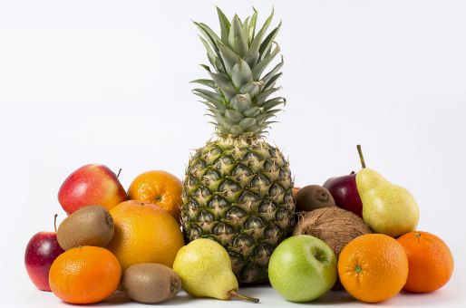
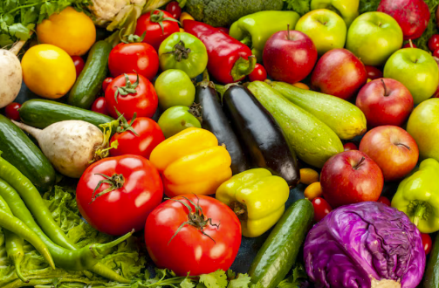
Food from plants
Wheat – used to make flour, bread and breakfast cereals
Fruit
Vegetables
Notes:
These are example foods.
Images: Designed by Freepik

Slide 3
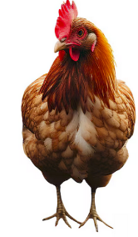
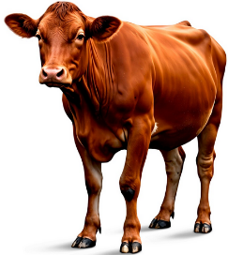
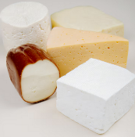
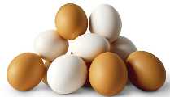
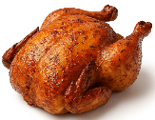

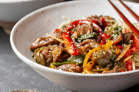

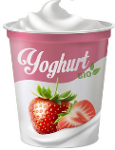
Food from animals
Dairy cow – produces milk for foods like milk, cheese, yoghurt
Chickens – for chicken meat, eggs
Beef cattle – for meat
Notes:
These are example foods.
Images: Designed by Freepik and ChatGPT

Slide 4
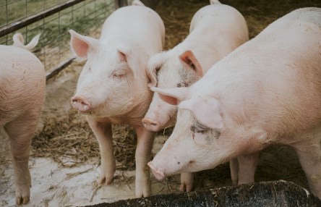
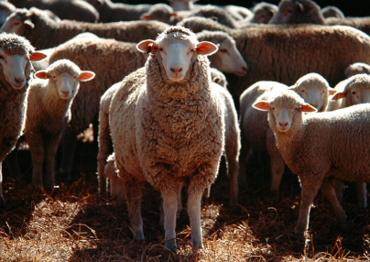
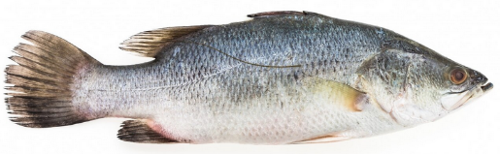
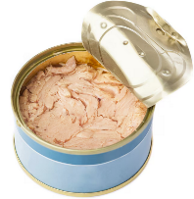
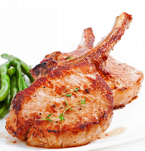
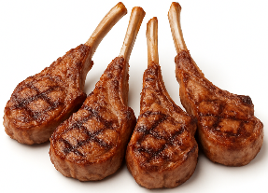
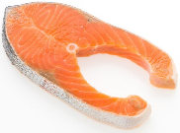
Food from animals
Fish – for fish fillets, crumbed fish, canned fish
Pig – for meat (pork)
Sheep – for meat and milk
Notes:
These are example foods.
Images: Designed by Freepik and ChatGPT

Slide 5

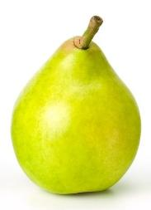
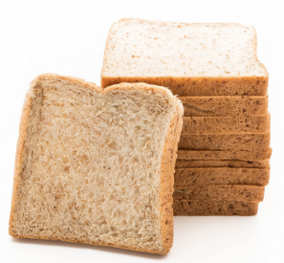
Are these from a plant or animal?
Animal (chickens)
Plant
Plant (mainly wheat)
Eggs
Pears
Bread
Notes:
Go through the examples with the students.
Images: Designed by Freepik and ChatGPT

Slide 6
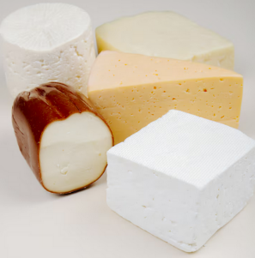
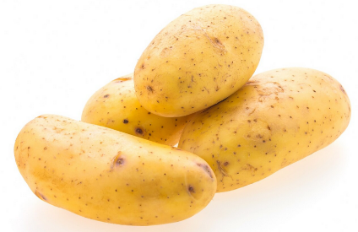
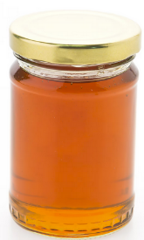
Are these from a plant or animal?
Animal (dairy cow)
Plant
Animal (made by bees)
Cheese
Potato
Honey
Notes:
Go through the examples with the students.
Images: Designed by Freepik

Slide 7
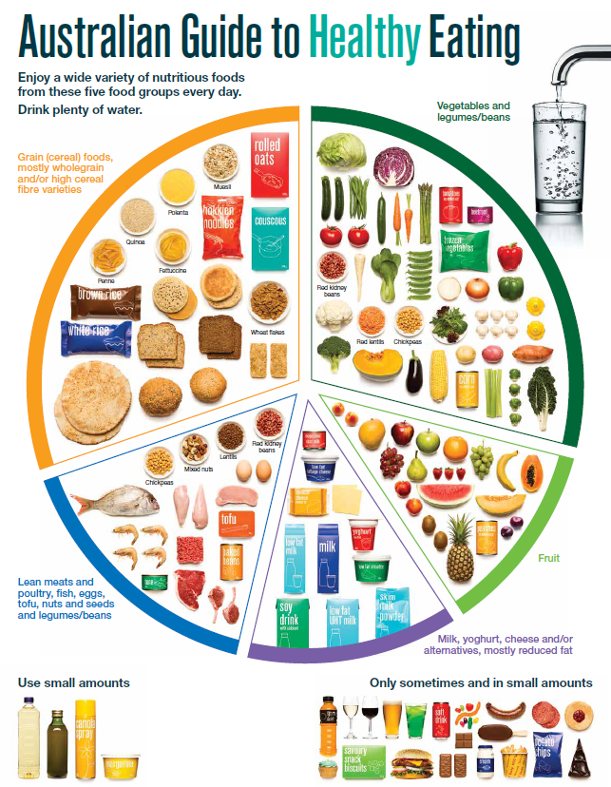
The Australian Guide to Healthy Eating
Let’s link this to the Australian Guide to Healthy Eating.
Notes:
Each of the foods in the food groups come from plants OR animals

Slide 8
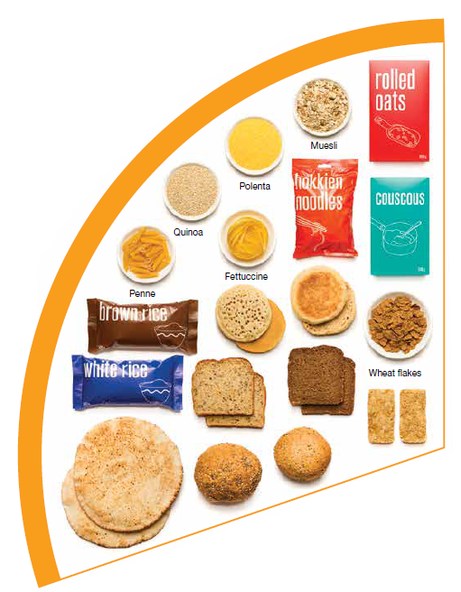
Grain foods come from plants

Slide 9
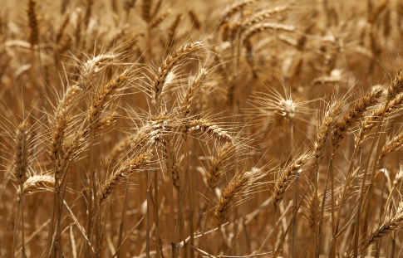
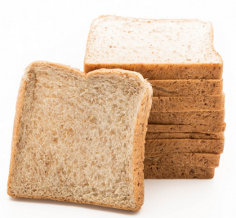
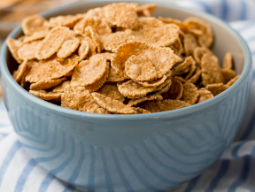
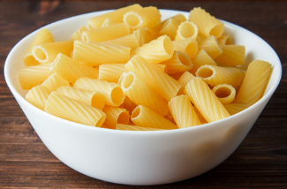
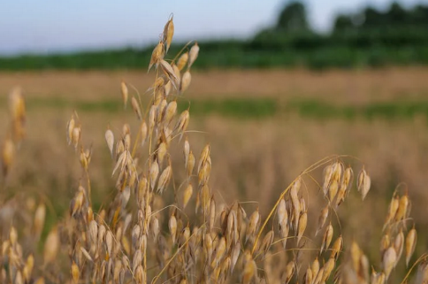
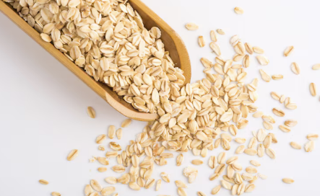
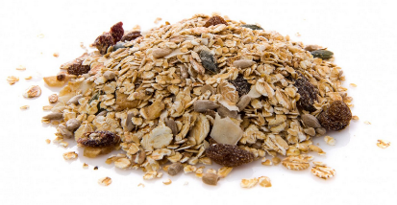
Grain foods
Wheat is used to make bread, breakfast cereal, pasta
Oats are used to make porridge and muesli
Notes:
Examples of how grains are used to produce foods in the food group.
Images: Designed by Freepik and Pexels

Slide 10
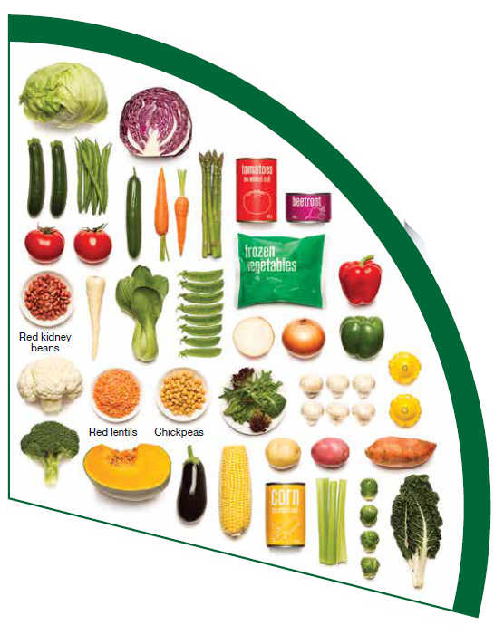
Vegetables come from plants

Slide 11
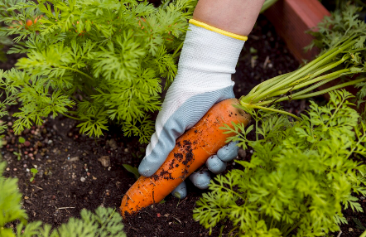
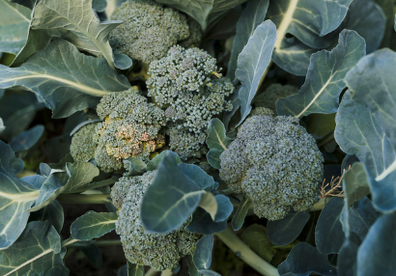
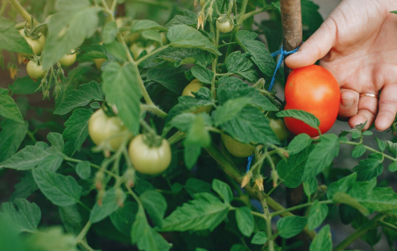
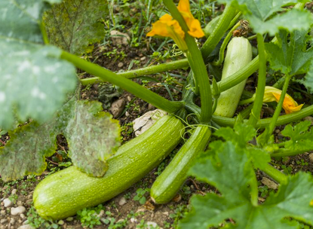
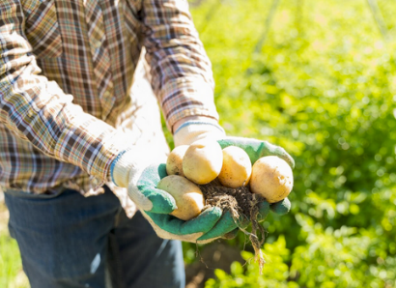
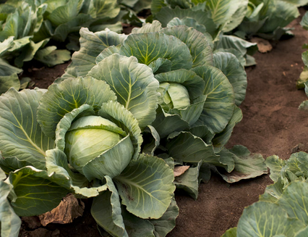
Vegetables
Notes:
Examples of vegetable plants.
Images: Designed by Freepik

Slide 12
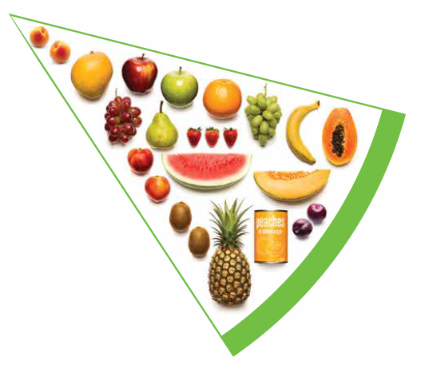
Fruit come from plants

Slide 13
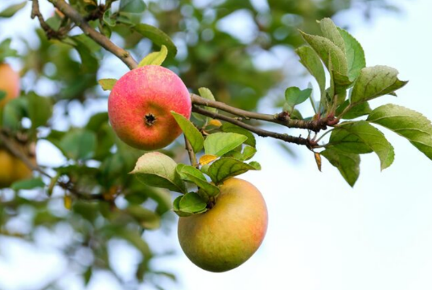
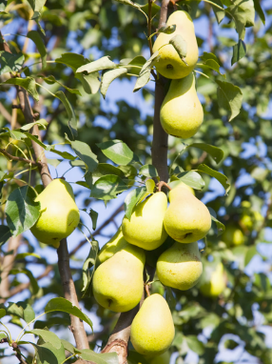
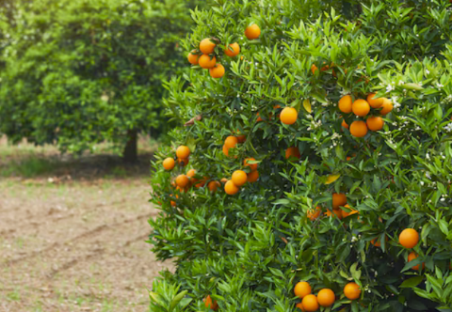
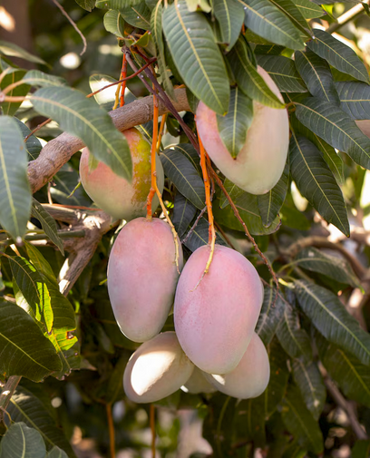
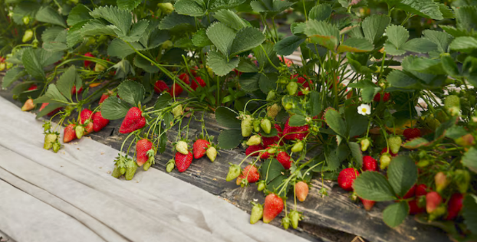
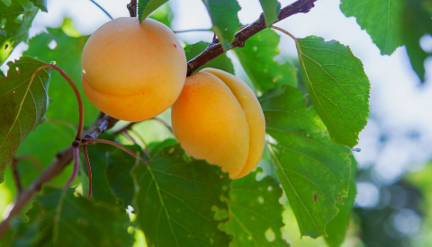
Fruit
Notes:
Examples of fruit trees and plants.
Images: Designed by Freepik

Slide 14
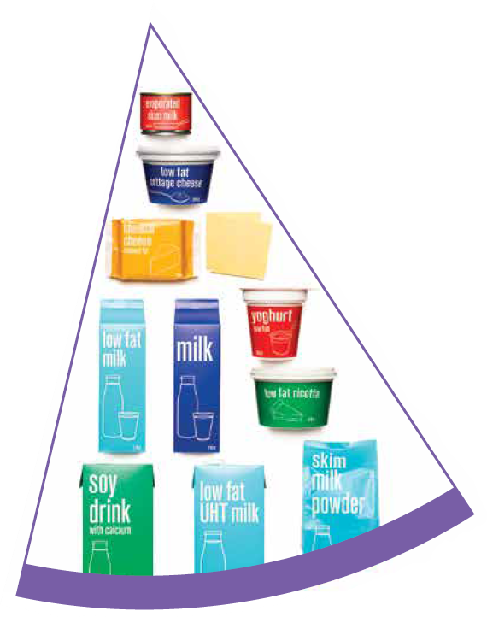
Dairy foods come from animals
Dairy alternatives (like soy milk) comes from plants

Slide 15
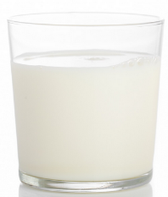

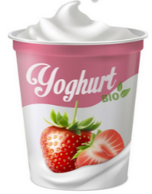




Dairy and alternative foods
Milk from cows is used to make drinking milk, cheese, yoghurt and custard
The juice from soybeans are used to make soy milk and soy yoghurt
Notes:
Images: Designed by Freepik

Slide 16

Meat foods come from animals
Meat alternatives (like tofu) come from plants

Slide 17






Meat and alternative foods
Beef cattle is used for beef (meat)
Chickens are used for chicken (meat) and eggs
Notes:
Images: Designed by Freepik and ChatGPT

