Slide 1
Food processing
All food that is reared (animals) or grown (like fruits and vegetables), are processed.
Some foods are processed more than others.
Different equipment is used when processing food.

Slide 2
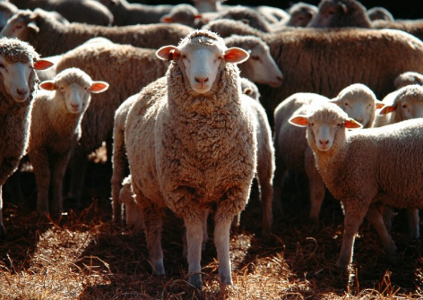
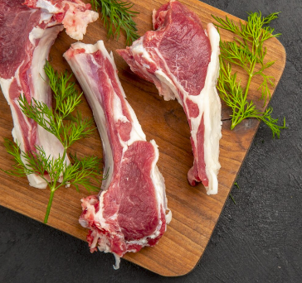
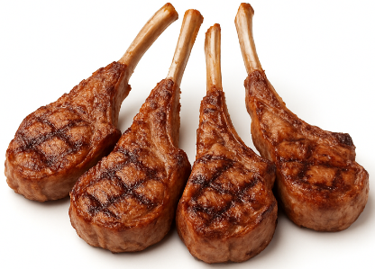
Grilled lamb
The lamb is reared on a farm
The lamb is processed to get different cuts of meat
We then cook this to eat as a meal
Notes:
Machines are used to transport sheep and cut up the meat ready for the supermarket.
Images: Designed by Freepik and ChatGPT

Slide 3
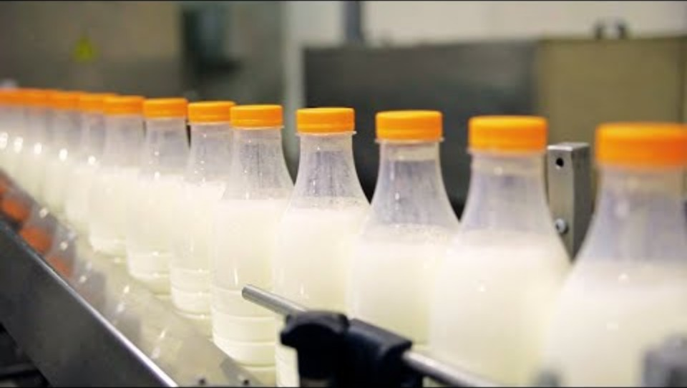
Milk from the farm to the supermarket
Notes:
[2.39]

Slide 4
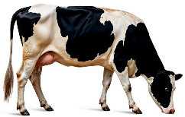
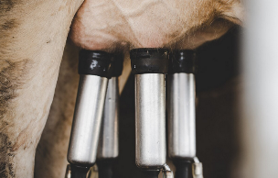
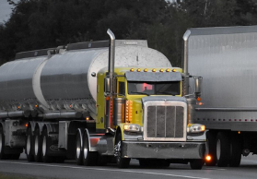
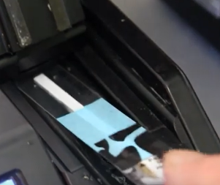
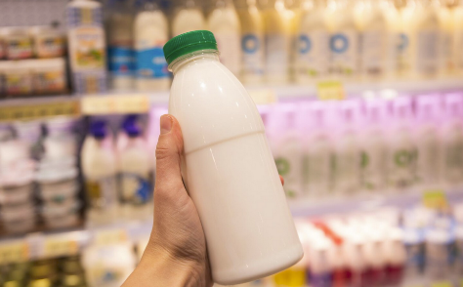
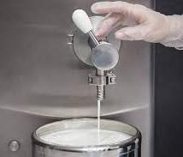
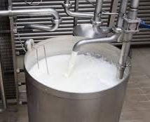
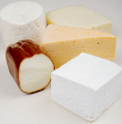
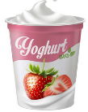
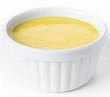
Bottled milk: farm to supermarket
1. The dairy cows are kept on a farm
2. The cows are milked on the farm
3. Tankers transport the milk to processing plant
4. The milk is tested
7. The milk is put in containers and transported
6. The milk is homogenised
5. The milk is pasteurised (heat treated)
8. Milk can also be used to make cheese, yoghurt and custard
Notes:
There are lots of steps that use different equipment to bring milk from the farm to the supermarket. This is a simplified flowchart of what was shown in the video.
Dairy cows are kept on a farm where they are given different food to help them produce milk.
The cows are milked by farmers in sheds on the farm.
The milk is pumped into a milk tank and transported to the nearest processing plant.
The testing process is to ensure there is no harmful bacteria and has the right level of nutrients.
The milk is pasteurised where it is heated at high temperatures to remove any harmful bacteria.
The milk is homogenised, which evenly distribute the fat globules (otherwise the fat would sit on top of the milk).
The milk is put into containers and transported to the shops for us to buy.
It can also be made into other products, like cheese, yoghurt and custard.
Images: Some images designed by Freepik

Slide 5
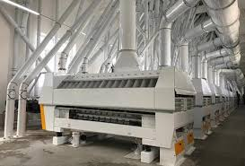
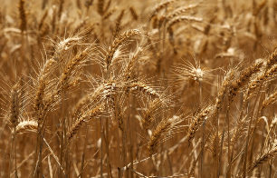
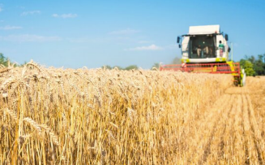
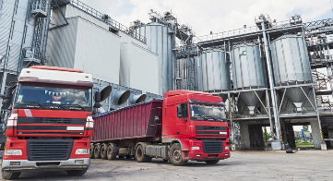
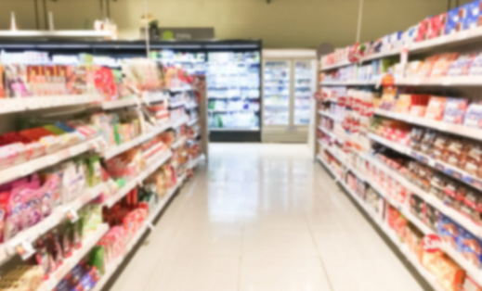
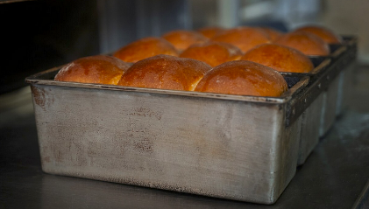
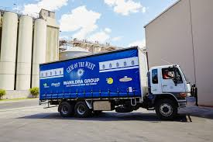
Bread: farm to supermarket
1. Wheat grown on a farm
2. The wheat is harvested with equipment
3. The wheat is transported to a flour mill
4. The wheat is milled into flour
7. The bread is transported
6. The flour is mixed with other ingredients to make bread
5. The flour is transported to a bakery
Notes:
There are lots of steps that use different equipment to bring wheat from the farm, to make bread, to then appear at the shops.
Images: Some images designed by Freepik

