Slide 1
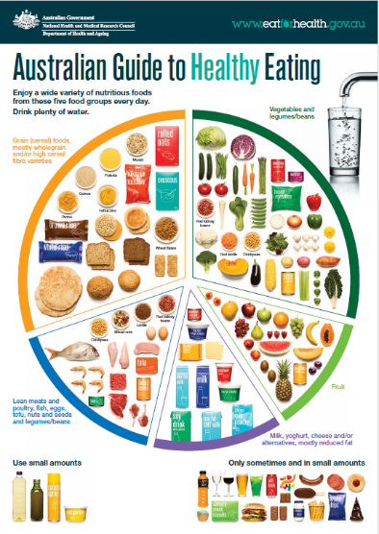
About the five food groups
Food and nutrition unit
Foundation

Slide 2
Contents
Lesson 1 | Lesson 6
Lesson 2 | Lesson 7
Lesson 3 | Lesson 8
Lesson 4 | Lesson 9
Lesson 5

Slide 3
Lesson 1

Slide 4
Learning intention: To show what you know about healthy eating.
Success criteria:
draw pictures
write words you know.

Slide 5

Tuning in with Bluey
Notes:
Tuning in phase to introduce the unit. This Bluey clip [3.08] is not necessarily about healthy eating, but it focuses on fun and family in relation to food.
After the video, explain that in this unit, the class will be focusing on foods that are healthy for our body (good for our body) and how we can have fun with food.

Slide 6
Activity 1: Booklet task
What do you know about healthy eating?
Draw pictures
Write words you know
What foods do you think of as being good for your body?
Can you think of any groups of food that are good for your body?

Slide 7
Lesson 2

Slide 8
Learning intention: To learn about grain foods.
Success criteria:
identify grain foods
identify why grain foods are important.

Slide 9
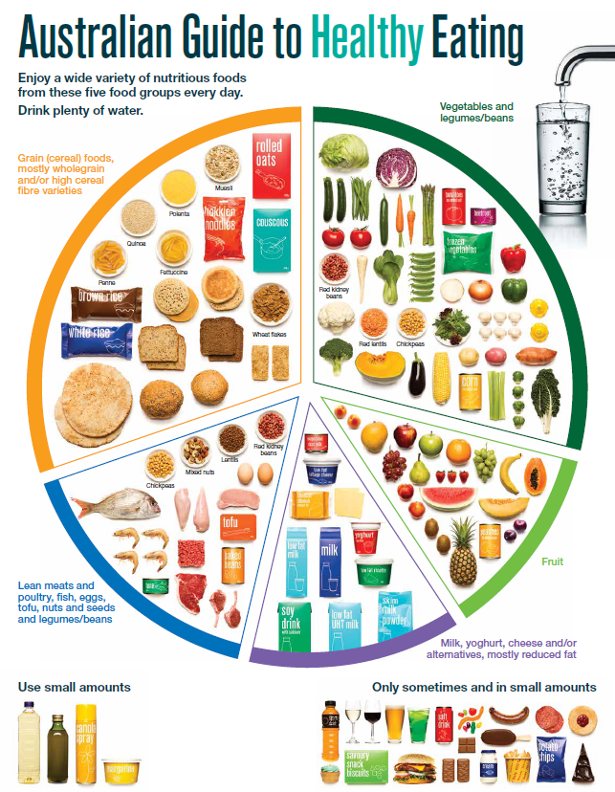
The Australian Guide to Healthy Eating
Notes:
The Australian Guide to Healthy Eating (AGHE) is a visual representation of the Australian Dietary Guidelines.
It is a broad guide to the types and amounts of foods we should eat each day.
The food groups:
Grain foods
Vegetables
Fruit
Dairy and alternatives
Meat and alternatives
Sitting off to the side are foods categorised as ‘sometimes’ foods. These foods are high in saturated fat and/or added sugars, added salt or alcohol and low in fibre. These foods and drinks can also be high in kilojoules (energy).
Explain that over the next few lessons in this food and nutrition unit students will be focusing on each of the five food groups.

Slide 10
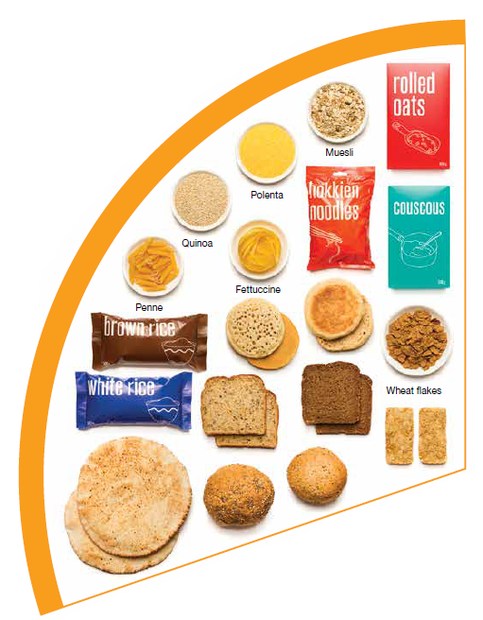
Grain foods
What do you know about grain foods?
Notes:
Elicit responses from students.
Image: Based on material provided by the National Health and Medical Research Council (representing the Commonwealth of Australia)

Slide 11

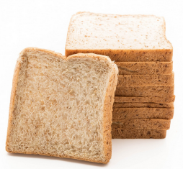
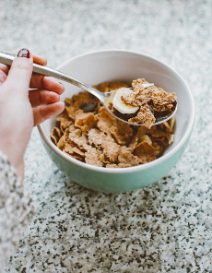
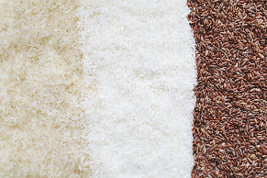

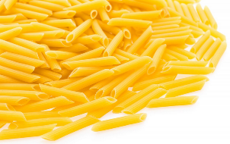
Grain foods
Breads
Breakfast cereal
Grains
Pasta
Other products
Mostly wholegrain and/or high cereal fibre varieties
Notes:
Grain foods comprise grains that can be cooked and eaten whole, ground into flour to make cereal foods, or made into breakfast cereals:
Breads: wholemeal, wholegrain, white, rye, pita, focaccia, crispbreads.
Breakfast cereals: high fibre (wholegrain) oats, porridge, muesli, wholewheat biscuits, ready to eat (such as cornflakes, cheerios).
Grains: rice, barley, corn, polenta, buckwheat, spelt, millet.
Pasta: short and long (white and wholemeal).
Other products: noodles, English muffin, crumpet, rice cakes, couscous, popcorn, flour.
The recommendation is for ‘mostly wholegrain and/or high cereal fibre varieties’ (at least two thirds). Wholegrain cereals contain more nutrients than refined cereal foods (e.g. white bread), because many of the important nutrients occur in the outer layer of the grain which is lost during processing.
Images: Designed by Pexels and Freepik
Based on material provided by the National Health and Medical Research Council (representing the Commonwealth of Australia)

Slide 12
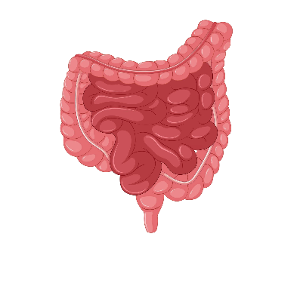





Why grain foods are important
Provide the best source of energy (slow-release energy): fuels our brain (for concentration) and our body
Provide fibre: to help keep our intestines healthy
Provide lots of vitamins and minerals to help our bodies grow and age
Notes:
The complex carbohydrates in grain foods are slowly digested, which provides energy over time and helps prevent overeating.
Carbohydrate provides the best source of energy for the brain.
Fibre helps us stay fuller for longer, which can help with concentration.
Fibre is especially useful in keeping the digestive track (including the intestines) healthy and can assist with constipation.
The vast range of vitamins and minerals are important for growth and repair, healthy ageing, and preventing chronic conditions.
Images: Designed by Pexels and Freepik

Slide 13
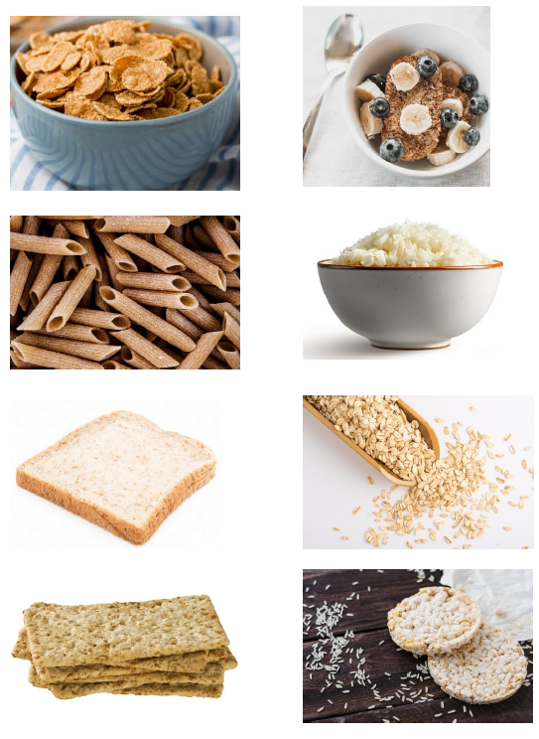
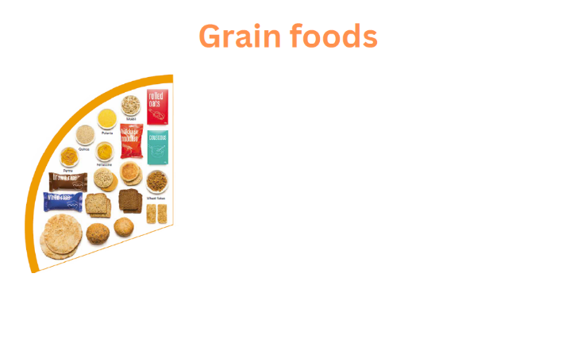
Activity 1: Grain foods display
Let’s create together
Notes:
Create a class display of grain foods. Use the grain foods display template and images. Alternatively, download a supermarket catalogue to identify grain foods.
Students could also create this independently or in small groups.
Draw additional foods, including foods from the different cultural groups from within the class (try to ensure they do not cross over to the ‘sometimes foods’ e.g. cakes, sweet biscuits). Some muesli bars can be nutritious e.g. chewy Uncle Tobys bars. For muesli bars look for:
Nutrients per serve
At least 3 grams of dietary fibre
Less than 5 grams of sugar
Less than 2.5 grams of saturated fat
The on-pack health star rating can also be a guide. For muesli bars, look for products with 4 or more stars.
Add some words on why grain foods are important.

Slide 14
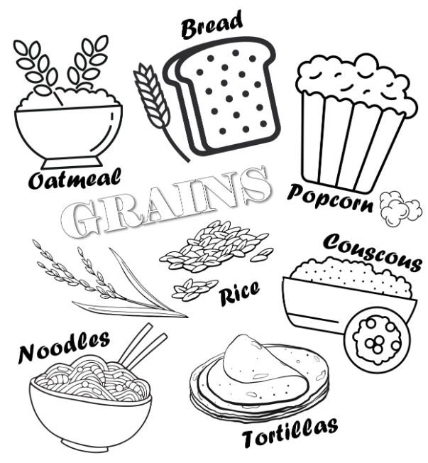
Activity 2: Booklet task
Grain foods are important because (draw or write)
Notes:
Students colour the grains images in their unit booklet.
Draw or write: Grain foods are important because…… [Teacher to assist with scribing as needed].

Slide 15
Lesson 3

Slide 16
Review

Slide 17
The Australian Guide to Healthy Eating
Notes:
The Australian Guide to Healthy Eating (AGHE) is a visual representation of the Australian Dietary Guidelines.
It is a broad guide to the types and amounts of foods we should eat each day.
The food groups:
Grain foods
Vegetables
Fruit
Dairy and alternatives
Meat and alternatives
Sitting off to the side are foods categorised as ‘sometimes’ foods. These foods are high in saturated fat and/or added sugars, added salt or alcohol and low in fibre. These foods and drinks can also be high in kilojoules (energy).

Slide 18
Name one type of grain food

Slide 19
Answer: Name one type of grain foods
Breads
Breakfast cereal
Grains
Pasta
Other products
Mostly wholegrain and/or high cereal fibre varieties
Notes:
Images: Designed by Pexels and Freepik

Slide 20
Why are grain foods important?
How many reasons can you think of?

Slide 21
Answer: Why are grain foods important?
Provide the best source of energy (slow-release energy): fuels our brain (for concentration) and our body
Provide fibre: to help keep our intestines healthy
Provide lots of vitamins and minerals to help our bodies grow and age
Notes:
Images: Designed by Pexels and Freepik

Slide 22
Learning intention: To learn about meat and alternative foods.
Success criteria:
identify meat and alternative foods
identify why meat and alternative foods are important.

Slide 23
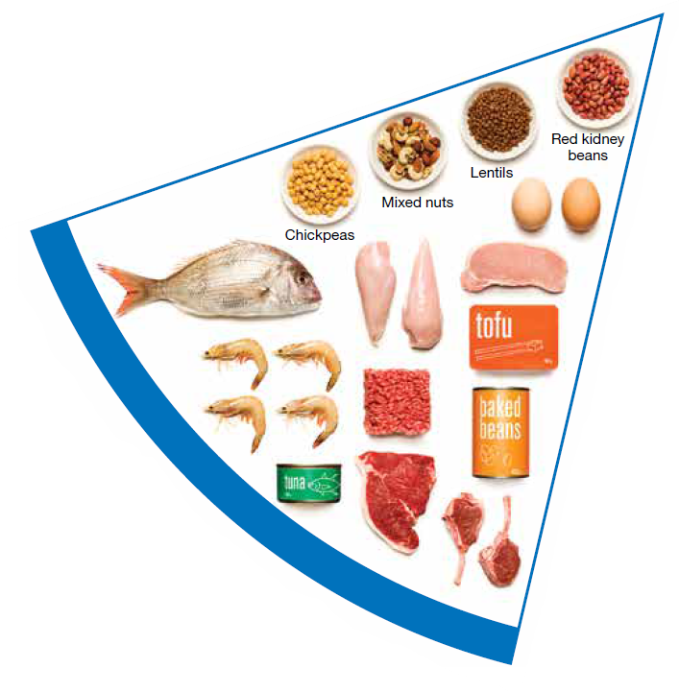
Meat and alternatives
What do you know about meat foods?
What do you think ‘meat alternative’ means?
Notes:
Elicit responses from students.
Meat alternatives (plant foods):
Nuts and seeds.
Legumes/beans appear in this group as well as the vegetable group.
For vegetarians and vegans, these foods are a key source of nutrients, particularly protein and iron, and need to be included regularly to ensure their diet is nutritionally balanced.
Image: Based on material provided by the National Health and Medical Research Council (representing the Commonwealth of Australia)

Slide 24

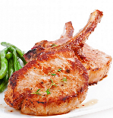

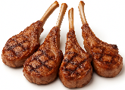
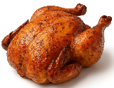
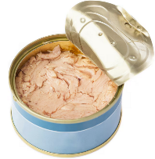
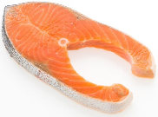

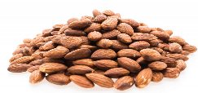
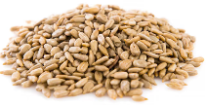
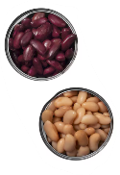

Meat and alternatives
Pink and red meat
Poultry
Fish and seafood
Eggs
Nuts and seeds
Legumes/beans
Choose meat without visible fat
Notes:
Types of foods:
Lean meats: beef, lamb, pork, kangaroo, lean and low salt sausages.
Poultry: chicken, turkey, duck, emu, goose.
Fish and seafood: fish, prawns, crab, lobster, mussels, oysters, scallops, clams.
Eggs: chicken eggs, duck eggs.
Nuts and seeds: almonds, pine nuts, walnut, macadamia, hazelnut, cashew, peanut, nut spreads, brazil nuts, seeds.
Legumes/beans: all beans, lentils, chickpeas, split peas, tofu.
To ensure adequate iron and zinc, about half the serves from this food group should be lean meats. For those who do not eat animal foods, nuts, seeds, legumes (including tofu) can provide some iron and zinc, plus a good mix of plant-based protein.
Choose lean meat options and/or remove the visible fat from the meat prior to cooking to reduce the total amount of saturated fat consumed.
Fresh, frozen and canned varieties of meat, poultry or fish are included in this group. It is important that canned varieties are low in fat and low in salt (no added salt) and canned in water rather than in oil or brine.
Sausages, commercial burgers and meat pastries can be high in saturated fat and are classified as a ‘sometimes’ food. It is recommended the consumption of these foods be limited. If purchasing sausages, it is best to select lean or reduced fat versions and boil or fry in a non-stick pan or BBQ.
Processed meats, such as salami and bacon are high in salt and saturated fats are classified as a ‘sometimes’ food. Consumption should be limited.
Meat alternatives (plant foods):
Nuts and seeds.
Legumes/beans appear in this group as well as the vegetable group.
For vegetarians and vegans, these foods are a key source of nutrients, particularly protein and iron, and need to be included regularly to ensure their diet is nutritionally balanced.
Images: Designed by Freepik and ChatGPT
Based on material provided by the National Health and Medical Research Council (representing the Commonwealth of Australia)

Slide 25


Why meat and alternative foods are important
Provide zinc and iron: keeps our blood healthy and gives us energy
Provide protein: helps our body grow and become strong
Provide essential fatty acids to keep our brains and heart healthy
Notes:
Proteins are made up of chemical 'building blocks' called amino acids. Your body uses amino acids to build and repair muscles and bones.
Iron is particularly important for transporting oxygen in the blood. This is essential for providing energy for daily life. Iron also helps our immune system fight infection.
Zinc is important for growth and for the immune system to fight infection.
Images: Designed by Freepik

Slide 26

Meat and alternatives
Notes:
[2.03]
Discussion:
- What is the message?
Link to the previous slide on why meat and alternatives are important (protein).

Slide 27
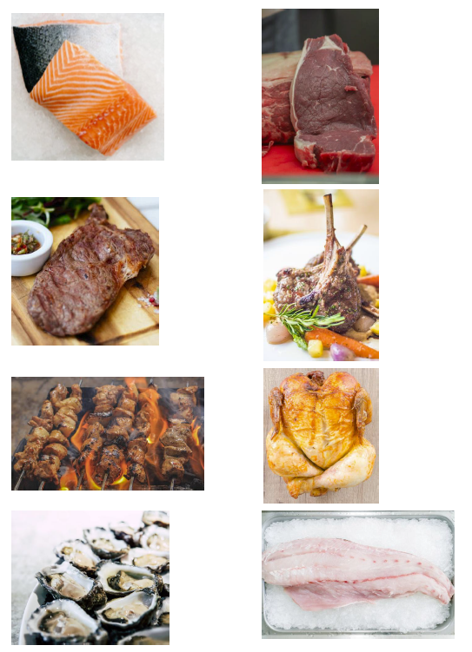
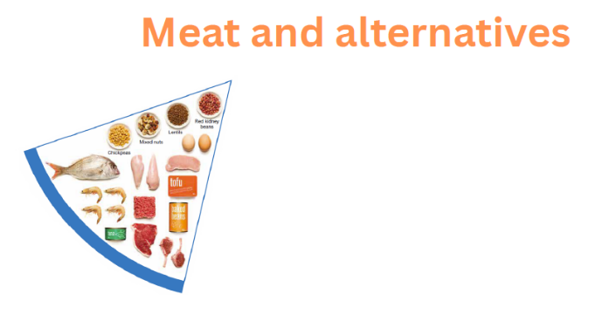
Activity 1: Meat and alternative foods display
Let’s create together
Notes:
Create a class display of meat and alternative foods. Use the meat and alternative foods display template and images. Alternatively, download a supermarket catalogue to identify foods.
Students could also create this independently or in small groups.
You may wish to sort them into groups e.g. foods from plants, food from animals.
Draw additional foods, including foods from the different cultural groups from within the class (try to ensure they do not cross over to the ‘sometimes foods’ e.g. sausages, take away burgers – these are ok in small amounts).
Considerations with the ‘sometimes’ foods: how much fat, sugar and salt has been added.
Sausages, commercial burgers and meat pastries can be high in saturated fat and are classified as a discretionary food choice according to the Australian Guide to Healthy Eating. It is recommended the consumption of these foods be limited. If purchasing sausages, it is best to select lean or reduced fat versions and boil or fry in a non-stick pan or BBQ.
Processed meats, such as salami and bacon are high in salt and saturated fats are classified as discretionary choices and their intake should be limited.
Add some words on why meat and alternative foods are important.

Slide 28
Activity 2: Booklet task
What meat and alternative foods do you like?
Draw pictures
Why are meat and alternative foods important?
Draw pictures
Write words
Notes:
In their unit booklet, students draw images of meat and alternative foods that they like.
Draw or write: Meat and alternative foods are important because…… [Teacher to assist with scribing as needed].

Slide 29
Lesson 4

Slide 30
Review

Slide 31
The Australian Guide to Healthy Eating
Notes:
The Australian Guide to Healthy Eating (AGHE) is a visual representation of the Australian Dietary Guidelines.
It is a broad guide to the types and amounts of foods we should eat each day.
The food groups:
Grain foods
Vegetables
Fruit
Dairy and alternatives
Meat and alternatives
Sitting off to the side are foods categorised as ‘sometimes’ foods. These foods are high in saturated fat and/or added sugars, added salt or alcohol and low in fibre. These foods and drinks can also be high in kilojoules (energy).

Slide 32
Are plant foods part of the meat and alternatives food group?

Slide 33
Answer: Yes!
Pink and red meat
Poultry
Fish and seafood
Eggs
Nuts and seeds
Legumes/beans
Choose meat without visible fat
Notes:
Meat alternatives:
Nuts and seeds.
Legumes/beans appear in this group as well as the vegetable group.
For vegetarians and vegans, these foods are a key source of nutrients, particularly protein and iron, and need to be included regularly to ensure their diet is nutritionally balanced.
Images: Designed by Freepik and ChatGPT

Slide 34
Why are meat and alternative foods important?
How many reasons can you think of?

Slide 35
Answer: Why are meat and alternative foods important?
Provide zinc and iron: keeps our blood healthy and gives us energy
Provide protein: helps our body grow and become strong
Provide essential fatty acids to keep our brains and heart healthy
Notes:
Images: Designed by Freepik

Slide 36
Learning intention: To learn about the fruit food group.
Success criteria:
identify different types of fruit
identify why fruit is important.

Slide 37
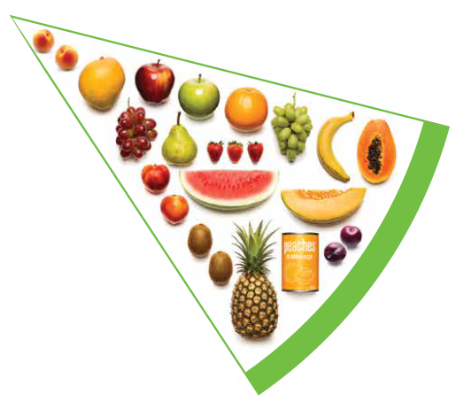
Fruit
What do you know about fruit?
Notes:
Elicit responses from students.
Differences between fruit and vegetables:
Fruits and vegetables are from different parts of a plant. Fruits come from the flowering part of a plant and contain seeds. Vegetables are the edible parts of a plant, such as the leaves, stem, roots, and bulbs
What fruits are eaten like vegetables? (pumpkin, cucumber, tomato)
Image: Based on material provided by the National Health and Medical Research Council (representing the Commonwealth of Australia)

Slide 38
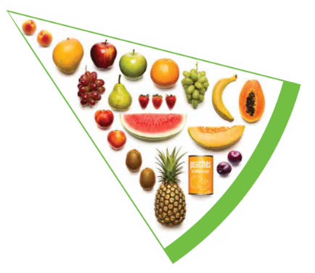


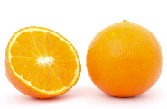

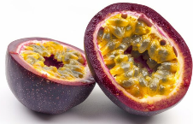
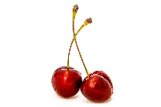




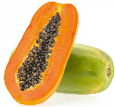
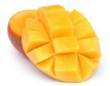
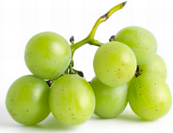

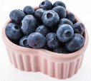
Fruit
Pomme
Citrus
Stone
Tropical
Berries
Choose dried fruit or fruit juice only occasionally
Notes:
Types of fruit:
Pome fruit: apple, pear.
Citrus fruit: orange, mandarin, grapefruit.
Stone fruit: apricot, cherry, peach, nectarine, plum.
Tropical: banana, paw paw, mangoes, pineapple and melon.
Berries: strawberry, blueberry, raspberry, blackberry.
Other: grapes, passionfruit.
Whole or chopped fruit is the best choice.
Fresh, frozen and canned fruits are all part of this food group. It is best to avoid fruits canned in syrup and choose varieties canned in natural juice or water instead.
Choose dried fruit or fruit juice only occasionally:
Eating dried fruit regularly is not recommended as it is high in kilojoules, can stick to the teeth and increases the risk of dental decay. You can also easily eat more than you realise.
Fruit juice is acidic and can increase the risk of dental decay. Fruit juice also has less fibre and other nutrients than whole fruit.
Different fruits can help protect our bodies in different ways, so it’s important to choose a variety, including different colours, each day.
Differences between fruit and vegetables
Fruits and vegetables are from different parts of a plant. Fruits come from the flowering part of a plant and contain seeds. Vegetables are the edible parts of a plant, such as the leaves, stem, roots, and bulbs.
Fruits that are eaten like vegetables: pumpkin, cucumber, tomato (and therefore part of the vegetable group).
Images: Designed by Pexels, Freepik and ChatGPT
Based on material provided by the National Health and Medical Research Council (representing the Commonwealth of Australia)

Slide 39
Why fruit is important?
Provide the best source of energy (slow-release energy): fuels our brain (for concentration) and our body
Provide fibre: to help keep our intestines healthy
Provide lots of vitamins and minerals to help our bodies grow and age
Notes:
Provides energy in the form of carbohydrate.
Carbohydrate provides the best source of energy for the brain.
Fibre helps us stay fuller for longer, which can help with concentration.
Fibre is especially useful in keeping the digestive track (including the intestines) healthy and can assist with constipation.
The vast range of vitamins and minerals are important for growth and repair, healthy ageing, and preventing chronic conditions.
Images: Designed by Pexels and Freepik

Slide 40

Fruit
Notes:
[0.30]
Discussion:
- What is the message?
Link to the previous slide on why fruit is important (carbohydrates for energy, vitamins and minerals).

Slide 41
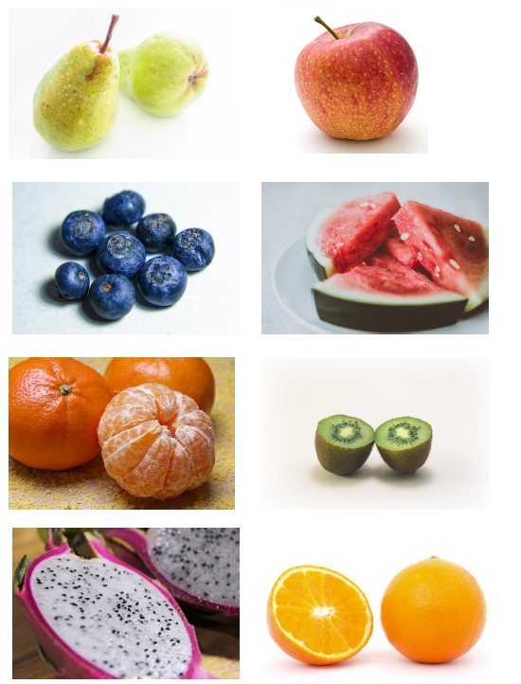
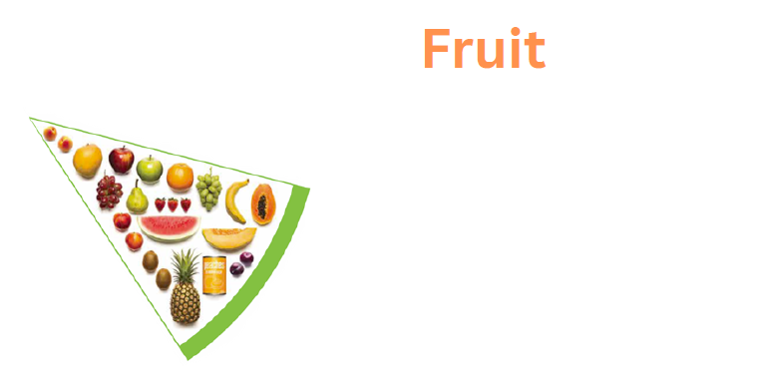
Activity 1: Fruit display
Let’s create together
Notes:
Create a class display of fruit foods and products – categorise into ‘core’ and ‘sometimes’ categories. Use the fruit foods display template and images. Alternatively, download a supermarket catalogue to identify foods.
Students could also create this independently or in small groups.
Draw additional fruits.
Considerations with the ‘sometimes’ foods: how much fat, sugar and salt has been added.
Discussion: foods such as apple pie, berries and ice cream and fruit muffin are not ‘bad’ choices. There are, however, more nutritious fruit options.
Foods such as juice and dried fruit can contribute to a serve of fruit.
Smoothie: where would that fit? No right or wrong here. Depends on how it is made and if eaten occasionally.
Use the groups created as a guide and consider the key differences i.e. the sometimes foods generally undergo more change by machines/humans.
Add some words on why fruit is important.

Slide 42
Activity 2: Booklet task
What fruit do you like?
Draw pictures
Why is fruit important?
Draw pictures
Write words
Notes:
In their unit booklet, students draw images of fruits that they like.
Draw or write: Fruit is important because…… [Teacher to assist with scribing as needed].

Slide 43
Lesson 5

Slide 44
Review

Slide 45
The Australian Guide to Healthy Eating
Notes:
The Australian Guide to Healthy Eating (AGHE) is a visual representation of the Australian Dietary Guidelines.
It is a broad guide to the types and amounts of foods we should eat each day.
The food groups:
Grain foods
Vegetables
Fruit
Dairy and alternatives
Meat and alternatives
Sitting off to the side are foods categorised as ‘sometimes’ foods. These foods are high in saturated fat and/or added sugars, added salt or alcohol and low in fibre. These foods and drinks can also be high in kilojoules (energy).

Slide 46
What is the best way to eat fruit?

Slide 47
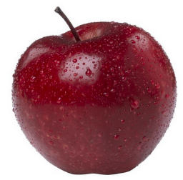
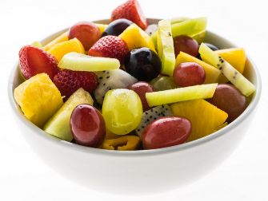
Answer: Whole or chopped!
Notes:
Images: Designed by Freepik

Slide 48
Why is fruit important?
How many reasons can you think of?

Slide 49
Answer: Why is fruit important?
Provide the best source of energy (slow-release energy): fuels our brain (for concentration) and our body
Provide fibre: to help keep our intestines healthy
Provide lots of vitamins and minerals to help our bodies grow and age
Notes:
Images: Designed by Pexels and Freepik

Slide 50
Learning intention: To learn about the vegetables food group.
Success criteria:
identify different types of vegetables
identify why vegetables are important.

Slide 51
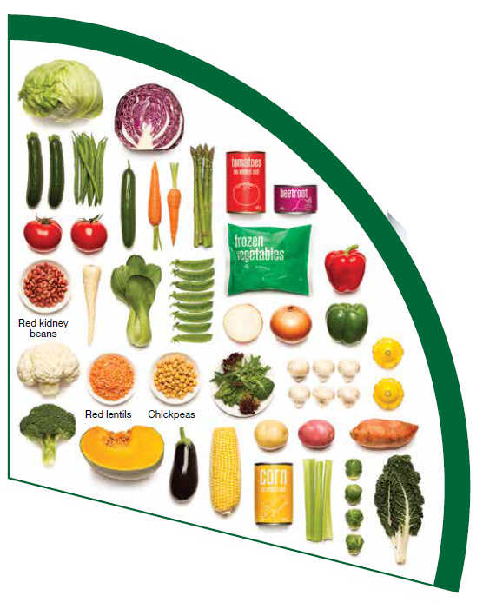
Vegetables
What do you know about vegetables?
Notes:
Elicit responses from students.
Differences between fruit and vegetables:
Fruits and vegetables are from different parts of a plant. Fruits come from the flowering part of a plant and contain seeds. Vegetables are the edible parts of a plant, such as the leaves, stem, roots, and bulbs
What fruits are eaten like vegetables? (pumpkin, cucumber, tomato)
Image: Based on material provided by the National Health and Medical Research Council (representing the Commonwealth of Australia)

Slide 52

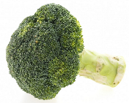

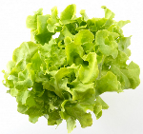

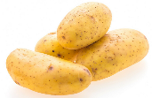
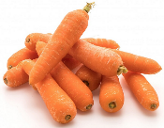
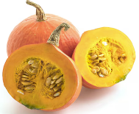
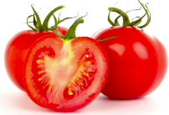
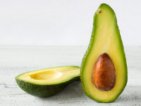
Vegetables
Dark green and cruciferous
Root/ tubular/ bulb
Legumes/beans
Other
Choose a variety, including different colours, each day
Notes:
Types of vegetables (also includes legumes and beans):
Dark green and cruciferous: broccoli, brussels sprouts, bok choy, cabbages, cauliflower, lettuce, spinach, snow peas.
Root/ tubular/ bulb: potato, sweet potato, carrots, beetroot, onion, shallots, garlic, swede, turnip.
Legumes/ beans: kidney beans, soybeans, lima beans, cannellini beans, chickpeas, lentils, split peas, tofu.
Other: tomato, celery, zucchini, avocado, capsicum, eggplant, mushrooms, cucumber, pumpkin, green peas, green beans.
Eat different colours of vegetables, as the different colour groups have different vitamins and minerals.
Vegetables such as tomatoes and pumpkins are technically classified as fruit because they have seeds. They are included in the vegetable group because they have similar nutritional properties as vegetables and are typically eaten as a vegetable.
Images: Designed by Freepik
Based on material provided by the National Health and Medical Research Council (representing the Commonwealth of Australia)

Slide 53
Why vegetables are important
Provide the best source of energy (slow-release energy): fuels our brain (for concentration) and our body
Provide fibre: to help keep our intestines healthy
Provide lots of vitamins and minerals to help our bodies grow and age
Notes:
The complex carbohydrates in vegetables are slowly digested, which provides energy over time and helps prevent overeating.
Carbohydrate provides the best source of energy for the brain.
Fibre helps us stay fuller for longer, which can help with concentration.
Fibre is especially useful in keeping the digestive track (including the intestines) healthy and can assist with constipation.
The vast range of vitamins and minerals are important for growth and repair, healthy ageing, and preventing chronic conditions.
Images: Designed by Pexels and Freepik

Slide 54

Vegetables (and fruit)
Notes:
[3.16]
Discussion:
- What is the message?
Link to the previous slide on why vegetables are important (carbohydrates for energy, vitamins and minerals).

Slide 55
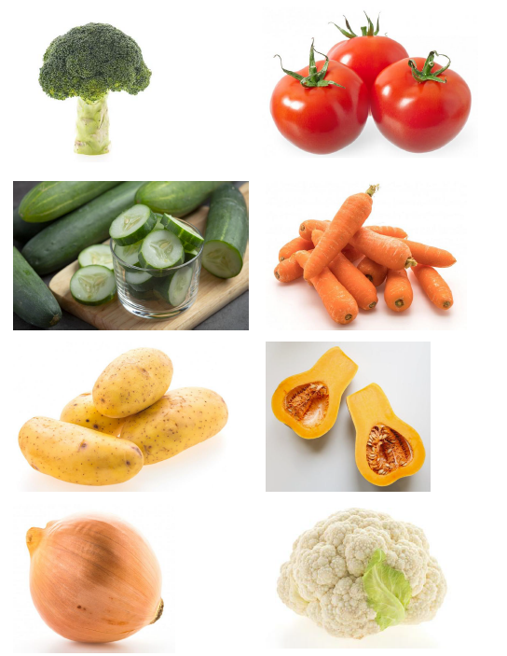
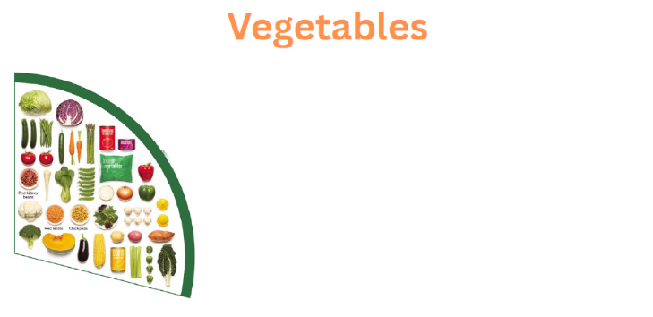
Activity 1: Vegetables display
Let’s create together
Notes:
Create a class display of vegetable products. Use the vegetable foods display template and images. Alternatively, download a supermarket catalogue to identify foods.
Students could also create this independently or in small groups.
You may wish to sort them into groups e.g. based on the categories, changed by machines.
Draw additional foods, including foods from the different cultural groups from within the class (try to ensure they do not cross over to the ‘sometimes foods’ e.g. hot chips, crisps – these are ok in small amounts).

Slide 56

Activity 2: Booklet task
Types of vegetables
Why vegetables are important
Notes:
In their unit booklet, students draw images of vegetables that they like.
Students add information on why vegetables are important [Teacher to assist with scribing as needed].

Slide 57
Lesson 6

Slide 58
Review

Slide 59
The Australian Guide to Healthy Eating
Notes:
The Australian Guide to Healthy Eating (AGHE) is a visual representation of the Australian Dietary Guidelines.
It is a broad guide to the types and amounts of foods we should eat each day.
The food groups:
Grain foods
Vegetables
Fruit
Dairy and alternatives
Meat and alternatives
Sitting off to the side are foods categorised as ‘sometimes’ foods. These foods are high in saturated fat and/or added sugars, added salt or alcohol and low in fibre. These foods and drinks can also be high in kilojoules (energy).

Slide 60
What is your favourite vegetable?

Slide 61
Answer: Lots of different responses!

Slide 62
Why are vegetables important?
How many reasons can you think of?

Slide 63
Answer: Why are vegetables important?
Provide the best source of energy (slow-release energy): fuels our brain (for concentration) and our body
Provide fibre: to help keep our intestines healthy
Provide lots of vitamins and minerals to help our bodies grow and age
Notes:
Images: Designed by Pexels and Freepik

Slide 64
Learning intention: To learn about the dairy and alternatives food group.
Success criteria:
identify dairy and alternatives foods
identify why dairy and alternative foods are important.

Slide 65
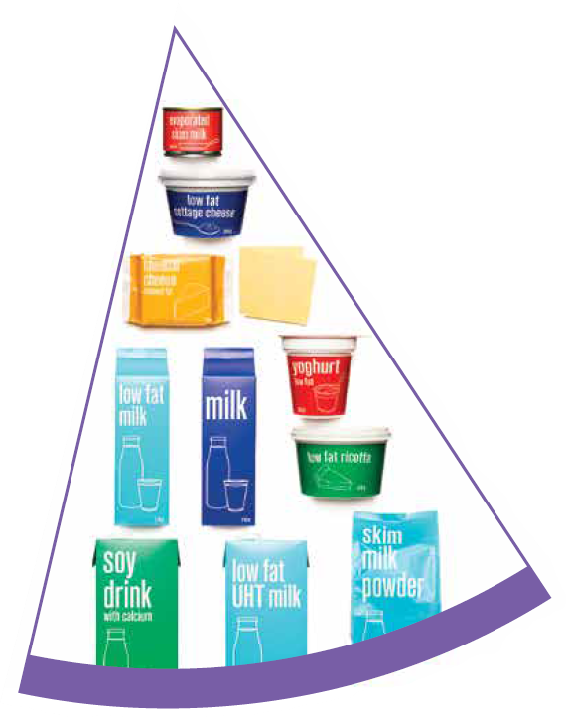
Dairy and alternatives
What do you know about dairy foods?
What do you think ‘dairy alternative’ means?
Notes:
Elicit responses from students.
Dairy = products made from milk.
Dairy alternatives:
Calcium-enriched dairy alternatives include soy, rice, almond or oat milk and soy or lactose free yoghurts and cheeses.
Non-dairy alternatives do not naturally contain calcium. It is important to select products labelled as calcium-fortified.
Many of the alternative milks, with the exception of soy milk products, may not be a good source of protein and other key nutrients found in milk and products made from milk.
Image: Based on material provided by the National Health and Medical Research Council (representing the Commonwealth of Australia)

Slide 66
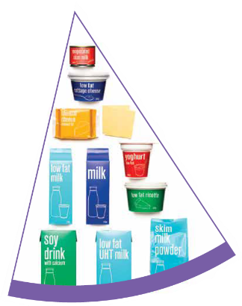


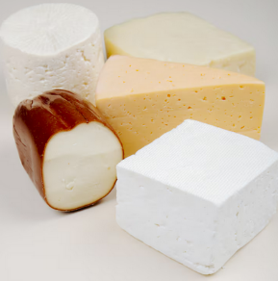
Dairy and alternatives
Milk (fresh and long life)
Yoghurt
Cheese
Reduced fat varieties are the best choice for most
Notes:
Types of foods:
Milks: All reduced fat or full cream milks, plain and flavoured, long life milks, powdered milk, evaporated milk, soy beverages (fortified with at least 100mg calcium/100mL).
Yoghurt: All yoghurts including reduced fat or full cream, plain and flavoured, soy yoghurt (calcium fortified).
Cheese: All hard cheeses, reduced or full fat, for example cheddar, red Leicester, Gloucester, Edam, Gouda Soy cheeses (calcium fortified).
Dairy = products made from milk.
Dairy alternatives:
Calcium-fortified dairy alternatives include soy, rice, almond or oat milk and soy or lactose free yoghurts and cheeses.
Non-dairy alternatives do not naturally contain calcium. It is important to select products labelled as calcium-fortified.
Many of the alternative milks, with the exception of soy milk products, may not be a good source of protein and other key nutrients found in milk and products made from milk.
For vegetarians and vegans, dairy alternative products such as soy milk and cheese are a key source of nutrients, particularly protein and calcium (if calcium is added by the manufacturer), and need to be included regularly to ensure their diet is nutritionally balanced.
Images: Designed by Freepik
Based on material provided by the National Health and Medical Research Council (representing the Commonwealth of Australia)

Slide 67
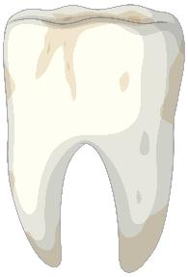
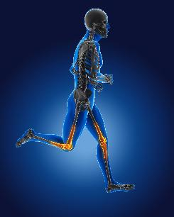
Why dairy and alternative foods are important
Provide calcium: for strong bones and teeth
Provide protein: helps our body grow and become strong
Provide lots of vitamins and minerals to help our bodies grow and age
Notes:
Calcium helps ensure strong bones and teeth.
Proteins are made up of chemical 'building blocks' called amino acids. Your body uses amino acids to build and repair muscles and bones.
Iodine is needed to make essential thyroid hormones. These are used by the body for growth and energy use, as well as brain and bone development in the early years.
Vitamin B12 is essential for the production of red blood cells, which are needed to carry oxygen from the lungs to the body’s tissues and organs.
Images: Designed by Pexels and Freepik

Slide 68

Dairy and alternatives
Notes:
[1.41]
Discussion:
- What is the message?
Link to the previous slide on why dairy is important (calcium, protein, vitamins and minerals).

Slide 69


Activity 1: Dairy and alternative foods display
Let’s create together
Notes:
Create a class display of dairy products – categorise into ‘core’ and ‘sometimes’ categories. Use the dairy and alternatives display template and images. Alternatively, download a supermarket catalogue to identify foods.
Students could also create this independently or in small groups.
Bring in the concept of foods from plants and food from animals.
Draw additional foods, including foods from the different cultural groups from within the class (try to ensure they do not cross over to the ‘sometimes foods’.
Considerations with the ‘sometimes’ foods: how much fat, sugar and salt has been added.
Discussion: foods such as ice cream, custard and cream can be higher in sugar and saturated fat than other dairy foods. They are not ‘bad’ choices. There are, however, more nutritious dairy food options. These foods are classified as discretionary choices in the Australian Dietary Guidelines.
Add some words on why dairy and alternatives are important.

Slide 70

Activity 2: Booklet task
Grain foods are important because (draw or write)
Notes:
Students colour the dairy and alternatives images in their unit booklet.
Draw or write: Dairy and alternative foods are important because…… [Teacher to assist with scribing as needed].

Slide 71
Lesson 7

Slide 72
Review

Slide 73
What is your favourite dairy and alternatives food?

Slide 74
Answer: Lots of different responses!

Slide 75
Why are dairy and alternative foods important?
How many reasons can you think of?

Slide 76
Answer: Why dairy and alternative foods are important
Provide calcium: for strong bones and teeth
Provide protein: helps our body grow and become strong
Provide lots of vitamins and minerals to help our bodies grow and age
Notes:
Calcium helps ensure strong bones and teeth.
Proteins are made up of chemical 'building blocks' called amino acids. Your body uses amino acids to build and repair muscles and bones.
Iodine is needed to make essential thyroid hormones. These are used by the body for growth and energy use, as well as brain and bone development in the early years.
Vitamin B12 is essential for the production of red blood cells, which are needed to carry oxygen from the lungs to the body’s tissues and organs.
Images: Designed by Pexels and Freepik

Slide 77
Learning intention: To learn about ‘sometimes’ foods.
Success criteria:
identify examples of ‘sometimes’ foods
identify alternatives to different ‘sometimes’ foods.

Slide 78
‘Sometimes’ foods
Why do you think the ‘sometimes’ foods fit outside the plate?
Notes:
Elicit student responses
Sitting off to the side are foods categorised as ‘sometimes’ foods. These foods are high in saturated fat and/or added sugars, added salt or alcohol and low in fibre. These foods and drinks can also be high in kilojoules (energy).
Image: Based on material provided by the National Health and Medical Research Council (representing the Commonwealth of Australia)

Slide 79







‘Sometimes’ foods
Higher in added sugars
Higher in fat (and sodium)
Higher in both
To be consumed sometimes and in small amounts
Notes:
Types of foods:
Higher added sugars: Soft drinks, energy drinks, sugar confectionary, jams, some sauces.
Higher fat: Most processed meats (bacon, ham, sausages, frankfurts), crisps, butter, cream, pastry products, meat pies, sausage rolls, potato chips, commercial pizza.
Higher added sugars AND higher fat: Biscuits, cakes, chocolate, doughnuts, ice cream, iced buns, some muesli bars, muffins, sweet pastries.
Alcoholic drinks.
‘Sometimes’ foods in a healthy diet:
Some people require extra serves of food for example, those who are taller and more active. These can sometimes include extra serves of ‘sometimes’ foods. It is best if these extra serves come from the five food groups, particularly wholegrain cereals, vegetables including legumes/beans and fruit. However, they can also sometimes include serves of ‘sometimes’ foods (discretionary foods).
These foods can, however, contribute to a feeling of enjoyment. They should be consumed sometimes, and in small amounts, such as once a week.
Images: Designed by Freepik
Based on material provided by the National Health and Medical Research Council (representing the Commonwealth of Australia)

Slide 80

‘Sometimes’ foods
Notes:
[2.23]
This video gives examples of different sometimes food.

Slide 81


Activity 1: ‘Sometimes’ foods display
Let’s create together
Notes:
Using a supermarket catalogue, create a class display of ‘sometimes’ foods. Use the ‘sometimes’ foods display template and supermarket catalogue images. [Or have students create independently or in small groups].
Students could also create this independently or in small groups.
Add some words on why we should eat these foods only sometimes.

Slide 82

Activity 2: Booklet task
Notes:
In their unit booklet, students draw a sometimes food, and then draw a food they could have instead, which aligns with the five food groups.
Depending on time, students could draw additional ‘swaps’.

Slide 83
Lesson 8

Slide 84
Learning intention: To make something healthy and tasty.

Slide 85
Options
Fruit skewers
Fruit salad with yoghurt
Vegetable slices and dip (bought hummus or tzatziki or make your own)
Fruit smoothie
Mixed vegetable salad with dressing
Sandwiches with different fillings (roast chicken, egg, salad items)

Slide 86
Lesson 9

Slide 87
Learning intention: To represent the Australian Guide to Healthy Eating.

Slide 88
Task
Create your own version of the Australian Guide to Healthy Eating, which could be used to promote healthy eating at our school.
Options:
picture with labels
digital
recorded message

Slide 89
Success criteria
Show the five food groups, with at least 2 foods from each group.
Show where ‘sometimes’ foods fit.
Extension
Identify why the five food groups are important.

Slide 90


