Slide 1
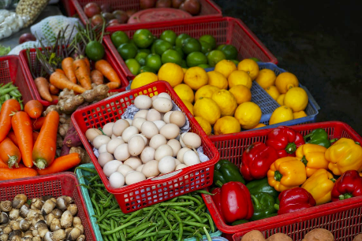
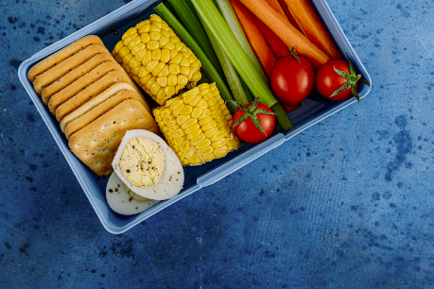
Strategies to enhance healthy eating
Food and nutrition unit
Year 9
Notes:
Images: Designed by Pexels

Slide 2
Contents
Lesson 1 | Lesson 5
Lesson 2 | Lesson 6
Lesson 3 | Lesson 7, 8 and 9
Lesson 4

Slide 3
Lesson 1

Slide 4
In this unit we will be:
reviewing the Australian Guide to Healthy Eating
investigating food and nutrient intake data
looking at barriers to healthy eating
investigating the credibility of nutrition information
introduced to nutrition promotion strategies
proposing a nutrition promotion strategy that aims to enhance the nutritional quality of food intake of children and adolescents.

Slide 5
Learning intention: To promote the food group needs of a population group.
Success criteria:
number of serves
serve size recommendations.

Slide 6
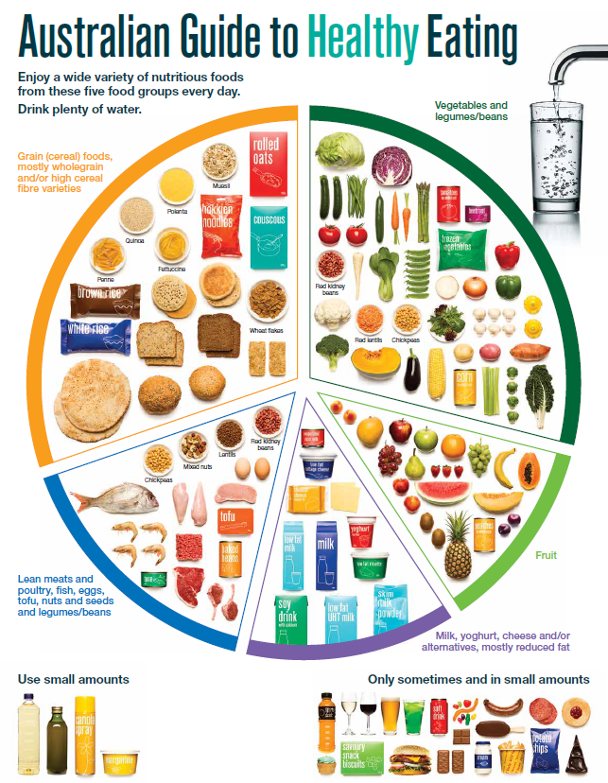
The Australian Guide to Healthy Eating
Notes:
The Australian Guide to Healthy Eating (AGHE) is a visual representation of the Australian Dietary Guidelines.
It is a broad guide to the types and amounts of foods we should eat each day.
The food groups:
Grain foods
Vegetables
Fruit
Dairy and alternatives
Meat and alternatives
Sitting off to the side are foods categorised as ‘sometimes’ foods. These foods are high in saturated fat and/or added sugars, added salt or alcohol and low in fibre. These foods and drinks can also be high in kilojoules (energy).

Slide 7

Overview of the AGHE
Notes:
[2.27]
While this video is directed at teachers, it provides a good overview of the five food groups, represented in the Australian Guide to healthy Eating.

Slide 8
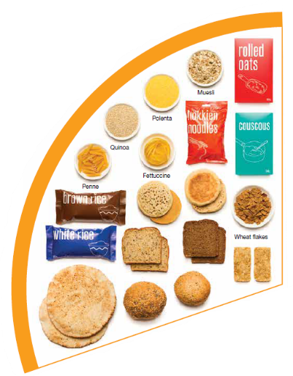
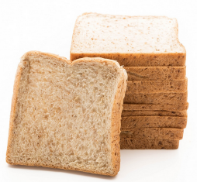
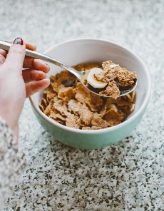
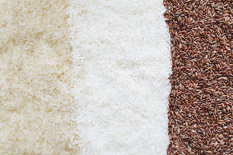
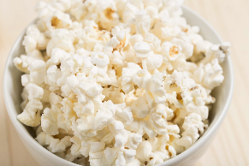
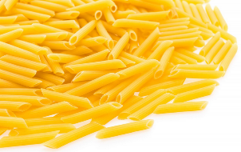
Grain foods
Breads
Breakfast cereal
Grains
Pasta
Other products
Mostly wholegrain and/or high cereal fibre varieties
Notes:
Grain foods comprise grains that can be cooked and eaten whole, ground into flour to make cereal foods, or made into breakfast cereals:
Breads: wholemeal, wholegrain, white, rye, pita, focaccia, crispbreads.
Breakfast cereals: high fibre (wholegrain) oats, porridge, muesli, wholewheat biscuits, ready to eat (such as cornflakes, cheerios).
Grains: rice, barley, corn, polenta, buckwheat, spelt, millet.
Pasta: short and long (white and wholemeal).
Other products: noodles, English muffin, crumpet, rice cakes, couscous, popcorn, flour.
The recommendation is for ‘mostly wholegrain and/or high cereal fibre varieties’ (at least two thirds). Wholegrain cereals contain more nutrients than refined cereal foods (e.g. white bread), because many of the important nutrients occur in the outer layer of the grain which is lost during processing.
Images: Designed by Pexels and Freepik
Based on material provided by the National Health and Medical Research Council (representing the Commonwealth of Australia)

Slide 9
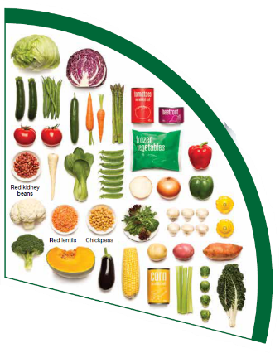
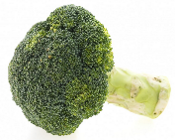
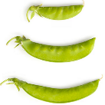
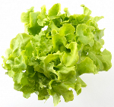



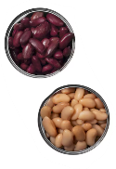

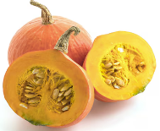
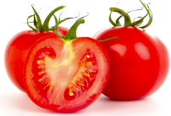
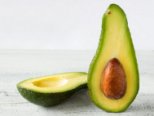
Vegetables
Dark green and cruciferous
Root/ tubular/ bulb
Legumes/beans
Other
Choose a variety, including different colours, each day
Notes:
Types of vegetables (also includes legumes and beans):
Dark green and cruciferous: broccoli, brussels sprouts, bok choy, cabbages, cauliflower, lettuce, spinach, snow peas.
Root/ tubular/ bulb: potato, sweet potato, carrots, beetroot, onion, shallots, garlic, swede, turnip.
Legumes/ beans: kidney beans, soybeans, lima beans, cannellini beans, chickpeas, lentils, split peas, tofu.
Other: tomato, celery, zucchini, avocado, capsicum, eggplant, mushrooms, cucumber, pumpkin, green peas, green beans.
Eat different colours of vegetables, as the different colour groups have different vitamins and minerals.
Vegetables such as tomatoes and pumpkins are technically classified as fruit because they have seeds. They are included in the vegetable group because they have similar nutritional properties as vegetables and are typically eaten as a vegetable.
Images: Designed by Freepik
Based on material provided by the National Health and Medical Research Council (representing the Commonwealth of Australia)

Slide 10
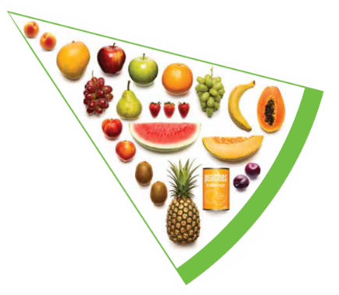
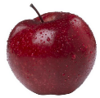

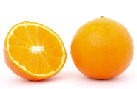

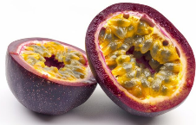
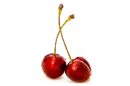




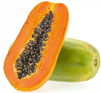
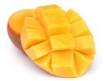
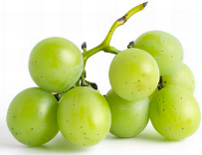

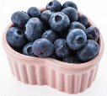
Fruit
Pomme
Citrus
Stone
Tropical
Berries
Choose dried fruit or fruit juice only occasionally
Notes:
Types of fruit:
Pome fruit: apple, pear.
Citrus fruit: orange, mandarin, grapefruit.
Stone fruit: apricot, cherry, peach, nectarine, plum.
Tropical: banana, paw paw, mangoes, pineapple and melon.
Berries: strawberry, blueberry, raspberry, blackberry.
Other: grapes, passionfruit.
Whole or chopped fruit is the best choice.
Fresh, frozen and canned fruits are all part of this food group. It is best to avoid fruits canned in syrup and choose varieties canned in natural juice or water instead.
Choose dried fruit or fruit juice only occasionally:
Eating dried fruit regularly is not recommended as it is high in kilojoules, can stick to the teeth and increases the risk of dental decay. You can also easily eat more than you realise.
Fruit juice is acidic and can increase the risk of dental decay. Fruit juice also has less fibre and other nutrients than whole fruit.
Different fruits can help protect our bodies in different ways, so it’s important to choose a variety, including different colours, each day.
Differences between fruit and vegetables
Fruits and vegetables are from different parts of a plant. Fruits come from the flowering part of a plant and contain seeds. Vegetables are the edible parts of a plant, such as the leaves, stem, roots, and bulbs.
Fruits that are eaten like vegetables: pumpkin, cucumber, tomato (and therefore part of the vegetable group).
Images: Designed by Pexels, Freepik and ChatGPT
Based on material provided by the National Health and Medical Research Council (representing the Commonwealth of Australia)

Slide 11
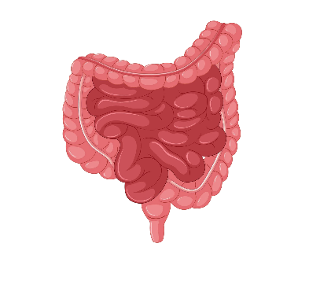
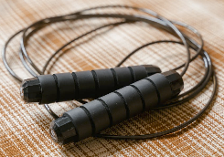


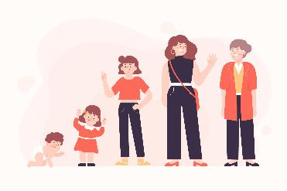
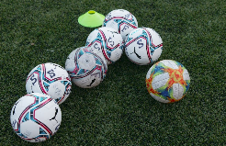
Why grain foods, vegetables and fruit are important
Provide the best source of energy (slow-release energy): fuels our brain (for concentration) and our body
Provide fibre: to help keep our intestines healthy
Provide lots of vitamins and minerals to help our bodies grow and age
Notes:
The complex carbohydrates in these foods are slowly digested, which provides energy over time and helps prevent overeating.
Carbohydrate provides the best source of energy for the brain.
Fibre helps us stay fuller for longer, which can help with concentration.
Fibre is especially useful in keeping the digestive track (including the intestines) healthy and can assist with constipation.
The vast range of vitamins and minerals are important for growth and repair, healthy ageing, and preventing chronic conditions.
Images: Designed by Pexels and Freepik

Slide 12
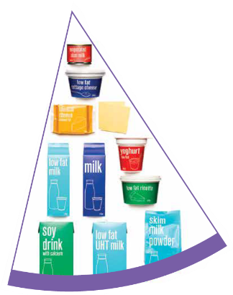
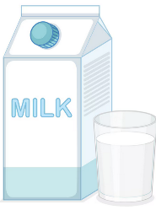
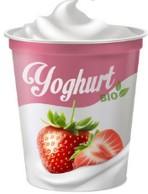
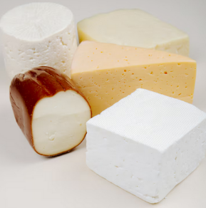
Dairy and alternatives
Milk (fresh and long life)
Yoghurt
Cheese
Reduced fat varieties are the best choice for most
Notes:
Types of foods:
Milks: All reduced fat or full cream milks, plain and flavoured, long life milks, powdered milk, evaporated milk, soy beverages (fortified with at least 100mg calcium/100mL).
Yoghurt: All yoghurts including reduced fat or full cream, plain and flavoured, soy yoghurt (calcium fortified).
Cheese: All hard cheeses, reduced or full fat, for example cheddar, red Leicester, Gloucester, Edam, Gouda Soy cheeses (calcium fortified).
Dairy = products made from milk.
Dairy alternatives:
Calcium-fortified dairy alternatives include soy, rice, almond or oat milk and soy or lactose free yoghurts and cheeses.
Non-dairy alternatives do not naturally contain calcium. It is important to select products labelled as calcium-fortified.
Many of the alternative milks, with the exception of soy milk products, may not be a good source of protein and other key nutrients found in milk and products made from milk.
For vegetarians and vegans, dairy alternative products such as soy milk and cheese are a key source of nutrients, particularly protein and calcium (if calcium is added by the manufacturer), and need to be included regularly to ensure their diet is nutritionally balanced.
Images: Designed by Freepik
Based on material provided by the National Health and Medical Research Council (representing the Commonwealth of Australia)

Slide 13

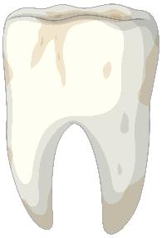
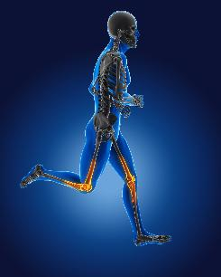
Why dairy and alternative foods are important
Provide calcium: for strong bones and teeth
Provide protein: helps our body grow and become strong
Provide lots of vitamins and minerals to help our bodies grow and age
Notes:
Calcium helps ensure strong bones and teeth.
Proteins are made up of chemical 'building blocks' called amino acids. Your body uses amino acids to build and repair muscles and bones.
Iodine is needed to make essential thyroid hormones. These are used by the body for growth and energy use, as well as brain and bone development in the early years.
Vitamin B12 is essential for the production of red blood cells, which are needed to carry oxygen from the lungs to the body’s tissues and organs.
Images: Designed by Pexels and Freepik

Slide 14
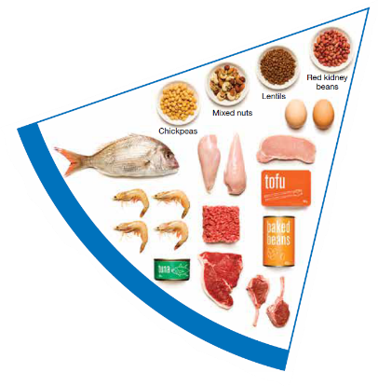



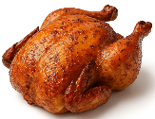
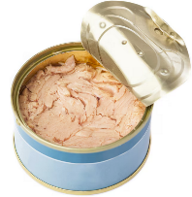
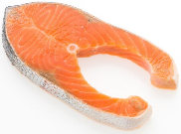

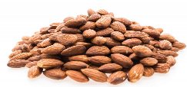
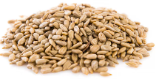
Meat and alternatives
Pink and red meat
Poultry
Fish and seafood
Eggs
Nuts and seeds
Legumes/beans
Choose meat without visible fat
Notes:
Types of foods:
Lean meats: beef, lamb, pork, kangaroo, lean and low salt sausages.
Poultry: chicken, turkey, duck, emu, goose.
Fish and seafood: fish, prawns, crab, lobster, mussels, oysters, scallops, clams.
Eggs: chicken eggs, duck eggs.
Nuts and seeds: almonds, pine nuts, walnut, macadamia, hazelnut, cashew, peanut, nut spreads, brazil nuts, seeds.
Legumes/beans: all beans, lentils, chickpeas, split peas, tofu.
To ensure adequate iron and zinc, about half the serves from this food group should be lean meats. For those who do not eat animal foods, nuts, seeds, legumes (including tofu) can provide some iron and zinc, plus a good mix of plant-based protein.
Choose lean meat options and/or remove the visible fat from the meat prior to cooking to reduce the total amount of saturated fat consumed.
Fresh, frozen and canned varieties of meat, poultry or fish are included in this group. It is important that canned varieties are low in fat and low in salt (no added salt) and canned in water rather than in oil or brine.
Sausages, commercial burgers and meat pastries can be high in saturated fat and are classified as a ‘sometimes’ food. It is recommended the consumption of these foods be limited. If purchasing sausages, it is best to select lean or reduced fat versions and boil or fry in a non-stick pan or BBQ.
Processed meats, such as salami and bacon are high in salt and saturated fats are classified as a ‘sometimes’ food. Consumption should be limited.
Meat alternatives (plant foods):
Nuts and seeds.
Legumes/beans appear in this group as well as the vegetable group.
For vegetarians and vegans, these foods are a key source of nutrients, particularly protein and iron, and need to be included regularly to ensure their diet is nutritionally balanced.
Images: Designed by Freepik and ChatGPT
Based on material provided by the National Health and Medical Research Council (representing the Commonwealth of Australia)

Slide 15

Why meat and alternative foods are important
Provide zinc and iron: keeps our blood healthy and gives us energy
Provide protein: helps our body grow and become strong
Provide essential fatty acids to keep our brains and heart healthy
Notes:
Proteins are made up of chemical 'building blocks' called amino acids. Your body uses amino acids to build and repair muscles and bones.
Iron is particularly important for transporting oxygen in the blood. This is essential for providing energy for daily life. Iron also helps our immune system fight infection.
Zinc is important for growth and for the immune system to fight infection.
Images: Designed by Freepik

Slide 16
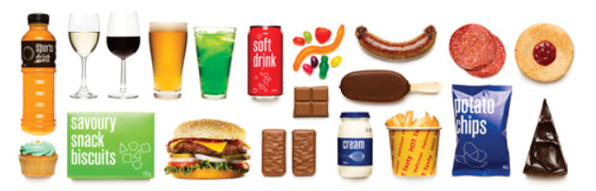





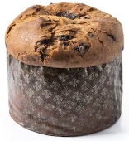
‘Sometimes' foods
Higher in added sugars
Higher in fat (and sodium)
Higher in both
To be consumed sometimes and in small amounts
Notes:
Some foods and drinks do not fit into the five food groups. These foods are high in saturated fat and/or added sugars, added salt or alcohol and low in fibre. These foods and drinks can also be high in kilojoules (energy).
Types of foods:
Higher added sugars: Soft drinks, energy drinks, sugar confectionary, jams, some sauces.
Higher fat: Most processed meats (bacon, ham, sausages, frankfurts), crisps, butter, cream, pastry products, meat pies, sausage rolls, potato chips, commercial pizza.
Higher added sugars AND higher fat: Biscuits, cakes, chocolate, doughnuts, ice cream, iced buns, some muesli bars, muffins, sweet pastries.
Alcoholic drinks.
‘Sometimes’ foods in a healthy diet:
Some people require extra serves of food, for example, those who are taller and more active. These can sometimes include extra serves of ‘sometimes’ foods. It is best if these extra serves come from the five food groups, particularly wholegrain cereals, vegetables including legumes/beans and fruit. However, they can also sometimes include serves of ‘sometimes’ foods (discretionary foods).
These foods can, however, contribute to a feeling of enjoyment. They should be consumed sometimes, and in small amounts, such as once a week.
Images: Designed by Freepik
Based on material provided by the National Health and Medical Research Council (representing the Commonwealth of Australia)

Slide 17
How much should you be eating?
There is a recommended amount of each food group that should be eaten each day.
These amounts are different depending on your age, and sometimes your gender.

Slide 18
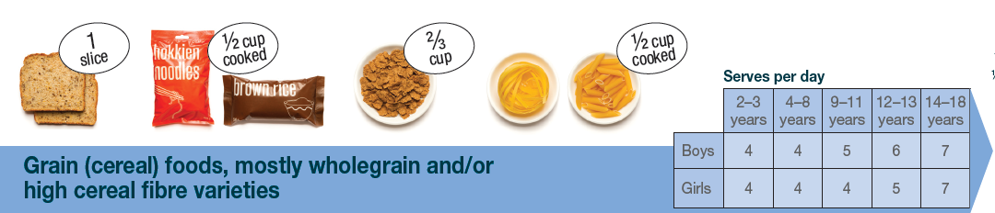
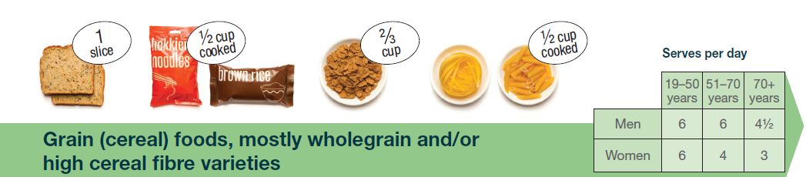
Grain food serves
The amount of grain foods we need increases and then decreases with age.
Notes:
The recommended serves of grain foods changes throughout the life stage.
They increase from 2 years, before decreasing after 50 years. This is because of the reduced overall energy needs as we get older.
Example serve sizes are provided – these are different for different foods in this food group.
Based on material provided by the National Health and Medical Research Council (representing the Commonwealth of Australia)

Slide 19
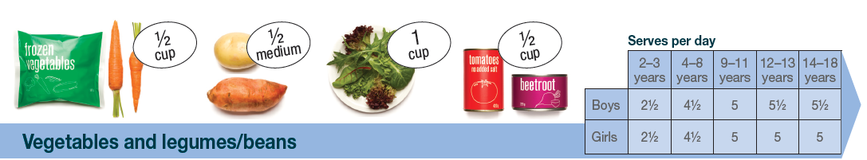
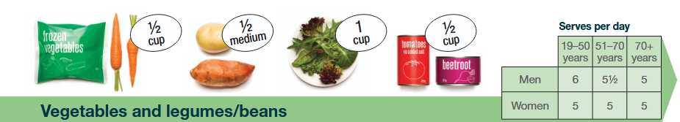
Vegetable serves
From the age of 9 years, we all need around 5 serves of vegetables each day.
Notes:
Children aged 12-13 years require a similar amount of vegetable serves as adults (5 serves).
Younger children (aged 2-3 years) require half this amount.
From the age of 9 years, we all need around 5 serves of vegetables each day.
Example serve sizes are provided – these are different for different foods in this food group.
Based on material provided by the National Health and Medical Research Council (representing the Commonwealth of Australia)

Slide 20
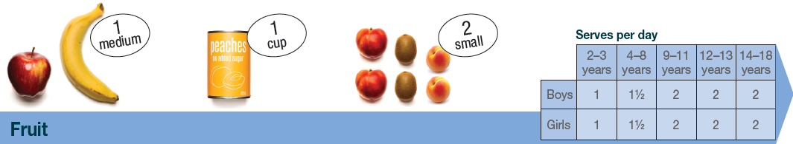
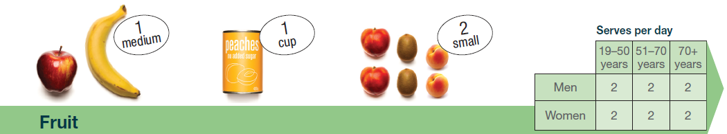
Fruit serves
From the age of 9 years, we all need 2 serves of fruit each day.
Notes:
Children aged 12-13 years require a similar amount of vegetable serves as adults (2 serves).
Younger children (aged 2-3 years) require half this amount.
From the age of 9 years, we all need 2 serves of fruit each day.
Example serve sizes are provided – these are different for different foods in this food group.
Based on material provided by the National Health and Medical Research Council (representing the Commonwealth of Australia)

Slide 21


Dairy and alternatives serves
Notes:
The recommended serves of dairy and alternative foods changes throughout the life stage.
They increase from 2 years, before decreasing after 18 years for men but increasing for women.
This is largely because of the varying needs for calcium as we get older (women require more than men).
Example serve sizes are provided – these are different for different foods in this food group.
Based on material provided by the National Health and Medical Research Council (representing the Commonwealth of Australia)

Slide 22


Meat and alternatives serves
From the age of 9 years, we need between 2 and 3 serves each day.
Notes:
Children aged 12-13 years require a similar amount of meat and alternative serves as adults (2 1/2 serves).
Younger children (aged 2-3 years) require around half this amount.
From the age of 9 years, we need between 2 and 3 serves each day. From the age of 50 years, women require half a serve less.
Example serve sizes are provided – these are different for different foods in this food group.
Based on material provided by the National Health and Medical Research Council (representing the Commonwealth of Australia)

Slide 23

Nutrient Reference Values
Source: https://www.eatforhealth.gov.au/nutrient-reference-values/resources/nrv-summary-tables
Notes:
The recommended serves of the food groups are based on meeting the specific nutrient requirements at different life stages.
Full table is linked in the lesson plan.
Source: https://www.eatforhealth.gov.au/nutrient-reference-values/resources/nrv-summary-tables

Slide 24
‘Sometimes’ foods
These foods can add to our enjoyment with eating.
They might be nice to have ‘sometimes’ and ‘in small amounts’, such as once a week.

Slide 25
‘Sometimes’ foods
We are, however, currently eating too much of these foods:
Age group (years) | Males (%) | Females (%)
2–4 | 28 | 26
5–11 | 37 | 38
12–17 | 34 | 36
18–29 | 32 | 29
30–49 | 29 | 31
50–64 | 32 | 30
65–74 | 32 | 29
75 and over | 33 | 31
A third of energy intake
Notes:
For adolescents aged 12-17, these foods make up around one third energy intake. While these foods can contribute to a feeling of enjoyment, this level is currently too high.
To note: This level slightly decreased from the previous survey in 2011-12, with sometimes foods contributing around 40% of energy intake for children and adolescents.
Source: 2023 National Nutrition and Physical Activity Survey

Slide 26
Activity 1: Booklet task
Choose a population group from the AGHE categories.
Develop a promotional message for this group highlighting their food group needs each day.
Include (as a minimum):
- Number of serves
- Example serve sizes
Be as creative as you like!
Notes:
Use the ADGs brochures
Link to the NRVs document in the lesson plan.

Slide 27
Lesson 2

Slide 28
Review

Slide 29
Why are the recommended daily serves of food groups different across population groups?
There are different energy and nutrient requirements at different life stages and for different genders.
Notes:
Responses vary

Slide 30
For children and adolescents (9–18 years), what is the proportion of energy intake that comes from ‘sometimes’ foods?
Around 40%. While these foods can contribute to a feeling of enjoyment, this level is currently too high.
Notes:
Responses vary

Slide 31
Learning intention: To review food and nutrient intake data sources.
Success criteria:
at least 5 key statistics on food and nutrient intake for a population group
comparison with recommendations.

Slide 32
Sources of food and nutrition information
A range of credible information and data are available to support the development of food and nutrition information for consumers.

Slide 33

National Nutrition and Physical Activity Survey
Notes:
The Australian Bureau of Statistics conducted the National Nutrition and Physical Activity Survey (NNPAS) in 2023–24.
It involved collecting detailed information on dietary intake and foods consumed from around 10,000 participants across Australia. The precious NNPAS was conducted in 2011–12.
Information for the nutrition component of the NNPAS was gathered using a 24-hour dietary recall on all foods, beverages and dietary supplements consumed on the day prior to the interview. Where possible, at least 8 days after the first interview, respondents were followed up to provide a second 24-hour dietary recall either via a web form or a second face-to-face interview.
This provided data on ‘usual intake’ of nutrients, which could be compared with recommended intakes.
Data from 24-hour food recalls are considered more robust than from food frequency questionnaires; however, they are more expensive and therefore, less frequently undertaken.

Slide 34

National Nutrition and Physical Activity Survey
Notes:
Review the available data with the students: https://www.abs.gov.au/statistics/health/food-and-nutrition/food-and-nutrients/2023#key-statistics

Slide 35

National Health Survey
Notes:
The Australian Bureau of Statistics conducted the National Health Survey (NHS) from January 2022 to April 2023.
Data was collected from approximately 13,100 households around Australia.
The survey focused on the health status of Australians and health-related aspects of their lifestyles.
Information was collected about respondents' long-term health conditions and on lifestyle factors which may affect health, such as tobacco smoking and vaping, alcohol consumption, fruit and vegetable consumption, and physical activity.
Self-reported health status, height, and weight were also collected.
In addition to the self-reported measures, respondents could voluntarily provide blood pressure, height, weight and waist measurements.
Food intake data were collected via a food frequency questionnaire, which is not as robust as the 24-hour food intake recall, but it can still provide useful information.

Slide 36

National Health Survey
Notes:
Source: https://www.abs.gov.au/statistics/health/health-conditions-and-risks/national-health-survey/2022#health-risk-factors

Slide 37

National Health Measures Survey
Notes:
The Australian Bureau of Statistics conducted the National Health Measures Survey (NHMS) in 2022–24.
It involved the collection of biomedical samples from participants aged 5 years and over across Australia.
The NHMS measured specific biomarkers for chronic disease and nutrition status, from tests on blood and urine samples.
Data are available on the prevalence of chronic conditions and nutrient biomarkers (indicators of food intake).

Slide 38

National Health Measures Survey
Notes:
Source: https://www.abs.gov.au/statistics/health/health-conditions-and-risks/national-health-measures-survey/2022-24#key-statistics

Slide 39

Apparent Consumption of Selected Foodstuffs
Notes:
The Australian Bureau of Statistics data on Apparent Consumption of Selected Foodstuffs provides experimental estimates of apparent consumption per capita of selected foods based on sales of products in Australia.
It provides an indication only, but can be useful for monitoring trends over time.

Slide 40

Apparent Consumption of Selected Foodstuffs
Notes:
Source: https://www.abs.gov.au/statistics/health/health-conditions-and-risks/apparent-consumption-selected-foodstuffs-australia/latest-release

Slide 41


Australia’s health
Notes:
Produced by the Australian Institute of Health and Welfare, Australia’s health has information on determinants of health, including diet and physical activity.
These summaries use data from other sources, including the Australian Health Survey and National Health Surveys from the Australian Bureau of Statistics.
Australia’s health is published every 2 years and is available on the AIHW website: aihw.gov.au

Slide 42

Australia’s health

Slide 43
Activity 1: Booklet task
Choose a population group from the AGHE categories.
Record at least 5 key statistics on their current food and nutrient intake.
Include details on how this compares with
the recommendations.

Slide 44
Lesson 3

Slide 45
Review

Slide 46
How does current food intake compare with the healthy eating recommendations?
Notes:
Responses vary based on the student research from the previous lesson.

Slide 47
Learning intention: To investigate barriers to healthy eating.
Success criteria:
at least 3 strategies for overcoming barriers.

Slide 48
Barriers to healthy eating
There are several factors that influence our ability to select and consume healthy foods.
What do you think these could be?
Notes:
List student responses.

Slide 49
Limited availability: cost and access
High cost of some nutritious foods.
Limited income to spend on food.
Lack of availability e.g. remote areas.
Difficulties accessing food supplies
e.g. lack of transport.
Notes:
Availability issues can stem from cost and/ or access factors.
Source: Nutrition - The inside story, 2020

Slide 50
Limited availability: cost and access
Market basket surveys compare the price of a basket of healthy foods (based on the Australian Dietary Guidelines) between different geographical areas.

Slide 51
Limited availability: cost and access
The Northern Territory Market Basket Survey has been conducted since 2000, with data collected across the Northern Territory in remote stores and district centre supermarkets.

Slide 52

Limited availability: cost and access
Notes:
This survey found that in 2023, a healthy food basket cost 40% more in remote stores than in district centre supermarkets.
This difference is getting bigger over time.
Source: https://data.nt.gov.au/dataset/nt-market-basket-survey-2023/resource/1cb2186e-63ea-4343-abee-d6e0fbc31f27

Slide 53
Lack of food preparation skills
People with sufficient food preparation skills are more likely to eat a healthy diet than those with a low level of food preparation skills.
If you know how to cook, you are more like to eat a healthy diet.
Notes:
Source:
Burton, M., Reid, M., Worsley, A., Mavondo, F. (2017) Food skills confidence and household gatekeepers' dietary practices, Appetite, 108 (183-190).
Celik, OM., Sahin, GA., Gurel, S. (2023) Do cooking and food preparation skills affect healthy eating in college students? Food Science & Nutrition, 11 (5898-5907).

Slide 54

Lack of knowledge on healthy eating
Through awareness of the short- and long-term benefits of eating a diet that aligns with the Australian Guide to Healthy Eating, the aim is to influence food choices and behaviours.

Slide 55





Misinformation
Celebrities, influencers and the general promotion of misinformation can create confusion around healthy eating.
Messaging does not align with the Australian Guide to Healthy Eating

Slide 56
Activity 1: Booklet task
Identify one barrier to healthy eating.
Identify at least 3 strategies for overcoming these barriers, whether at the individual, school or government level.
Notes:
They can choose barriers covered in this lesson or one they identify themselves.
Students can research for ideas.

Slide 57
Lesson 4

Slide 58
Review

Slide 59
What is one barrier to healthy eating and how can this barrier be overcome?
Notes:
Responses vary based on the student research from the previous lesson.

Slide 60
Learning intention: To develop skills to critique nutrition information.
Success criteria:
critique nutrition information based on key questions.

Slide 61
Healthy Eating Messaging
We are surrounded by messaging about nutrition and healthy eating.
This can come via television, social media, internet.
This information comes from people with varying levels of qualifications (or no
qualifications!).

Slide 62
Healthy eating messaging
Making food choices based on evidence is important.
What questions should you ask when trying to work out whether food and nutrition information is reliable?
Notes:
What should you look for when trying to work out whether food and nutrition information is reliable?

Slide 63
Questions to ask
Does the messaging vary substantially from the AGHE?
The Australian Guide to Healthy Eating (based on the Australian Dietary Guidelines), is based on a comprehensive review of evidence from university qualified nutrition professionals.
Notes:
If the messaging variers substantially from the AGHE, this could be an initial flag that it is not reliable.

Slide 64
Questions to ask
Who is the author and what are their qualifications?
Trusted nutrition professionals in Australia are university qualified in food and nutrition science. Look for whether they are Accredited Practicing Dietitians or Registered Nutritionists.

Slide 65
Questions to ask
Are they trying to sell something?
Sometimes (not always), information is misleading as the author is trying to sell a product. If you are unsure, cross-check the information with other sources.

Slide 66
Questions to ask
Is the information based on trusted scientific research?
If you are unsure, cross-check the information with other sources.

Slide 67
Questions to ask
Does the information promote extreme eating behaviour?
Eating behaviours with strict rules on what you ‘can’ and ‘can’t’ eat might sound easier to follow, but they can also be hard to sustain and/ or dangerous to your
health.
Notes:
These types of diets may not align with the Australian Dietary Guidelines because they often cut out whole food groups.
This means you will miss out on essential nutrients you need to stay healthy.

Slide 68



‘Healthy eating’ messaging
Protein is important at all stages of our life. Protein requirements for women only slightly increase after the age of 70 years (from 46 g/day to 57 g/day).
Uses the term ‘avoid’, which we need to be careful as it can cause challenges with adherence, and it can eliminate important foods.
How realistic and sustainable are these breakfast choices?
What are they ultimately trying to sell?
Who is this author and what are their qualifications?
BTW – eggs are actually high in protein and low in carbohydrates, so this is an error.
What is the evidence for this? No references are cited.
Notes:
What are some problems with this message? Ask the students for their response first, then go through some of the examples.
Uses the term ‘avoid’, which we need to be careful as it can cause challenges with adherence, and it can eliminate important foods.
Protein is important at all stages of our life. Protein requirements for women only slightly increase after the age of 70 years (from 46 g/day to 57 g/day).
What is the evidence for this? No references are cited.
What are they ultimately trying to sell?
How realistic and sustainable are these breakfast choices?
BTW – eggs are actually high in protein and low in carbohydrates, so this is an error.
Finally, who is this author and what are their qualifications?
The overall messaging does not align with the Australian Guide to Healthy Eating.

Slide 69

Activity 1: Booklet task
Review this infographic. Instructions are on the following slide.
Source: Instagram; however, the author is unknown.

Slide 70
Activity 1: Booklet task
Provide a critique of this infographic considering.
Does this message vary substantially from the AGHE?
Who is the author and what are their qualifications?
Are they trying to sell something?
Is the evidence based on trusted scientific research?
Does the information promote extreme eating behaviour?

Slide 71
Lesson 5

Slide 72
Review

Slide 73
Who is the author and what are their qualifications?
Does the information promote extreme eating behaviour?
What questions should you ask when trying to work out whether food and nutrition information is reliable?
Are they trying to sell something?
Is the evidence based on trusted scientific research?
Does this message vary substantially from the AGHE?
Notes:
Elicit responses from students, prior to going through the list of questions

Slide 74
Learning intention: To investigate different nutrition promotion strategies in schools.
Success criteria:
summary of strategy
steps to implementation
stakeholders that are important to success.

Slide 75
Nutrition promotion strategies
Schools are a great place to integrate and promote healthy eating.
In addition to learning about healthy eating through lessons, additional strategies can be undertaken to help improve the quality of food intake.
Let’s look at some of these.

Slide 76

National school canteen guidelines
Notes:
The school canteen is a key source of food for some children.
Some canteens are following healthy eating principles, and the Australian Government has developed guidelines to assist canteens become a ‘Healthy School Canteen’.
This is a framework to help guide menu development.
Source: https://www.health.gov.au/resources/publications/national-healthy-school-canteens-guidelines-for-healthy-foods-and-drinks-supplied-in-school-canteens

Slide 77

National school canteen guidelines
Notes:
Here are some examples of how these guidelines have been applied.

Slide 78

National school canteen guidelines
Notes:
Here are some examples of how these guidelines have been applied.

Slide 79



Fruit and vegetable break time
Notes:
Some schools may not currently have a designated fruit and vegetable break time.
This could be a time for students to stop and eat (5-8 minutes). Alternatively, students can eat while they work.
This program could be attached to a policy and information to parents.
Source: https://www.crunchandsip.com.au/

Slide 80


Healthy fundraising ideas
Notes:
Fundraising is important to schools. Most of the time, however, fundraising revolves around foods that would be classified as ‘sometimes’ foods.
A variety of resources are available to assist with healthy food fundraising ideas, or through non-food items.
Take the students through some examples (linked in the first image).
Source: https://actnss.org/wordpress/wp-content/uploads/2022/08/Healthy-Fundraising-200916.pdf

Slide 81


Lunch box guidelines
Notes:
Lunchbox guidelines can be provided to parents, along with reminders.
Posters can also be displayed in classrooms and around the school.
Source:
https://heas.health.vic.gov.au/resources/food-drink-ideas/healthy-lunchboxes/
https://www.crunchandsip.com.au/news/healthy-back-to-school-lunchbox-guide

Slide 82







Healthy eating messages
Notes:
Regular promotion of heathy eating via the school FB page, newsletter and school environment.
There are resources available, and students can create their own.
Source: https://education.nt.gov.au/policies/health-safety/school-nutrition-and-healthy-eating

Slide 83
Activity 1: Booklet task
Select on nutrition promotion strategy from this lesson.
Research the strategy and identify the potential key benefits in terms of healthy eating.
This information would help justify the
need for the strategy.

Slide 84
Lesson 6

Slide 85
Review

Slide 86
Fruit and vegetable break time
Healthy eating messages
What are some strategies that can be implemented in schools to enhance the quality of food intake?
Healthy fundraising ideas
Lunchbox guidelines
National school canteen guidelines

Slide 87
Learning intention: To develop a project plan for a nutrition promotion strategy.
Success criteria:
Activity (strategy) name
Target audience
Activity goals
Activity details
Timing and duration
Resources needed
Who will be involved (stakeholders)
Steps needed for the activity to be implemented

Slide 88
Nutrition promotion strategies
School canteen guidelines.
Fruit and vegetable break time.
Healthy fundraising ideas.
Lunchbox guidelines.
Healthy eating messages.
Notes:
We reviewed these in the last lesson.

Slide 89
Activity 1: Booklet task
Select a nutrition promotion strategy from this unit.
Map out a project plan including:
Activity (strategy) name
Target audience
Activity goals
Activity details
Timing and duration
Resources needed
Who will be involved (stakeholders)
Steps needed for the activity to be implemented

Slide 90
Lesson 7, 8 and 9

Slide 91
Learning intention: To develop a proposal to enhance the nutritional quality of food intake of children and/or adolescents.

Slide 92
Task
To propose and justify 1 key strategy that aims to enhance the nutritional quality of food intake of children and/or adolescents.

Slide 93


Slide 94


