Slide 1
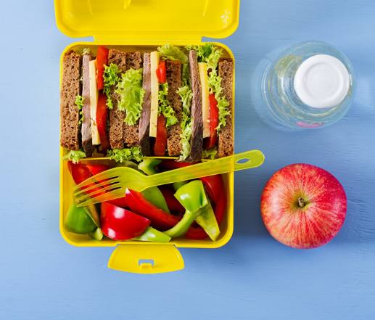
Designing a healthy lunchbox
Food and nutrition unit
Year 3
Notes:
Image: Designed by Freepik

Slide 2
Contents
Lesson 1 | Lesson 6
Lesson 2 | Lesson 7
Lesson 3 | Lesson 8
Lesson 4
Lesson 5

Slide 3
Lesson 1

Slide 4
In this unit we will be:
growing knowledge on healthy eating and the five food groups
applying this knowledge to design a healthy lunchbox.

Slide 5
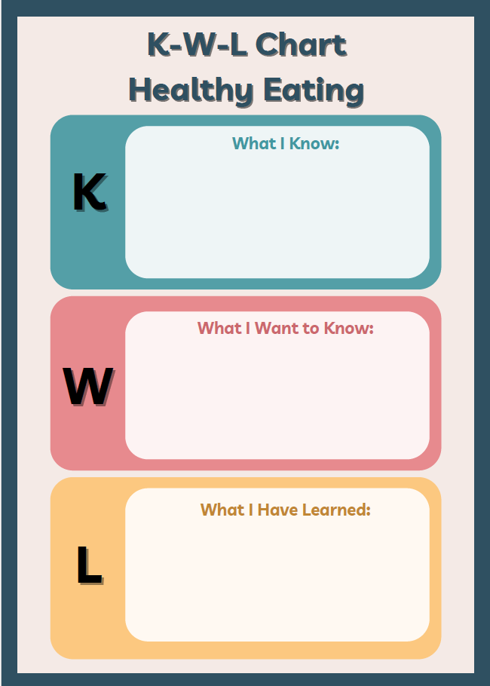
Activity 1: Booklet task
What do you know about the five food groups and healthy eating?
What do you know about healthy lunchboxes?
What would you like to know?

Slide 6
Learning intention: To create your own healthy eating plate.
Success criteria:
include the five food groups
include at least 3 foods from each food group.

Slide 7
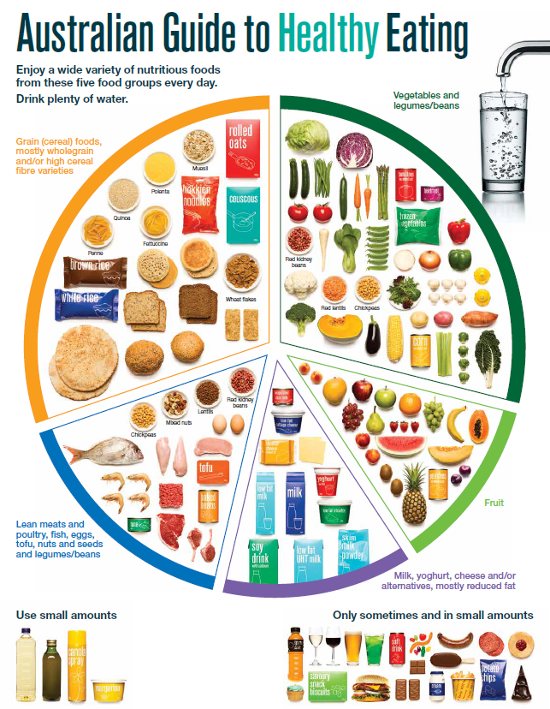
The Australian Guide to Healthy Eating
Notes:
The Australian Guide to Healthy Eating (AGHE) is a visual representation of the Australian Dietary Guidelines.
It is a broad guide to the types and amounts of foods we should eat each day.
The food groups:
Grain foods
Vegetables
Fruit
Dairy and alternatives
Meat and alternatives
Sitting off to the side are foods categorised as ‘sometimes’ foods. These foods are high in saturated fat and/or added sugars, added salt or alcohol and low in fibre. These foods and drinks can also be high in kilojoules (energy).

Slide 8
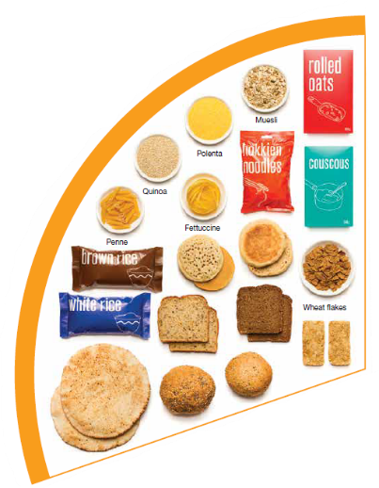
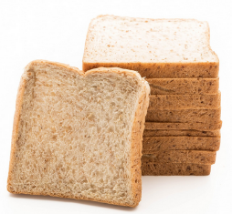
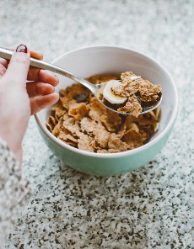
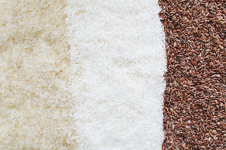

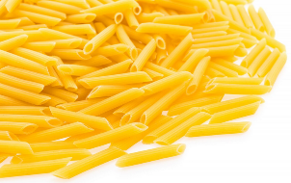
Grain foods
Breads
Breakfast cereal
Grains
Pasta
Other products
Mostly wholegrain and/or high cereal fibre varieties
Notes:
Grain foods comprise grains that can be cooked and eaten whole, ground into flour to make cereal foods, or made into breakfast cereals:
Breads: wholemeal, wholegrain, white, rye, pita, focaccia, crispbreads.
Breakfast cereals: high fibre (wholegrain) oats, porridge, muesli, wholewheat biscuits, ready to eat (such as cornflakes, cheerios).
Grains: rice, barley, corn, polenta, buckwheat, spelt, millet.
Pasta: short and long (white and wholemeal).
Other products: noodles, English muffin, crumpet, rice cakes, couscous, popcorn, flour.
The recommendation is for ‘mostly wholegrain and/or high cereal fibre varieties’ (at least two thirds). Wholegrain cereals contain more nutrients than refined cereal foods (e.g. white bread), because many of the important nutrients occur in the outer layer of the grain which is lost during processing.
Images: Designed by Pexels and Freepik
Based on material provided by the National Health and Medical Research Council (representing the Commonwealth of Australia)

Slide 9
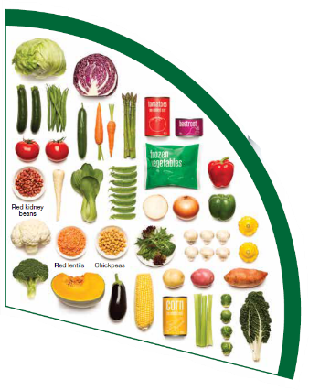
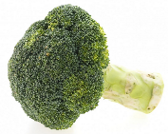

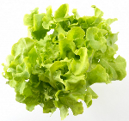



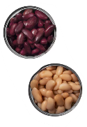

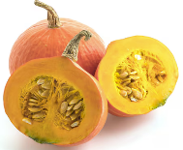


Vegetables
Dark green and cruciferous
Root/ tubular/ bulb
Legumes/beans
Other
Choose a variety, including different colours, each day
Notes:
Types of vegetables (also includes legumes and beans):
Dark green and cruciferous: broccoli, brussels sprouts, bok choy, cabbages, cauliflower, lettuce, spinach, snow peas.
Root/ tubular/ bulb: potato, sweet potato, carrots, beetroot, onion, shallots, garlic, swede, turnip.
Legumes/ beans: kidney beans, soybeans, lima beans, cannellini beans, chickpeas, lentils, split peas, tofu.
Other: tomato, celery, zucchini, avocado, capsicum, eggplant, mushrooms, cucumber, pumpkin, green peas, green beans.
Eat different colours of vegetables, as the different colour groups have different vitamins and minerals.
Vegetables such as tomatoes and pumpkins are technically classified as fruit because they have seeds. They are included in the vegetable group because they have similar nutritional properties as vegetables and are typically eaten as a vegetable.
Images: Designed by Freepik
Based on material provided by the National Health and Medical Research Council (representing the Commonwealth of Australia)

Slide 10
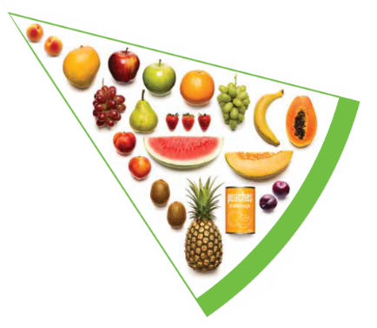


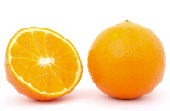

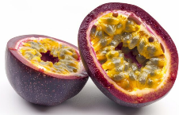





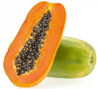
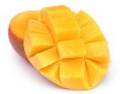
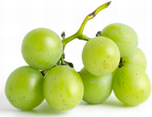

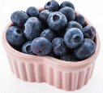
Fruit
Pomme
Citrus
Stone
Tropical
Berries
Choose dried fruit or fruit juice only occasionally
Notes:
Types of fruit:
Pome fruit: apple, pear.
Citrus fruit: orange, mandarin, grapefruit.
Stone fruit: apricot, cherry, peach, nectarine, plum.
Tropical: banana, paw paw, mangoes, pineapple and melon.
Berries: strawberry, blueberry, raspberry, blackberry.
Other: grapes, passionfruit.
Whole or chopped fruit is the best choice.
Fresh, frozen and canned fruits are all part of this food group. It is best to avoid fruits canned in syrup and choose varieties canned in natural juice or water instead.
Choose dried fruit or fruit juice only occasionally:
Eating dried fruit regularly is not recommended as it is high in kilojoules, can stick to the teeth and increases the risk of dental decay. You can also easily eat more than you realise.
Fruit juice is acidic and can increase the risk of dental decay. Fruit juice also has less fibre and other nutrients than whole fruit.
Different fruits can help protect our bodies in different ways, so it’s important to choose a variety, including different colours, each day.
Differences between fruit and vegetables
Fruits and vegetables are from different parts of a plant. Fruits come from the flowering part of a plant and contain seeds. Vegetables are the edible parts of a plant, such as the leaves, stem, roots, and bulbs.
Fruits that are eaten like vegetables: pumpkin, cucumber, tomato (and therefore part of the vegetable group).
Images: Designed by Pexels, Freepik and ChatGPT
Based on material provided by the National Health and Medical Research Council (representing the Commonwealth of Australia)

Slide 11
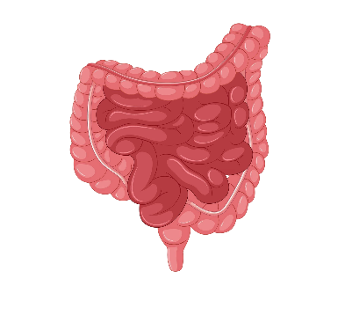



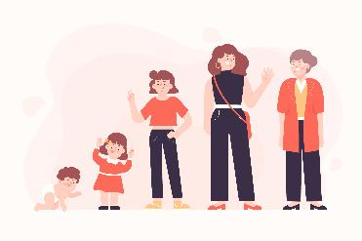

Why grain foods, vegetables and fruit are important
Provide the best source of energy (slow-release energy): fuels our brain (for concentration) and our body
Provide fibre: to help keep our intestines healthy
Provide lots of vitamins and minerals to help our bodies grow and age
Notes:
The complex carbohydrates in these foods are slowly digested, which provides energy over time and helps prevent overeating.
Carbohydrate provides the best source of energy for the brain.
Fibre helps us stay fuller for longer, which can help with concentration.
Fibre is especially useful in keeping the digestive track (including the intestines) healthy and can assist with constipation.
The vast range of vitamins and minerals are important for growth and repair, healthy ageing, and preventing chronic conditions.
Images: Designed by Pexels and Freepik

Slide 12
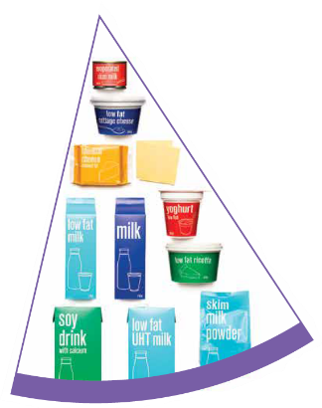


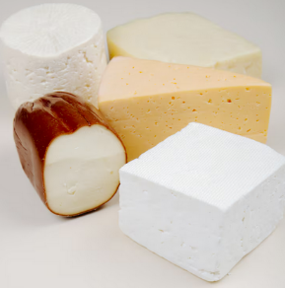
Dairy and alternatives
Milk (fresh and long life)
Yoghurt
Cheese
Reduced fat varieties are the best choice for most
Notes:
Types of foods:
Milks: All reduced fat or full cream milks, plain and flavoured, long life milks, powdered milk, evaporated milk, soy beverages (fortified with at least 100mg calcium/100mL).
Yoghurt: All yoghurts including reduced fat or full cream, plain and flavoured, soy yoghurt (calcium fortified).
Cheese: All hard cheeses, reduced or full fat, for example cheddar, red Leicester, Gloucester, Edam, Gouda Soy cheeses (calcium fortified).
Dairy = products made from milk.
Dairy alternatives:
Calcium-fortified dairy alternatives include soy, rice, almond or oat milk and soy or lactose free yoghurts and cheeses.
Non-dairy alternatives do not naturally contain calcium. It is important to select products labelled as calcium-fortified.
Many of the alternative milks, with the exception of soy milk products, may not be a good source of protein and other key nutrients found in milk and products made from milk.
For vegetarians and vegans, dairy alternative products such as soy milk and cheese are a key source of nutrients, particularly protein and calcium (if calcium is added by the manufacturer), and need to be included regularly to ensure their diet is nutritionally balanced.
Images: Designed by Freepik
Based on material provided by the National Health and Medical Research Council (representing the Commonwealth of Australia)

Slide 13

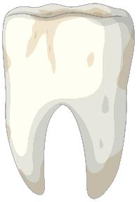
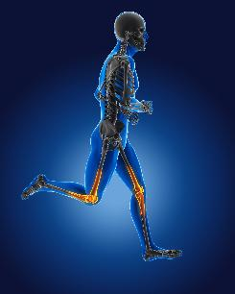
Why dairy and alternative foods are important
Provide calcium: for strong bones and teeth
Provide protein: helps our body grow and become strong
Provide lots of vitamins and minerals to help our bodies grow and age
Notes:
Calcium helps ensure strong bones and teeth.
Proteins are made up of chemical 'building blocks' called amino acids. Your body uses amino acids to build and repair muscles and bones.
Iodine is needed to make essential thyroid hormones. These are used by the body for growth and energy use, as well as brain and bone development in the early years.
Vitamin B12 is essential for the production of red blood cells, which are needed to carry oxygen from the lungs to the body’s tissues and organs.
Images: Designed by Pexels and Freepik

Slide 14
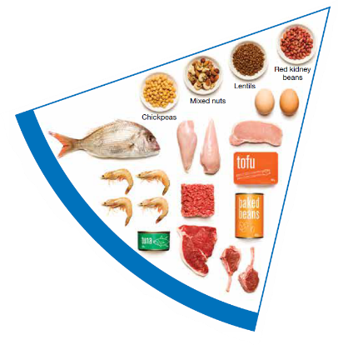


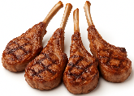
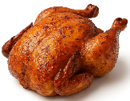
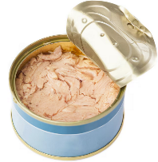
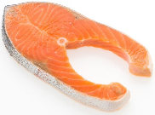

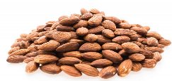
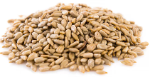
Meat and alternatives
Pink and red meat
Poultry
Fish and seafood
Eggs
Nuts and seeds
Legumes/beans
Choose meat without visible fat
Notes:
Types of foods:
Lean meats: beef, lamb, pork, kangaroo, lean and low salt sausages.
Poultry: chicken, turkey, duck, emu, goose.
Fish and seafood: fish, prawns, crab, lobster, mussels, oysters, scallops, clams.
Eggs: chicken eggs, duck eggs.
Nuts and seeds: almonds, pine nuts, walnut, macadamia, hazelnut, cashew, peanut, nut spreads, brazil nuts, seeds.
Legumes/beans: all beans, lentils, chickpeas, split peas, tofu.
To ensure adequate iron and zinc, about half the serves from this food group should be lean meats. For those who do not eat animal foods, nuts, seeds, legumes (including tofu) can provide some iron and zinc, plus a good mix of plant-based protein.
Choose lean meat options and/or remove the visible fat from the meat prior to cooking to reduce the total amount of saturated fat consumed.
Fresh, frozen and canned varieties of meat, poultry or fish are included in this group. It is important that canned varieties are low in fat and low in salt (no added salt) and canned in water rather than in oil or brine.
Sausages, commercial burgers and meat pastries can be high in saturated fat and are classified as a ‘sometimes’ food. It is recommended the consumption of these foods be limited. If purchasing sausages, it is best to select lean or reduced fat versions and boil or fry in a non-stick pan or BBQ.
Processed meats, such as salami and bacon are high in salt and saturated fats are classified as a ‘sometimes’ food. Consumption should be limited.
Meat alternatives (plant foods):
Nuts and seeds.
Legumes/beans appear in this group as well as the vegetable group.
For vegetarians and vegans, these foods are a key source of nutrients, particularly protein and iron, and need to be included regularly to ensure their diet is nutritionally balanced.
Images: Designed by Freepik and ChatGPT
Based on material provided by the National Health and Medical Research Council (representing the Commonwealth of Australia)

Slide 15

Why meat and alternative foods are important
Provide zinc and iron: keeps our blood healthy and gives us energy
Provide protein: helps our body grow and become strong
Provide essential fatty acids to keep our brains and heart healthy
Notes:
Proteins are made up of chemical 'building blocks' called amino acids. Your body uses amino acids to build and repair muscles and bones.
Iron is particularly important for transporting oxygen in the blood. This is essential for providing energy for daily life. Iron also helps our immune system fight infection.
Zinc is important for growth and for the immune system to fight infection.
Images: Designed by Freepik

Slide 16






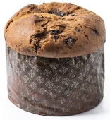
‘Sometimes’ foods
Higher in added sugars
Higher in fat (and sodium)
Higher in both
To be consumed sometimes and in small amounts
Notes:
Some foods and drinks do not fit into the five food groups. These foods are high in saturated fat and/or added sugars, added salt or alcohol and low in fibre. These foods and drinks can also be high in kilojoules (energy).
Types of foods:
Higher added sugars: Soft drinks, energy drinks, sugar confectionary, jams, some sauces.
Higher fat: Most processed meats (bacon, ham, sausages, frankfurts), crisps, butter, cream, pastry products, meat pies, sausage rolls, potato chips, commercial pizza.
Higher added sugars AND higher fat: Biscuits, cakes, chocolate, doughnuts, ice cream, iced buns, some muesli bars, muffins, sweet pastries.
Alcoholic drinks.
‘Sometimes’ foods in a healthy diet:
Some people require extra serves of food, for example, those who are taller and more active. These can sometimes include extra serves of ‘sometimes’ foods. It is best if these extra serves come from the five food groups, particularly wholegrain cereals, vegetables including legumes/beans and fruit. However, they can also sometimes include serves of ‘sometimes’ foods (discretionary foods).
These foods can, however, contribute to a feeling of enjoyment. They should be consumed sometimes, and in small amounts, such as once a week.
Images: Designed by Freepik
Based on material provided by the National Health and Medical Research Council (representing the Commonwealth of Australia)

Slide 17
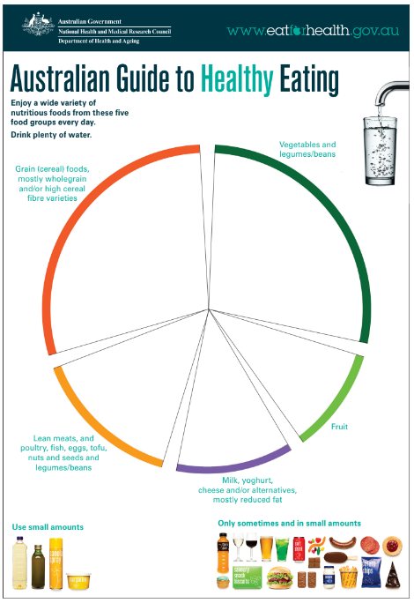
Activity 2: Booklet task
Create your own Australian Guide to Heathy Eating
Include:
foods from the five food groups
at least 3 foods from each group.
Extension:
How are the foods in the food groups good for our bodies?
Notes:
Students create their own Australian Guide to Healthy Eating.
They are to include:
foods from the five food groups
at least 3 foods from each food group
Students add text; answering the question: How are the foods in the food groups good for our bodies?
Image: National Health and Medical Research Council (representing the Commonwealth of Australia)

Slide 18
Lesson 2

Slide 19
Review

Slide 20
Why are grain foods, vegetables and fruit important?
How many reasons can you think of?

Slide 21
Answer: Why are grain foods, vegetables and fruit important?
Provide the best source of energy (slow-release energy): fuels our brain (for concentration) and our body
Provide fibre: to help keep our intestines healthy
Provide lots of vitamins and minerals to help our bodies grow and age
Notes:
The complex carbohydrates in these foods are slowly digested, which provides energy over time and helps prevent overeating.
Carbohydrate provides the best source of energy for the brain.
Fibre helps us stay fuller for longer, which can help with concentration.
Fibre is especially useful in keeping the digestive track (including the intestines) healthy and can assist with constipation.
The vast range of vitamins and minerals are important for growth and repair, healthy ageing, and preventing chronic conditions.
Images: Designed by Pexels and Freepik

Slide 22
Why are dairy and alternative foods important?
How many reasons can you think of?

Slide 23
Answer: Why are dairy and alternative foods important?
Provide calcium: for strong bones and teeth
Provide protein: helps our body grow and become strong
Provide lots of vitamins and minerals to help our bodies grow and age
Notes:
Calcium helps ensure strong bones and teeth.
Proteins are made up of chemical 'building blocks' called amino acids. Your body uses amino acids to build and repair muscles and bones.
Iodine is needed to make essential thyroid hormones. These are used by the body for growth and energy use, as well as brain and bone development in the early years.
Vitamin B12 is essential for the production of red blood cells, which are needed to carry oxygen from the lungs to the body’s tissues and organs.
Images: Designed by Pexels and Freepik

Slide 24
Why are meat and alternative foods important?
How many reasons can you think of?

Slide 25
Answer: Why are meat and alternative foods important?
Provide zinc and iron: keeps our blood healthy and gives us energy
Provide protein: helps our body grow and become strong
Provide essential fatty acids to keep our brains and heart healthy
Notes:
Proteins are made up of chemical 'building blocks' called amino acids. Your body uses amino acids to build and repair muscles and bones.
Iron is particularly important for transporting oxygen in the blood. This is essential for providing energy for daily life. Iron also helps our immune system fight infection.
Zinc is important for growth and for the immune system to fight infection.
Images: Designed by Freepik

Slide 26
Learning intention: To investigate the five food groups.
Success criteria:
example foods
recommended serves per day
why food group is important.

Slide 27

Make those bodies sing!
Notes:
Play this TV commercial for bananas [0.30].
Explain that this is an engaging advertisement with a catchy tune; however, the concept is important. That is, fruit (in this case bananas) is an important food to be including in our diet to help us do the things we enjoy doing. This equally applies to other foods in the food groups.

Slide 28
How much should you be eating?
There is a recommended amount of each food group that should be eaten each day.
These amounts are different depending on your age, and sometimes your gender.

Slide 29
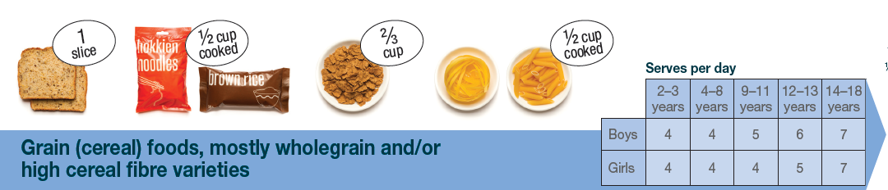
Grain food serves
Children aged 9–11 years need 5 (boys) and 4 (girls) serves of grain
foods each day.
Notes:
Focus on children aged 9-11 years.
Based on material provided by the National Health and Medical Research Council (representing the Commonwealth of Australia)

Slide 30
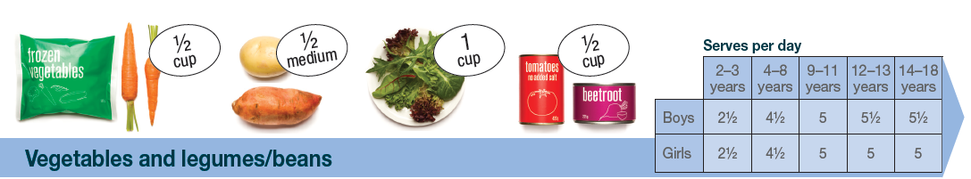
Vegetable serves
Children aged 9–11 years need 5 serves of vegetables each day.
Notes:
Focus on children aged 9-11 years.
Based on material provided by the National Health and Medical Research Council (representing the Commonwealth of Australia)

Slide 31
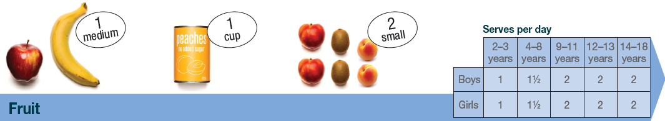
Fruit serves
Children aged 9–11 years need 2 serves of fruit each day.
Notes:
Focus on children aged 9-11 years.
Based on material provided by the National Health and Medical Research Council (representing the Commonwealth of Australia)

Slide 32
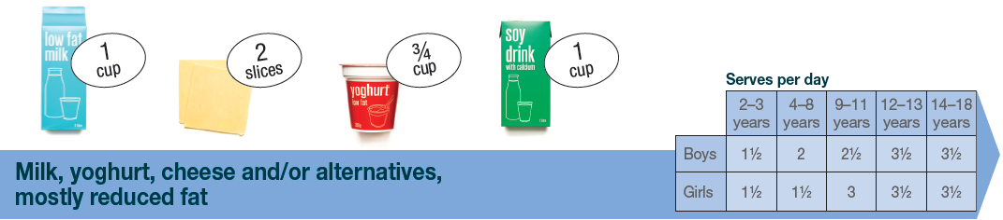
Dairy and alternative serves
Children aged 9–11 years need 2½ (boys) and 3 (girls) serves of dairy and alternative foods each day.
Notes:
Focus on children aged 9-11 years.
These difference in serves relates to the high calcium and protein needs for girls in this age group.
Based on material provided by the National Health and Medical Research Council (representing the Commonwealth of Australia)

Slide 33
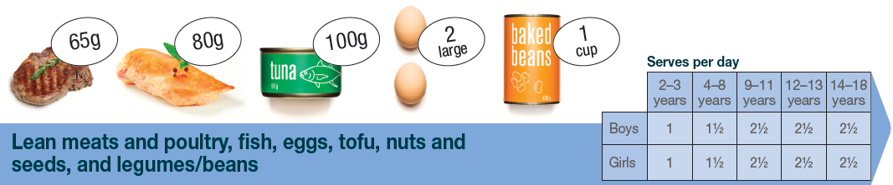
Meat and alternative serves
Children aged 9–11 years need 2½ serves of meat and alternative foods each day.
Notes:
Focus on children aged 9-11 years.
Based on material provided by the National Health and Medical Research Council (representing the Commonwealth of Australia)

Slide 34
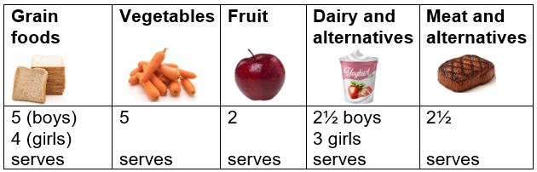
Food group serves: 9–11 years
Notes:
This slide brings together the serves for children aged 9–11 years.
Why are the serve amounts different across the food groups?
Responses could include:
Different types of nutrients (vitamins and minerals) provided.
Different amounts of energy (sugars) in the foods e.g. more sugar in fruit than in vegetables.
Images: Designed by Pexels, Freepik and ChatGPT
Based on material provided by the National Health and Medical Research Council (representing the Commonwealth of Australia)

Slide 35
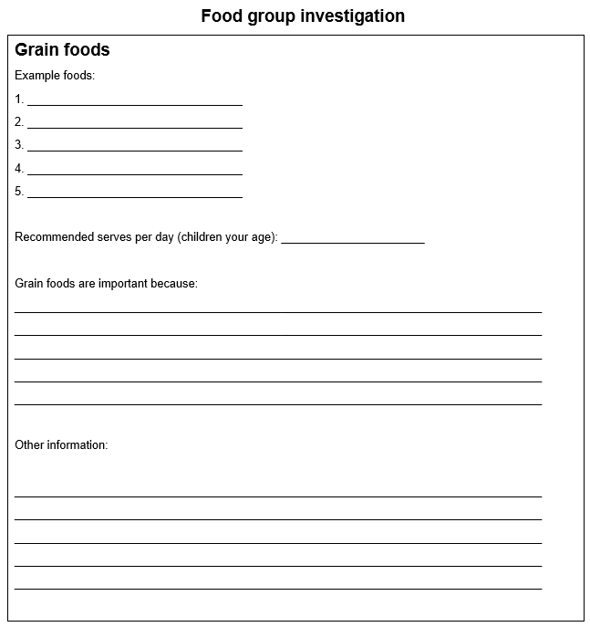
Activity 1: Group task
Notes:
In groups, students are assigned one of the five food groups.
Students are to create an information sheet on their food group [research template available to use].
If needed, go back through the slides from Lesson 1.
Also available is the AGHE guide, with information on each food group.
Students can do additional research.

Slide 36
Lesson 3

Slide 37
Review

Slide 38

How many serves of grain foods do children aged 9-11 years need each day?
5 (boys)
4 (girls)
Notes:
Based on material provided by the National Health and Medical Research Council (representing the Commonwealth of Australia)

Slide 39

How many serves of vegetables do children aged 9-11 years need each day?
5
Notes:
Based on material provided by the National Health and Medical Research Council (representing the Commonwealth of Australia)

Slide 40
How many serves of fruit do children aged 9-11 years need each day?
2
Notes:
Based on material provided by the National Health and Medical Research Council (representing the Commonwealth of Australia)

Slide 41
How many serves of dairy and alternative foods do children aged 9-11 years need each day?
2½ (boys)
3 (girls)
Notes:
Based on material provided by the National Health and Medical Research Council (representing the Commonwealth of Australia)

Slide 42
How many serves of meat and alternative foods do children aged 9-11 years need each day?
2½
Notes:
Based on material provided by the National Health and Medical Research Council (representing the Commonwealth of Australia)

Slide 43
Learning intention: To draw and label a design.
Success criteria:
title
draw design
label each part of the design.

Slide 44
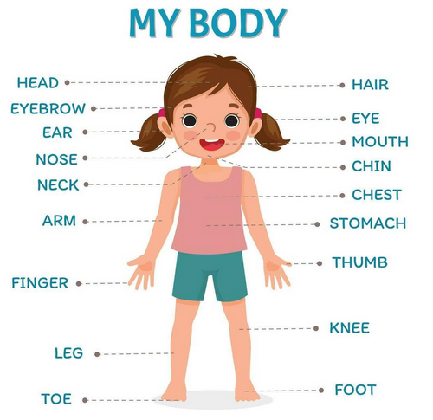
Notes:
I do: Explain that adding labels to images helps the reader understand the image a lot better and can help communicate a message.
In this image, we can see a girl, with the labels telling us about the parts of her body.
Image: Vecteezy

Slide 45
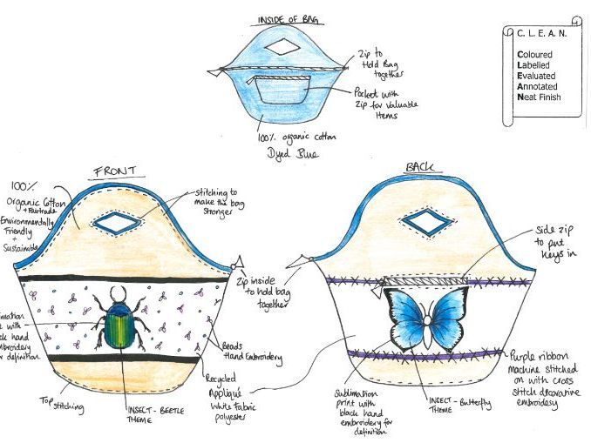
My bag design
Notes:
I do: In this image here, we can see a bag design, with each of the parts of the design labelled.
Notice the words with the lines? Each line links the words with the part of the bag.

Slide 46

Activity 1: Labelling a design
Let’s create together
Notes:
We do: Display this design and work with the students to add labels.
Complete on an anchor chart OR the image is available as a file to annotate with the students.

Slide 47
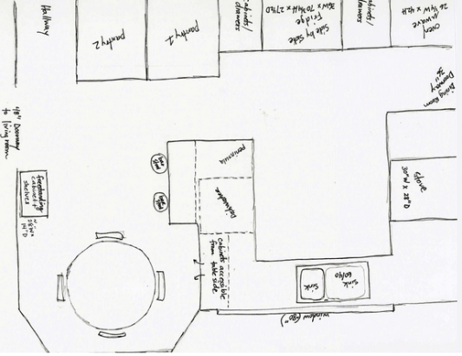
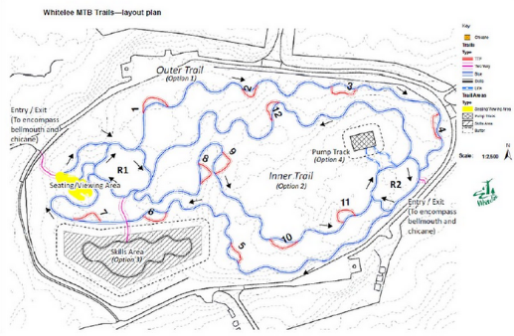
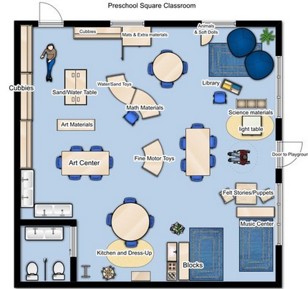
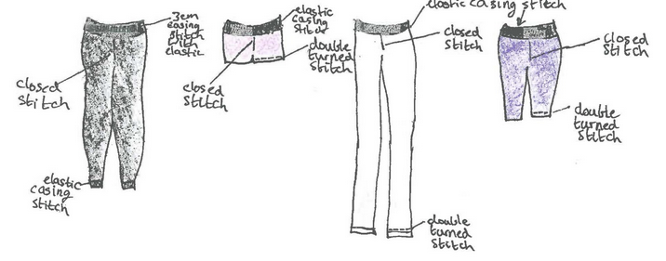
Activity 2: Booklet task
Title
Design
Label each part of the image
Mountain bike/ sporting track
House/bedroom
Clothing
Notes:
Using their unit booklet (lesson 4), students draw and label a design of their choice.
Students to include:
Title
Design
Label each part of the design
Design options (if needed):
Bedroom
Classroom
Own playground
Clothing
Mountain bike track (and other sporting tracks).

Slide 48
Lesson 4

Slide 49
Review

Slide 50
What are examples of dairy and alternative foods?

Slide 51
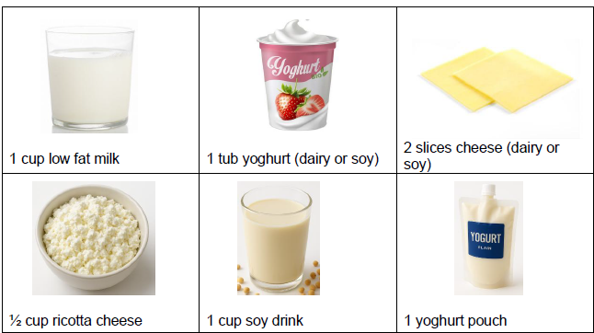
Answer: What are examples of dairy and alternative foods?
Notes:
Images: Designed by Freepik and ChatGPT

Slide 52
What are examples of grain foods?

Slide 53
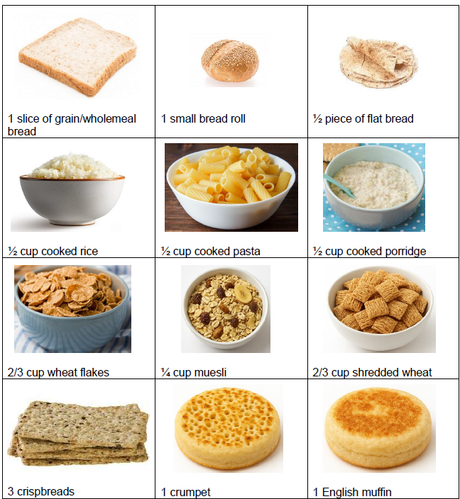
Answer: What are examples of grain foods?
Notes:
Images: Designed by Freepik and ChatGPT

Slide 54
Learning intention: To investigate healthy lunchbox snacks.
Success criteria:
at least 3 items
label each item and its parts
label the food groups in each item.

Slide 55
Snacks
Why do we need snacks?
When are you likely to have snacks?
What are some of the snacks you eat?
Notes:
Elicit responses from students.

Slide 56
Snacks
What should we look for when choosing snacks?
Notes:
Elicit responses from students.
From a nutritional perspective, we should focus on from the Australian Guide to Healthy Eating (the five food groups). However, we also consider taste and convenience. The key is to get a balance between these.

Slide 57
Snacks
Aim for foods from the five food groups
Vegetable pieces and dip | Plain or flavoured milk | Home made fruit muffins
Nuts and seeds (not at school) | Can of tuna | Home made protein balls
Fruit | Hard boiled egg | Baked beans
Flatbread wraps/ sandwich with spread (avocado, cheese) | Wholegrain crackers and spread | Cheese and wholegrain crackers
Yoghurt | Fruit bread | Fruit with yoghurt
Rice cakes with toppings e.g. cheese (tasty, ricotta, cottage), avocado, vegemite
What else can you suggest?

Slide 58

Snacks
For packaged food, you can also use the Health Star Rating as a guide.
Step 1: Identify whether food is a core food in the AGHE.
Step 2: Select a packaged food with the highest rating in that category.

Slide 59

Activity 1: Booklet task
Draw 3 healthy lunchbox snacks based on the Australian Guide to Healthy Eating.
Label each item and its parts.
Label the food groups in each item.
Notes:
Use the previous slide for examples.
Students can identify their own.

Slide 60
Lesson 5

Slide 61
Review

Slide 62

What concept helps guide the choice of lunchbox snack items?
Answer: Choose foods that fit within the Australian Guide to Healthy Eating

Slide 63
What are some healthy lunchbox snack items?
Vegetable pieces and dip | Plain or flavoured milk | Home made fruit muffins
Nuts and seeds (not at school) | Can of tuna | Home made protein balls
Fruit | Hard boiled egg | Baked beans
Flatbread wraps/ sandwich with spread (avocado, cheese) | Wholegrain crackers and spread | Cheese and wholegrain crackers
Yoghurt | Fruit bread | Fruit with yoghurt
Rice cakes with toppings e.g. cheese (tasty, ricotta, cottage), avocado, vegemite
What else can you suggest?

Slide 64
Learning intention: To investigate healthy lunch items.
Success criteria:
at least 3 items
label each item and its parts
label the food groups in each item.

Slide 65

Notes:
The poster shows how students can apply the concepts of the Australian Guide to Healthy Eating (AGHE) to create a healthy lunchbox every day.
We should include at least one option from the food groups (on their own or as part of a recipe).
Page 2 of the poster (next slide) shows the types of foods to enjoy from within each category, which can be used in a school lunchbox.

Slide 66


Slide 67
What lunch items do you enjoy?
What lunch items could be included in a nutritious lunchbox?
Do these align with the five food groups from the AGHE?
What food groups are covered in these suggestions?
Notes:
Refer back to page 2 of the Pick&Mix poster as a guide.
What lunch items do you enjoy? Receive responses from the different cultural groups from within the class.
Do these align with the five food groups from the Australian Guide to Healthy Eating? If no, could they be adapted?
What food groups are included in these suggestions?
Record student responses.

Slide 68
Activity 1: Booklet task
Draw 3 healthy lunch items based on the Australian Guide to Healthy Eating.
Label each item and its parts.
Label the food groups in each item.
Notes:
Students are to develop a set of nutritious lunch items that could be included in a school lunchbox (not snacks).
Students can use the Pick&Mix 1-6 poster to help them with the task.

Slide 69
Lesson 6

Slide 70
Learning intention: To make a lunchbox item that is healthy and tasty.

Slide 71
Options
Sandwiches with different fillings
Chicken and avocado wrap
Vegetable slices and dip
Fruit salad with yoghurt
Share platter
Homemade pizzas
Muesli slice
Apple cinnamon muffins

Slide 72
Lesson 7

Slide 73
Review

Slide 74
What are examples of meat and alternative foods?

Slide 75

Answer: What are examples of meat and alternative foods?
Notes:
Images: Designed by Freepik and ChatGPT

Slide 76
What are examples of vegetables?

Slide 77

Answer: What are examples of vegetables?
Notes:
Images: Designed by Freepik and ChatGPT

Slide 78
Learning intention: To suggest changes to lunchbox items to make them healthier options.
Success criteria:
identify changes for 8 lunchbox items
changes align with the AGHE
label images with suggested
changes.

Slide 79
Notes:
Review:
The poster shows how students can apply the concepts of the Australian Guide to Healthy Eating (AGHE) to create a healthy lunchbox every day.
We should include at least one option from the food groups (on their own or as part of a recipe).
Page 2 of the poster (next slide) shows the types of foods to enjoy from within each category, which can be used in a school lunchbox.

Slide 81








Lunchbox items
Notes:
These are food items than can be found in lunchboxes.
There are changes/swaps that can be made to these items so that they are healthier options based on the AGHE.
Teacher note: Many of these items as ‘sometimes’ foods, which can be enjoyed occasionally and in small amounts. They are not the best choices to include in lunchboxes.
Images: Designed by Freepik and ChatGPT

Slide 82
Activity 1: Booklet task
Review the 8 lunchbox items.
Suggest changes to make them healthier (modify or swap for something else).
Label each image with suggested changes
Notes:
The aim for this task is for students to try and align the foods with the AGHE.
Students to use the Pick&Mix 1-6 poster to assist.
Suggested responses for items include:
swapping the white bread for brown, adding cheese and salad vegetables (white bread is fine as well; however, brown bread is often higher in fibre)
swapping the lollies for dried fruit
adding cheese or hummus dip to go with the biscuits and/or swapping the biscuits for wholegrain biscuits
swapping for the potato crisps for wholegrain crisps (like Grain Waves).
Swapping the chocolate wafer bar for a wholegrain muesli bar (like Uncle Tobys bars)
Swapping the chocolate muffin and chocolate chip biscuits for a home-made fruit muffin
swapping the fruit drink for water or 100% orange juice

Slide 83
Lesson 8

Slide 84
Learning intention: To design a healthy lunchbox for yourself or someone your age.

Slide 85
Task
To design a healthy lunchbox. Explain how your lunchbox will help support health and wellbeing.

Slide 86


Slide 87


