Slide 1
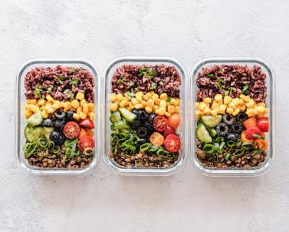

Promoting healthy eating
Food and nutrition unit
Year 7
Notes:
Images: Designed by Pexels

Slide 2
Contents
Lesson 1 | Lesson 5
Lesson 2 | Lesson 6
Lesson 3 | Lesson 7, 8 and 9
Lesson 4

Slide 3
Lesson 1

Slide 4
In this unit we will be:
reviewing current nutrition advertising practices
reviewing the Australian Guide to Healthy Eating
investigating food labelling
investigating food allergies and intolerances
investigating the impact of media on healthy eating
developing a nutrition promotion advertisement that aims to encourage healthy eating.

Slide 5
Learning intention: To review current nutrition advertising practices.
Success criteria:
promotional strategies
key messages
credibility of information
advertising mediums.

Slide 6
Eating healthy foods is important for a healthy life.
Despite this importance, nutrition promotion through advertising is not as prevalent as it should be.
When was the last time you saw advertising on healthy eating?

Slide 7
Advertising of healthy eating is undertaken, which is often by food companies and nutrition professionals.
Today, this is largely undertaken through social media.

Slide 8
Let’s look at some examples

Slide 9
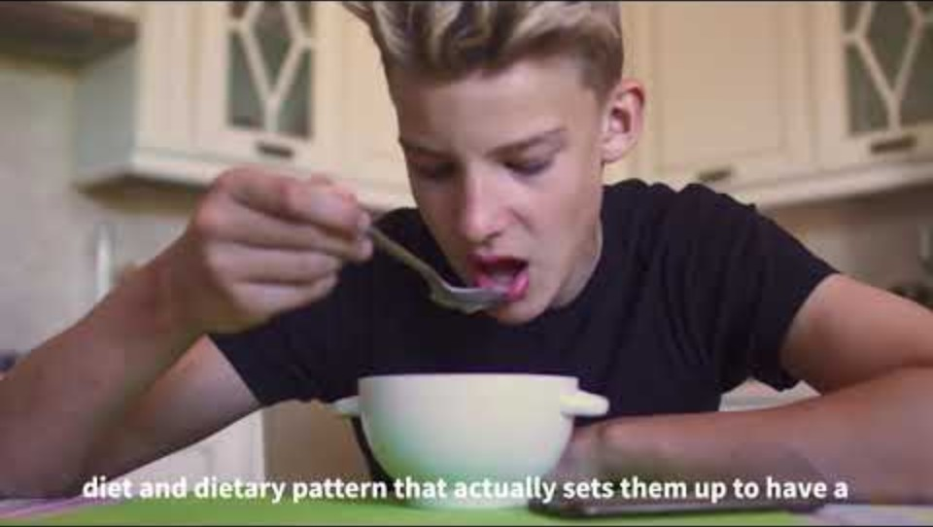
Healthy eating for teenagers
Notes:
[5.57]
As students watch this, they are to identify:
Promotional strategies used. Does this appeal to the audience?
Key messages.
Credibility of information (think about the author).
Advertising mediums e.g. video, infographic, You Tube short.

Slide 10
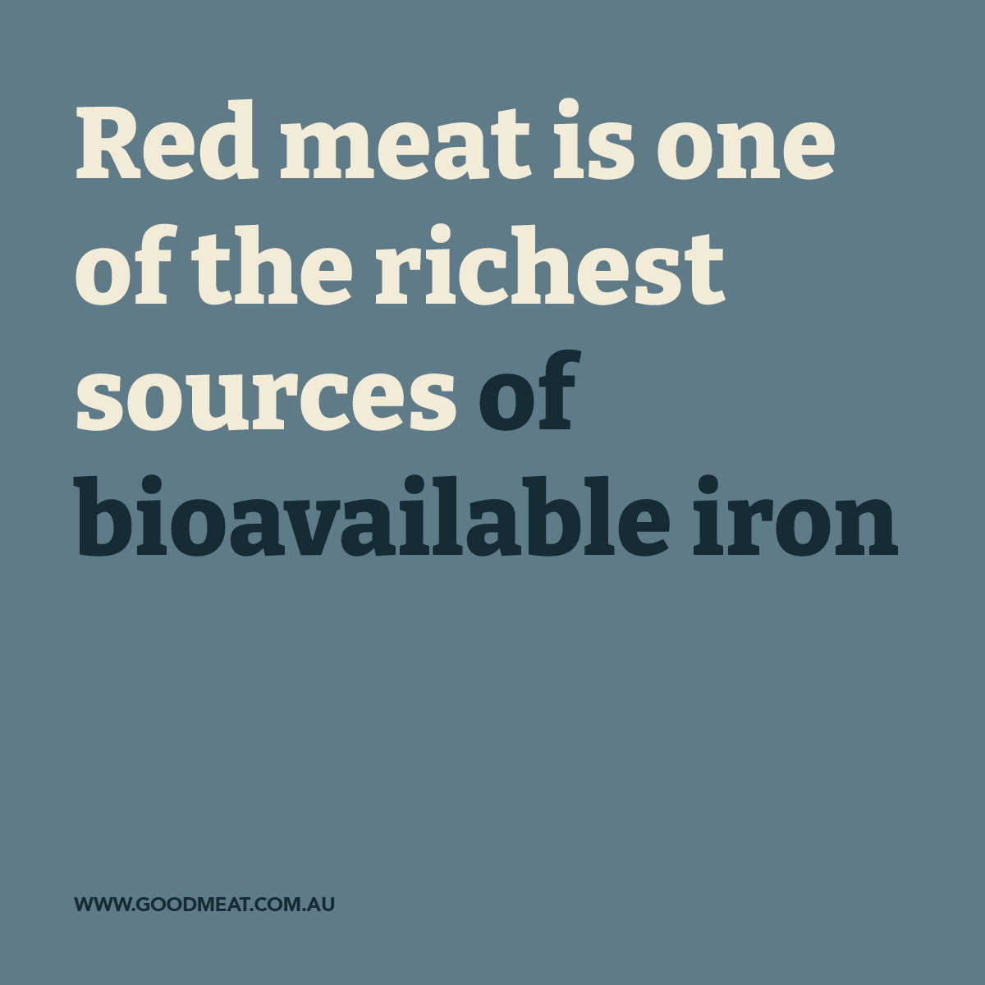
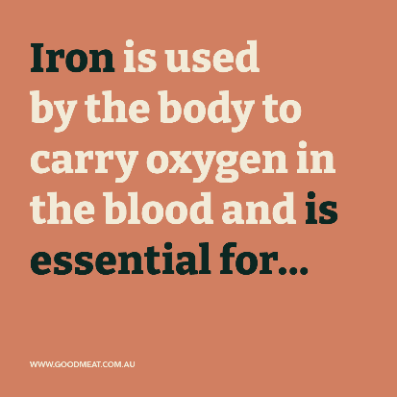
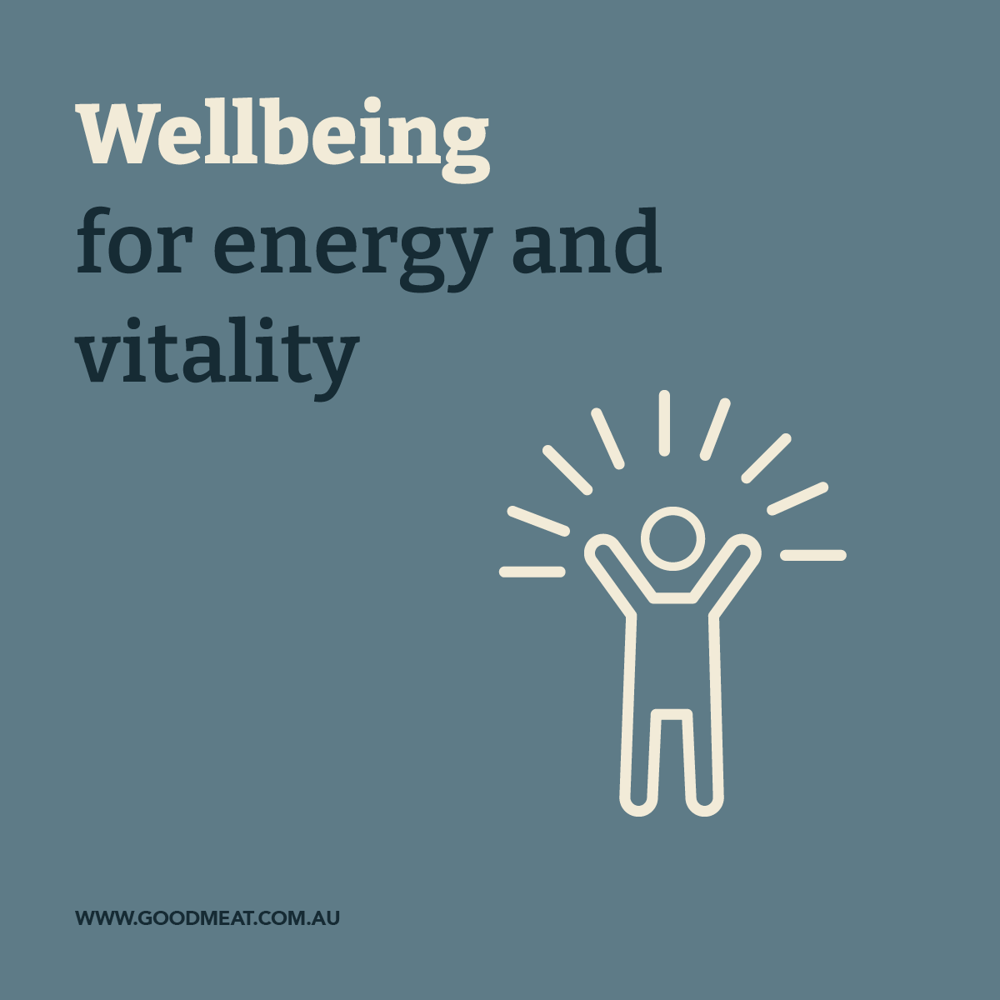
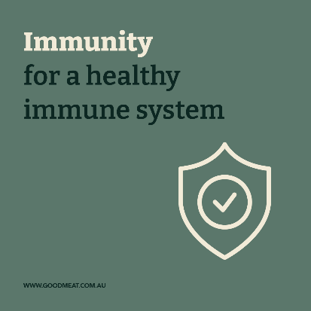
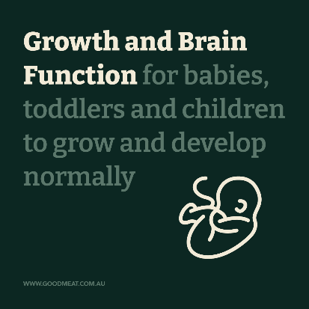
Infographics
Source: goodmeat.com.au
Notes:
These are from the red meat industry, so they are focussed on red meat products.
Do these have more of an appeal than the video? Are they for a different purpose? (overall nutrition information vs information on red meat and iron).

Slide 11
Activity 1: Booklet task
Review current nutrition advertisements
Identify the :
promotional strategies used
key messages
credibility of information (consider the author)
advertising medium (video, infographic, YouTube short).
Notes:
Review current nutrition advertisements or promotional material. Record information from each of these.
Suggested advertisements, and links to advertisements are provided in the Lesson plans (lesson 1)

Slide 12
Lesson 2

Slide 13
Review

Slide 14
What are some promotional strategies used to encourage healthy eating?
Notes:
Responses vary

Slide 15
What are some popular advertising mediums for nutrition messaging?
Notes:
Responses vary

Slide 16
Learning intention: To identify the nutritional needs of a population group.
Success criteria:
five food group recommendations
types of foods
benefits of these foods
specific nutrient needs.

Slide 17
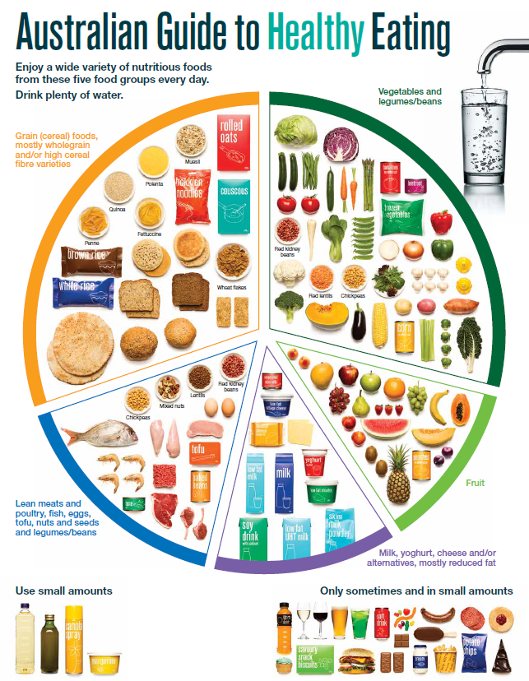
The Australian Guide to Healthy Eating
Notes:
The Australian Guide to Healthy Eating (AGHE) is a visual representation of the Australian Dietary Guidelines.
It is a broad guide to the types and amounts of foods we should eat each day.
The food groups:
Grain foods
Vegetables
Fruit
Dairy and alternatives
Meat and alternatives
Sitting off to the side are foods categorised as ‘sometimes’ foods. These foods are high in saturated fat and/or added sugars, added salt or alcohol and low in fibre. These foods and drinks can also be high in kilojoules (energy).

Slide 18

Overview of the AGHE
Notes:
[2.27]
While this video is directed at teachers, it provides a good overview of the five food groups, represented in the Australian Guide to healthy Eating.

Slide 19
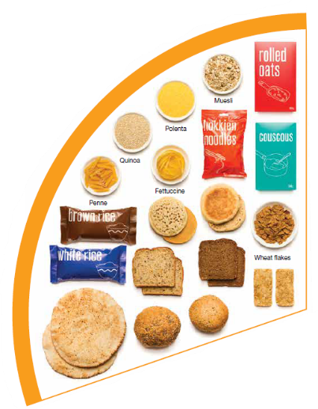
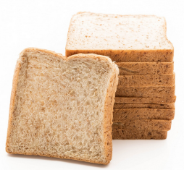
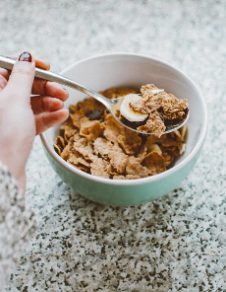
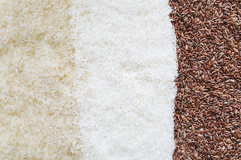
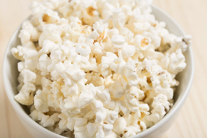
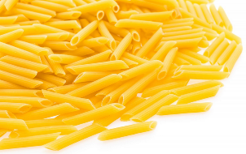
Grain foods
Breads
Breakfast cereal
Grains
Pasta
Other products
Mostly wholegrain and/or high cereal fibre varieties
Notes:
Grain foods comprise grains that can be cooked and eaten whole, ground into flour to make cereal foods, or made into breakfast cereals:
Breads: wholemeal, wholegrain, white, rye, pita, focaccia, crispbreads.
Breakfast cereals: high fibre (wholegrain) oats, porridge, muesli, wholewheat biscuits, ready to eat (such as cornflakes, cheerios).
Grains: rice, barley, corn, polenta, buckwheat, spelt, millet.
Pasta: short and long (white and wholemeal).
Other products: noodles, English muffin, crumpet, rice cakes, couscous, popcorn, flour.
The recommendation is for ‘mostly wholegrain and/or high cereal fibre varieties’ (at least two thirds). Wholegrain cereals contain more nutrients than refined cereal foods (e.g. white bread), because many of the important nutrients occur in the outer layer of the grain which is lost during processing.
Images: Designed by Pexels and Freepik
Based on material provided by the National Health and Medical Research Council (representing the Commonwealth of Australia)

Slide 20
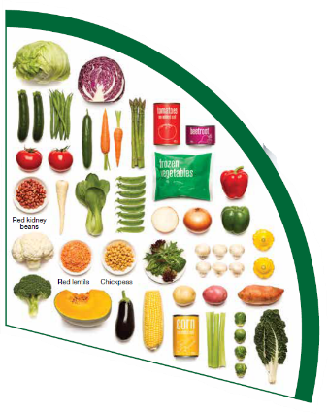
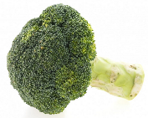

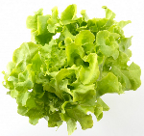


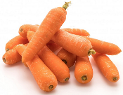
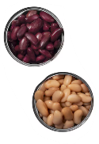
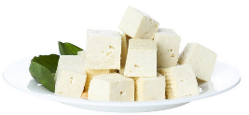
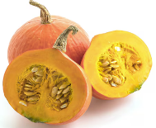
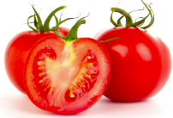
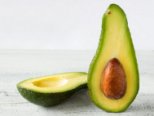
Vegetables
Dark green and cruciferous
Root/ tubular/ bulb
Legumes/beans
Other
Choose a variety, including different colours, each day
Notes:
Types of vegetables (also includes legumes and beans):
Dark green and cruciferous: broccoli, brussels sprouts, bok choy, cabbages, cauliflower, lettuce, spinach, snow peas.
Root/ tubular/ bulb: potato, sweet potato, carrots, beetroot, onion, shallots, garlic, swede, turnip.
Legumes/ beans: kidney beans, soybeans, lima beans, cannellini beans, chickpeas, lentils, split peas, tofu.
Other: tomato, celery, zucchini, avocado, capsicum, eggplant, mushrooms, cucumber, pumpkin, green peas, green beans.
Eat different colours of vegetables, as the different colour groups have different vitamins and minerals.
Vegetables such as tomatoes and pumpkins are technically classified as fruit because they have seeds. They are included in the vegetable group because they have similar nutritional properties as vegetables and are typically eaten as a vegetable.
Images: Designed by Freepik
Based on material provided by the National Health and Medical Research Council (representing the Commonwealth of Australia)

Slide 21
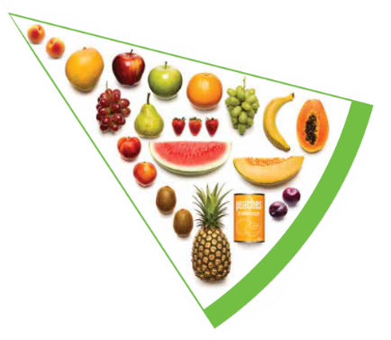
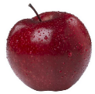

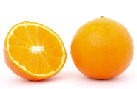

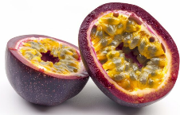
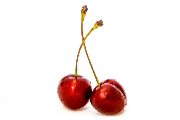




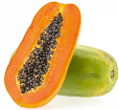
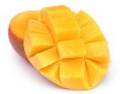
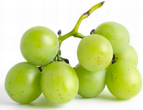

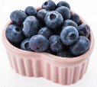
Fruit
Pomme
Citrus
Stone
Tropical
Berries
Choose dried fruit or fruit juice only occasionally
Notes:
Types of fruit:
Pome fruit: apple, pear.
Citrus fruit: orange, mandarin, grapefruit.
Stone fruit: apricot, cherry, peach, nectarine, plum.
Tropical: banana, paw paw, mangoes, pineapple and melon.
Berries: strawberry, blueberry, raspberry, blackberry.
Other: grapes, passionfruit.
Whole or chopped fruit is the best choice.
Fresh, frozen and canned fruits are all part of this food group. It is best to avoid fruits canned in syrup and choose varieties canned in natural juice or water instead.
Choose dried fruit or fruit juice only occasionally:
Eating dried fruit regularly is not recommended as it is high in kilojoules, can stick to the teeth and increases the risk of dental decay. You can also easily eat more than you realise.
Fruit juice is acidic and can increase the risk of dental decay. Fruit juice also has less fibre and other nutrients than whole fruit.
Different fruits can help protect our bodies in different ways, so it’s important to choose a variety, including different colours, each day.
Differences between fruit and vegetables
Fruits and vegetables are from different parts of a plant. Fruits come from the flowering part of a plant and contain seeds. Vegetables are the edible parts of a plant, such as the leaves, stem, roots, and bulbs.
Fruits that are eaten like vegetables: pumpkin, cucumber, tomato (and therefore part of the vegetable group).
Images: Designed by Pexels, Freepik and ChatGPT
Based on material provided by the National Health and Medical Research Council (representing the Commonwealth of Australia)

Slide 22
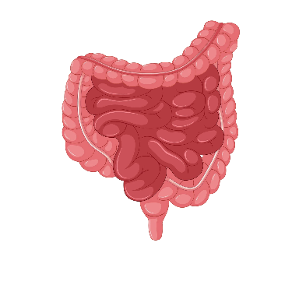



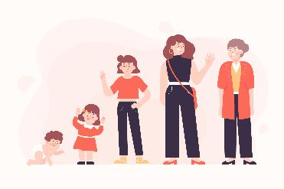

Why grain foods, vegetables and fruit are important
Provide the best source of energy (slow-release energy): fuels our brain (for concentration) and our body
Provide fibre: to help keep our intestines healthy
Provide lots of vitamins and minerals to help our bodies grow and age
Notes:
The complex carbohydrates in these foods are slowly digested, which provides energy over time and helps prevent overeating.
Carbohydrate provides the best source of energy for the brain.
Fibre helps us stay fuller for longer, which can help with concentration.
Fibre is especially useful in keeping the digestive track (including the intestines) healthy and can assist with constipation.
The vast range of vitamins and minerals are important for growth and repair, healthy ageing, and preventing chronic conditions.
Images: Designed by Pexels and Freepik

Slide 23
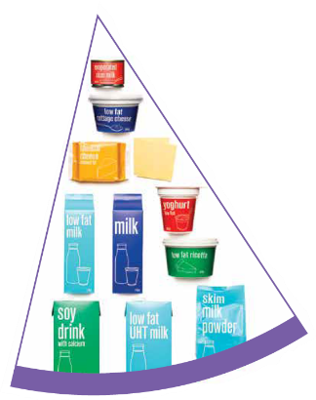
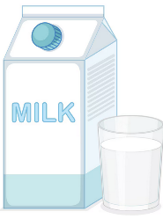
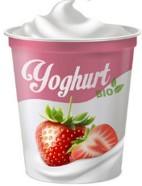
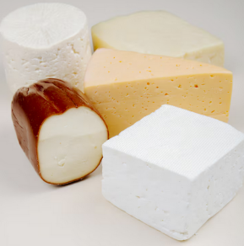
Dairy and alternatives
Milk (fresh and long life)
Yoghurt
Cheese
Reduced fat varieties are the best choice for most
Notes:
Types of foods:
Milks: All reduced fat or full cream milks, plain and flavoured, long life milks, powdered milk, evaporated milk, soy beverages (fortified with at least 100mg calcium/100mL).
Yoghurt: All yoghurts including reduced fat or full cream, plain and flavoured, soy yoghurt (calcium fortified).
Cheese: All hard cheeses, reduced or full fat, for example cheddar, red Leicester, Gloucester, Edam, Gouda Soy cheeses (calcium fortified).
Dairy = products made from milk.
Dairy alternatives:
Calcium-fortified dairy alternatives include soy, rice, almond or oat milk and soy or lactose free yoghurts and cheeses.
Non-dairy alternatives do not naturally contain calcium. It is important to select products labelled as calcium-fortified.
Many of the alternative milks, with the exception of soy milk products, may not be a good source of protein and other key nutrients found in milk and products made from milk.
For vegetarians and vegans, dairy alternative products such as soy milk and cheese are a key source of nutrients, particularly protein and calcium (if calcium is added by the manufacturer), and need to be included regularly to ensure their diet is nutritionally balanced.
Images: Designed by Freepik
Based on material provided by the National Health and Medical Research Council (representing the Commonwealth of Australia)

Slide 24

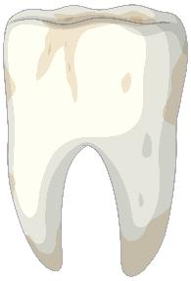
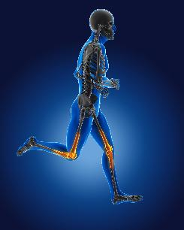
Why dairy and alternative foods are important
Provide calcium: for strong bones and teeth
Provide protein: helps our body grow and become strong
Provide lots of vitamins and minerals to help our bodies grow and age
Notes:
Calcium helps ensure strong bones and teeth.
Proteins are made up of chemical 'building blocks' called amino acids. Your body uses amino acids to build and repair muscles and bones.
Iodine is needed to make essential thyroid hormones. These are used by the body for growth and energy use, as well as brain and bone development in the early years.
Vitamin B12 is essential for the production of red blood cells, which are needed to carry oxygen from the lungs to the body’s tissues and organs.
Images: Designed by Pexels and Freepik

Slide 25
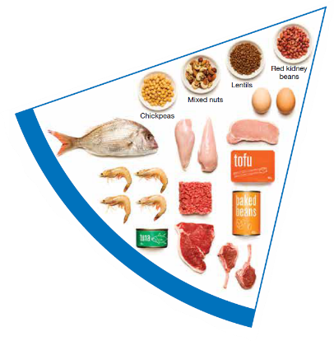
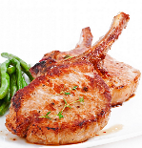

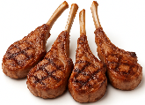
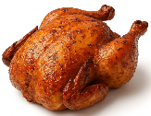
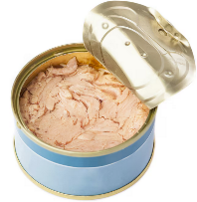
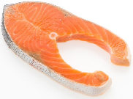

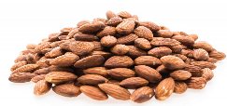
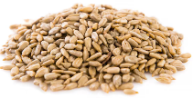
Meat and alternatives
Pink and red meat
Poultry
Fish and seafood
Eggs
Nuts and seeds
Legumes/beans
Choose meat without visible fat
Notes:
Types of foods:
Lean meats: beef, lamb, pork, kangaroo, lean and low salt sausages.
Poultry: chicken, turkey, duck, emu, goose.
Fish and seafood: fish, prawns, crab, lobster, mussels, oysters, scallops, clams.
Eggs: chicken eggs, duck eggs.
Nuts and seeds: almonds, pine nuts, walnut, macadamia, hazelnut, cashew, peanut, nut spreads, brazil nuts, seeds.
Legumes/beans: all beans, lentils, chickpeas, split peas, tofu.
To ensure adequate iron and zinc, about half the serves from this food group should be lean meats. For those who do not eat animal foods, nuts, seeds, legumes (including tofu) can provide some iron and zinc, plus a good mix of plant-based protein.
Choose lean meat options and/or remove the visible fat from the meat prior to cooking to reduce the total amount of saturated fat consumed.
Fresh, frozen and canned varieties of meat, poultry or fish are included in this group. It is important that canned varieties are low in fat and low in salt (no added salt) and canned in water rather than in oil or brine.
Sausages, commercial burgers and meat pastries can be high in saturated fat and are classified as a ‘sometimes’ food. It is recommended the consumption of these foods be limited. If purchasing sausages, it is best to select lean or reduced fat versions and boil or fry in a non-stick pan or BBQ.
Processed meats, such as salami and bacon are high in salt and saturated fats are classified as a ‘sometimes’ food. Consumption should be limited.
Meat alternatives (plant foods):
Nuts and seeds.
Legumes/beans appear in this group as well as the vegetable group.
For vegetarians and vegans, these foods are a key source of nutrients, particularly protein and iron, and need to be included regularly to ensure their diet is nutritionally balanced.
Images: Designed by Freepik and ChatGPT
Based on material provided by the National Health and Medical Research Council (representing the Commonwealth of Australia)

Slide 26

Why meat and alternative foods are important
Provide zinc and iron: keeps our blood healthy and gives us energy
Provide protein: helps our body grow and become strong
Provide essential fatty acids to keep our brains and heart healthy
Notes:
Proteins are made up of chemical 'building blocks' called amino acids. Your body uses amino acids to build and repair muscles and bones.
Iron is particularly important for transporting oxygen in the blood. This is essential for providing energy for daily life. Iron also helps our immune system fight infection.
Zinc is important for growth and for the immune system to fight infection.
Images: Designed by Freepik

Slide 27
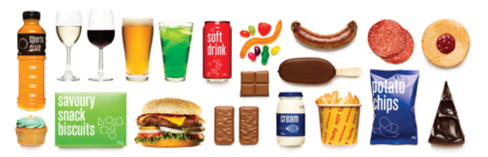


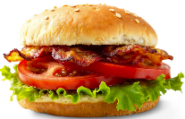



‘Sometimes' foods
Higher in added sugars
Higher in fat (and sodium)
Higher in both
To be consumed sometimes and in small amounts
Notes:
Some foods and drinks do not fit into the five food groups. These foods are high in saturated fat and/or added sugars, added salt or alcohol and low in fibre. These foods and drinks can also be high in kilojoules (energy).
Types of foods:
Higher added sugars: Soft drinks, energy drinks, sugar confectionary, jams, some sauces.
Higher fat: Most processed meats (bacon, ham, sausages, frankfurts), crisps, butter, cream, pastry products, meat pies, sausage rolls, potato chips, commercial pizza.
Higher added sugars AND higher fat: Biscuits, cakes, chocolate, doughnuts, ice cream, iced buns, some muesli bars, muffins, sweet pastries.
Alcoholic drinks.
‘Sometimes’ foods in a healthy diet:
Some people require extra serves of food, for example, those who are taller and more active. These can sometimes include extra serves of ‘sometimes’ foods. It is best if these extra serves come from the five food groups, particularly wholegrain cereals, vegetables including legumes/beans and fruit. However, they can also sometimes include serves of ‘sometimes’ foods (discretionary foods).
These foods can, however, contribute to a feeling of enjoyment. They should be consumed sometimes, and in small amounts.
Images: Designed by Freepik
Based on material provided by the National Health and Medical Research Council (representing the Commonwealth of Australia)

Slide 28
How much should you be eating?
There is a recommended amount of each food group that should be eaten each day.
These amounts are different depending on your age, and sometimes your gender.

Slide 29


Grain food serves
The amount of grain foods we need increases and then decreases with age.
Notes:
The recommended serves of grain foods changes throughout the life stage.
They increase from 2 years, before decreasing after 50 years. This is because of the reduced overall energy needs as we get older.
Example serve sizes are provided – these are different for different foods in this food group.
Based on material provided by the National Health and Medical Research Council (representing the Commonwealth of Australia)

Slide 30


Vegetable serves
From the age of 9 years, we all need around 5 serves of vegetables each day.
Notes:
Children aged 12-13 years require a similar amount of vegetable serves as adults (5 serves).
Younger children (aged 2-3 years) require half this amount.
From the age of 9 years, we all need around 5 serves of vegetables each day.
Example serve sizes are provided – these are different for different foods in this food group.
Based on material provided by the National Health and Medical Research Council (representing the Commonwealth of Australia)

Slide 31


Fruit serves
From the age of 9 years, we all need 2 serves of fruit each day.
Notes:
Children aged 12-13 years require a similar amount of vegetable serves as adults (2 serves).
Younger children (aged 2-3 years) require half this amount.
From the age of 9 years, we all need 2 serves of fruit each day.
Example serve sizes are provided – these are different for different foods in this food group.
Based on material provided by the National Health and Medical Research Council (representing the Commonwealth of Australia)

Slide 32


Dairy and alternatives serves
Notes:
The recommended serves of dairy and alternative foods changes throughout the life stage.
They increase from 2 years, before decreasing after 18 years for men but increasing for women.
This is largely because of the varying needs for calcium as we get older (women require more than men).
Example serve sizes are provided – these are different for different foods in this food group.
Based on material provided by the National Health and Medical Research Council (representing the Commonwealth of Australia)

Slide 33


Meat and alternatives serves
From the age of 9 years, we need between 2 and 3 serves each day.
Notes:
Children aged 12-13 years require a similar amount of meat and alternative serves as adults (2 1/2 serves).
Younger children (aged 2-3 years) require around half this amount.
From the age of 9 years, we need between 2 and 3 serves each day. From the age of 50 years, women require half a serve less.
Example serve sizes are provided – these are different for different foods in this food group.
Based on material provided by the National Health and Medical Research Council (representing the Commonwealth of Australia)

Slide 34

Nutrient Reference Values
Source: https://www.eatforhealth.gov.au/nutrient-reference-values/resources/nrv-summary-tables
Notes:
The recommended serves of the food groups are based on meeting the specific nutrient requirements at different life stages.
Full table is linked in the lesson plan.
Source: https://www.eatforhealth.gov.au/nutrient-reference-values/resources/nrv-summary-tables

Slide 35
‘Sometimes’ foods
These foods can add to our enjoyment with eating.
They might be nice to have ‘sometimes’ and ‘in small amounts’, such as once a week.

Slide 36
‘Sometimes’ foods
We are, however, currently eating too much of these foods:
Age group (years) | Males (%) | Females (%)
2–4 | 28 | 26
5–11 | 37 | 38
12–17 | 34 | 36
18–29 | 32 | 29
30–49 | 29 | 31
50–64 | 32 | 30
65–74 | 32 | 29
75 and over | 33 | 31
A third of energy intake
Notes:
For adolescents aged 12-17, these foods make up around one third energy intake. While these foods can contribute to a feeling of enjoyment, this level is currently too high.
To note: This level slightly decreased from the previous survey in 2011-12, with sometimes foods contributing around 40% of energy intake for children and adolescents.
Source: 2023 National Nutrition and Physical Activity Survey

Slide 37
Activity 1: Booklet task
Select a population group (age and gender) and summarise their nutritional needs.
Select the format and medium in which to present your work e.g. poster, information sheet, infographic (on paper or digital).
Notes:
Options:
Male/Female
2-3
4-8
9-11
12-13
14-18
19-50
51-70
70+

Slide 38
Lesson 3

Slide 39
Review

Slide 40
Why are the recommended daily serves of food groups different across population groups?
There are different energy and nutrient requirements at different life stages and for different genders.
Notes:
Responses vary

Slide 41
For children and adolescents (9–18 years), what is the proportion of energy intake that comes from ‘sometimes’ foods?
Around 40%. While these foods can contribute to a feeling of enjoyment, this level is currently too high.
Notes:
Responses vary

Slide 42
Learning intention: To interpret food labels.
Success criteria:
review the nutritional quality of foods
identify suggested improvements
identify types of nutrition claims
identify appealing images.

Slide 43
Food labelling
Food labelling provides consumers with information to make safe and nutritious food choices.
Food Standards Australia New Zealand (FSANZ) sets the standards for what information must be on food labels.
Notes:
See: https://www.foodstandards.gov.au/consumer/labelling

Slide 44
Food labelling
Mandatory information
Additional information may be included.
Name and/or description of the food | Name and Australian street address of the supplier of food
‘Lot’ number (for traceability) | List of ingredients
Date mark (use by or best before) | Nutrition information panel (NIP)
Country of origin of the food | Warning and advisory statements and declarations (e.g. for allergens)
Directions for use and storage (some foods)
Notes:
Further specific information is available here:
https://www.foodauthority.nsw.gov.au/food-labelling/labels-law/labelling-laws

Slide 45

Ingredient list
Notes:
[1.24]
For additional information see:
https://www.foodstandards.gov.au/consumer/labelling/ingredients

Slide 46

Nutrition Information Panel (NIP)
Notes:
[0.54]
For additional information see:
https://www.foodstandards.gov.au/consumer/labelling/panels

Slide 47

Nutrition Information Panel (NIP)
Notes:
This infographic provides further details on the NIP. It provides information on what to look for in terms of making healthier food choices.
Source: National Health and Medical Research Council (representing the Commonwealth of Australia)

Slide 48
Nutrition and health claims
These claims can be voluntarily added.
Nutrition content claims = claims about the content of certain nutrients or substances in a food e.g. low in fat, good source of calcium.
Notes:
The FSANZ Food Standards Code regulates these claims, including the foods in which they can be placed (not all foods can carry nutrition and health claims).
For further details:
https://www.foodauthority.nsw.gov.au/food-labelling/labels-law/health-nutrition-claims
https://www.foodstandards.gov.au/consumer/labelling/nutrition

Slide 49
Nutrition and health claims
Health claims = relationship between a food and its health benefits.
There are two types:
  Low level e.g. Fibre helps keep you regular.
  High level e.g. Diets high in calcium may reduce the risk of osteoporosis in people
  65 years of age and over.

Slide 50


Health Star Rating
The Health Star Rating can be voluntarily added.
This system rates the overall nutritional profile of a packaged food.
Rating from ½ to 5 stars (higher is better).
This rating is based on foods within the same category e.g. don’t compare
muesli bar and bread.
Notes:
See: https://www.foodstandards.gov.au/consumer/labelling

Slide 51

Health Star Rating
For packaged food, you can use the Health Star Rating as a food selection guide.
Step 1: Identify whether food is a core food in the AGHE.
Step 2: Select a packaged food with
the highest rating in that category.

Slide 52
Activity 1: Booklet task
Select 3 products and review the labels.
Identify:
nutritional quality
suggested improvements to enhance nutritional quality
types of claims
appealing images.
Notes:
Nutritional quality of product–using the Nutrition Information Panel, Health Star Rating. Is it a nutritious choice?
Could the nutritional quality be improved? If yes, how?
Types of claims (nutrition/ health claims).
Images to appeal to consumers.
Other interesting label information.

Slide 53
Lesson 4

Slide 54
Review

Slide 55
What is the information that must be included on food labels?
Name and/or description of the food | Name and Australian street address of the supplier of food
‘Lot’ number (for traceability) | List of ingredients
Date mark (use by or best before) | Nutrition information panel (NIP)
Country of origin of the food | Warning and advisory statements and declarations (e.g. for allergens)
Directions for use and storage (some foods)
Notes:
Responses vary

Slide 56
What is the Health Star Rating?
A system that rates the overall nutritional profile of a packaged food.
Rating from ½ to 5 stars (higher is better).
This rating is based on foods within the same category e.g. don’t compare muesli bar and bread.
Notes:
Responses vary

Slide 57
Learning intention: To identify strategies for managing food allergies in different settings.
Success criteria:
at least 4 strategies in each setting.

Slide 58
Allergies
Allergy: immune system reacts to substances in the environment that are harmless for most people.
Examples: pollen, mould, dust mites, insect bites and food.
Response: immune system releases large amount of chemicals leading to signs and symptoms of an allergic reaction.
Notes:
People can be allergic to many things, such as pollen, mould, dust mites, animal dander or saliva, insect stings or bites, medication, food, and latex.
Source: https://allergyfacts.org.au/about-allergies/

Slide 59
Allergies
An allergic reaction can involve the gut, skin, breathing and/or heart systems.
Symptoms can be mild to moderate or severe (known as anaphylaxis).
Anaphylaxis is a life-threatening emergency as it affects breathing and blood pressure.
Notes:
Source: https://allergyfacts.org.au/__interest/food-allergy/

Slide 60

Allergic reactions
Notes:
Source: https://allergyfacts.org.au/signs-and-symptoms-of-an-allergic-reaction/

Slide 61

Common food allergens
Notes:
Source: https://www.foodstandards.gov.au/consumer/labelling/allergen-labelling

Slide 62
Food allergen labelling
Allergens must be declared in the ingredient list of foods using the exact name and bolded text e.g. cheese (milk) or milk powder.
A bolded, separate allergen summary statement starting with the word ‘contains’ also needs to be provided near the
ingredient list e.g. ‘Contains milk’.
Notes:
Source: https://www.foodstandards.gov.au/consumer/labelling/allergen-labelling

Slide 63

Food allergen labelling
Notes:
Labelling example.
Source: https://foodallergyaware.org.au/everyone/reading-food-labels-for-food-allergens

Slide 64
Precautionary allergen labelling
Statements can be used to warn people that a food might be accidentally contaminated with an allergen.
These are not mandatory, meaning companies can choose to use them.
Made on equipment that also produces products containing…
May be present
May contain….
Notes:
People with food allergies need to make their own decision on whether foods with these labels are safe for them (usually with the help of a doctor or dietitian).
Note: Research by Food Standards Australia New Zealand found that consumers viewed PAL statements such as ‘may contain’, ‘may be present’, ‘made in a factory that also processes’, etc. as unhelpful and confusing, and that they ultimately restrict rather than enable safe food choices (https://allergyfacts.org.au/news/research-allergy-declarations-and-pal/)
Source: https://foodallergyaware.org.au/everyone/reading-food-labels-for-food-allergens

Slide 65
Food intolerance
Food intolerance: chemical reaction to a food (not an allergic reaction).
Can cause can cause gastrointestinal (gut) symptoms such as bloating, gas/flatulence, diarrhoea, constipation, stomach pain, headaches, migraines and fatigue.
Notes:
Source:
https://allergyfacts.org.au/food-allergy-or-food-intolerance/
https://www.betterhealth.vic.gov.au/health/conditionsandtreatments/food-allergy-and-intolerance

Slide 66
Food intolerance
Substances that can trigger symptoms:
Lactose: a sugar found in milk | Vasoactive amines: found naturally in a range of foods
Monosodium glutamate (MSG): added to some foods, and glutamates are also naturally occurring | Salicylates: found in many herbs, spices, fruits, and vegetables
Notes:
Source: https://www.allergy.org.au/patients/food-other-adverse-reactions/food-intolerance

Slide 67
Managing allergies and intolerances
People with food allergies and intolerances must play close attention to the food they eat and their ingredients.
This is particularly important with food allergies because the allergic reaction can be life threatening.

Slide 68
Activity 1: Booklet task
Identify at least 4 strategies for managing allergens in each of these settings:
eating out
schools
school camps
feeding family/ friends (who have a food allergy)
Notes:
Students will need to access: Living with allergies (https://allergyfacts.org.au/living-with-allergies/), which includes links to other resources.

Slide 69
Lesson 5

Slide 70
Review

Slide 71
What is the difference between a food allergy and a food intolerance?
Allergy: immune system reacts to substances in the environment that are harmless for most people.
Mild to moderate response. Anaphylaxis can be life threatening.
Intolerance: chemical reaction to a food.

Slide 72
What are common food allergens?

Slide 73
Learning intention: To critique nutrition messaging in the media.
Success criteria:
Positive aspects
Negative aspects
Any supportive evidence
Whether the messaging is supported by nutrition professionals

Slide 74
Healthy eating messaging
We are surrounded by messaging about nutrition and healthy eating.
This can come via television, social media, internet.
This information comes from people with varying levels of qualifications (or no qualifications!).

Slide 75






‘Healthy eating’ messaging
Messaging does not align with the Australian Guide to Healthy Eating
Notes:
There is a lot of healthy eating messaging that is not back by credible evidence.
These messages often advocate avoiding particular foods or food groups. Or, they make claims about particular foods, for which there is little evidence or the evidence is low quality.
This messaging does not align with the Australian Guide to Healthy Eating, which is based on strong evidence reviewed by university qualified nutrition professionals.

Slide 76

Healthy eating messaging
The Australian Guide to Healthy Eating (based on the Australian Dietary Guidelines), is based on a comprehensive review of evidence from university qualified nutrition professionals.

Slide 77
Healthy eating messaging
Questions to ask:
Who is the author and what are their qualifications?
Does the messaging vary substantially from the AGHE?
Does it promote extreme eating behaviours?
Notes:
Trusted nutrition professionals in Australia are university qualified in food and nutrition science. Look for whether they are Accredited Practicing Dietitians or Registered Nutritionists.
If the messaging varies from the AGHE and/or it promotes extreme eating behaviours, it is important to question the information.

Slide 78

Activity 1: Booklet task
Provide a critique of the paleo diet.
Positive aspects.
Negative aspects.
Identify any supporting evidence for the diet.
Identify whether the diet is supported by qualified nutrition professionals.

Slide 79
Lesson 6

Slide 80
Review

Slide 81
What are some questions to ask when reviewing nutrition information?
Who is the author and what are their qualifications?
Does the messaging vary substantially from the AGHE?
Does it promote extreme eating behaviours?

Slide 82
Learning intention: To identify information to assist with healthy eating messaging
Success criteria:
at least 5 key food and nutrition statistics from 3 sources.

Slide 83
Sources of food and nutrition information
A range of credible information and data are available to support the development of food and nutrition information for consumers.

Slide 84

Eat for Health
www.eatforhealth.gov.au
Notes:
Eat for Health (information on the Australian Dietary Guidelines and associated Australian Guide to Healthy Eating).
This site more so provides summary information, rather than quantitative data. This site is great for context for any nutrition information.

Slide 85

National Nutrition and Physical Activity Survey
Notes:
The Australian Bureau of Statistics conducted the National Nutrition and Physical Activity Survey (NNPAS) in 2023–24.
It involved collecting detailed information on dietary intake and foods consumed from around 10,000 participants across Australia. The precious NNPAS was conducted in 2011–12.
Information for the nutrition component of the NNPAS was gathered using a 24-hour dietary recall on all foods, beverages and dietary supplements consumed on the day prior to the interview. Where possible, at least 8 days after the first interview, respondents were followed up to provide a second 24-hour dietary recall either via a web form or a second face-to-face interview.
This provided data on ‘usual intake’ of nutrients, which could be compared with recommended intakes.
Data from 24-hour food recalls are considered more robust than from food frequency questionnaires; however, they are more expensive and therefore, less frequently undertaken.

Slide 86

National Health Survey
Notes:
The Australian Bureau of Statistics conducted the National Health Survey (NHS) from January 2022 to April 2023.
Data was collected from approximately 13,100 households around Australia.
The survey focused on the health status of Australians and health-related aspects of their lifestyles.
Information was collected about respondents' long-term health conditions and on lifestyle factors which may affect health, such as tobacco smoking and vaping, alcohol consumption, fruit and vegetable consumption, and physical activity.
Self-reported health status, height, and weight were also collected.
In addition to the self-reported measures, respondents could voluntarily provide blood pressure, height, weight and waist measurements.
Food intake data were collected via a food frequency questionnaire, which is not as robust as the 24-hour food intake recall, but it can still provide useful information.

Slide 87

National Health Measures Survey
Notes:
The Australian Bureau of Statistics conducted the National Health Measures Survey (NHMS) in 2022–24.
It involved the collection of biomedical samples from participants aged 5 years and over across Australia.
The NHMS measured specific biomarkers for chronic disease and nutrition status, from tests on blood and urine samples.
Data are available on the prevalence of chronic conditions and nutrient biomarkers (indicators of food intake).

Slide 88


Australia’s health
Notes:
Produced by the Australian Institute of Health and Welfare, Australia’s health has information on determinants of health, including diet and physical activity.
These summaries use data from other sources, including the Australian Health Survey and National Health Surveys from the Australian Bureau of Statistics.
Australia’s health is published every 2 years and is available on the AIHW website: aihw.gov.au

Slide 89

CSIRO Healthy Diet Score
Notes:
The CSIRO Healthy Diet Score is an online survey which estimates diet quality using short questions.
They survey assesses 9 components of diet, including quantity, quality and variety of foods consumed, and estimates compliance with the Australian Dietary Guidelines to generate a score out of 100.
The subsequent report describes the diet quality of Australian adults based on the diet scores of a weighted sample of 235,268 adults who completed the survey between May 2015 to July 2023.
While not as robust as the ABS data, it provides a useful overview of food intakes in Australia.

Slide 90
Activity 1: Booklet task
Review the different food and nutrition data sources.
Identify at least 5 key food and nutrition statistics from 3 of these sources.

Slide 91
Lesson 7, 8 and 9

Slide 92
Learning intention: To design a nutrition promotion advertisement that aims to encourage healthy eating.

Slide 93
Task
To design a nutrition promotion advertisement that aims to encourage healthy eating in one or more areas.
Explain the strategy for your promotion piece and how it aims to influence behaviours around healthy eating.

Slide 94


Slide 95


