Slide 1
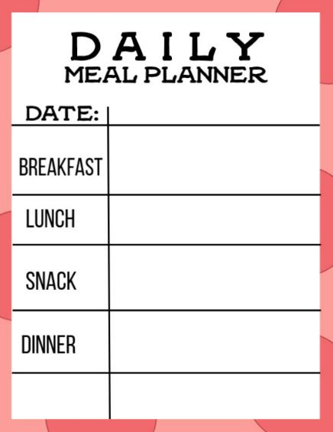
Designing a daily meal plan
Food and nutrition unit
Year 5

Slide 2
Contents
Lesson 1 | Lesson 6
Lesson 2 | Lesson 7
Lesson 3 | Lesson 8 and 9
Lesson 4
Lesson 5

Slide 3
Lesson 1

Slide 4
In this unit we will be:
investigating the importance of nutrition information
analysing menus for nutritional quality
investigating different daily meal plans
developing design criteria
developing a daily meal plan.

Slide 5
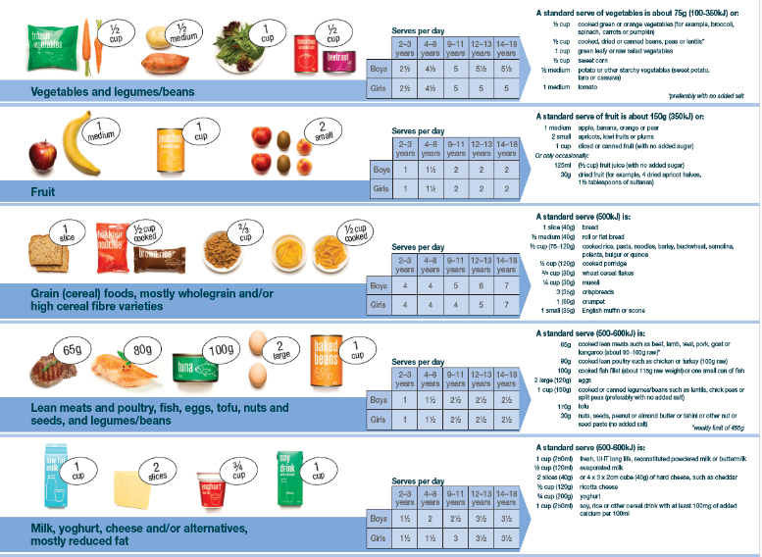
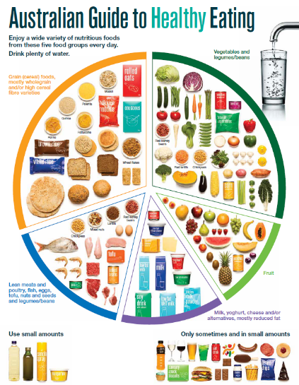
Activity 1: Booklet task
What do you know about the five food groups (through the Australian Guide to Healthy Eating)?
What do you know about food group serve recommendations?
Notes:
Students are to record everything they know about these documents, including how they can be used to guide our daily food choices.
Images: National Health and Medical Research Council (representing the Commonwealth of Australia)

Slide 6
Learning intention: To review the Australian Guide to Healthy Eating.
Success criteria:
food groups
food group serves.

Slide 7

The Australian Guide to Healthy Eating
Notes:
The Australian Guide to Healthy Eating (AGHE) is a visual representation of the Australian Dietary Guidelines.
It is a broad guide to the types and amounts of foods we should eat each day.
The food groups:
Grain foods
Vegetables
Fruit
Dairy and alternatives
Meat and alternatives
Sitting off to the side are foods categorised as ‘sometimes’ foods. These foods are high in saturated fat and/or added sugars, added salt or alcohol and low in fibre. These foods and drinks can also be high in kilojoules (energy).

Slide 8

Overview of the AGHE
Notes:
[2.27]
While this video is directed at teachers, it provides a good overview of the five food groups, represented in the Australian Guide to healthy Eating.

Slide 9
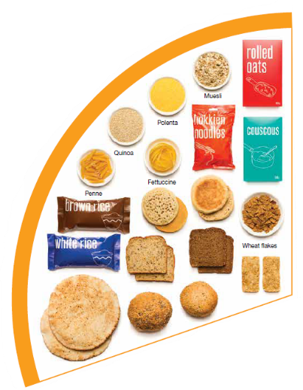
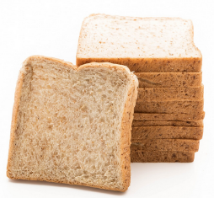
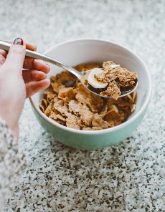
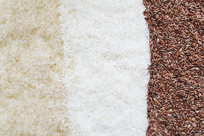

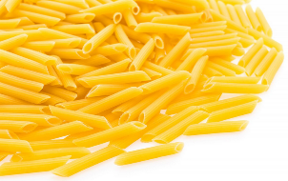
Grain foods
Breads
Breakfast cereal
Grains
Pasta
Other products
Mostly wholegrain and/or high cereal fibre varieties
Notes:
Grain foods comprise grains that can be cooked and eaten whole, ground into flour to make cereal foods, or made into breakfast cereals:
Breads: wholemeal, wholegrain, white, rye, pita, focaccia, crispbreads.
Breakfast cereals: high fibre (wholegrain) oats, porridge, muesli, wholewheat biscuits, ready to eat (such as cornflakes, cheerios).
Grains: rice, barley, corn, polenta, buckwheat, spelt, millet.
Pasta: short and long (white and wholemeal).
Other products: noodles, English muffin, crumpet, rice cakes, couscous, popcorn, flour.
The recommendation is for ‘mostly wholegrain and/or high cereal fibre varieties’ (at least two thirds). Wholegrain cereals contain more nutrients than refined cereal foods (e.g. white bread), because many of the important nutrients occur in the outer layer of the grain which is lost during processing.
Images: Designed by Pexels and Freepik
Based on material provided by the National Health and Medical Research Council (representing the Commonwealth of Australia)

Slide 10
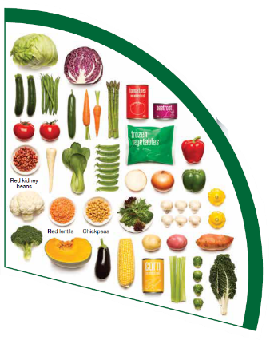
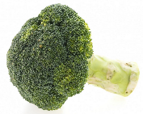

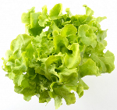

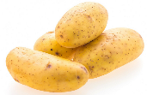
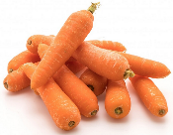
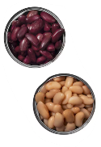

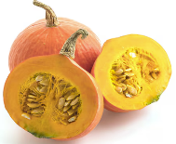
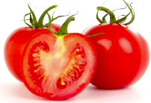
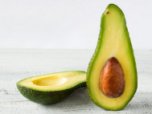
Vegetables
Dark green and cruciferous
Root/ tubular/ bulb
Legumes/beans
Other
Choose a variety, including different colours, each day
Notes:
Types of vegetables (also includes legumes and beans):
Dark green and cruciferous: broccoli, brussels sprouts, bok choy, cabbages, cauliflower, lettuce, spinach, snow peas.
Root/ tubular/ bulb: potato, sweet potato, carrots, beetroot, onion, shallots, garlic, swede, turnip.
Legumes/ beans: kidney beans, soybeans, lima beans, cannellini beans, chickpeas, lentils, split peas, tofu.
Other: tomato, celery, zucchini, avocado, capsicum, eggplant, mushrooms, cucumber, pumpkin, green peas, green beans.
Eat different colours of vegetables, as the different colour groups have different vitamins and minerals.
Vegetables such as tomatoes and pumpkins are technically classified as fruit because they have seeds. They are included in the vegetable group because they have similar nutritional properties as vegetables and are typically eaten as a vegetable.
Images: Designed by Freepik
Based on material provided by the National Health and Medical Research Council (representing the Commonwealth of Australia)

Slide 11
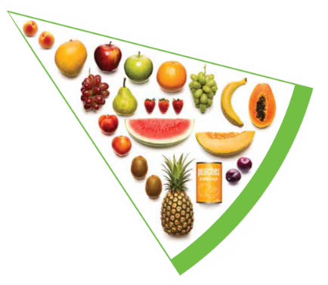


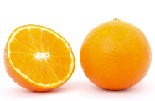

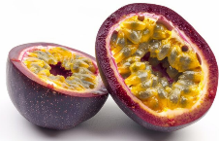





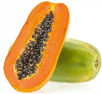
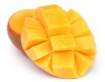
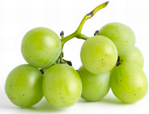

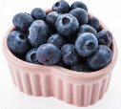
Fruit
Pomme
Citrus
Stone
Tropical
Berries
Choose dried fruit or fruit juice only occasionally
Notes:
Types of fruit:
Pome fruit: apple, pear.
Citrus fruit: orange, mandarin, grapefruit.
Stone fruit: apricot, cherry, peach, nectarine, plum.
Tropical: banana, paw paw, mangoes, pineapple and melon.
Berries: strawberry, blueberry, raspberry, blackberry.
Other: grapes, passionfruit.
Whole or chopped fruit is the best choice.
Fresh, frozen and canned fruits are all part of this food group. It is best to avoid fruits canned in syrup and choose varieties canned in natural juice or water instead.
Choose dried fruit or fruit juice only occasionally:
Eating dried fruit regularly is not recommended as it is high in kilojoules, can stick to the teeth and increases the risk of dental decay. You can also easily eat more than you realise.
Fruit juice is acidic and can increase the risk of dental decay. Fruit juice also has less fibre and other nutrients than whole fruit.
Different fruits can help protect our bodies in different ways, so it’s important to choose a variety, including different colours, each day.
Differences between fruit and vegetables
Fruits and vegetables are from different parts of a plant. Fruits come from the flowering part of a plant and contain seeds. Vegetables are the edible parts of a plant, such as the leaves, stem, roots, and bulbs.
Fruits that are eaten like vegetables: pumpkin, cucumber, tomato (and therefore part of the vegetable group).
Images: Designed by Pexels, Freepik and ChatGPT
Based on material provided by the National Health and Medical Research Council (representing the Commonwealth of Australia)

Slide 12
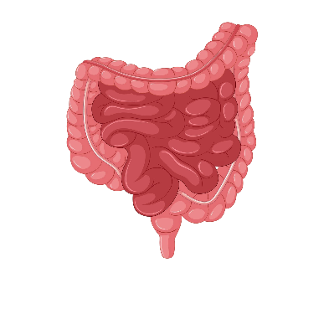



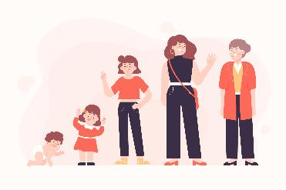

Why grain foods, vegetables and fruit are important
Provide the best source of energy (slow-release energy): fuels our brain (for concentration) and our body
Provide fibre: to help keep our intestines healthy
Provide lots of vitamins and minerals to help our bodies grow and age
Notes:
The complex carbohydrates in these foods are slowly digested, which provides energy over time and helps prevent overeating.
Carbohydrate provides the best source of energy for the brain.
Fibre helps us stay fuller for longer, which can help with concentration.
Fibre is especially useful in keeping the digestive track (including the intestines) healthy and can assist with constipation.
The vast range of vitamins and minerals are important for growth and repair, healthy ageing, and preventing chronic conditions.
Images: Designed by Pexels and Freepik

Slide 13
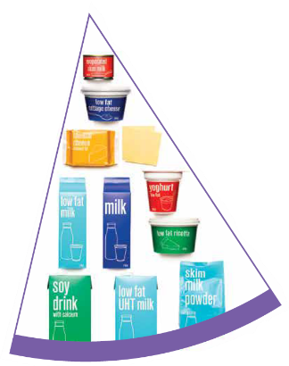


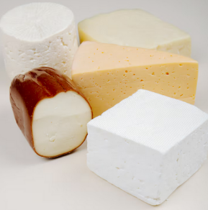
Dairy and alternatives
Milk (fresh and long life)
Yoghurt
Cheese
Reduced fat varieties are the best choice for most
Notes:
Types of foods:
Milks: All reduced fat or full cream milks, plain and flavoured, long life milks, powdered milk, evaporated milk, soy beverages (fortified with at least 100mg calcium/100mL).
Yoghurt: All yoghurts including reduced fat or full cream, plain and flavoured, soy yoghurt (calcium fortified).
Cheese: All hard cheeses, reduced or full fat, for example cheddar, red Leicester, Gloucester, Edam, Gouda Soy cheeses (calcium fortified).
Dairy = products made from milk.
Dairy alternatives:
Calcium-fortified dairy alternatives include soy, rice, almond or oat milk and soy or lactose free yoghurts and cheeses.
Non-dairy alternatives do not naturally contain calcium. It is important to select products labelled as calcium-fortified.
Many of the alternative milks, with the exception of soy milk products, may not be a good source of protein and other key nutrients found in milk and products made from milk.
For vegetarians and vegans, dairy alternative products such as soy milk and cheese are a key source of nutrients, particularly protein and calcium (if calcium is added by the manufacturer), and need to be included regularly to ensure their diet is nutritionally balanced.
Images: Designed by Freepik
Based on material provided by the National Health and Medical Research Council (representing the Commonwealth of Australia)

Slide 14

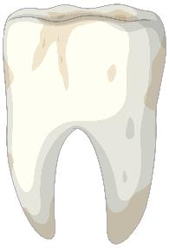
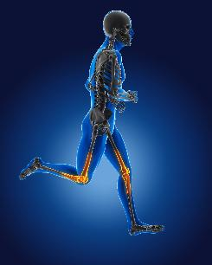
Why dairy and alternative foods are important
Provide calcium: for strong bones and teeth
Provide protein: helps our body grow and become strong
Provide lots of vitamins and minerals to help our bodies grow and age
Notes:
Calcium helps ensure strong bones and teeth.
Proteins are made up of chemical 'building blocks' called amino acids. Your body uses amino acids to build and repair muscles and bones.
Iodine is needed to make essential thyroid hormones. These are used by the body for growth and energy use, as well as brain and bone development in the early years.
Vitamin B12 is essential for the production of red blood cells, which are needed to carry oxygen from the lungs to the body’s tissues and organs.
Images: Designed by Pexels and Freepik

Slide 15
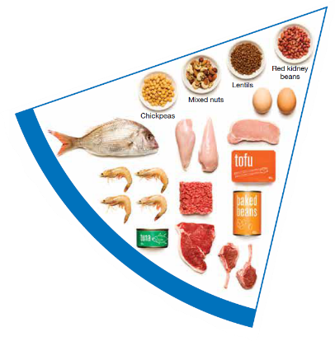
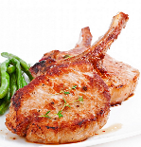

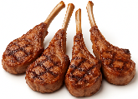
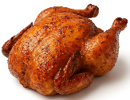
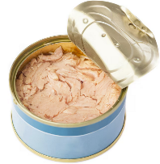
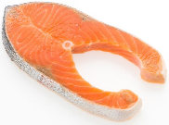

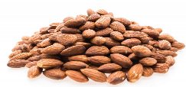
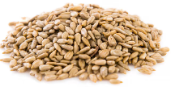
Meat and alternatives
Pink and red meat
Poultry
Fish and seafood
Eggs
Nuts and seeds
Legumes/beans
Choose meat without visible fat
Notes:
Types of foods:
Lean meats: beef, lamb, pork, kangaroo, lean and low salt sausages.
Poultry: chicken, turkey, duck, emu, goose.
Fish and seafood: fish, prawns, crab, lobster, mussels, oysters, scallops, clams.
Eggs: chicken eggs, duck eggs.
Nuts and seeds: almonds, pine nuts, walnut, macadamia, hazelnut, cashew, peanut, nut spreads, brazil nuts, seeds.
Legumes/beans: all beans, lentils, chickpeas, split peas, tofu.
To ensure adequate iron and zinc, about half the serves from this food group should be lean meats. For those who do not eat animal foods, nuts, seeds, legumes (including tofu) can provide some iron and zinc, plus a good mix of plant-based protein.
Choose lean meat options and/or remove the visible fat from the meat prior to cooking to reduce the total amount of saturated fat consumed.
Fresh, frozen and canned varieties of meat, poultry or fish are included in this group. It is important that canned varieties are low in fat and low in salt (no added salt) and canned in water rather than in oil or brine.
Sausages, commercial burgers and meat pastries can be high in saturated fat and are classified as a ‘sometimes’ food. It is recommended the consumption of these foods be limited. If purchasing sausages, it is best to select lean or reduced fat versions and boil or fry in a non-stick pan or BBQ.
Processed meats, such as salami and bacon are high in salt and saturated fats are classified as a ‘sometimes’ food. Consumption should be limited.
Meat alternatives (plant foods):
Nuts and seeds.
Legumes/beans appear in this group as well as the vegetable group.
For vegetarians and vegans, these foods are a key source of nutrients, particularly protein and iron, and need to be included regularly to ensure their diet is nutritionally balanced.
Images: Designed by Freepik and ChatGPT
Based on material provided by the National Health and Medical Research Council (representing the Commonwealth of Australia)

Slide 16

Why meat and alternative foods are important
Provide zinc and iron: keeps our blood healthy and gives us energy
Provide protein: helps our body grow and become strong
Provide essential fatty acids to keep our brains and heart healthy
Notes:
Proteins are made up of chemical 'building blocks' called amino acids. Your body uses amino acids to build and repair muscles and bones.
Iron is particularly important for transporting oxygen in the blood. This is essential for providing energy for daily life. Iron also helps our immune system fight infection.
Zinc is important for growth and for the immune system to fight infection.
Images: Designed by Freepik

Slide 17






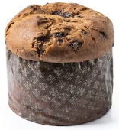
‘Sometimes' foods
Higher in added sugars
Higher in fat (and sodium)
Higher in both
To be consumed sometimes and in small amounts
Notes:
Some foods and drinks do not fit into the five food groups. These foods are high in saturated fat and/or added sugars, added salt or alcohol and low in fibre. These foods and drinks can also be high in kilojoules (energy).
Types of foods:
Higher added sugars: Soft drinks, energy drinks, sugar confectionary, jams, some sauces.
Higher fat: Most processed meats (bacon, ham, sausages, frankfurts), crisps, butter, cream, pastry products, meat pies, sausage rolls, potato chips, commercial pizza.
Higher added sugars AND higher fat: Biscuits, cakes, chocolate, doughnuts, ice cream, iced buns, some muesli bars, muffins, sweet pastries.
Alcoholic drinks.
‘Sometimes’ foods in a healthy diet:
Some people require extra serves of food, for example, those who are taller and more active. These can sometimes include extra serves of ‘sometimes’ foods. It is best if these extra serves come from the five food groups, particularly wholegrain cereals, vegetables including legumes/beans and fruit. However, they can also sometimes include serves of ‘sometimes’ foods (discretionary foods).
These foods can, however, contribute to a feeling of enjoyment. They should be consumed sometimes, and in small amounts.
Images: Designed by Freepik
Based on material provided by the National Health and Medical Research Council (representing the Commonwealth of Australia)

Slide 18
How much should you be eating?
There is a recommended amount of each food group that should be eaten each day.
These amounts are different depending on your age, and sometimes your gender.

Slide 19
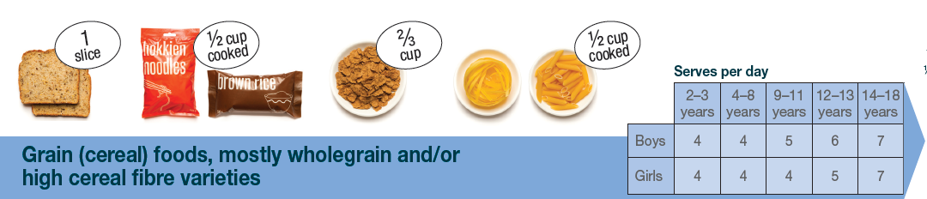
Grain food serves
Children aged 9–11 years need 5 (boys) and 4 (girls) serves of grain
foods each day.
Notes:
Focus on children aged 9-11 years.
Based on material provided by the National Health and Medical Research Council (representing the Commonwealth of Australia)

Slide 20
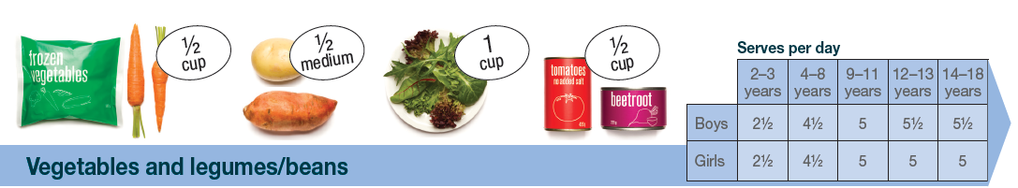
Vegetable serves
Children aged 9–11 years need 5 serves of vegetables each day.
Notes:
Focus on children aged 9-11 years.
Based on material provided by the National Health and Medical Research Council (representing the Commonwealth of Australia)

Slide 21
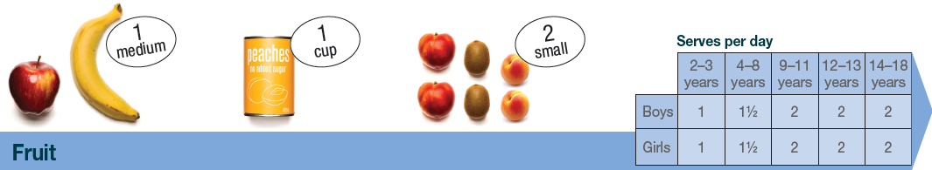
Fruit serves
Children aged 9–11 years need 2 serves of fruit each day.
Notes:
Focus on children aged 9-11 years.
Based on material provided by the National Health and Medical Research Council (representing the Commonwealth of Australia)

Slide 22
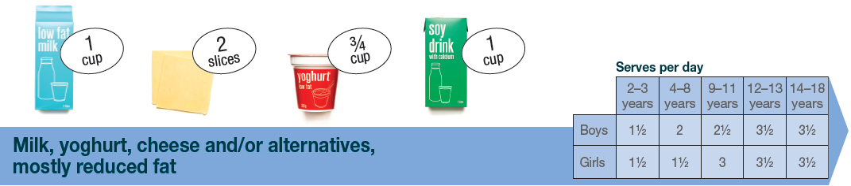
Dairy and alternative serves
Children aged 9–11 years need 2½ (boys) and 3 (girls) serves of dairy and alternative foods each day.
Notes:
Focus on children aged 9-11 years.
These difference in serves relates to the high calcium and protein needs for girls in this age group.
Based on material provided by the National Health and Medical Research Council (representing the Commonwealth of Australia)

Slide 23
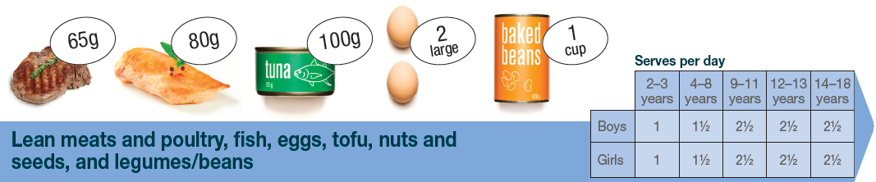
Meat and alternative serves
Children aged 9–11 years need 2½ serves of meat and alternative foods each day.
Notes:
Focus on children aged 9-11 years.
Based on material provided by the National Health and Medical Research Council (representing the Commonwealth of Australia)

Slide 24
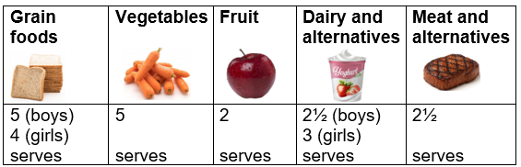
Food group serves: 9–11 years
Notes:
This slide brings together the serves for children aged 9–11 years.
Why are the serve amounts different across the food groups?
Responses could include:
Different types of nutrients (vitamins and minerals) provided.
Different amounts of energy (sugars) in the foods e.g. more sugar in fruit than in vegetables.
Images: Designed by Pexels, Freepik and ChatGPT
Based on material provided by the National Health and Medical Research Council (representing the Commonwealth of Australia)

Slide 25
Lesson 2

Slide 26
Review

Slide 27
Why are grain foods, vegetables and fruit important?
How many reasons can you think of?

Slide 28
Answer: Why are grain foods, vegetables and fruit important?
Provide the best source of energy (slow-release energy): fuels our brain (for concentration) and our body
Provide fibre: to help keep our intestines healthy
Provide lots of vitamins and minerals to help our bodies grow and age
Notes:
The complex carbohydrates in these foods are slowly digested, which provides energy over time and helps prevent overeating.
Carbohydrate provides the best source of energy for the brain.
Fibre helps us stay fuller for longer, which can help with concentration.
Fibre is especially useful in keeping the digestive track (including the intestines) healthy and can assist with constipation.
The vast range of vitamins and minerals are important for growth and repair, healthy ageing, and preventing chronic conditions.
Images: Designed by Pexels and Freepik

Slide 29
Why are dairy and alternative foods important?
How many reasons can you think of?

Slide 30
Answer: Why are dairy and alternative foods important?
Provide calcium: for strong bones and teeth
Provide protein: helps our body grow and become strong
Provide lots of vitamins and minerals to help our bodies grow and age
Notes:
Calcium helps ensure strong bones and teeth.
Proteins are made up of chemical 'building blocks' called amino acids. Your body uses amino acids to build and repair muscles and bones.
Iodine is needed to make essential thyroid hormones. These are used by the body for growth and energy use, as well as brain and bone development in the early years.
Vitamin B12 is essential for the production of red blood cells, which are needed to carry oxygen from the lungs to the body’s tissues and organs.
Images: Designed by Pexels and Freepik

Slide 31
Why are meat and alternative foods important?
How many reasons can you think of?

Slide 32
Answer: Why are meat and alternative foods important?
Provide zinc and iron: keeps our blood healthy and gives us energy
Provide protein: helps our body grow and become strong
Provide essential fatty acids to keep our brains and heart healthy
Notes:
Proteins are made up of chemical 'building blocks' called amino acids. Your body uses amino acids to build and repair muscles and bones.
Iron is particularly important for transporting oxygen in the blood. This is essential for providing energy for daily life. Iron also helps our immune system fight infection.
Zinc is important for growth and for the immune system to fight infection.
Images: Designed by Freepik

Slide 33
Learning intention: To interpret health information.
Success criteria:
overall healthy eating guidelines
each food group, including serves
the place for ‘sometimes’ foods.

Slide 34
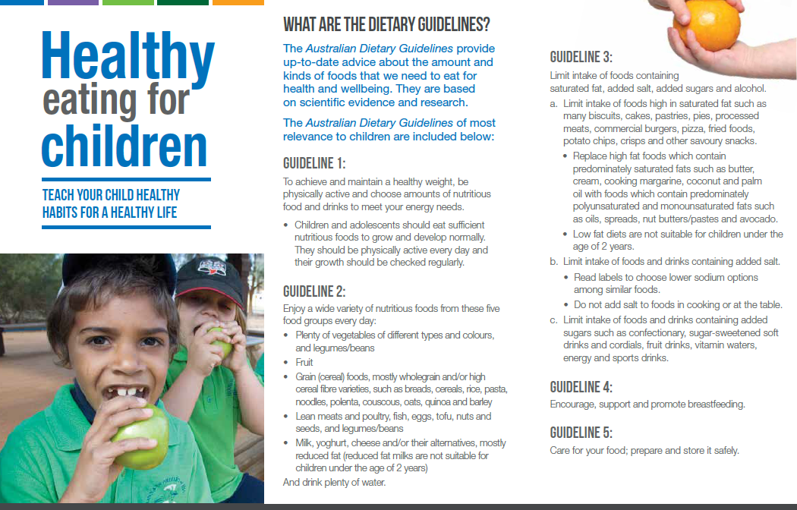
Australian Dietary Guidelines
Notes:
Introduce the Australian Dietary Guidelines brochure—the Dietary Guidelines are what underpin the Australian Guide to Healthy Eating.
Source: National Health and Medical Research Council (representing the Commonwealth of Australia)

Slide 35
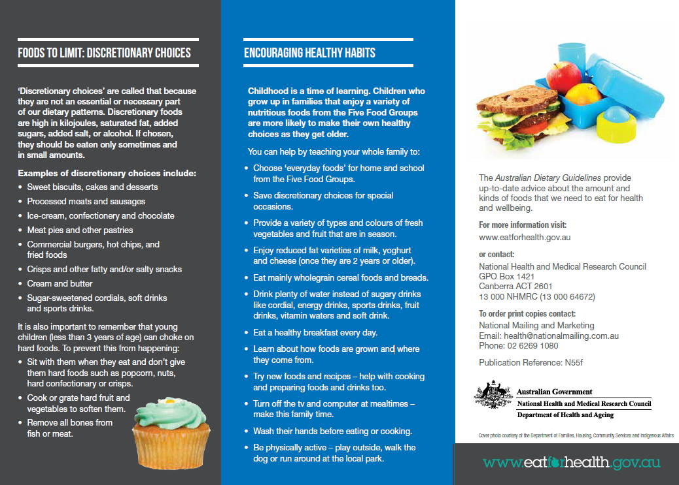
Australian Dietary Guidelines
Notes:
Page 2
Source: National Health and Medical Research Council (representing the Commonwealth of Australia)

Slide 36
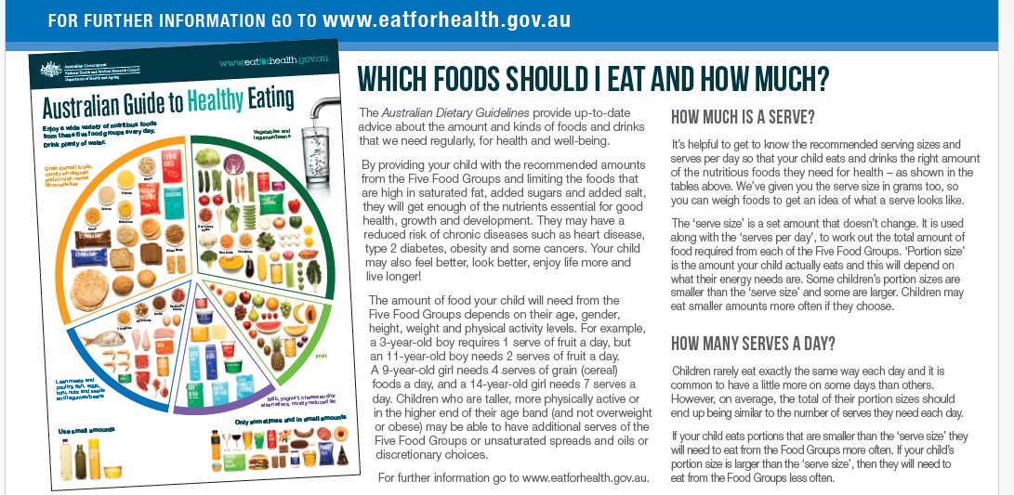
Australian Dietary Guidelines
Notes:
Page 3
Source: National Health and Medical Research Council (representing the Commonwealth of Australia)

Slide 37
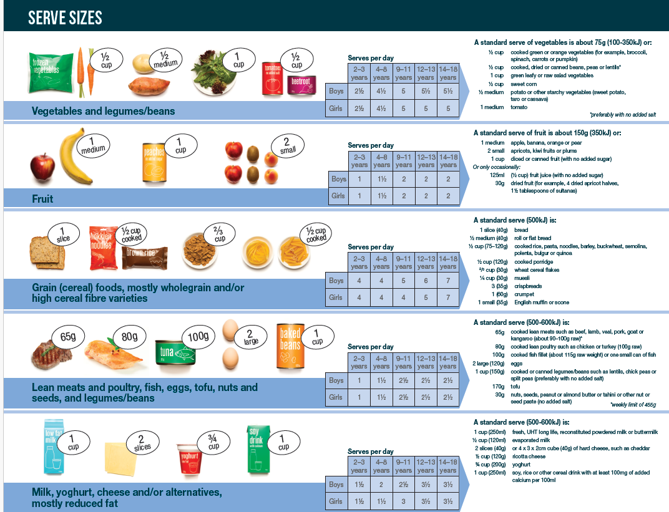
Australian Dietary Guidelines
Notes:
Page 4
Source: National Health and Medical Research Council (representing the Commonwealth of Australia)

Slide 38
Activity 1: Healthy Eating
Using the Australian Dietary Guidelines brochure, identify key information:
overall guidelines to healthy eating
food groups, serves
‘sometimes’ foods (discretionary foods).

Slide 39
Lesson 3

Slide 40
Learning intention: To interpret health information.
Success criteria:
overall healthy eating guidelines
each food group, including serves
the place for ‘sometimes’ foods.

Slide 41
Activity 1: Healthy Eating
Compile research from the previous lesson into a presentation:
poster
slides
speech
other

Slide 42
For next lesson
Bring in a recipe from home, which includes foods from at least 3 of the 5 food groups.
Alternatively, source a recipe from a recipe book or internet that you would enjoy.

Slide 43
Lesson 4

Slide 44
Learning intention: To evaluate a recipe against the AGHE.
Success criteria:
identify food group serves per recipe
identify food group serves per person
identify modifications to enhance nutritional value.

Slide 45
Spinach pesto spaghetti with grilled spiced chicken
Serves: 6 people
4 (about 200g each) chicken breast fillets 60ml (1/4 cup) fresh lemon juice 1 tsp sweet paprika 1 tsp dried oregano leaves 1 tbsp olive oil 1/2 red onion, finely chopped 150g baby spinach leaves 2 garlic cloves, finely chopped | 1 bunch fresh basil, leaves picked 100g low-fat feta 45g (1/3 cup) pecan halves 2 tbsp finely grated pecorino 60ml (1/4 cup) light and creamy evaporated milk 80ml (1/3 cup) olive oil, extra 500g spaghetti
Source: taste.com.au

Slide 46
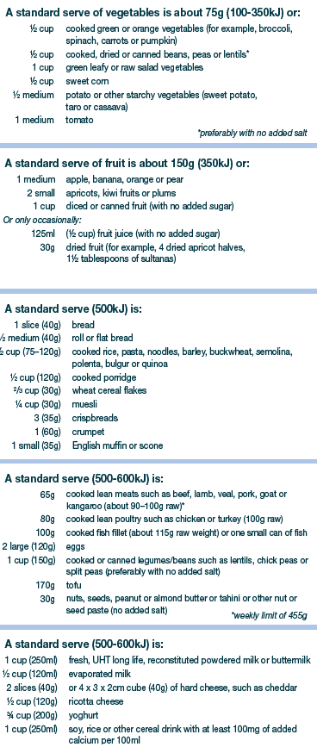
Use this as a guide for determining number of serves of food groups in the recipe.
You may need to make estimations for some items e.g. cooked v raw pasta – recipes specify raw, but this table specifies cooked pasta.
Notes:
Source: National Health and Medical Research Council (representing the Commonwealth of Australia)

Slide 47
Spinach pesto spaghetti with grilled spiced chicken
Just do the main ingredients, not the herbs and spices
Oil used is olive oil – used to aid cooking and add flavour
 | Vegetables | Fruit | Grain foods | Meat and alternatives | Dairy and alternatives | Sometimes foods
Serves per recipe | 1 (onion) 2 (spinach) Total: 3 | 0.5 (lemon juice) Total: 0.5 | 5 (spaghetti) (approximate) Total: 5 | 8 (chicken) 1.5 (pecans) Total: 9.5 | 1 (low fat feta) 0.5 (evaporated milk) Total: 1.5 | Total: 0
Serves per person | 0.5 | Not reportable e (very low) | 0.8 | Approx 1.5 | 0.25 | 0
Divide the serves per recipe by the number of serves per person (6 for this recipe)

Slide 48
Spinach pesto spaghetti with grilled spiced chicken
What food groups are missing or low in quantity?
Vegetables
Fruit
Dairy and alternatives
Does the recipe contain too many serves of ‘sometimes’ foods?
No. Olive oil is added to assist with cooking and flavour.

Slide 49
Spinach pesto spaghetti with grilled spiced chicken
How could you modify the recipe to:
Increase the servings of foods from the 5 food groups?
Enhance the nutritional quality of ingredients e.g. wholegrain cereals?
This could include adding additional items to serve with the recipe.
The recipe is low in fruit, but that is expected given it is a savoury dish.
The recipe contains a moderate amount of dairy. Additional low fat grated cheese could be added when serving.
To increase the vegetable serves, additional vegetables could be included in the dish, such as pumpkin or carrot. Or the pasta could be served with steamed vegetables or a salad.
The pasta could be changed to wholemeal pasta to enhance the nutritional
quality of the dish (but wholemeal pasta is not for everyone…!).
Notes:
Different responses are possible. Go through these with the students and discuss their merit. What else would they change?

Slide 50
Activity 1: Booklet task
Complete your own recipe analysis using your recipe from home.
Template is provided in your unit booklet.

Slide 51
Lesson 5

Slide 52
Learning intention: To review meal plans.
Success criteria:
identify structure
identify suggested content.

Slide 53
Review meal planning guidance

Slide 54

Example meal plans
Children
Adult male
Adult female
Notes:
Source: National Health and Medical Research Council (representing the Commonwealth of Australia)

Slide 55
Activity 1: Booklet task
Review the different meal plans and record suggestions for meal plan designs.
Notes:
Links are provided in the lesson plan.

Slide 56
Lesson 6

Slide 57
Learning intention: To investigate design criteria.
Success criteria:
at least 5 criteria for daily meal plan
reference to the AGHE.

Slide 58

Brainstorming design criteria
Notes:
Work with the students to brainstorm design criteria for a daily meal plan.
Ideas:
Aim for the recommended serves of the five food groups:
Vegetables: 5 serves
Fruit: 2 serves
Grain foods: 5 serves (boys), 4 serves (girls)
Meat and alternatives: 2 ½ serves
Dairy and alternatives: 2 ½ serves (boys), 3 serves (girls)
Includes breakfast, lunch, dinner and 2-3 snacks
Contains foods that you enjoy eating
Wholemeal/wholegrain options for bread
At least 1 serve of vegetables at lunch
[Include criteria that may be relevant to individuals e.g. no nuts for students with allergies]
Low-cost ingredients
Lunchbox friendly foods
Lunch and snacks can be prepared in 10 minutes
Images: Designed by Pexels, Freepik and ChatGPT
Based on material provided by the National Health and Medical Research Council (representing the Commonwealth of Australia)

Slide 59
Activity 1: Booklet task
Identity criteria for designing a daily meal plan.
at least 5 criteria
reference to the AGHE
Template is provided in your unit booklet.
Notes:
Students can use what the class has listed and add their own criteria.

Slide 60
Lesson 7

Slide 61
Learning intention: To map out a daily meal plan.
Success criteria:
meets design criteria from previous lesson.

Slide 62

I do
Notes:
I do: Example meal plan and hi.gh-level assessment against the recommended serves for children aged 9-11.

Slide 63

We do
Notes:
We do: Complete one together as a class

Slide 64

Activity 1: Booklet task
You do
Map out a daily meal plan.

Slide 65
Lesson 8 and 9

Slide 66
Learning intention: To design a daily meal plan.

Slide 67
Task
To design a daily meal plan. Explain how your meal plan will help support health and wellbeing.

Slide 68


Slide 69


Slide 70


